Slide 1


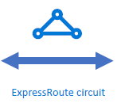

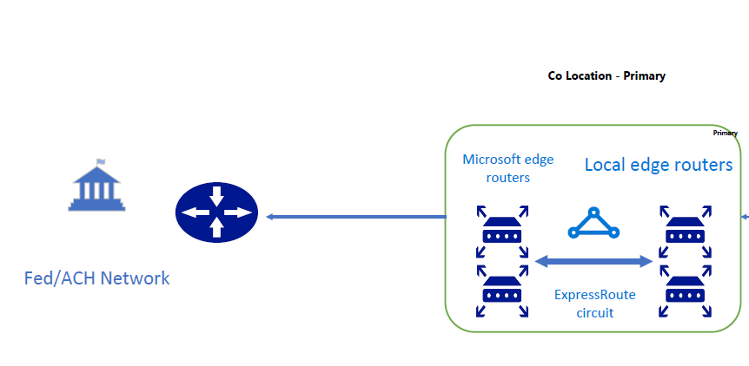
Payment Gateway SWIFT/TCH Payments
Bank N/W
Bank N/w
Payment Clearances

