Slide 1
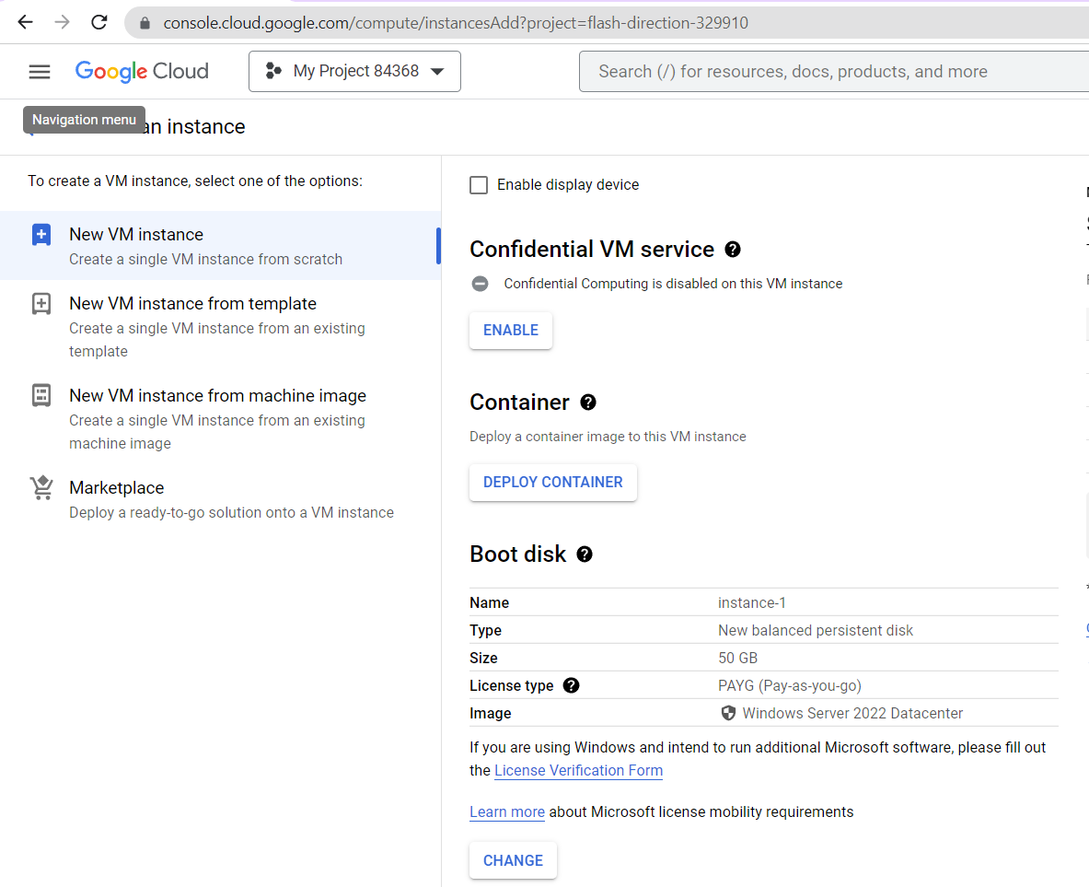
Steps in Google –Create VM for Demo

Slide 2
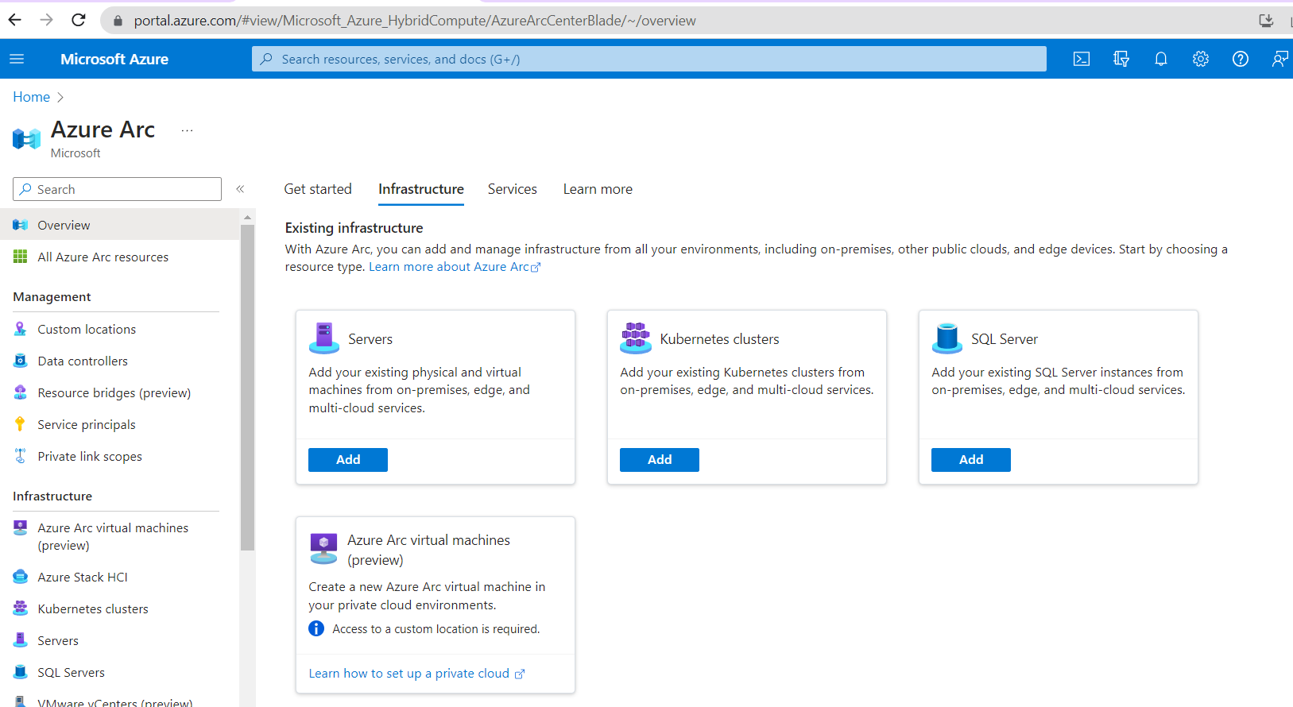
Enable the Azure Arc Enabled –Single Server
Steps in Google –Create VM for Demo

Slide 3
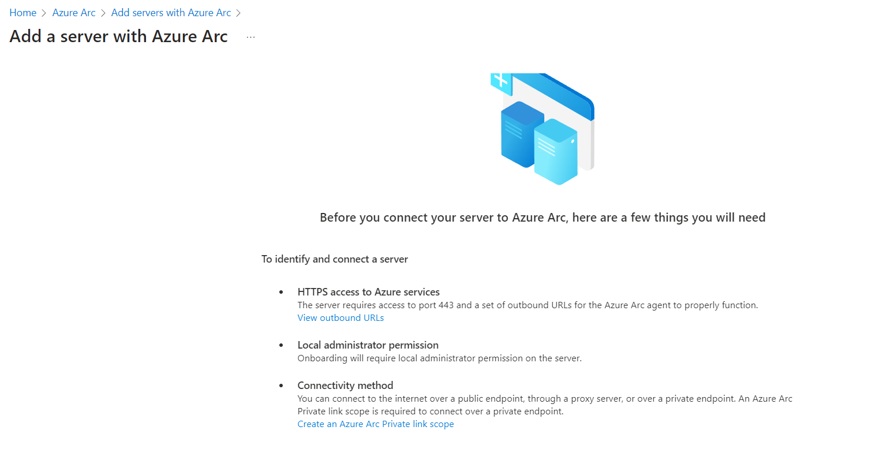
Enable the Azure Arc Enabled –Single Server
Steps in Google –Create VM for Demo

Slide 4
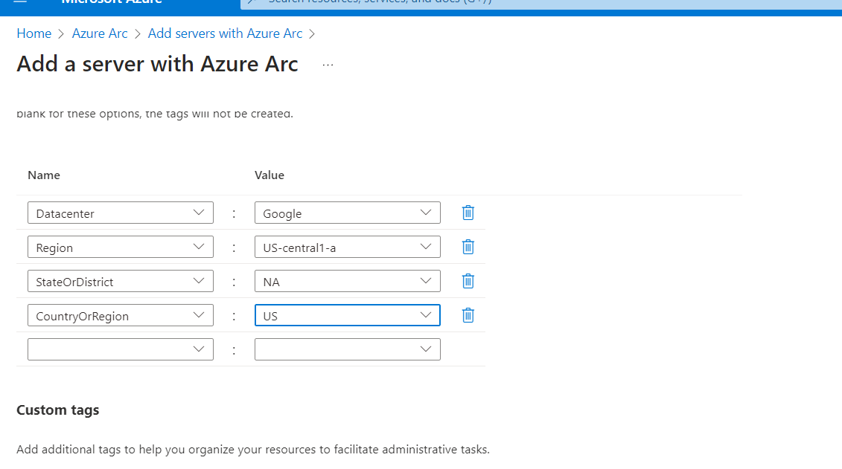
Enable the Azure Arc Enabled –Single Server
Steps in Google –Create VM for Demo

Slide 5
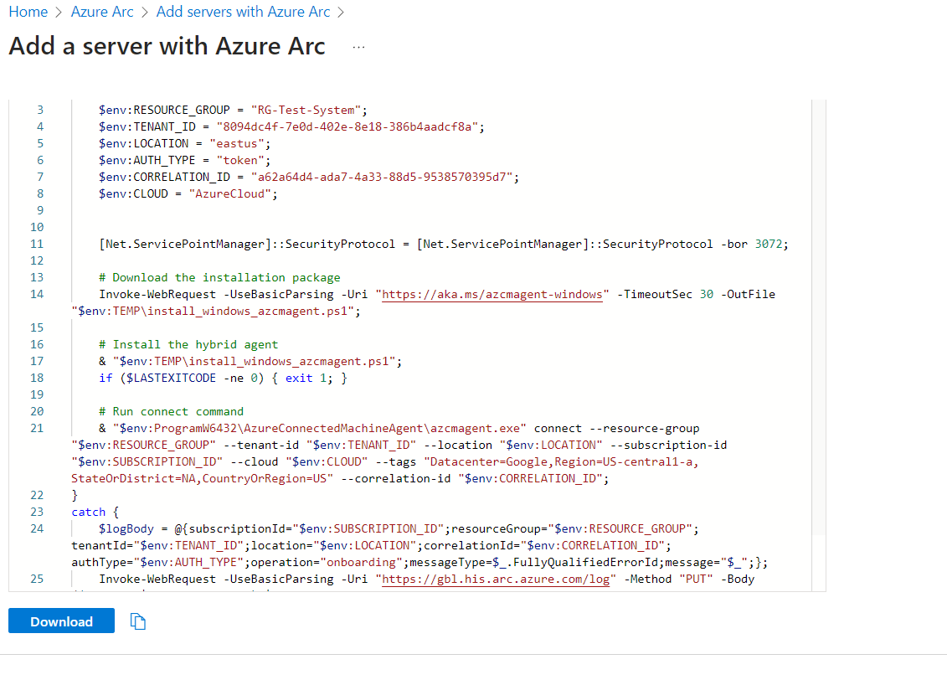
Enable the Azure Arc Enabled –Single Server
Steps in Google –Create VM for Demo

Slide 6
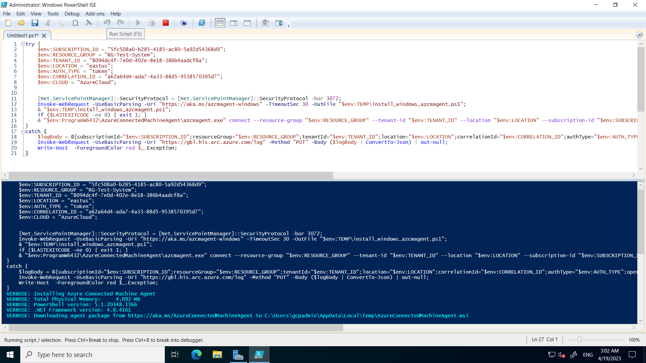
Execute the Arc Script in Google VM
Steps in Google –Create VM for Demo

Slide 7
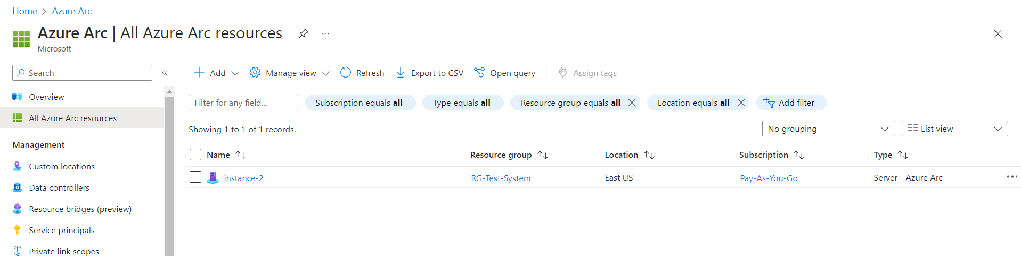
Report/View the Google VM in Azure As a Resource
Steps in Google –Create VM for Demo

Slide 8
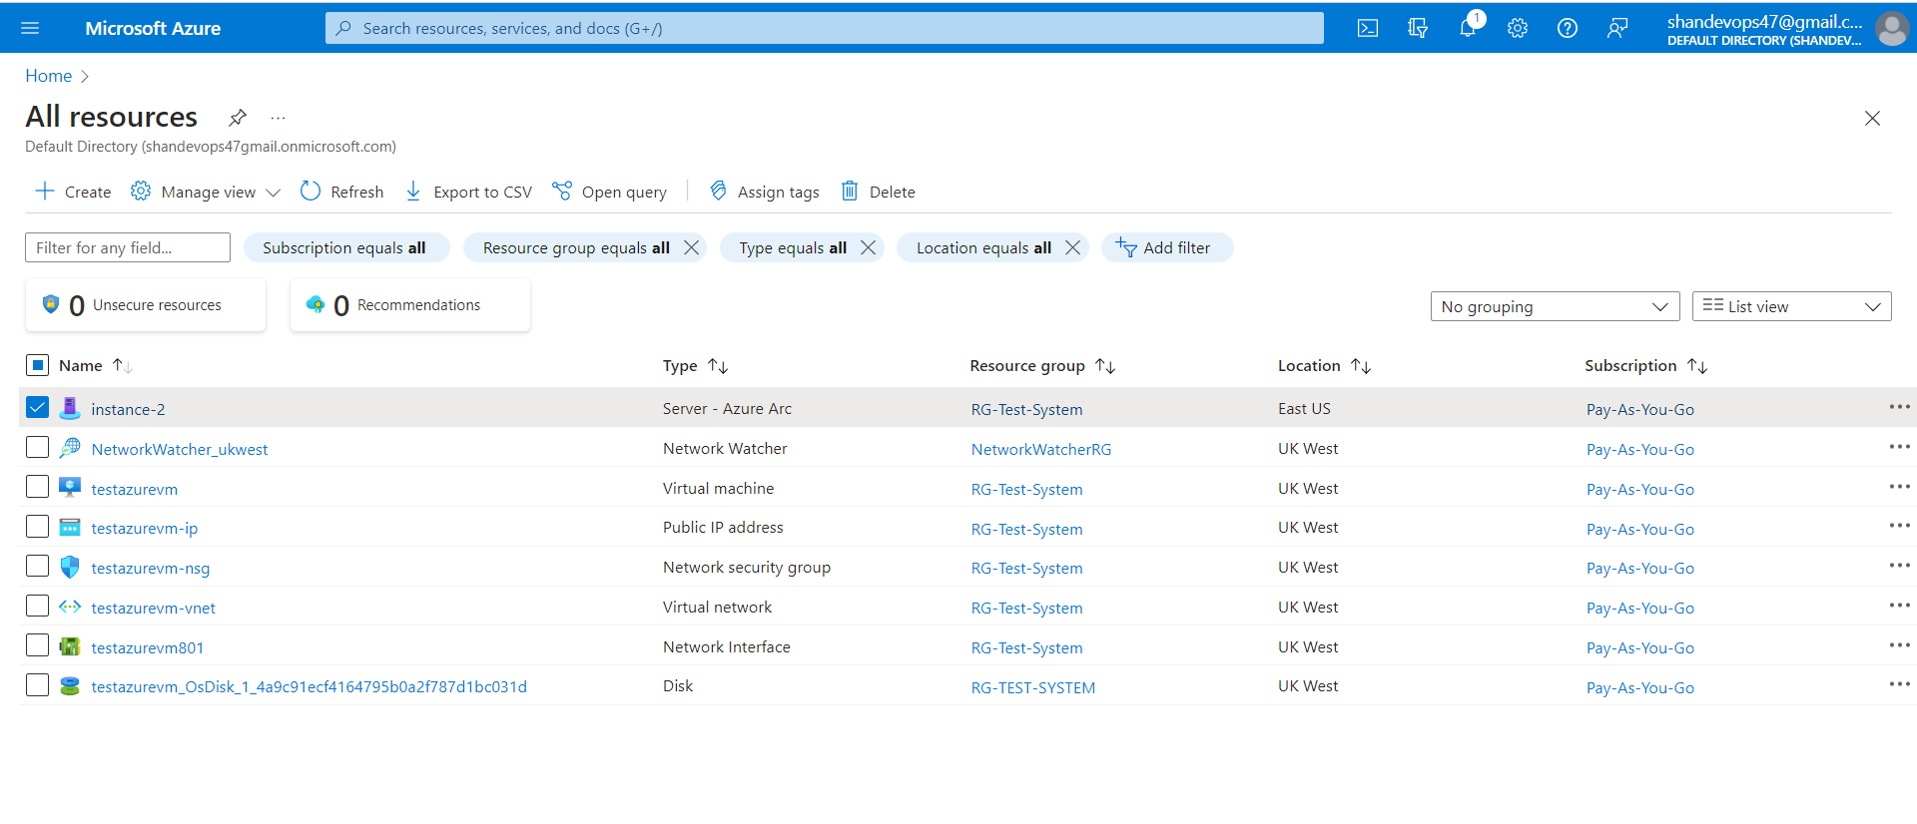
Consider as Azure Resource
Steps in Google –Create VM for Demo

Slide 9
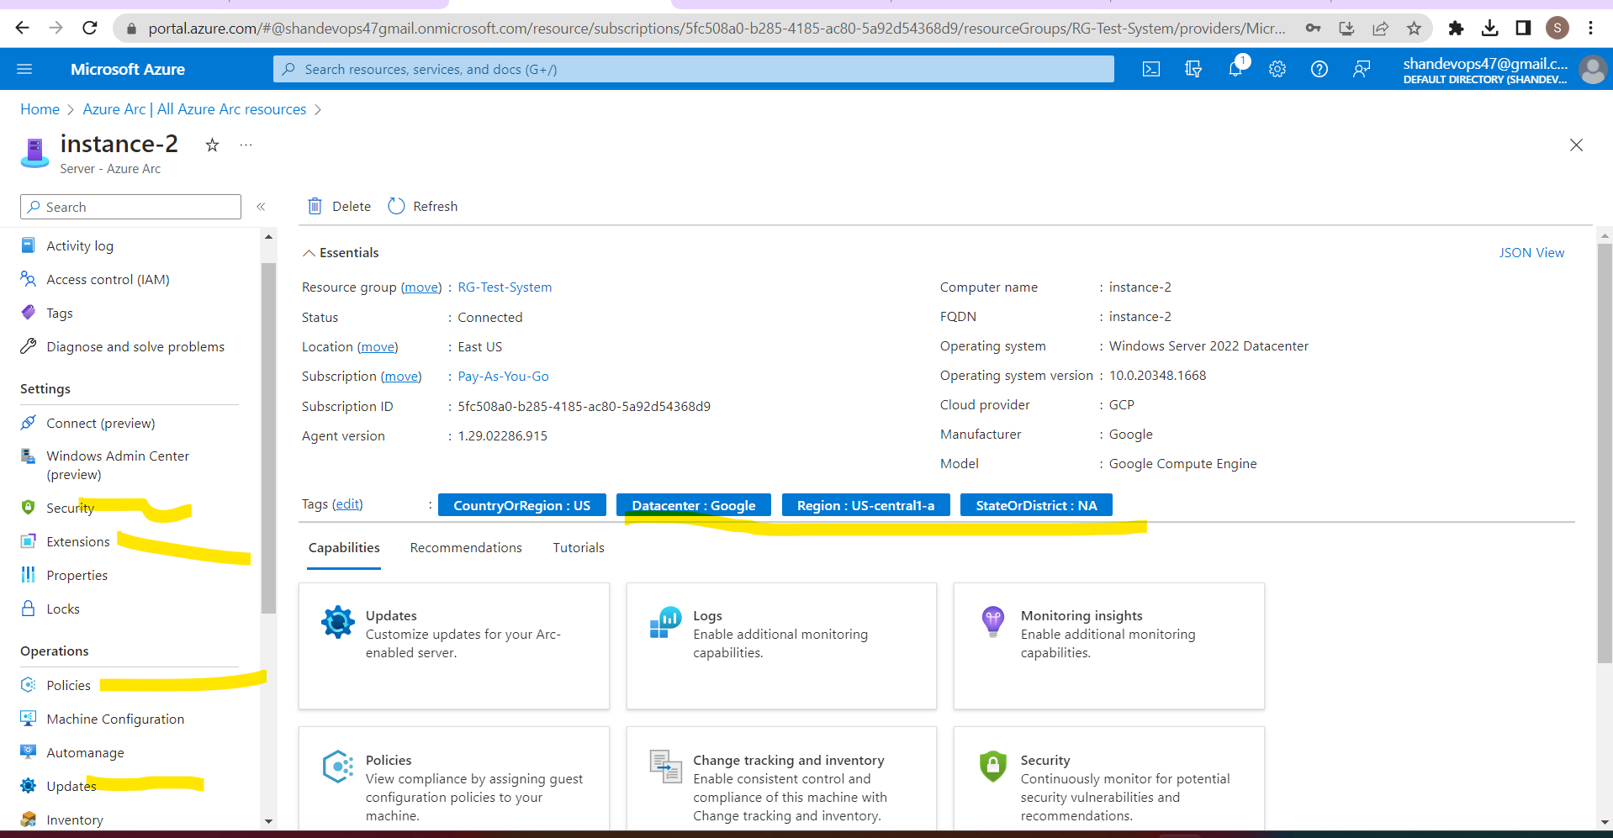
Consider as Azure Resource
Steps in Google –Create VM for Demo

