Slide 1
Topic modelling Organize, Understand, Summarize
Topic modelling - Book store web application
16-October-2019

Slide 2
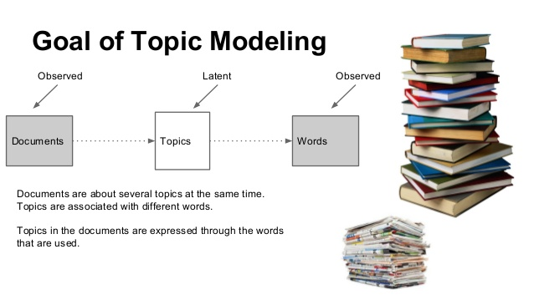
Presentation title, 42pt, bold max. 3 lines
Presentation subtitle, 20pt, max. 1 line
DATE, 12PT, BLACK, CAPITAL LETTERS
Please download pictures in suitable size here and insert them by clicking the symbol above.

Slide 3
Presentation summary
Team intro: more⁺
Project description
Project plan
Tools & infrastructure

Slide 4
Team intro
Team Name
“more⁺”
(more innovation + more efficient +more value)
Team members:
Shanoj Paramal
Rajesh Teppala
Narendran Bhuvaneshkumar

Slide 5
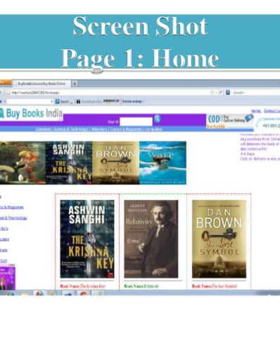

Topic Modelling
Topic modelling - Book store web application

Slide 6
Topic modelling – Book store web application
Project description
Summarize the document in the book store
When a Admin,
logins to the system and
Upload documents
The system summarize the document automatically
Present the book based on user search query
When book store user
Login to the system and
Searches his/her topic
System shows relevant books based on query

Slide 7
Project plan – Agile methodology
Userstory-1
As a admin I should be able to login to book store application
Userstory-2
As a admin, I should be able to upload documents and then see summary of the document in short description field
Userstory-3
As a book store user, I must be able to find books in bookstore relevant to my query

Slide 8
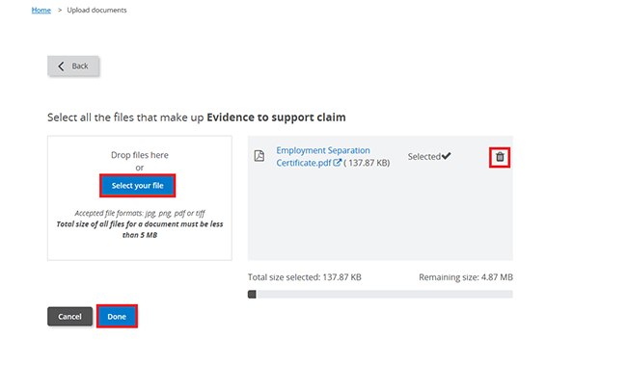
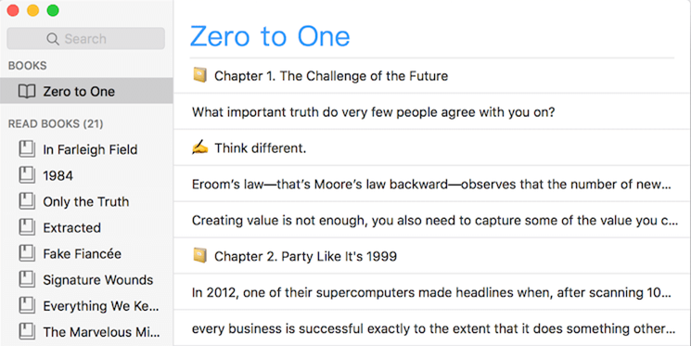
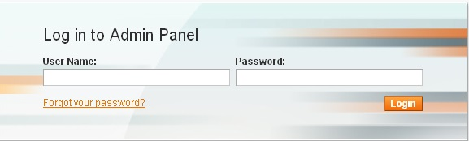
Book store web – using Topic modelling
Project plan
Admin logins to system
1st sprint - userstory1
Schedule: 21-Oct-19 to 08-Nov-19
Admin upload a document
2nd sprint – userstory2
Schedule: 11-Nov-19 to 29-Nov-19
System displays book on user’s query
3rd sprint – userstory3
Schedule: 02-Dec-19 to 20-Dec-19

Slide 9
Book store web app
Tools and Infrastructure
Web2py - Web2py is an open-source web application framework, to program dynamic web content.
Topic modelling(integrate logic to app)
Gensim - designed to automatically extract semantic topics from documents
Scikit learn - that implements a range of text pre-processing, cross-validation and visualization
Pandas – library for data manipulation and analysis
matplotlib - extension NumPy(library for scientific computing with Python)
wordcloud - is a data visualization technique used for representing text data

Slide 10
Thank you
Topic modelling
References:-
https://towardsdatascience.com/nlp-for-topic-modeling-summarization-of-legal-documents-8c89393b1534
https://www.machinelearningplus.com/nlp/topic-modeling-gensim-python/

Slide 11
Shanoj Paramal
QA Analyst • Chennai • India
• M. +91 9962 18 28 38
Shanoj.paramal@expleogroup.com

