Slide 1
SICKLE CELL DIAGNOSIS IN TESO REGION

Slide 2
INTRODUCTION:
Sickle cell disease is a genetic blood disorder that affects millions of people worldwide, It can cause severe complications, including chronic pain, organ damage, and increased risk of infections.
Early diagnosis and treatment are crucial in managing the disease and improving patient outcomes. However, current diagnostic methods can be limited in accuracy and accessibility, leading to delays in diagnosis and treatment initiation.

Slide 3
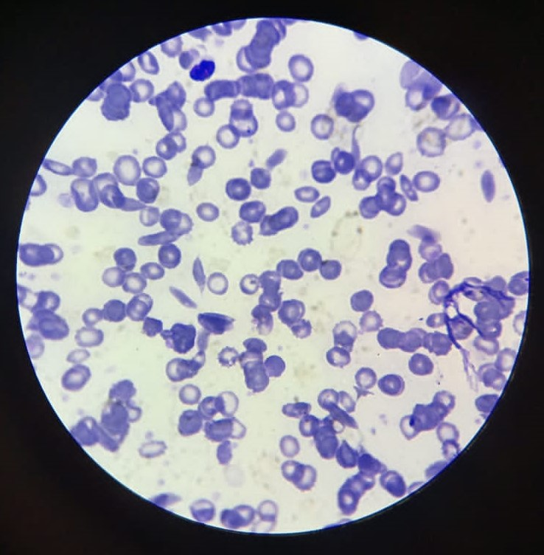
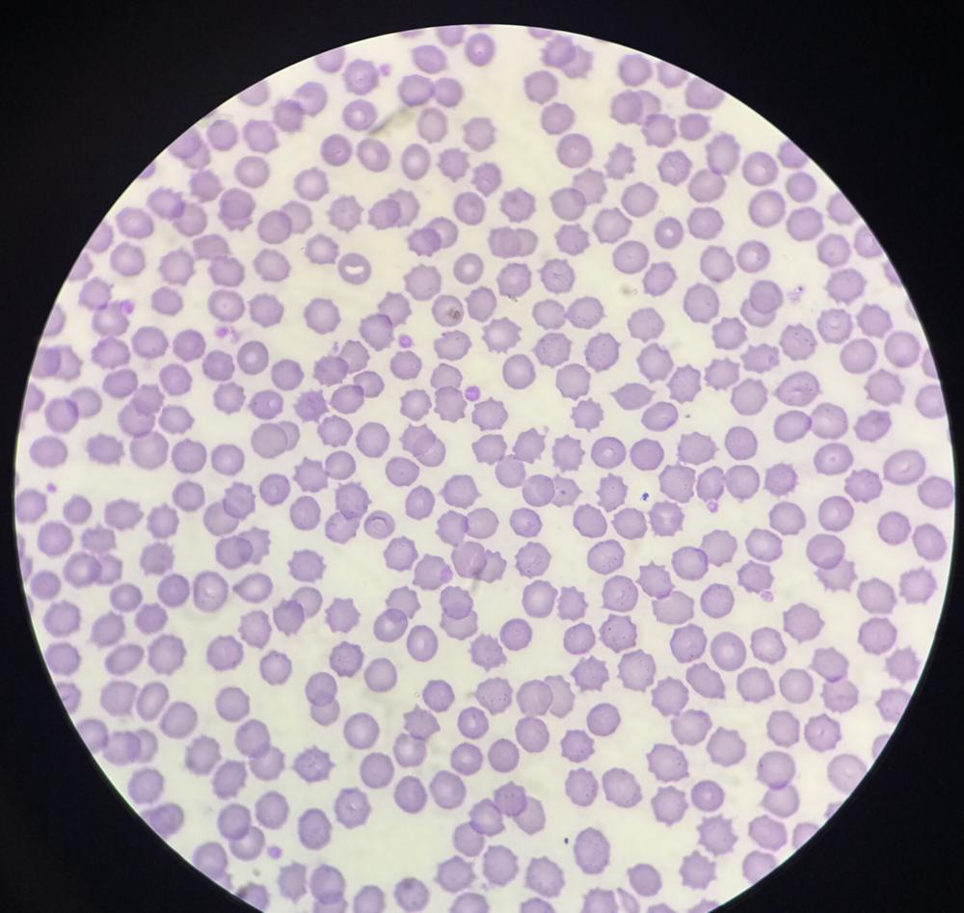
Sample dataset images
Positive
Negative

Slide 4
METHODOLOGY:
Data Collection
Data pre-processing
Model development
Training
Evaluation

Slide 5
Model used
Convolutional Neural Network: with six layers ie ;
Input layer
Conv2D layer
MaxPooling2D layers
Flatten Layer
Dense (Fully Connected) Layer
Output Layer

Slide 6
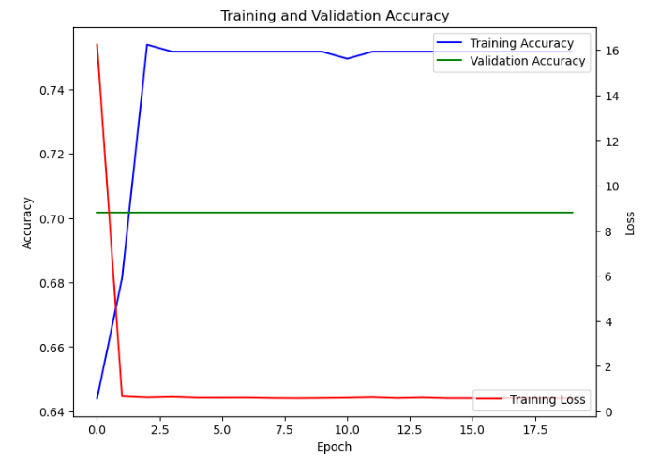
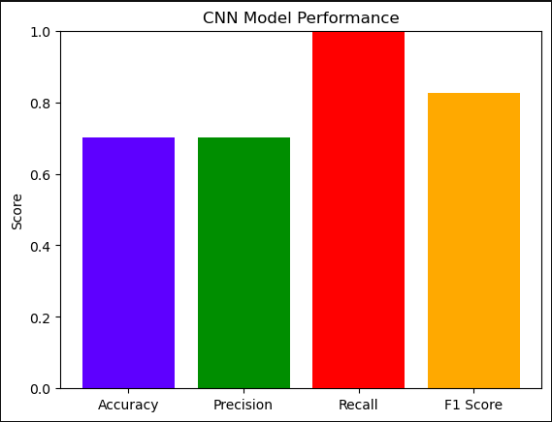
Results obtained:

Slide 7
Algorithms used
We used the following machine learning classifiers;
Random Forest
Decision Tree Classifier
Logistic Regression
Naive Bayes
Support Vector Machine.

Slide 8
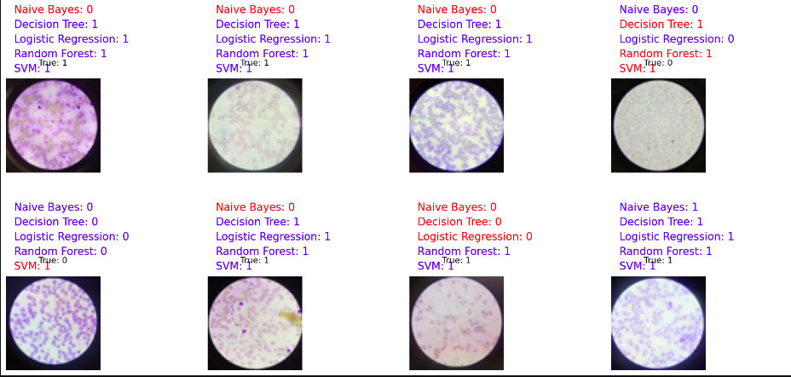
Classification Example

Slide 9
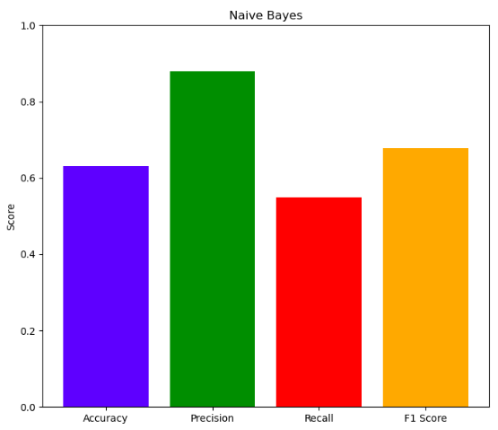
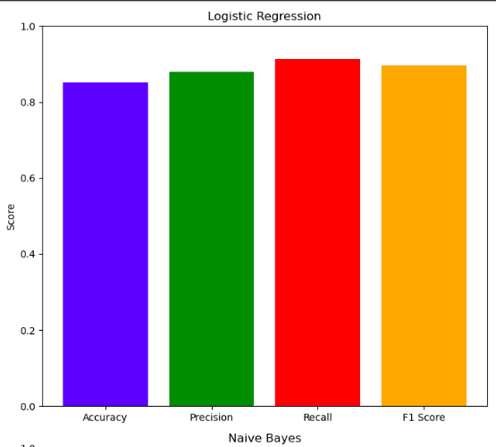
Evaluation of Algorithms
Logistic regression had the highest accuracy and f1 score, followed by Random Forest, then Support Vector Machine, then Decision Tree and classifier, and then Naive Bayes.
Naive Bayes had the worst performance overall

Slide 10
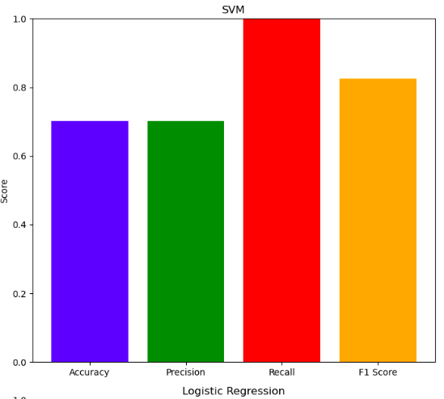
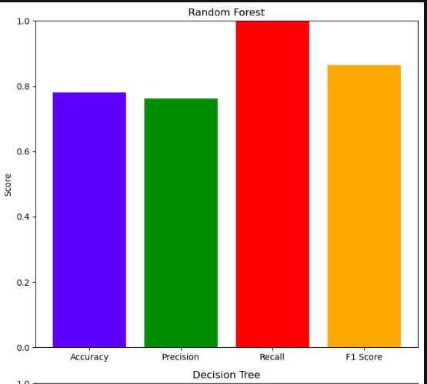
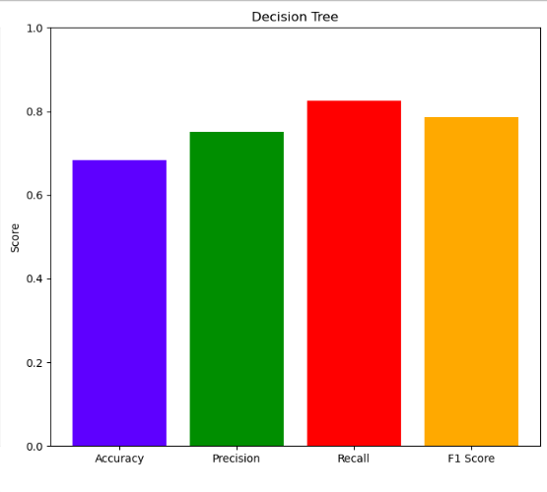

Slide 11
CONCLUSION:
In conclusion, this project proposal seeks to revolutionize the way sickle cell disease is diagnosed and managed, with the ultimate goal of improving patient outcomes and reducing the burden of this debilitating condition on individuals, families, and healthcare systems not only in Teso region but also other regions. By investing in early detection strategies and innovative diagnostic tools, we can make a significant impact in the fight against sickle cell disease and pave the way for a brighter future for those affected by this genetic disorder.

