Slide 1

Team Name : NEXUS 360
Team Leader Name : Gowri Shankar
Team Size : 4
Problem Statement : Customer 360 & Next Best Action for Insurance

Slide 2
YOURSTORY | snowflake | CoCo CLI
HACKATHON SUBMISSION
INSURANCE • CUSTOMER INTELLIGENCE
NEXUS 360
CUSTOMER
360
From Customer Question to Next Best Action
A Snowflake-native Customer 360 that unifies policies, claims, payments and conversations — then turns the signal into an explainable, human-approved action.
01
02
03
04
Unify structured + unstructured data
Detect customer moments & health
Recommend evidence-backed action
Close the loop with outcomes
NEXUS 360 • Insurance Customer Intelligence & Next Best Action
01

Slide 3
YOURSTORY | snowflake | CoCo CLI
01 • PROBLEM
The problem: insurers have the data — but not the decision
The customer story is fragmented across systems, while the most valuable signals are buried in conversations.
A real customer moment
Today: fragmented customer context
• Policy, claims, payments and renewal data live in separate workflows • Calls, emails, notes and complaints contain the “why” — but are hard to operationalize • Teams spend time searching, stitching context and deciding what to do • Generic retention or cross-sell actions can arrive at the wrong moment
1
2
3
4
CLAIM
CALL
CHAT
RENEWAL
27 days open
Negative sentiment
Competitor mentioned
18 days away
NEXUS detects the moment
HIGH-VALUE CUSTOMER + CLAIM FRICTION + NEGATIVE SENTIMENT + COMPETITOR SIGNAL + RENEWAL RISK → Critical retention / service-recovery moment
Primary users
Customer Service
Claims
Retention
Relationship Mgmt
Managers
NEXUS 360 • Insurance Customer Intelligence & Next Best Action
02

Slide 4
YOURSTORY | snowflake | CoCo CLI
02 • SOLUTION
One experience: KNOW → UNDERSTAND → DECIDE → ACT
NEXUS 360 moves from a customer question to a recommended action with evidence, guardrails and human approval.
01 KNOW
02 UNDERSTAND
03 DECIDE
04 ACT
Customer 360 Policy • Claims • Payments • Renewal • Interactions
Customer Intelligence Sentiment • Intent • Customer moments • Evidence
Context-aware NBA Risk • Value • Rules • Suppression • Confidence
Employee Copilot Approve • Modify • Escalate • Communicate • Track
What makes it enterprise-grade
What makes it Snowflake-native
Evidence-backed recommendations • Human-in-the-loop • Action audit trail • No cross-sell during active service friction
Structured analytics + unstructured search + Cortex Agent orchestration + Streamlit-in-Snowflake + Snowpark access
NEXUS 360 • Insurance Customer Intelligence & Next Best Action
03

Slide 5
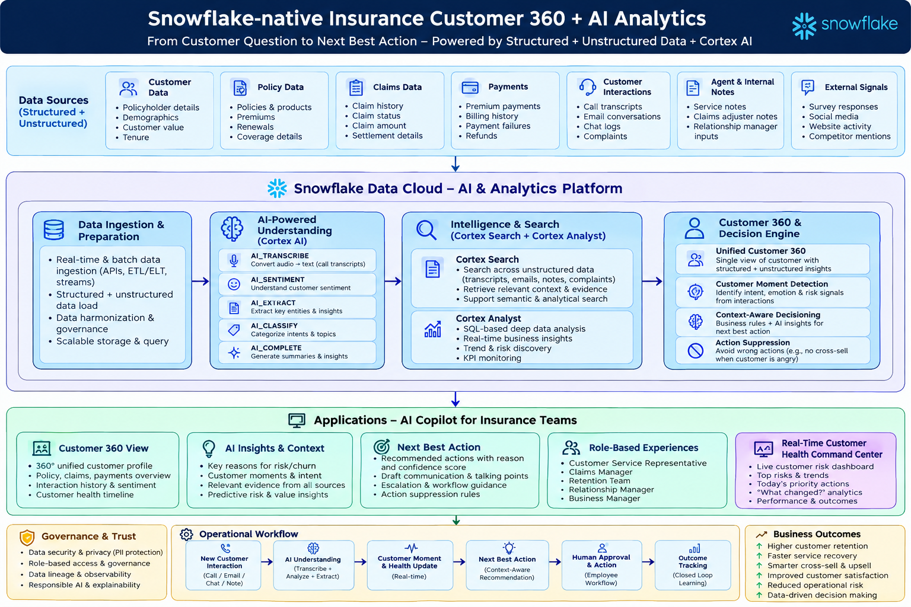
YOURSTORY | snowflake | CoCo CLI
03 • ARCHITECTURE
Enterprise architecture & data flow
Customer event → Snowflake → Cortex AI → Customer 360 → Decision Engine → Human-approved action → Outcome
CoCo CLI
Cortex Agent
NBA
NEXUS 360 • Insurance Customer Intelligence & Next Best Action
04

Slide 6
YOURSTORY | snowflake | CoCo CLI
04 • IMPACT
Impact: turn fragmented signals into measurable business action
The demo is designed around operational metrics — not just an AI answer.
↓ Search time
↑ Retention
↓ Resolution time
↑ Relevance
Faster access to customer context for frontline teams
Earlier intervention on high-value churn moments
Prioritize claims/service recovery with context
Cross-sell only when customer context is healthy
Closed-loop measurement
Recommendation
Approval
Outcome
NBA created Evidence + confidence
Employee action Approve / modify / dismiss
Customer response Health & sentiment shift
Scale beyond the demo
Insurance first; reusable pattern for lending and other financial-services journeys without changing the core Customer Intelligence + Next Best Action architecture.
Insurance first; reusable pattern for lending and other financial-services journeys without changing the core Customer Intelligence + Next Best Action architecture.
NEXUS 360 • Insurance Customer Intelligence & Next Best Action
05

Slide 7
YOURSTORY | snowflake | CoCo CLI
05 • DEMO & FUTURE
The 5-minute judge journey
Show the business problem, prove the AI reasoning, then demonstrate the closed loop.
01
ASK
“Who should I call today?”
Portfolio prioritization
02
OPEN
Select a high-risk customer
Customer 360 + timeline
03
EXPLAIN
“Why is Rajesh at risk?”
Evidence from claims + calls + renewal
04
DECIDE
“What should we do?”
Claims escalation + retention; cross-sell suppressed
05
ACT
Approve → simulate new call
Health/risk changes in real time
KNOW → UNDERSTAND → DECIDE → ACT → LEARN
NEXUS 360 • Insurance Customer Intelligence & Next Best Action
06

Slide 8


