Slide 1
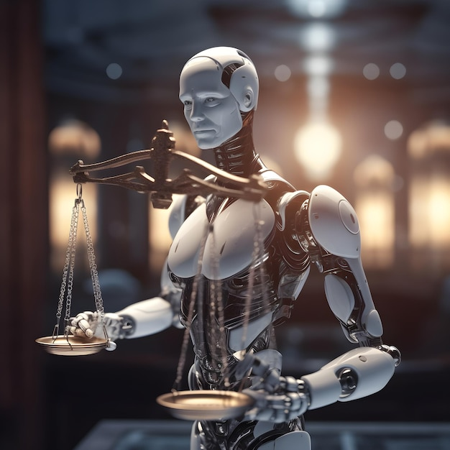
Moral and Ethical Challenges of Artificial Intelligence
Exploring the Impacts and Responsibilities of AI in Society
Presented By: Shantanu Shukla
Enrolment No.: 01211805424
Course: M.Tech. AI/DS
Institute: C-DAC Noida

Slide 2
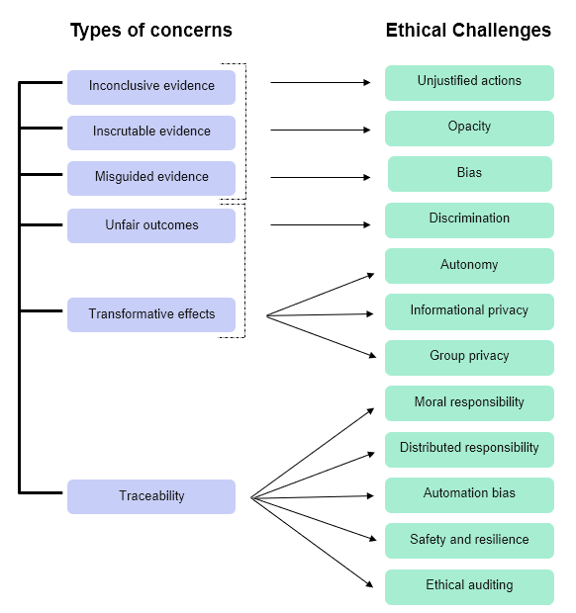
What Are Moral and Ethical Challenges in AI?
Definition of AI:
AI refers to computer systems capable of performing tasks that typically require human intelligence, such as learning, decision-making, and problem-solving.
Ethical Concerns in AI:
Fairness: Ensuring that AI systems treat all individuals equally and do not reinforce biases.
Accountability: Determining who is responsible for AI-driven decisions.
Transparency: Making AI systems understandable and explainable.
Unintended Consequences: Avoiding harm caused by unexpected AI behavior.
Why This Topic Matters:
AI is increasingly influencing critical areas such as healthcare, law enforcement, and employment.
Ethical challenges must be addressed to ensure AI benefits society without causing harm.

Slide 3
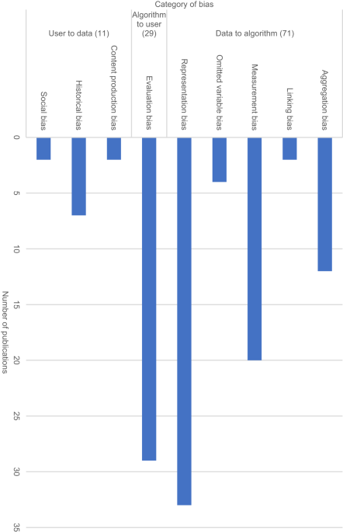
The Problem of Bias in AI
What Is Bias in AI?
AI systems can inherit biases present in the training data, leading to unequal or unfair treatment of certain groups.
Example: Facial recognition systems that perform poorly on certain demographics due to imbalanced training data.
Real-World Examples of Bias:
Hiring Algorithms: AI systems preferring male candidates due to historical hiring biases.
Judicial Systems: Predictive policing or sentencing tools disproportionately affecting minority groups.
Challenges of Ensuring Fairness:
Defining fairness: Different cultures and contexts have different standards of fairness.
Lack of diverse datasets to train AI.
Unconscious bias from developers influencing AI design.
Solutions to Reduce Bias:
Use diverse and representative datasets.
Conduct regular bias testing and fairness audits.
Incorporate fairness as a design principle in AI development.

Slide 4
AI and Data Privacy
Data-Driven AI:
AI relies on vast amounts of data for training and functioning, raising concerns about personal privacy.
Ethical Dilemmas:
Surveillance: Governments and corporations using AI to track individuals.
Data Exploitation: Social media and other platforms collecting and monetizing personal data without informed consent.
Real-World Example:
Cambridge Analytica scandal: Data misuse for political campaigns.
Proposed Solutions:
Strong data protection laws like GDPR(General Data Protection Regulation).
Implementing AI systems with privacy-first designs.
Educating users about their data rights.

Slide 5
Who Is Responsible for AI’s Decisions?
The "Black Box" Problem:
AI systems, especially deep learning models, are complex and lack interpretability, making it hard to trace decisions.
Ethical Questions:
Who is liable for AI errors or harm? Developers, deployers, or users?
Case study: Accidents involving autonomous vehicles.
Solutions:
Enforcing transparency in AI algorithms.
Developing accountability frameworks for creators and operators.
Establishing regulations to clarify legal responsibility.

Slide 6
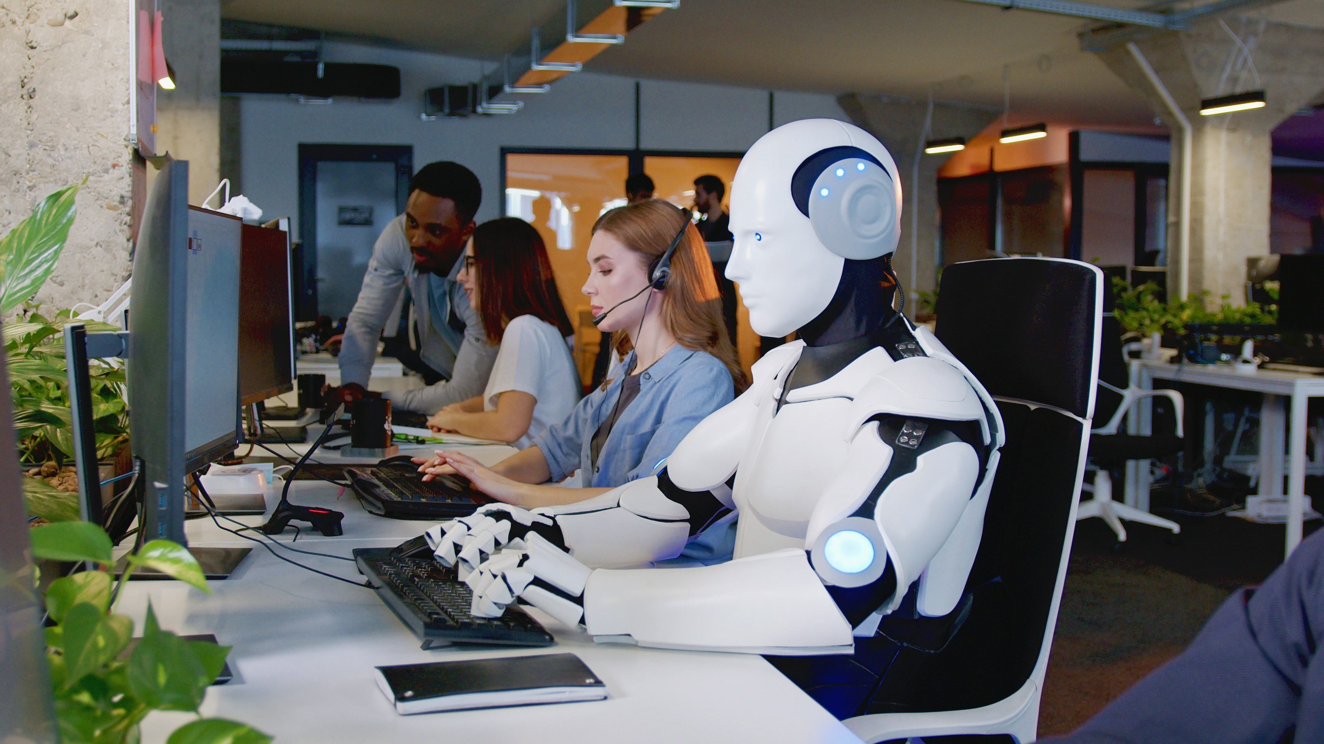
AI and the Future of Work
Impact on Jobs:
Automation by AI is replacing roles in manufacturing, customer service, and transportation.
Example: Autonomous vehicles reducing demand for drivers.
Ethical Concerns:
Widening economic inequality.
Social unrest due to mass unemployment in vulnerable sectors.
Proposed Solutions:
Reskilling programs to help workers transition to AI-complementary roles.
Promoting innovation in industries that create new jobs.

Slide 7
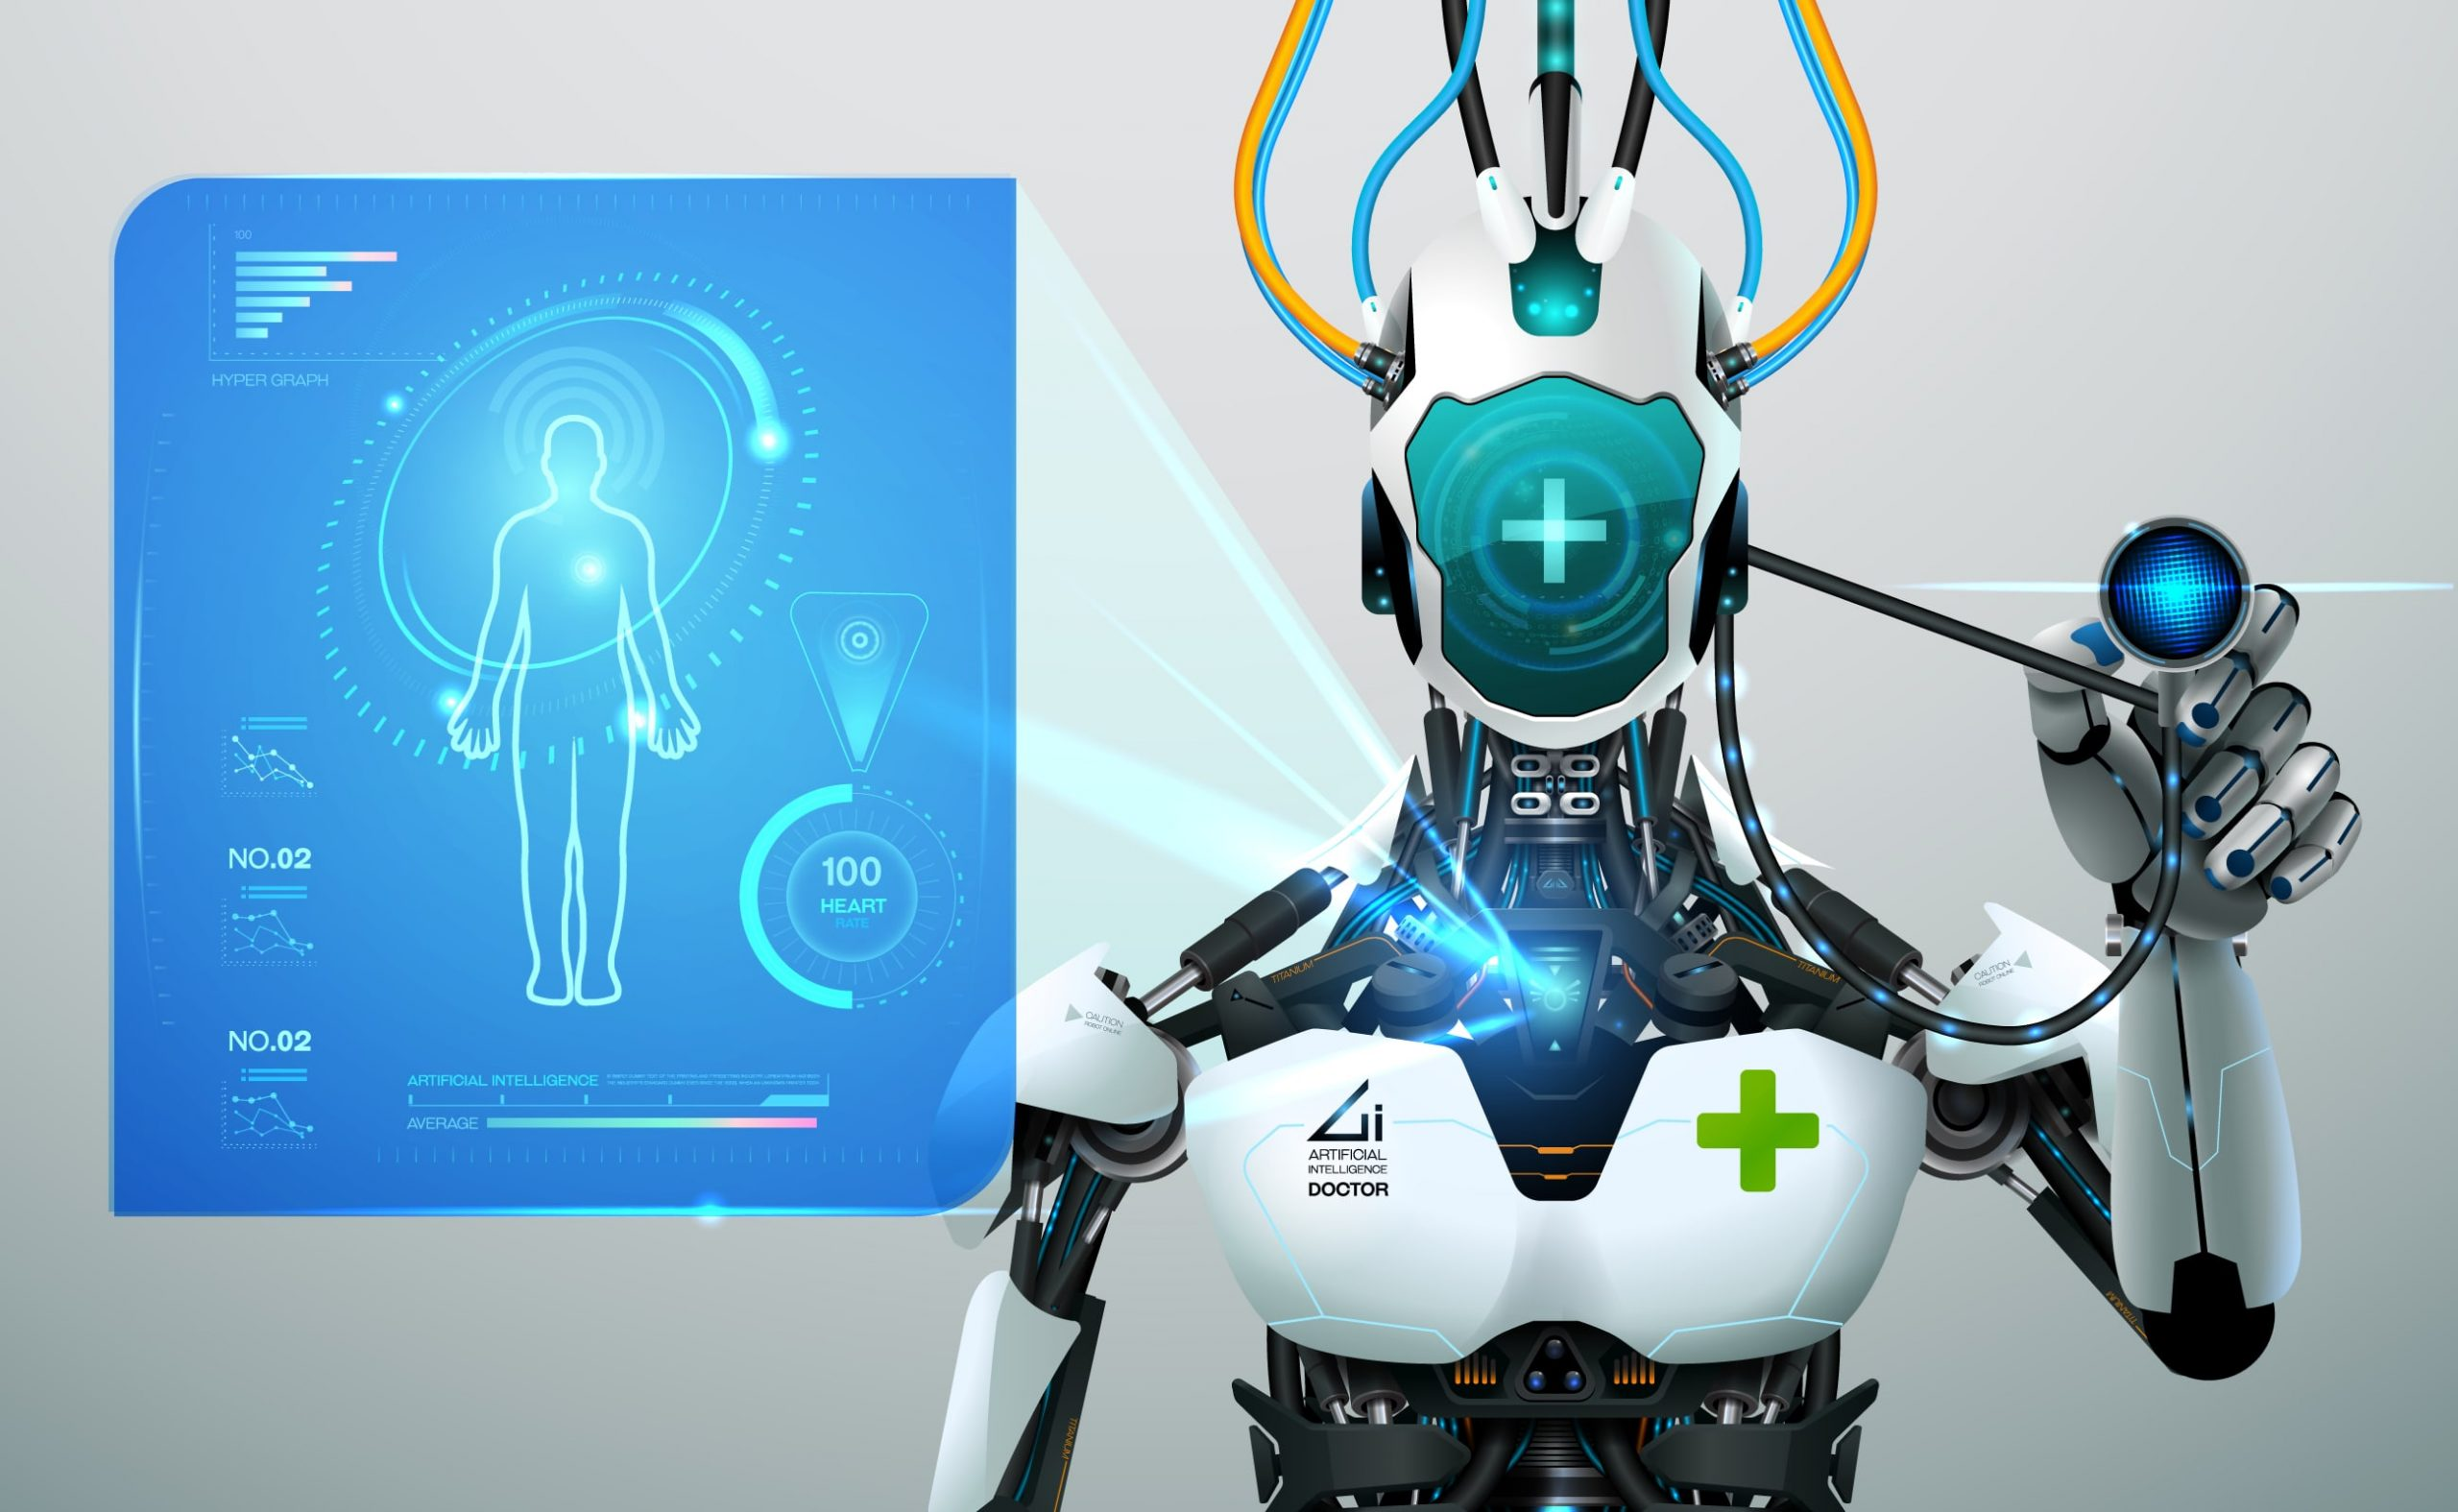
AI in Life-Altering Decisions
Critical Applications of AI:
Healthcare: AI diagnosing diseases or determining treatment plans.
Judicial Systems: AI used in sentencing or parole decisions.
Warfare: Autonomous weapons choosing targets.
Moral Challenges:
Can machines truly understand human ethics?
Is it ethical to let machines make decisions with life-or-death consequences?
Solutions:
Ensuring human oversight in critical applications.
Designing AI systems with ethical constraints built-in.

Slide 8
AI’s Impact on Developing Nations
Disparities in Access:
Developed nations lead in AI advancements, leaving developing nations behind.
Lack of infrastructure and funding for AI in poorer regions.
Potential Harms:
AI reinforcing existing inequalities.
Exploitation of resources in developing nations for AI projects.
Solutions:
Promote open access to AI technologies and research.
Encourage international collaboration for equitable AI development.

Slide 9
Addressing the Challenges
Existing Frameworks:
Example: Asilomar AI Principles focusing on safety and shared benefits.
OECD Principles on AI emphasizing human rights and sustainability.
Key Strategies:
Establish clear and enforceable regulations for AI ethics.
Promote interdisciplinary collaboration among technologists, ethicists, and policymakers.
Build public trust through transparency and education.
Notes:
OECD - The Organisation for Economic Co-operation and Development

Slide 10
The Path Forward
Key Takeaways:
AI has immense potential but poses significant moral and ethical challenges.
Proactive measures are essential to prevent harm and ensure equity.
Call to Action:
Encourage ethical design and responsible use of AI technologies.
Advocate for global cooperation in addressing AI’s societal impacts.
Inspirational Quote:
“Technology is a tool. It is up to us to use it responsibly and ethically.”

Slide 11
Open Floor for Questions
Thank you for your attention! Feel free to ask questions or share your thoughts.

Slide 12
References
Weiyu Wang & Keng Siau. Ethical and Moral Issues with AI -- A Case Study on Healthcare Robots.
Binns, R. (2018). Fairness in Machine Learning: Lessons from Political Philosophy.
Mittelstadt, B. D., et al. (2016). The Ethics of Algorithms: Mapping the Debate.
Eubanks, V. (2018). Automating Inequality: How High-Tech Tools Profile, Police, and Punish the Poor.
Floridi, L., & Cowls, J. (2019). A Unified Framework of Five Principles for AI in Society.
Russell, S., & Norvig, P. (2020). Artificial Intelligence: A Modern Approach.
O’Neil, C. (2016). Weapons of Math Destruction.
IEEE Global Initiative. (2019). Ethically Aligned Design.

