Slide 3





🔐 PART 1 OF 3 • TOOLS, PERMISSIONS & TRUST
Tools — What Claude Uses Under the Hood
Examples
📌 What are Tools?
Reading files
Claude Code internally uses different tools to complete tasks.
Read Tool
Editing code
Edit Tool
👉 Claude automatically decides:
WHICH tool to use
WHEN to use it
Running commands
Bash Tool
Searching internet
WebSearch Tool
MCP in Claude Code • Shan
9 / 13

Slide 4


🔐 PART 2 OF 3 • TOOLS, PERMISSIONS & TRUST
Permissions — You Stay in Control
Permissions
You approve Claude to use tools & commands.
✓
✓
Edit Tool
Git commands
✓
✓
WebSearch
GitHub MCP
Without permission — Claude ASKS before executing any action.
MCP in Claude Code • Shan
10 / 13

Slide 5







🛡️ WHY IT MATTERS
Permissions Build a Trust Model
Prevents Claude from:
Modifying files unexpectedly
Running dangerous commands
Accessing tools without approval
YOU
Permissions improve:
CLAUDE
EXTERNAL TOOLS
Safety
Control
Security
MCP in Claude Code • Shan
11 / 13

Slide 6


🔐 PART 3 OF 3 • TOOLS, PERMISSIONS & TRUST
Where Are Permissions Stored?
Permissions live in:
.claude/settings.local.json
.claude/settings.local.json
{
"permissions": {
"allow": [
"Bash(npm:*)",
"Edit",
"WebSearch"
],
"deny": [
"Bash(rm -rf:*)"
]
}
}
LOCAL
Allowed Tools
Allowed Commands
Deny Rules

Slide 7

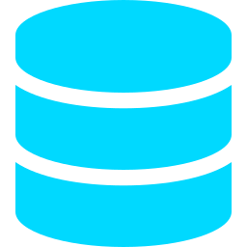




7 MCP Servers Every Developer Should Know
1
2
3
4
Context7
DBHub
Slack
JIRA
Fetch latest library docs
Talk to DBs — no Python needed
Read & post Slack messages
Tickets & sprint planning
5
6
7
AWS
Docker
GitHub
Cloud operations on AWS
Containerize & deploy apps
Read repos, issues, PRs
MCP in Claude Code • Shan
13 / 13

