Slide 1
Multi-perspective machine learning (MPML): A high-performance and interpretable ensemble method for heart disease prediction
From MPML to ENMPAN: A Neural Network Extension for Explainable Heart Disease Prediction

Slide 2
Team members
01 . Maria Islam
-- 0426140021
02 . Sumaiah Binta Musa
-- 0426140011
03 . Mahfuzur Rahman Ridoy
-- 0426140022
04 . SHANTA ISLAM
-- 0426140020
2

Slide 3
Heart Disease Dataset
↓
Feature Perspectives
↓
Individual ML Models
↓
Ensemble Blending
↓
Heart Disease Prediction
↓
Model Interpretation
Outcomes
Multi-perspective feature learning
Improved prediction accuracy
Diverse ensemble decision-making
Interpretable and explainable predictions
Better support for clinical decision-making
Overview
3

Slide 4
Introduction
Machine Learning is widely used in healthcare.
Many ML models achieve high accuracy but lack transparency.
Black-box predictions reduce trust in clinical decisions.
Traditional ensemble methods have limited interpretability.
Multiple feature perspectives can improve model performance.
MPML aims to provide accurate and explainable predictions.
It supports better clinical decision-making.
4

Slide 5
Motivation
Need for early and accurate heart disease prediction.
Need for both accuracy and interpretability.
Black-box AI reduces clinical trust..
MPML provides explainable multi-perspective learning.
5

Slide 6
Literature Review
Paper Name | Year | Method | Dataset | Accuracy
A Hybrid CNN-Transformer Model for Heart Disease Prediction Using Life History Data. | 2025 | CNN-Transformer Hybrid Model | Life History Dataset | 97.0%
Causal and Explainable Machine Learning Framework for Heart Disease Prediction using XGBoost and SHAP. | 2025 | Explainable XGBoost+SHAP | Heart Disease Dataset | 95.9%
Heart Failure Prediction Based on Bootstrap Sampling and Weighted Fusion LightGBM Model. | 2025 | LightGBM Fusion Model | Heart Failure Dataset | 96.4%
6

Slide 7
Literature Review
Paper Name | Year | Method | Dataset | Accuracy
Improving heart disease prediction using random Forest and AdaBoost algorithms. | 2021 | RF + AdaBoost (RFAB Hybrid Ensemble) | UCI (Cleveland, Statlog) | 96.16%
Predicting heart disease using Machine Learning: An evaluation of logistic regression, random forest, SVM, and KNN models on the UCI heart disease dataset. | 2025 | LR, RF, SVM, KNN | UCI Cleveland (303 samples) | RF: 88% (best)
Deep residual 2D convolutional neural network for cardiovascular disease classification | 2023 | Concatenated Hybrid Ensemble | UCI Combined Dataset | 96.5%
7

Slide 8
Literature Review
Paper Name | Year | Method | Dataset | Accuracy
AdaBoost Ensemble Methods Using K-Fold Cross Validation for Survivability with the Early Detection of Heart Disease, | 2022 | ResNet-based 2D CNN | UCI / Kaggle Clinical Data | 96.8–97.5%
Heart disease prediction using concatenated hybrid ensemble classifiers. | 2025 | XGBoost / LightGBM + Boosting | Multi-dataset (UCI + others) | 97.2%
Using convolutional neural networks with late fusion to predict heart disease | 2024 | Parallel 1D/2D CNN + Late Fusion | Multi-view Clinical Data | 95.2%
8

Slide 9
DATASETS
1
Heart Disease Dataset
https://www.kaggle.com/datasets/fedesoriano/heart-failure-prediction
2
Cardiovascular Disease Dataset
https://www.kaggle.com/datasets/sulianova/cardiovascular-disease-dataset
9

Slide 10
1
DATASETS
Heart Disease Dataset
It combines five famous heart datasets:
Cleveland
Hungarian
Switzerland
Long Beach VA
Statlog Heart Dataset
Features
The 11 features include:
Age
Sex
Chest Pain Type
Blood Pressure
Cholesterol
Fasting Blood Sugar
ECG Results
Maximum Heart Rate
Exercise Angina
Oldpeak (ST depression)
ST Slope
Target:
Heart Disease
Total:
1190 patients
11 features
Binary classification
10

Slide 11
DATASETS
2
Cardiovascular Disease Dataset
Contains: 70,000 patients
Balanced classes:
34,979 diseased
35,021 healthy
Features
Objective
age
height
weight
Gender
Lifestyle
Smoking
alcohol
activity
Clinical
systolic BP
diastolic BP
cholesterol
glucose
11

Slide 12
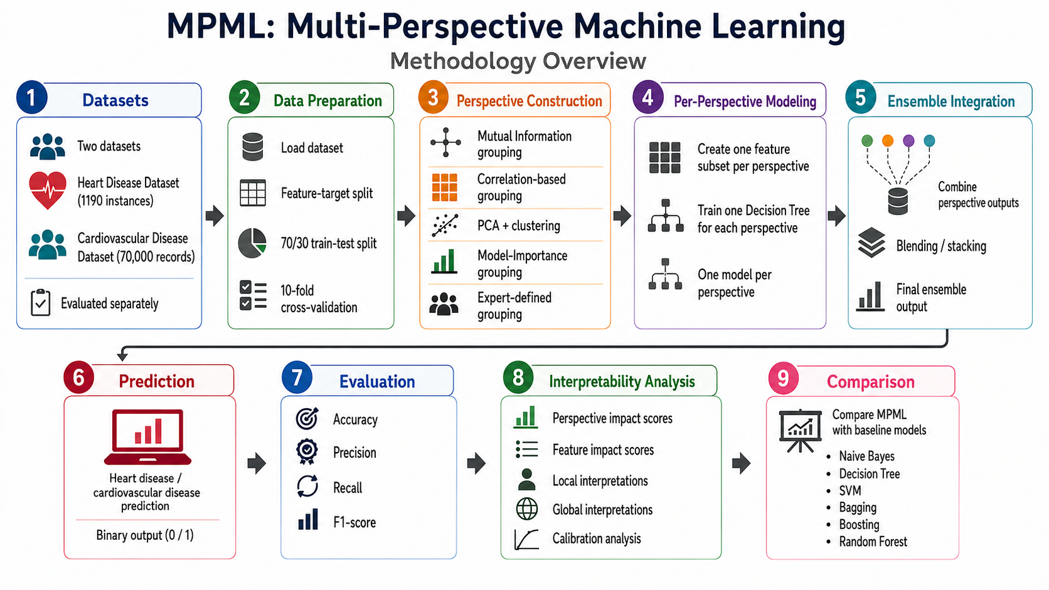
12

Slide 13
1
Manual Perspective Creation.
4
Research Gap
Computational Cost of Interpretation
2
Expert Knowledge Dependency.
5
No Real Clinical Workflow Validation
3
Traditional ML-Based Framework.
13

Slide 14
Why Extend MPML to Neural Network?
MPML is interpretable but uses traditional ML-based perspective learners.
Perspective construction depends on statistical or expert-defined grouping.
Manual perspective setup may introduce bias and reduce scalability.
Explainable Neural Multi-Perspective Attention Network(ENMPAN)
A neural attention-based model can automatically learn feature relationships.
Therefore, ENMPAN is proposed as a neural extension of MPML
14

Slide 15
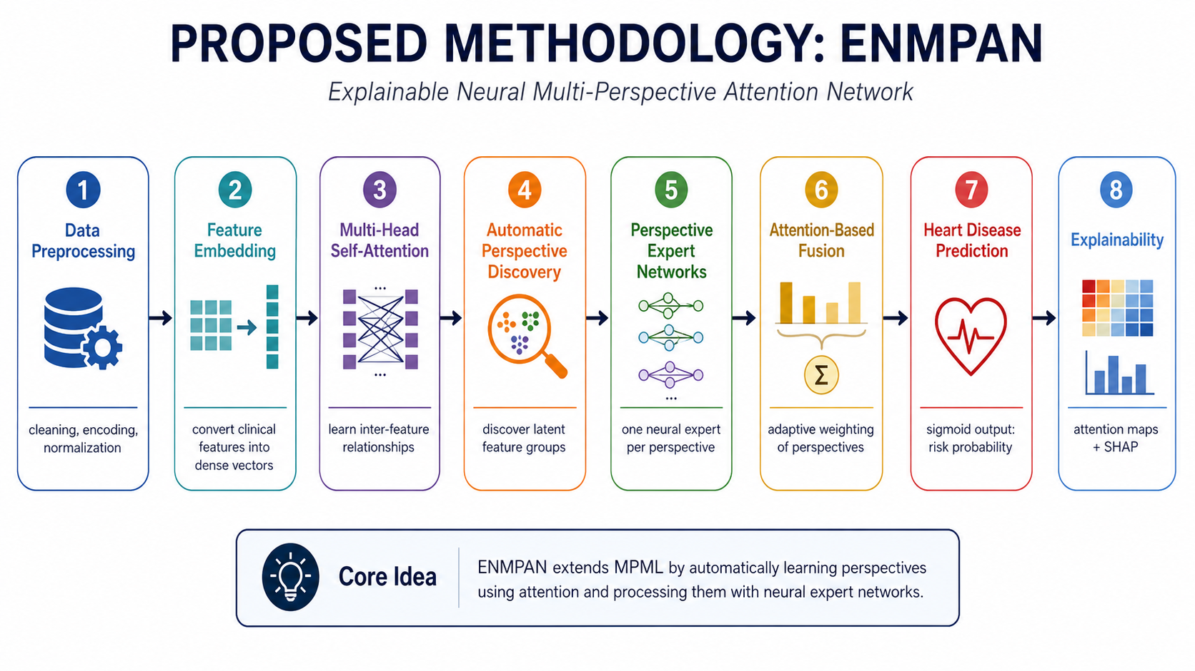
15

Slide 16
Key Innovations of ENMPAN
Attention-Based Fusion for adaptive perspective weighting.
Automatic Perspective Discovery without expert-defined grouping.
Dual Explainability using Attention Maps and SHAP.
Multi-Head Attention for learning complex feature interactions.
Designed to improve interpretability and predictive robustness over MPML
Perspective Expert Networks for specialized representation learning.
16

Slide 17
References
1 | R. Hao, Y. Xiang, J. Du, Q. He, J. Hu, and T. Xu, “A Hybrid CNN-Transformer Model for Heart Disease Prediction Using Life History Data,” in Proc. 8th Int. Symp. Big Data Appl. Stat. (ISBDAS), 2025, pp. 833–837, doi: 10.1109/ISBDAS64762.2025.11116866 3986.
2 | M. Mushtaq, Z. Mahmood, A. A. Butt, M. Y. Shabir, and M. N. Ulfatkhan, “Causal and Explainable Machine Learning Framework for Heart Disease Prediction using XGBoost and SHAP,” Journal of Computing & Biomedical Informatics, vol. 10, no. 1, Art. no. 1102, 2025, doi: 10.56979/1001/2025/1102.
3 | Y. Wang and H. Cao, “Heart Failure Prediction Based on Bootstrap Sampling and Weighted Fusion LightGBM Model,” Applied Sciences, vol. 15, no. 8, Art. no. 4360, 2025, doi: 10.3390/app15084360.
4 | Hamdaoui, H. E., Boujraf, S., Chaoui, N. E. H., Alami, B., & Maaroufi, M. (2021). Improving heart disease prediction using random Forest and AdaBoost algorithms. International Journal of Online and Biomedical Engineering (iJOE), 17(11), 60–75. https://doi.org/10.3991/ijoe.v17i11.24781
5 | Nasution, N., Hasan, M. A., & Nasution, F. B. (2025). Predicting heart disease using Machine Learning: An evaluation of logistic regression, random forest, SVM, and KNN models on the UCI heart disease dataset. IT JOURNAL RESEARCH AND DEVELOPMENT, 9(2), 140–150. https://doi.org/10.25299/itjrd.2025.17941
17

Slide 18
6 | Elyamani, H. A., Salem, M. A., Melgani, F., & Yhiea, N. M. (2024). Deep residual 2D convolutional neural network for cardiovascular disease classification. Scientific Reports, 14(1), 22040. https://doi.org/10.1038/s41598-024-72382-3
7 | Mahesh, T.R. et al. (2022) 'AdaBoost Ensemble Methods Using K-Fold Cross Validation for Survivability with the Early Detection of Heart Disease,' Computational Intelligence and Neuroscience, 2022, pp. 1–11. https://doi.org/10.1155/2022/9005278.
8 | Majumder, A. B., Gupta, S., Singh, D., Acharya, B., Gerogiannis, V. C., Kanavos, A., & Pintelas, P. (2023). Heart disease prediction using concatenated hybrid ensemble classifiers. Algorithms, 16(12), 538. https://doi.org/10.3390/a16120538
9 | AlSekait, D. M., Zakariah, M., Amin, S. U., Dubey, P., & Khan, Z. I. (2025). Using convolutional neural networks with late fusion to predict heart disease. Scientific Reports, 15(1), 41260. https://doi.org/10.1038/s41598-025-25100-6
18

Slide 19
Thank you !
19

