Slide 1
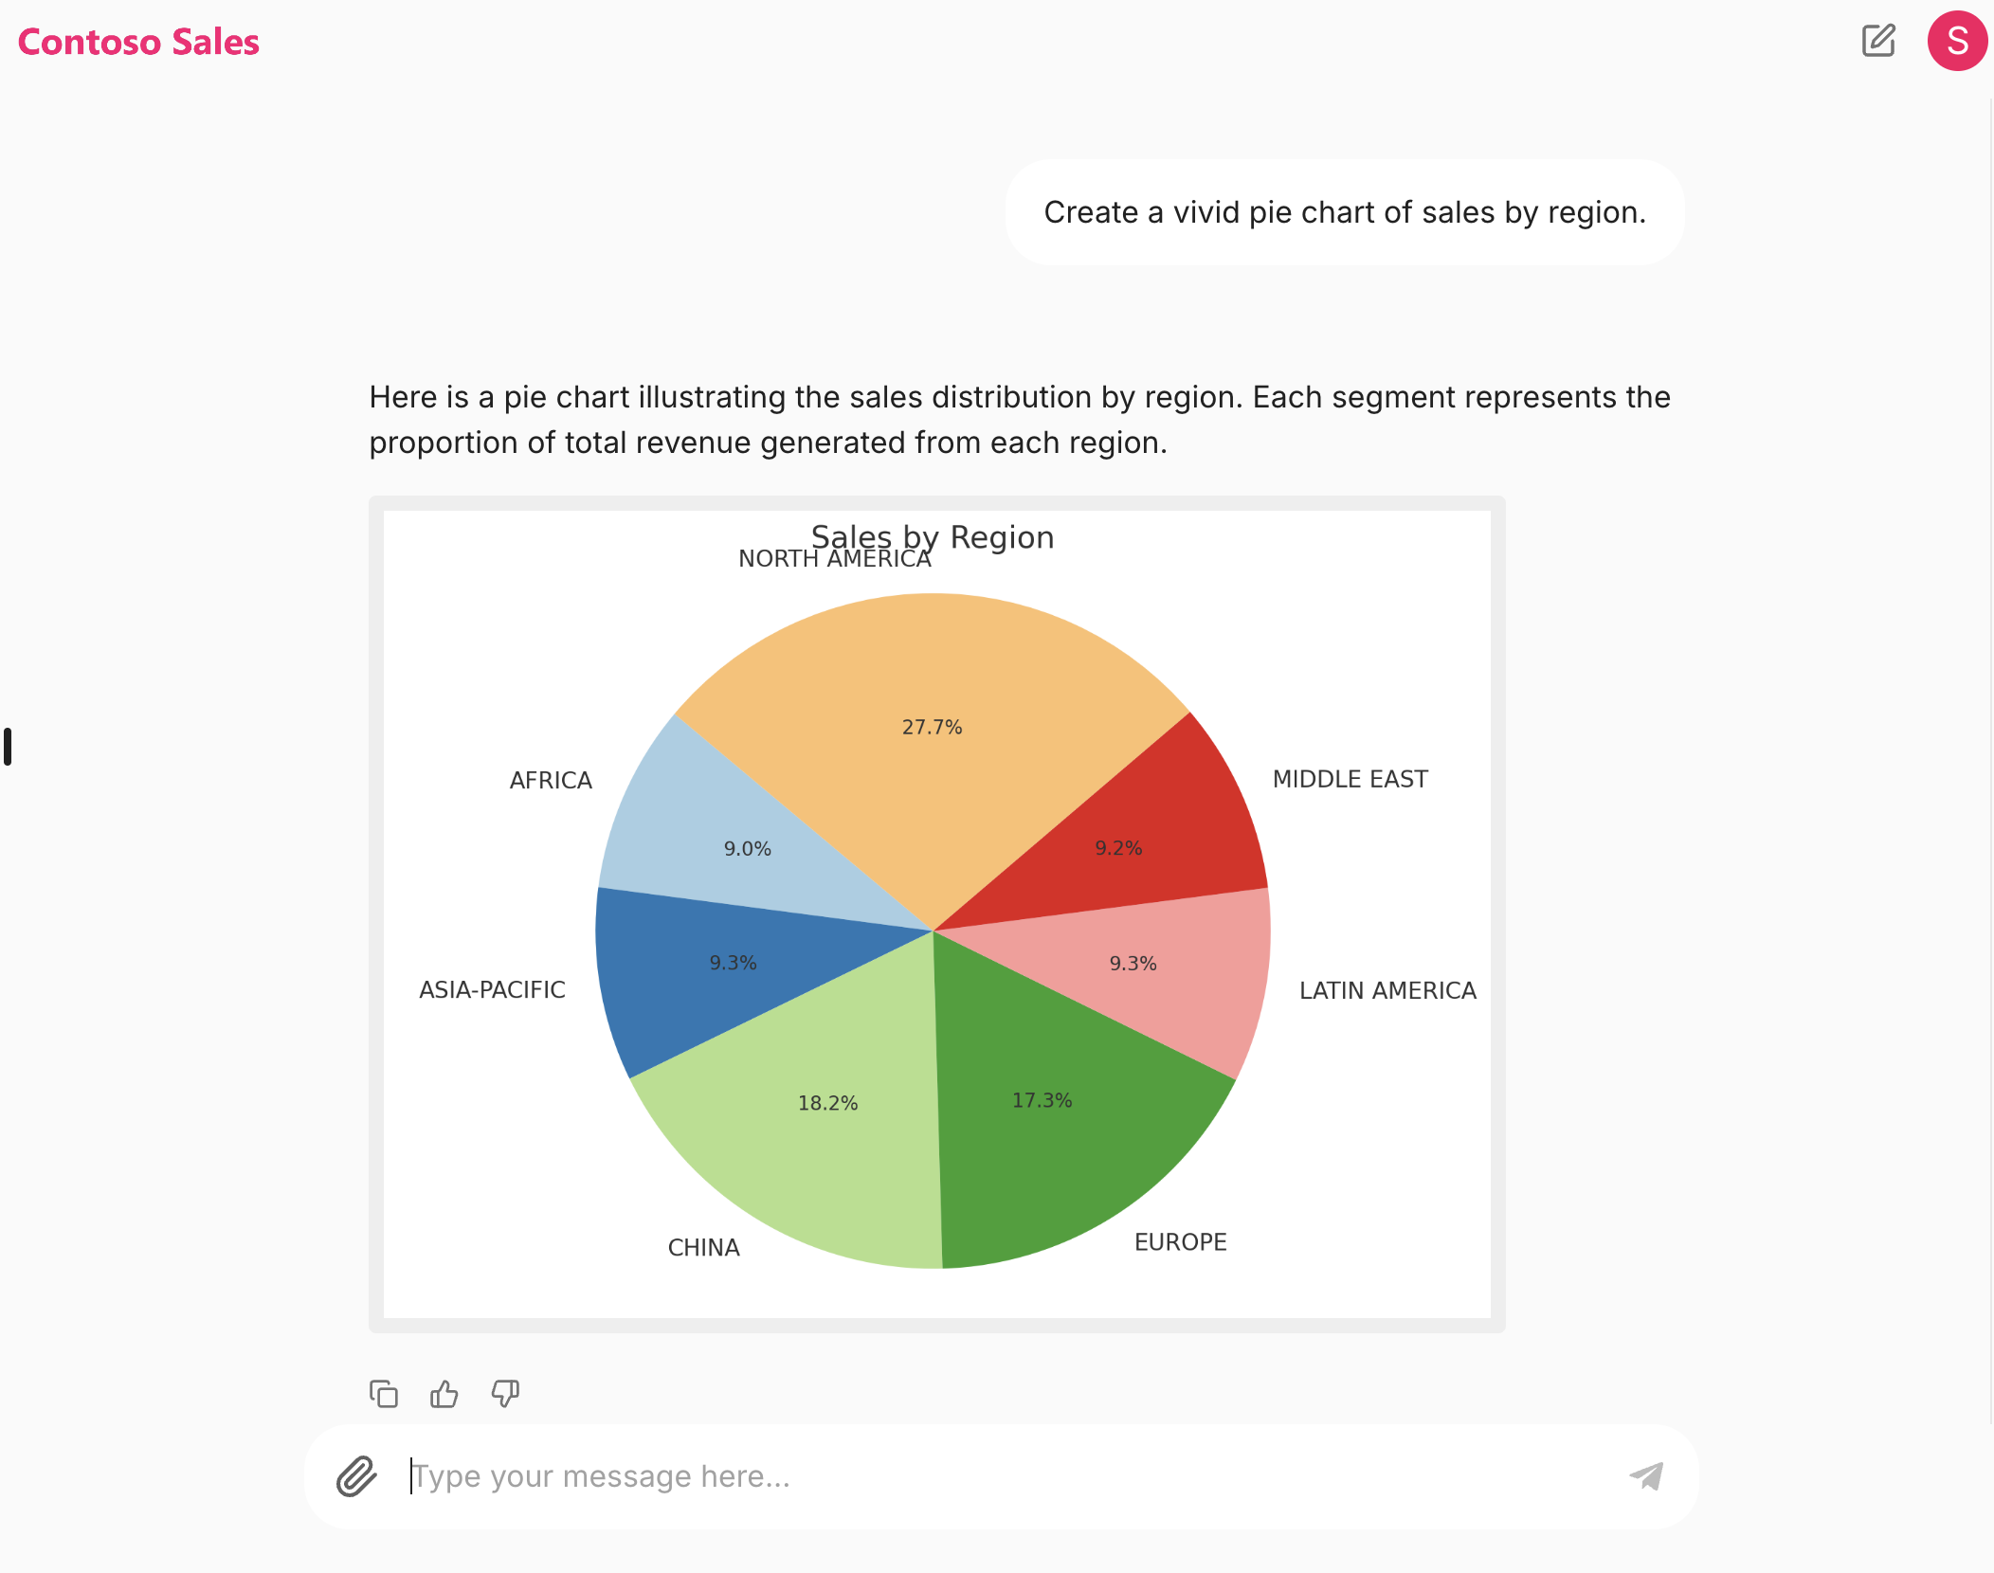

Azure
Azure Container App
Contoso Sales Assistant and SQLite
Contoso
Sales data
Azure OpenAI
gpt-4o
Assistants API

