Slide 1

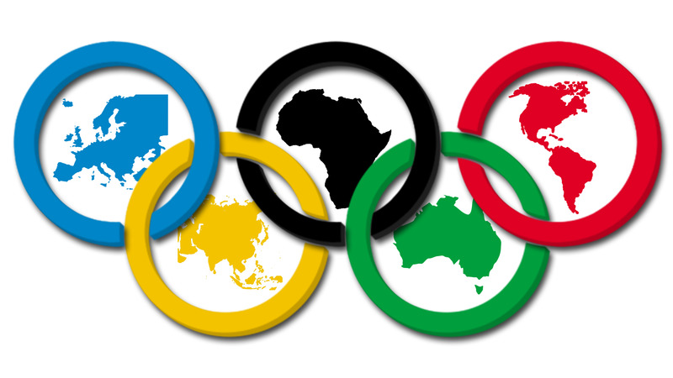
Summer Olympics
Exploratory Data Analysis

Slide 2
Analysis Steps
Introduction
Problem Statement
Installing and importing libraries
Data Acquisition
Pre-profiling
Data Cleaning (Pre-Processing)
Post-profiling
EDA
Conclusion

Slide 3
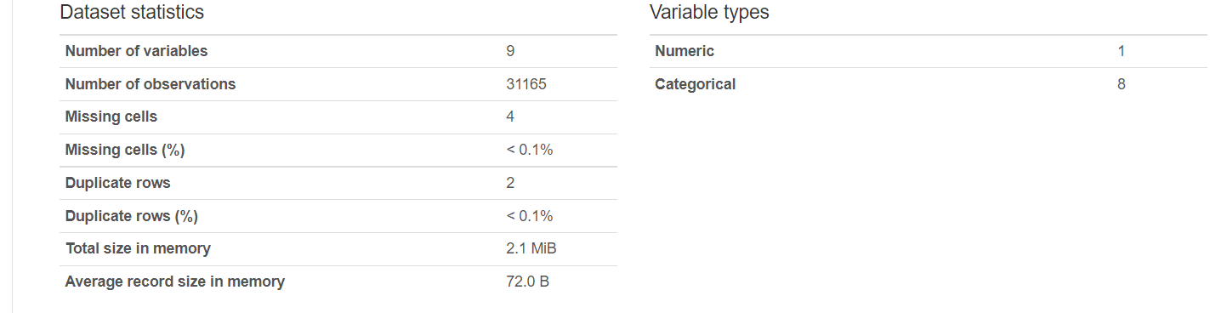
Data Pre-Processing

Slide 4
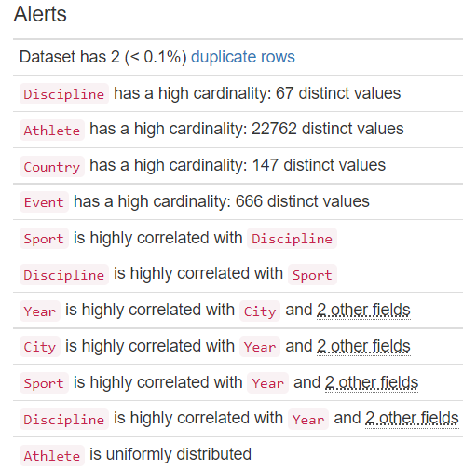
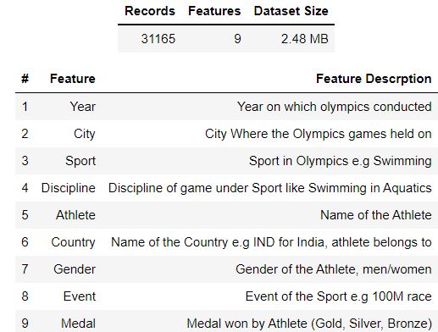
Data Pre-Processing

Slide 5
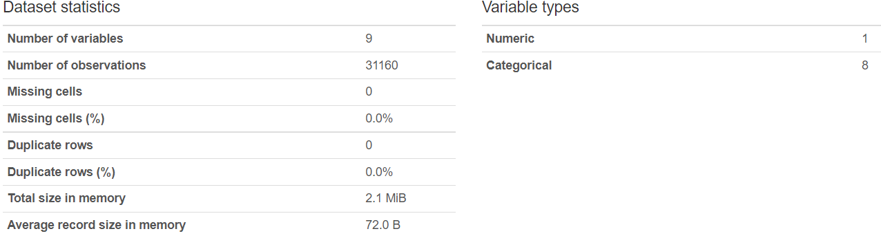
Data Cleaning

Slide 6
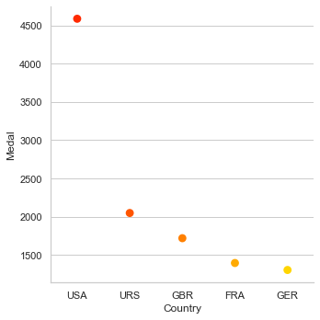
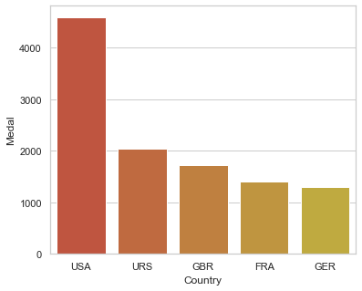
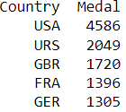
Top 5 Countries to secure most medals

Slide 7
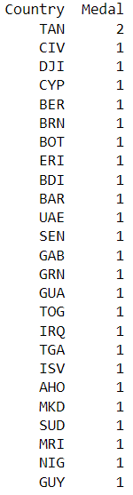
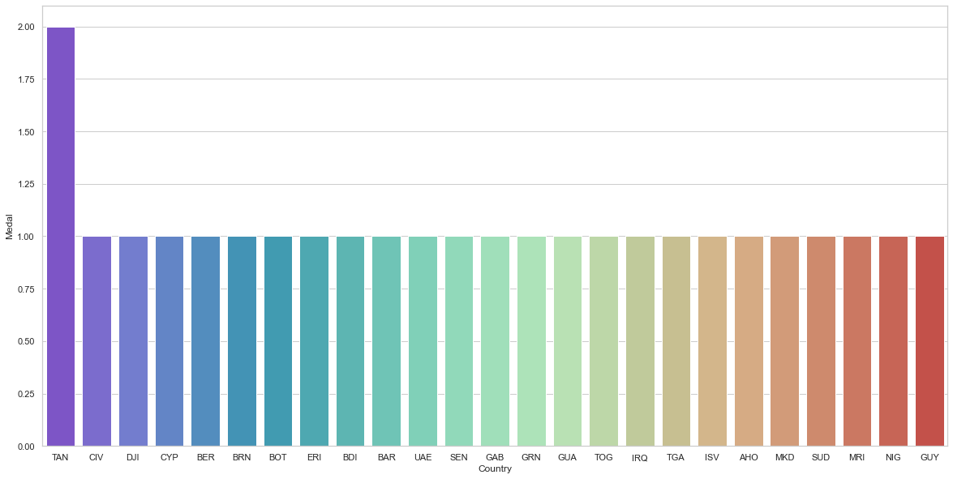
Countries to secure least medals

Slide 8
India's performance over the years
First Medal:
First Gold Medal: Hockey (1928)
Total Medals Won: 183 (Incl. Group events)

Slide 9
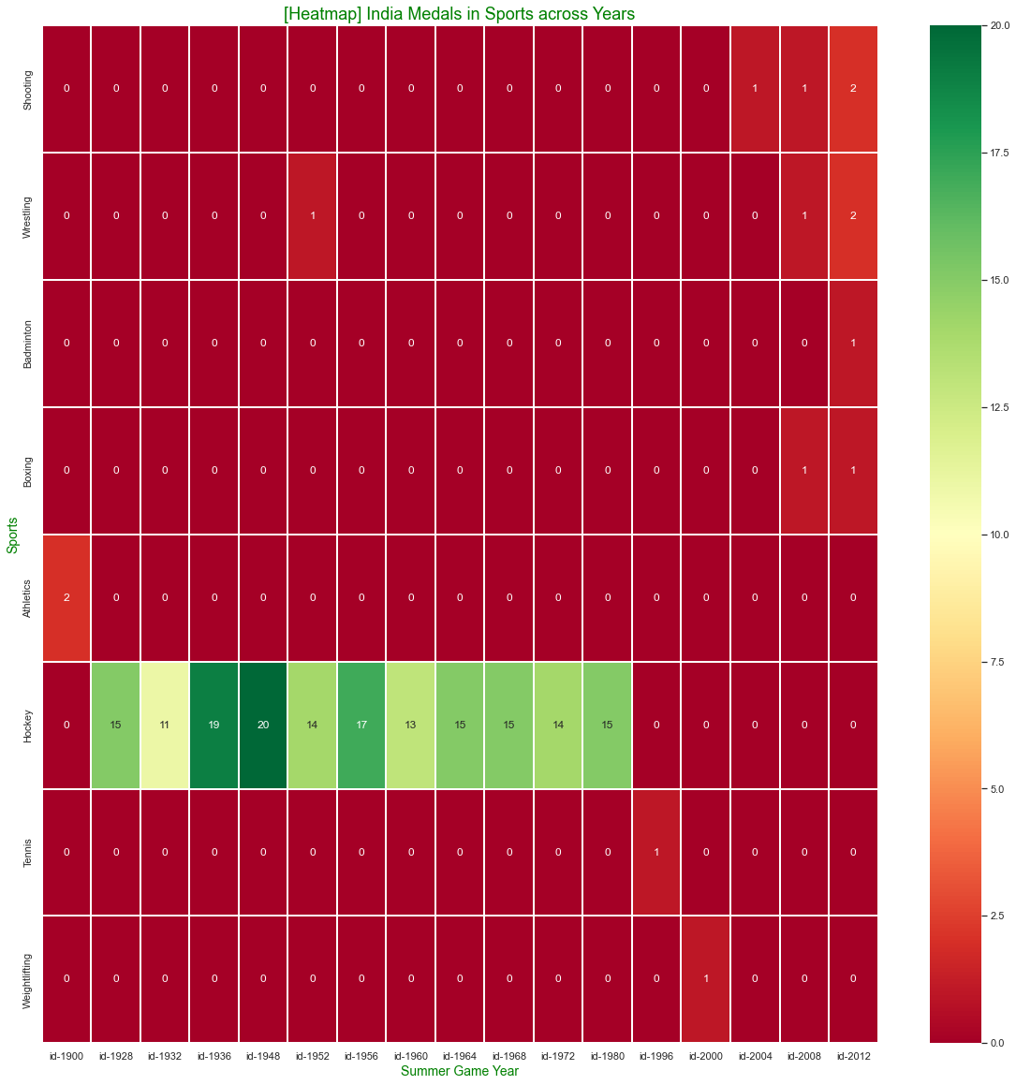

Slide 10
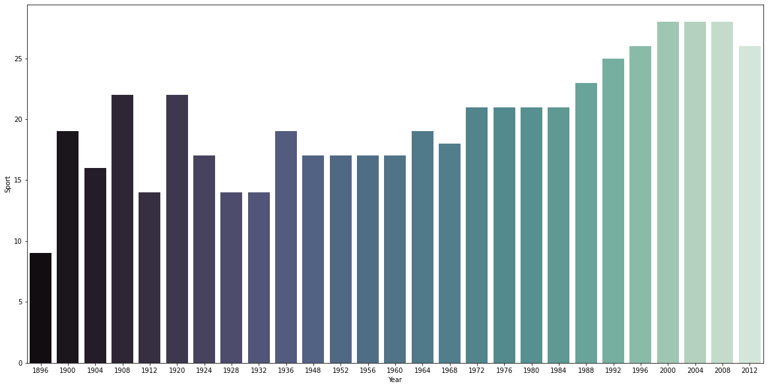
Number of sports held per year

Slide 11
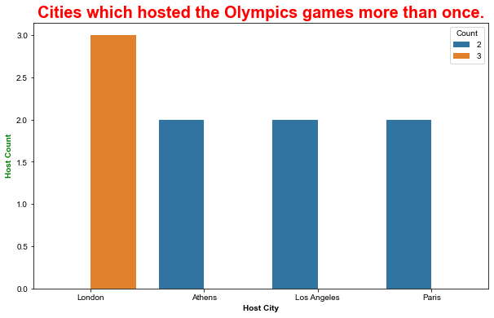
Cities which hosted Olympics more than once

Slide 12
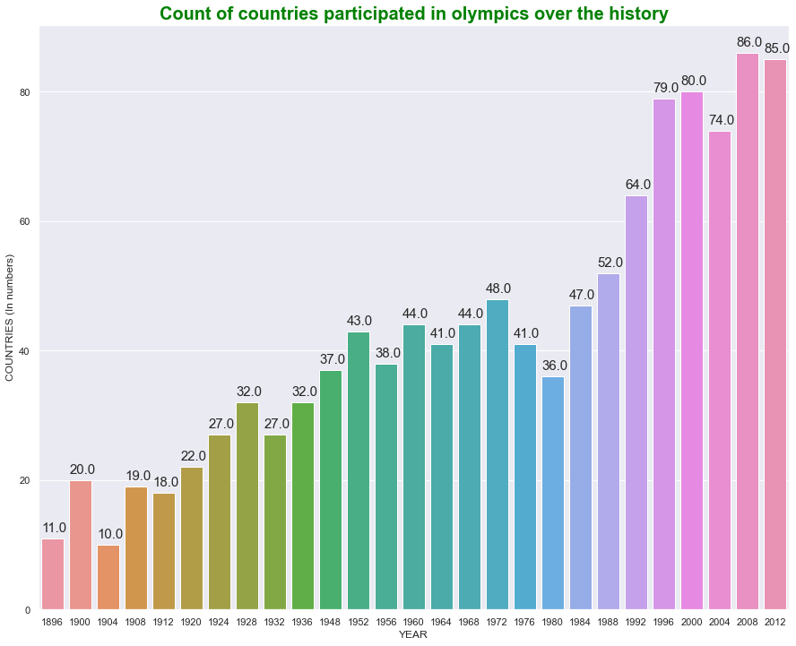
Level of participation over the years

Slide 13
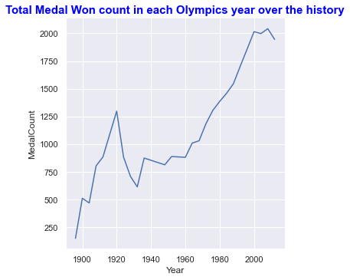
Medals win count per year

Slide 14
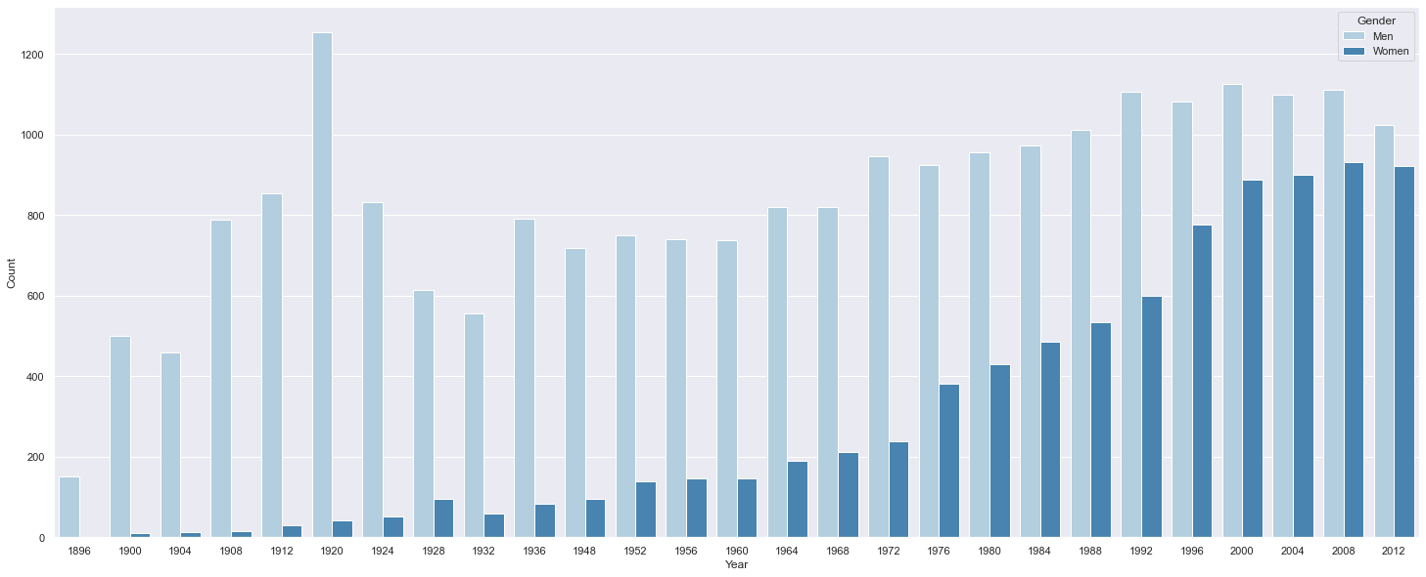
Gender participation

Slide 15
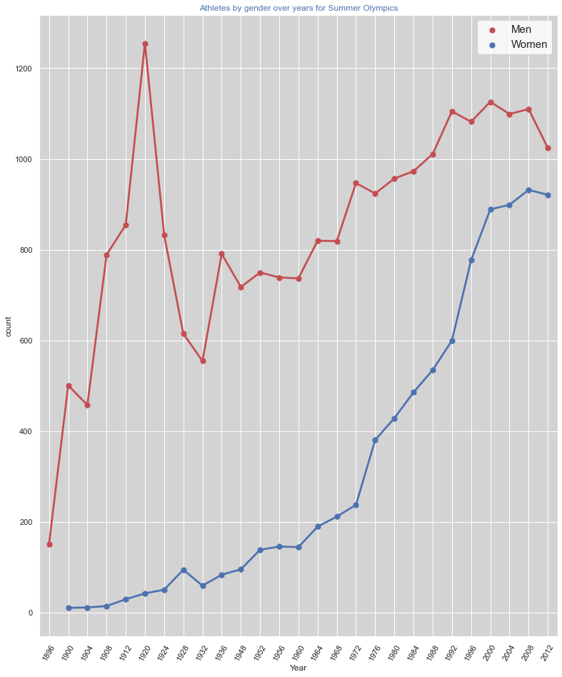

Slide 16
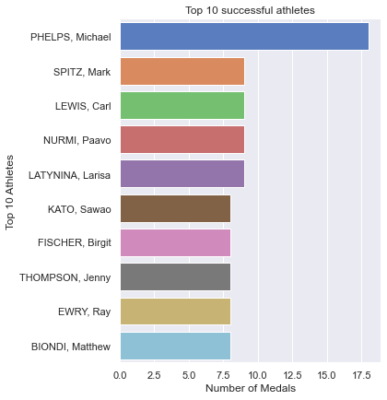
Top 10 successful athletes

Slide 17
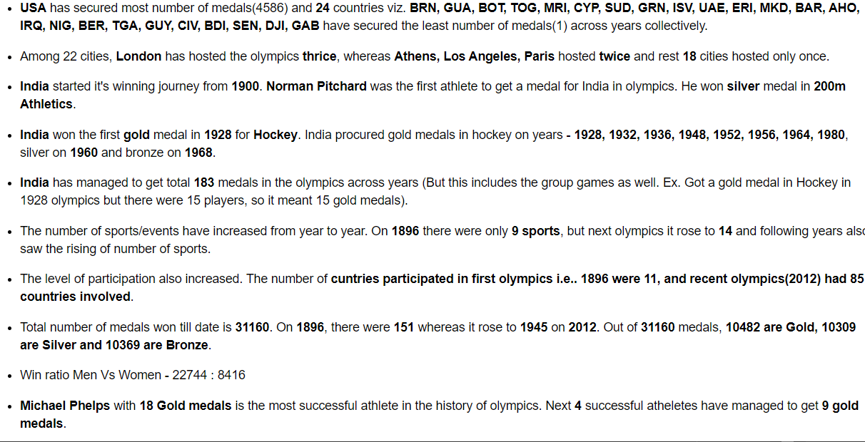
Conclusion

Slide 18


