Slide 1
Google Trends Analysis
Pepsi VS Coca Cola

Slide 2
WHAT IS GOOGLE TRENDS?
Google Trends is a very useful service for finding what’s popular among users of the Search engine and generating insights. Trending searches by Google users can be used as an information source that could perhaps improve the forecasts. In Google Trends, Google compiles and aggregates its search data, reflecting the interestin certain keywords or concepts.

Slide 3
WHY IT IS USEFUL?
In the marketing industry, the volume of queries made by users about the products via the search engine could reflect the potential volume of sales of these products. These data could therefore be considered as indicators of consumer purchase intention, both for manufactured goods and for services.

Slide 4
WHY WE USING R?
Using Google Trends manually is fun. However, it could be time-consuming and tedious if you would like to compare different search terms over different time frames.

Slide 5
Pepsi VS Coca-Cola
Interest Over Time
Interest By Country
Interest By City
Related Queries

Slide 6
WHAT IS INTEREST OVER TIME?
The scores awarded by Google Trends on the “interest over time” line graph express the popularity of that term over a specified time range. Google Trends scores are based on the absolute search volume for a term, relative to the number of searches received by Google.

Slide 7
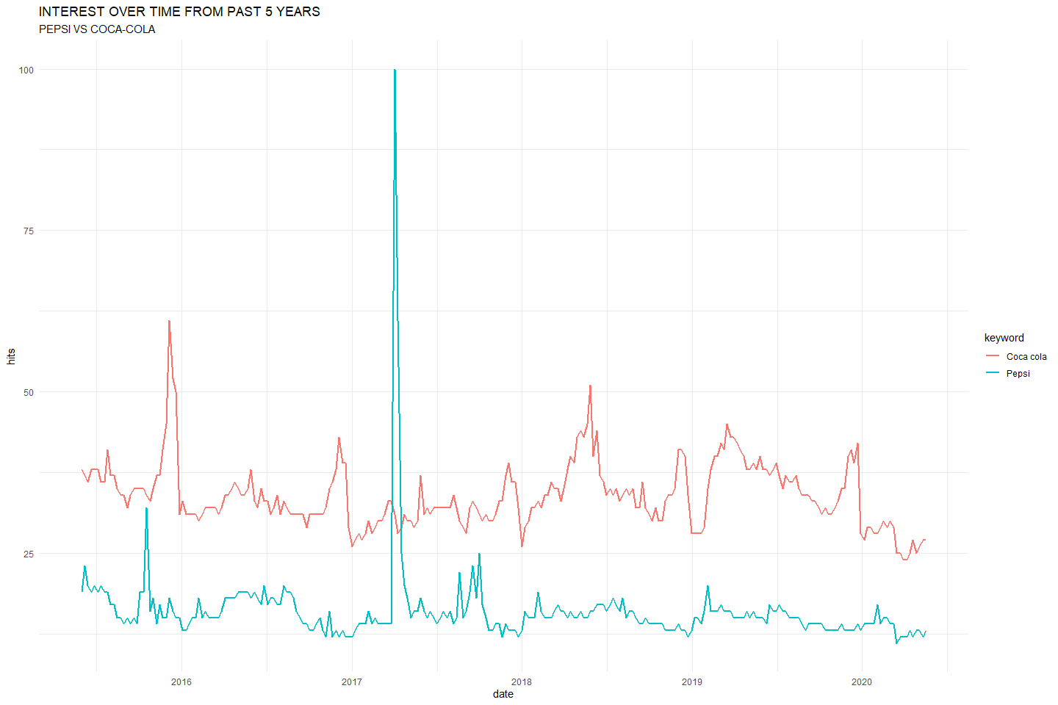
INTEREST OVER TIME GRAPH

Slide 8
WHAT IS INTEREST BY COUNTRY?
The scores awarded by Google Trends on the “INTEREST BY COUNTRY” Bar graph express the popularity of that term in different Countries.shows you the score of that keyword in a specific contries. The Bar Graph shows the Top 20 Contries with Highest Score for that term.

Slide 9
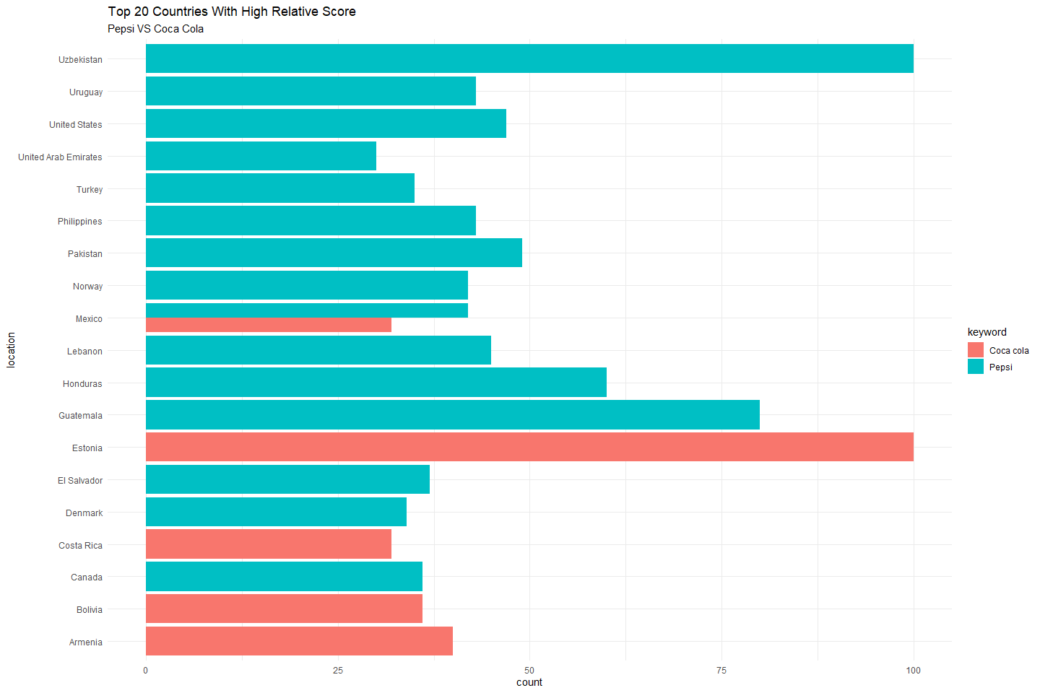
INTEREST BY COUNTRY GRAPH

Slide 10
RELATED TERMS
Is used to find NEW keyword ideas (AND even STEAL business from your competitors) Google Trends can reveal the queries people also search for when they search for your term. For example, people searching for “sneakers” also tend to search for “Nike” and “Adidas.”

Slide 11
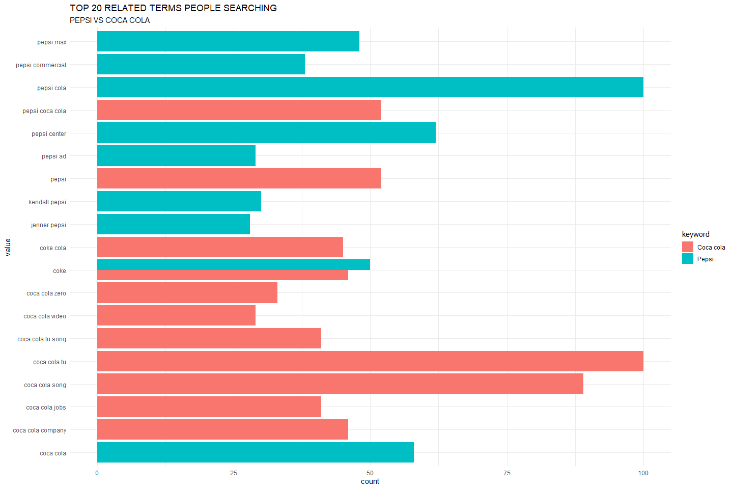
RELATED TERMS GRAPH

Slide 12
RISING TERMS
Rising queries are a bit more interesting. Instead of including an index number, there is a percentage or “breakout” associated with each query. This percentage indicates the increase in searches for this query in the time period you’ve defined, compared against the previous time period

Slide 13
RISING TEMRS FOR PEPSI
value | keyword
kendall pepsi ad | Pepsi
kendall jenner pepsi ad | Pepsi
kendall jenner pepsi | Pepsi
zula | Pepsi
kendall jenner | Pepsi
pepsi zula | Pepsi
jenner pepsi ad | Pepsi
jenner pepsi | Pepsi
kendall jenner pepsi commercial | Pepsi
kendall pepsi | Pepsi

Slide 14
value | keyword
pepsi commercial jenner | Pepsi
zula pepsi kodu | Pepsi
pepsi 1893 | Pepsi
kendall pepsi commercial | Pepsi
cardi b pepsi commercial | Pepsi
pepsi p1s | Pepsi
promoÃ§Ã£o pepsi 2016 | Pepsi
pepsi commercial 2017 | Pepsi
pepsi battle of the bands | Pepsi
NA | NA

Slide 15
ANY QUESTIONS?

Slide 16
Slide with R Output
summary(cars)
## speed dist ## Min. : 4.0 Min. : 2.00 ## 1st Qu.:12.0 1st Qu.: 26.00 ## Median :15.0 Median : 36.00 ## Mean :15.4 Mean : 42.98 ## 3rd Qu.:19.0 3rd Qu.: 56.00 ## Max. :25.0 Max. :120.00

Slide 17
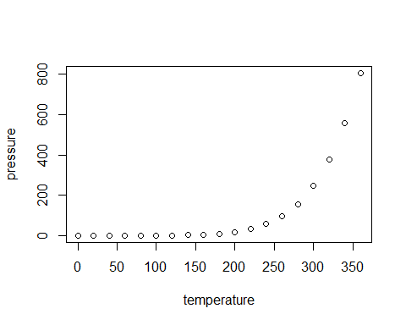
Slide with Plot

