Slide 1

1
Presented By:- Shantam Malgaonkar.

Slide 2
INDEX
2
SR.NO | TOPICS | PAGE
1 | INTRODUCTION | 3
2 | OVERVIEW | 5
3 | TECHNOLOGY USED | 6
4 | SOLUTION APPROACH | 8
5 | CONCLUSION | 17

Slide 3
INTRODUCTION
3
Servify enhances the device ownership experience for consumers, and connects the disintegrated ecosystem of brands, retailers and service providers.
Servify launched its mobile app-based solution that aims to work as a personal assistant for all electronic gadgets and appliances owned by consumers in a household. The app, in addition to helping consumers store their bills and warranty on cloud, also connects with brand authorized service ecosystem when consumers need a reliable repair.
The app boasts of being the first-of-its-kind, enabling service during warranty and out of warranty as it connects the brand authorized service ecosystem.
The app helps consumers track the status of service request real-time including, showing the distance of a service center on Google Maps within the app when the consumer has to carry the device to the nearest service center.

Slide 4
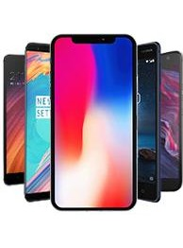
4
OBJECTIVES OF SERVIFY:
1.Protect your device
2.Proactive alerts
3.Keep bills and warranties safe
4.Brand authorized service
5.Brand authorized rates
6.Real-Time status
7.Pick up and drop services
8.Jump the queue by pre-booking

Slide 5
OVERVIEW
6
DATABASE DETAILS:
1.Consumer Table- All the entries related to consumers.
2.Consumer Product Table- Details about consumer brands,warranty of device etc.
3.Consumer Service Request Table- Details of requested service by consumer.
4.Sold Plan Table- Information about servify plans which is taken by consumer.

Slide 6

TECHNOLOGIES USED
7
About Python-Pandas:
1.Pandas being one of the most popular package in Python is widely used for data manipulation,data preprocessing. It is a very powerful and versatile package which makes data cleaning and wrangling much easier and pleasant.
2.Pandas is an open-source, BSD-licensed Python library providing high-performance, easy-to-use data structures and data analysis tools for the Python programming language.
3.In 2008, developer Wes McKinney started developing pandas when in need of high performance, flexible tool for analysis of data.
4.Pandas, we can accomplish five typical steps in the processing and analysis of data, regardless of the origin of data — load, prepare, manipulate, model, and analyze.

Slide 7
9
SOLUTION APPROACH
Problem statement 1: The average number of plans sold per week.
Solution: By starting with the coding part in the python I have imported pandas for data manipulation and seaborn,matplotlib for visualization and pymysql for accessing the data.so I used the pivot table to for summary and to get the average number of plans sold per week.
Problem statement 2: The brand (BrandID) with the highest number of plans bought by customers.
Solution: Same as the above problem, firstly I have joined the two tables to get all values then ,I have taken the brandID in rows and SoldplanID in values and taken the count and sorted the SoldPlanID by highest value.

Slide 8
10
Continue......
Problem statement 3:-
The percentage of service requests raised under a plan of the total number of requests raised
Solution :- firstly joined the two datasets which are sold_plan and the Consumer servicerequest and then taken the pivot table and in rows taken the planID and in values taken the count of ConsumerservicerequestID and then taken the percentage of it.

Slide 9
12
Screenshots

Slide 10
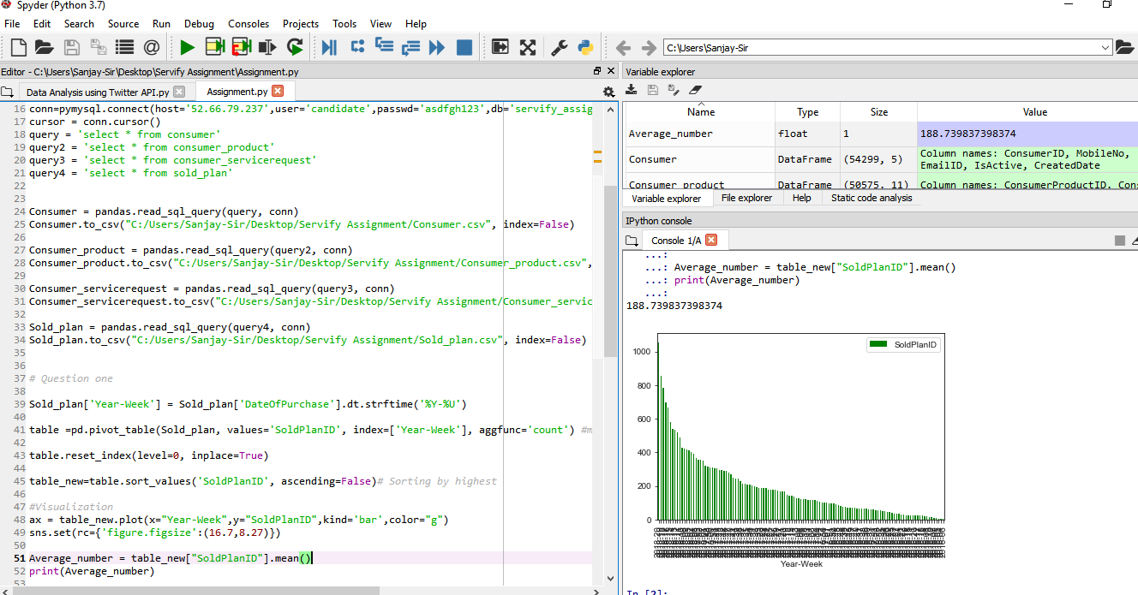
PYTHON
13

Slide 11
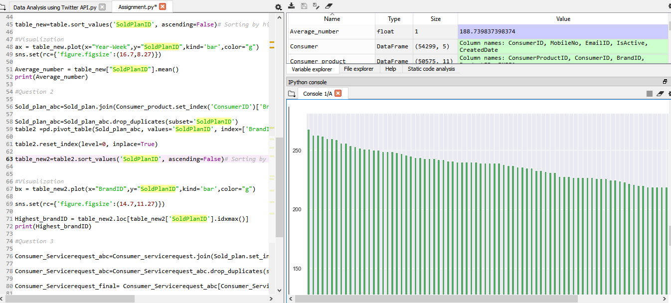
14
CONTINUE…

Slide 12
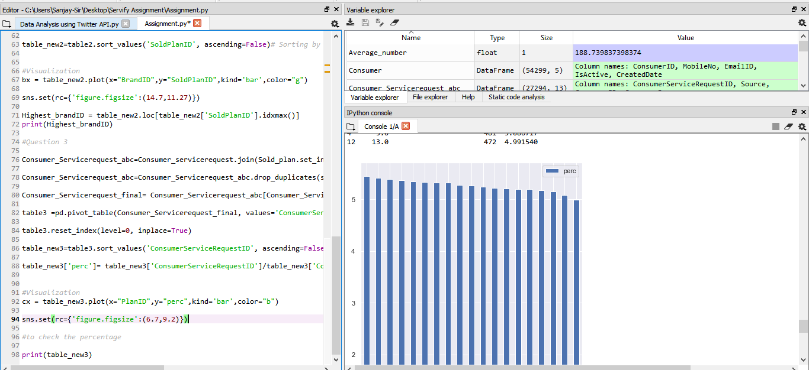
CONTINUE…
16

Slide 13
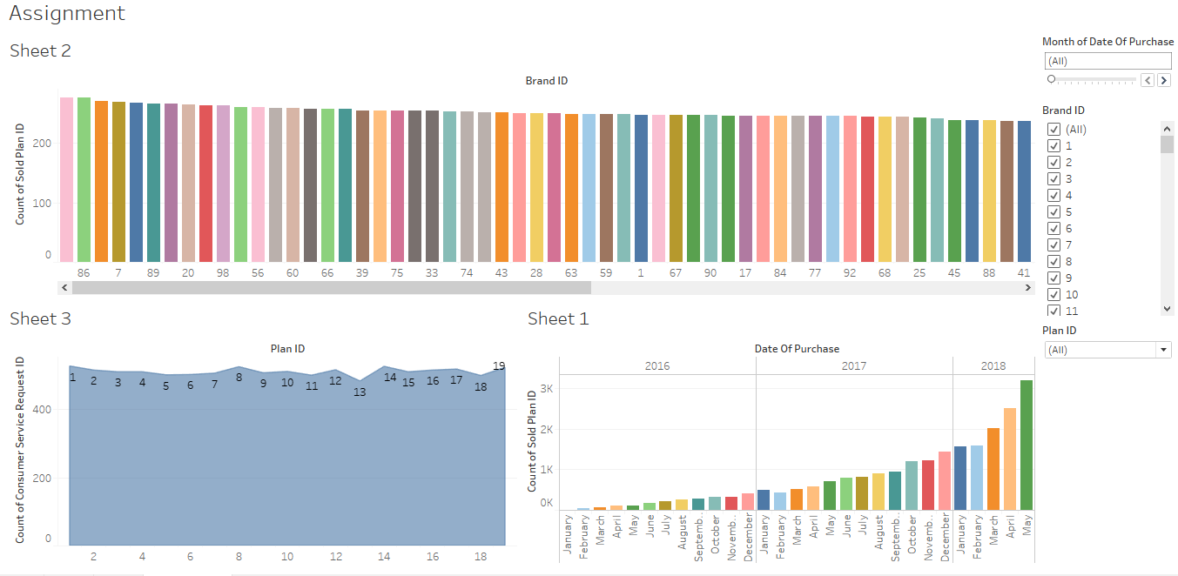
TABLEAU
17

Slide 14
CONCLUSION
29
The assignment helps me to understand and learn the pandas library. It helped me improving my various analytical skills and enhanced my knowledge in areas of Data Science .We can do various oprations by using pandas(data prepration,data exploration,data manipulation),matplotlib (for visualization in python).I have gone through the various notes and sites which helped me to go with the syntax and related information of that. It would be very greateful to work with data scienc team in servify and get the guideline as well as exposure in terms of related field .

Slide 15
30
tHank you !!!!!!!!

