Slide 1
Feed The Pollinators

Slide 2
Examples Of Pollinators
Insects
Birds
Mammals
Other animals
Humans

Slide 3
Insects
Bees (Apidae)
Honey bees (Apis mellifera)
Bumblebees (Bombus spp.), including:
Western bumblebee (Bombus occidentalis)
Yellow-faced bumblebee (Bombus vosnesenskii)
Mason bees (Osmia spp.), including:
Blue orchard mason bee (Osmia lignaria)
Leafcutter bees (Megachile spp.)
Sweat bees (Halictidae family)
Butterflies (Lepidoptera)
Monarch butterfly (Danaus plexippus) – migratory species
Western tiger swallowtail (Papilio rutulus)
Painted lady (Vanessa cardui)
Moths (Lepidoptera)
Hawk moths (Sphingidae family)
Hummingbird clearwing moth (Hemaris thysbe)
Beetles (Coleoptera)
Flower beetles (Cetoniidae family)
Soldier beetles (Cantharidae family)
Flies (Diptera)
Hoverflies (Syrphidae family)
Bee flies (Bombyliidae family)
Wasps (Hymenoptera)
Paper wasps (Polistes spp.)

Slide 4
Birds
Hummingbirds (Trochilidae family)
  Rufous hummingbird (Selasphorus rufus)
Calliope hummingbird (Selasphorus calliope)

Slide 5
Mammals
Bats (Chiroptera)
Little brown bat (Myotis lucifugus)
Hoary bat (Lasiurus cinereus)

Slide 6
Other Animals
Reptiles**
- Some species of lizards, such as the Day gecko (Phelsuma spp.)

Slide 7
Humans
Humans also play a role in pollination through hand pollination in agriculture and horticulture.

Slide 8
Plants that feed pollinators
Trees
Shrubs
Wild Flowers
Herbs
Annuals

Slide 9
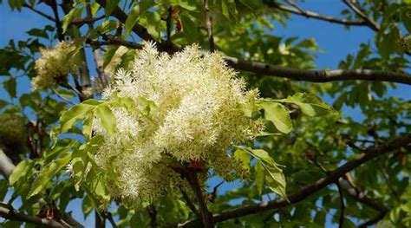
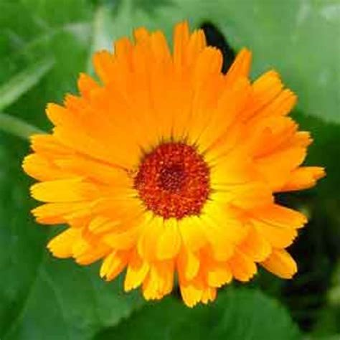
Trees
Trees provide nectar and Pollen.
earliest pollen sources in the year.
Downward orientation
One Large tree = acre of flowers.

Slide 10
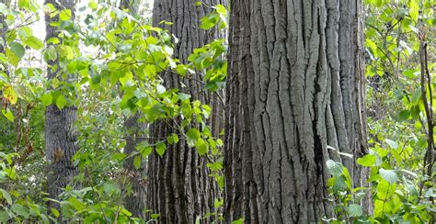
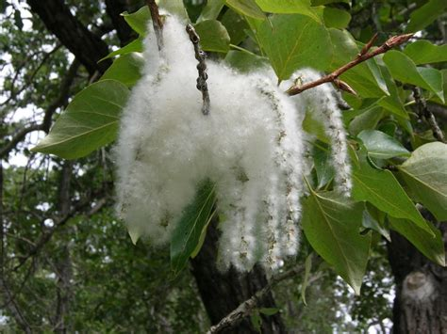
Cottonwood (Populus spp.)
Bloom Time: March to April
Pollinators: Wind-pollinated, but bees visit catkins for pollen

Slide 11
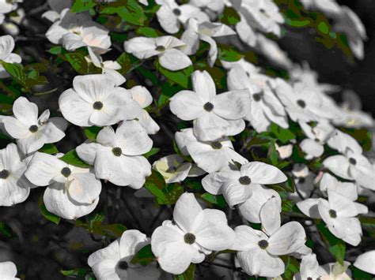
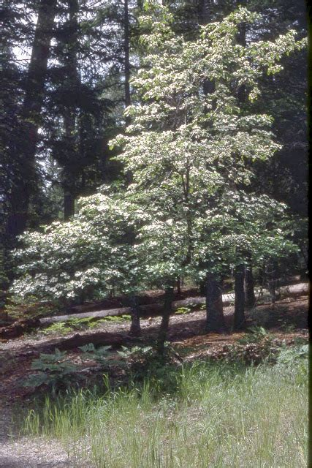
Pacific Dogwood
(Cornus nuttallii)
Bloom Time: April to May
Pollinators: Bees, butterflies

Slide 12
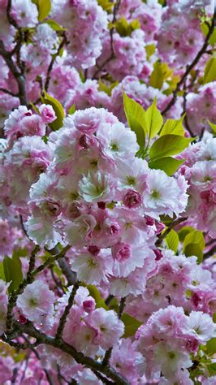
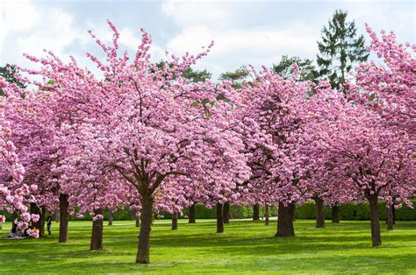
Cherry (Prunus spp.)
Bloom Time: March to April
Pollinators: Bees

Slide 13
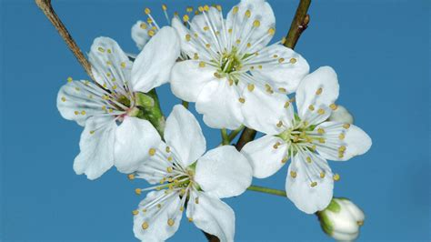
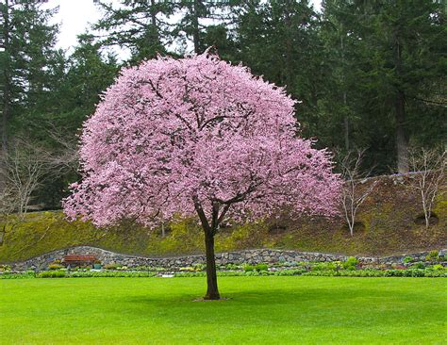
Plum (Prunus domestica)
Bloom Time: March to April
Pollinators: Bees

Slide 14
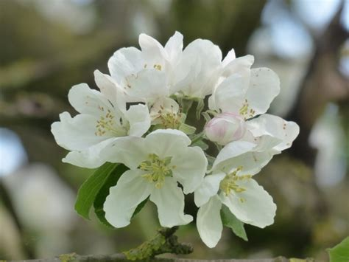
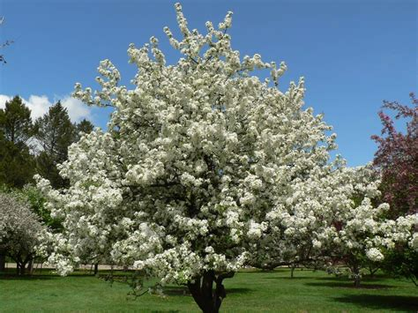
Apple (Moles spp.)
Bloom Time: April to May
Pollinators: Bees

Slide 15
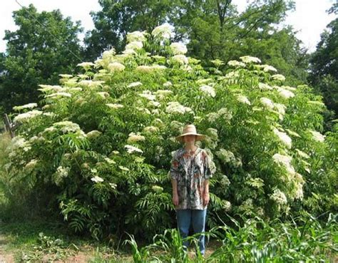
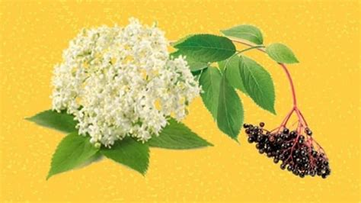
Elderberry (Sambucus spp.)
Bloom Time: late May to early July.
Pollinators: Bees (various species), Flies (such as hoverflies), Butterflies

Slide 16
Elderberry (Sambucus spp.)
Botanical Name:
- Sambucus spp.
Common Names:
- Elderberry
- Black Elderberry
- Common Elder
- American Elder
- European Elder
Images:
![Elderberry](https://www.gardenia.net/storage/app/public/guides/detail/Elderberry-Flowers.jpg)
![Elderberry Fruit](https://www.gardenia.net/storage/app/public/guides/detail/Elderberry-Berries.jpg)
Identifying Characteristics:
- Leaves: Pinnately compound leaves, with 5-9 leaflets, serrated margins.
- Flowers: Large, flat-topped clusters of small, white to creamy flowers (cymes), typically blooming in late spring to early summer.
- Fruits: Small, dark purple to black berries in clusters, ripening in late summer to early fall.
- Bark: Smooth and gray-brown when young, becoming furrowed with age.
- Height: Can grow as a large shrub or small tree, reaching heights of 5-12 feet (1.5-3.6 meters).
Distribution:
- Native Range: Temperate regions of North America and Europe.
- Habitat: Prefers moist, well-drained soils and can often be found along streams, rivers, and in wet woodlands.
Flowering Dates:
- Flowering Time: Typically from late May to early July.
Known Pollinators:
- Bees (various species)
- Flies (such as hoverflies)
- Butterflies
Resources Provided to Pollinators:
- Nectar: Provides a rich source of nectar for bees, butterflies, and other pollinators.
- Pollen: Offers pollen for bees and other insects, essential for their nutrition and hive health.
Therapeutic Actions:
- Berries: Rich in antioxidants, vitamins A and C, and have antiviral properties.
- Flowers: Used in teas and infusions for their diaphoretic (sweat-inducing) and anti-inflammatory properties.
Historical Uses:
- Medicinal: Used traditionally for treating colds, flu, and boosting the immune system.
- Culinary: Berries are used in syrups, jams, jellies, wines, and pies. Flowers can be used to make elderflower cordial or elderflower fritters.
Cultivation Methods:
- Soil: Prefers rich, moist, well-drained soil.
- Light: Thrives in full sun to partial shade.
- Watering: Requires regular watering, especially in dry periods.
- Propagation: Can be propagated by seed, cuttings, or root suckers.
Constituents:
- Berries: High in vitamins A and C, flavonoids, anthocyanins, and antioxidants.
- Flowers: Contain flavonoids, essential oils, tannins, and mucilage.
Parts Used:
- Berries: Used for syrups, jams, wines, and medicinal extracts.
- Flowers: Used for teas, infusions, and culinary applications.
Toxicity Level:
- Unripe Berries: Contain cyanogenic glycosides which can be toxic if consumed raw in large quantities. Cooking or processing the berries removes the toxins.
Origin:
- North America: Native to a wide range of areas, from the eastern United States to the Pacific Northwest.
- Europe: Widely distributed across Europe.
Culinary Applications:
- Berries: Used in making jams, syrups, jellies, wines, and desserts.
- Flowers: Used to make elderflower cordial, teas, and as a flavoring in various dishes.
Solvents Used:
- Water: For making teas and infusions.
- Alcohol: For tinctures and extracts.
Uses for Animals:
- Berries and Flowers: Not commonly used in veterinary applications, but the plant provides habitat and food for wildlife.
Diseases and Treatments:
- For the Plant: Prone to aphids, powdery mildew, and fungal diseases. Can be treated with appropriate organic fungicides and insecticides.
- For Humans: Berries and flowers are used to treat colds, flu, and support the immune system.
Chinese Medicinal Use:
- Elderberry (Sambucus spp.) is not traditionally used in Chinese medicine.
Edibility:
- Berries: Edible when cooked or processed. Should not be eaten raw in large quantities due to potential toxicity.
- Flowers: Edible and used in culinary preparations.
Environmental Considerations:
- Pros: Provides food and habitat for wildlife, supports pollinators, and can be used in permaculture and sustainable landscaping.
- Cons: Can become invasive in some regions if not managed properly.
Contraindications:
- Unripe Berries: Should not be consumed raw. Can cause nausea, vomiting, and diarrhea if eaten in large quantities.
- Pregnancy and Breastfeeding: Consult a healthcare professional before use.
Homeopathic Uses:
- Homeopathic Remedies: Sometimes used in homeopathy for treating cold and flu symptoms.
Pollinators:
- Bees, butterflies, and flies.
Harvesting Practices:
- Flowers: Harvest in late spring when they are fully open.
- Berries: Harvest in late summer to early fall when they are fully ripe and dark in color.
Medicinal Properties:
- Antiviral, anti-inflammatory, immune-boosting properties.
Disease Treatments:
- For Humans: Used to treat colds, flu, and other respiratory infections.
References:
- "Elderberry: The Immune-Boosting Superberry" by John W. Travis.
- "The Complete Elderberry Guide" by Sandra Kynes.
- "The Elderberry Book: Forage, Cultivate, Prepare, Preserve" by John Moody.
This detailed listing provides comprehensive information on Elderberry (Sambucus spp.), covering its characteristics, uses, and benefits for pollinators and humans.

Slide 17
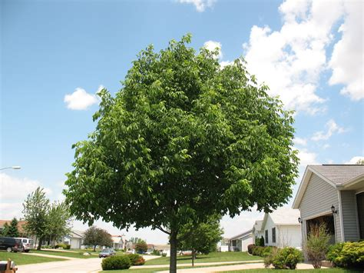
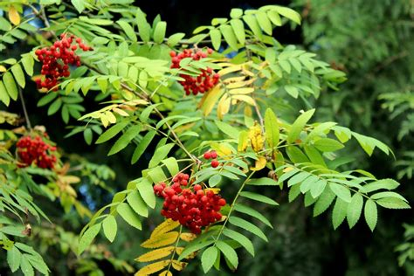
Ash (*Fraxinus excelsior*)
Bloom Time: May to June
- Pollinators: Wind-pollinated, but bees visit for pollen

Slide 18
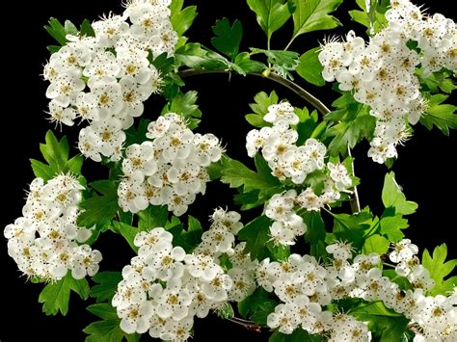
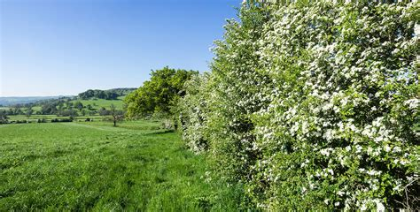
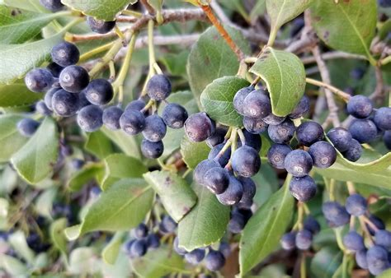
Hawthorn
(*Crataegus ongoing*)
Bloom Time: May to June
- Pollinators: Bees, flies, and beetles

Slide 19
Hawthorn (Crataegus spp.)
Hawthorn (Crataegus spp.)
Botanical Name:
- Crataegus spp.
Common Names:
- Hawthorn
- May-tree
- Quickthorn
- Thornapple
- Whitethorn
- Hawberry
Images:
![Hawthorn Flowers](https://www.gardenia.net/storage/app/public/guides/detail/Hawthorn-Flowers.jpg)
![Hawthorn Berries](https://www.gardenia.net/storage/app/public/guides/detail/Hawthorn-Berries.jpg)
Identifying Characteristics:
- Leaves: Typically lobed with toothed edges, varying in shape between species.
- Flowers: Small, white to pink, with five petals, appearing in clusters (corymbs) in late spring.
- Fruits: Small, apple-like berries (haws) that turn red or orange when ripe in the fall.
- Bark: Smooth and gray on young trees, becoming rough and scaly with age.
- Height: Generally grows as a small tree or large shrub, reaching heights of 15-45 feet (4.5-14 meters).
Distribution:
- Native Range: Temperate regions of Europe, Asia, and North America.
- Habitat: Prefers well-drained soils and can often be found in hedgerows, woodlands, and along field edges.
Flowering Dates:
- Flowering Time: Typically from late April to June, depending on the species and local climate.
Known Pollinators:
- Bees (various species)
- Butterflies
- Moths
- Flies
Resources Provided to Pollinators:
- Nectar: Rich source of nectar for bees, butterflies, and other pollinators.
- Pollen: Offers pollen for bees and other insects, essential for their nutrition and hive health.
Therapeutic Actions:
- Heart Health: Traditionally used to support cardiovascular health, improve blood circulation, and treat heart conditions.
- Digestive Aid: Used to improve digestion and relieve stomach ailments.
Historical Uses:
- Medicinal: Used in traditional medicine for heart health, digestive issues, and as a sedative.
- Culinary: Berries are used to make jams, jellies, wines, and as a flavoring for various dishes.
Cultivation Methods:
- Soil: Prefers well-drained, loamy soils but can tolerate a range of soil types.
- Light: Thrives in full sun to partial shade.
- Watering: Requires regular watering, especially during dry periods.
- Propagation: Can be propagated by seed, cuttings, or grafting.
Constituents:
- Leaves and Flowers: Contain flavonoids, tannins, and triterpenoids.
- Berries: High in antioxidants, vitamins C and B-complex, and flavonoids.
Parts Used:
- Leaves, Flowers, and Berries: All parts are used for their medicinal properties.
Toxicity Level:
- Low: Generally considered safe when used appropriately. However, the seeds contain amygdalin, which can release cyanide when ingested in large quantities.
Origin:
- Europe and Asia: Widely distributed across Europe and parts of Asia.
- North America: Several species are native to North America.
Culinary Applications:
- Berries: Used in making jams, jellies, wines, and as a flavoring in various dishes.
- Flowers and Leaves: Sometimes used to make tea.
Solvents Used:
- Water: For making teas and infusions.
- Alcohol: For tinctures and extracts.
Uses for Animals:
- Wildlife: Provides food for birds and mammals; the dense foliage offers shelter and nesting sites.
Diseases and Treatments:
- For the Plant: Prone to aphids, rusts, fireblight, and leaf spot diseases. Can be treated with appropriate organic fungicides and insecticides.
- For Humans: Berries and flowers are used to support heart health, improve circulation, and treat digestive issues.
Chinese Medicinal Use:
- Hawthorn (Crataegus spp.) is used in Traditional Chinese Medicine (TCM) to aid digestion, promote blood circulation, and treat cardiovascular conditions.
Edibility:
- Berries: Edible and used in culinary applications. Seeds should not be consumed in large quantities due to potential toxicity.
- Flowers and Leaves: Can be used to make tea.
Environmental Considerations:
- Pros: Provides food and habitat for wildlife, supports pollinators, and can be used in permaculture and sustainable landscaping.
- Cons: Some species can become invasive if not managed properly.
Contraindications:
- Pregnancy and Breastfeeding: Consult a healthcare professional before use.
- Heart Medications: May interact with certain heart medications, so consult a healthcare professional before use.
Homeopathic Uses:
- Homeopathic Remedies: Used in homeopathy for treating heart conditions and improving circulation.
Pollinators:
- Bees, butterflies, moths, and flies.
Harvesting Practices:
- Flowers: Harvest in late spring when they are fully open.
- Berries: Harvest in late summer to early fall when they are fully ripe and colorful.
Medicinal Properties:
- Cardiovascular Health: Supports heart health and improves blood circulation.
- Digestive Aid: Used to improve digestion and relieve stomach ailments.
- Sedative: Has calming and sedative effects.
Disease Treatments:
- For Humans: Used to treat heart conditions, improve circulation, and support digestive health.
References:
- "Hawthorn: Herb of the Heart" by Matthew Wood.
- "The Healing Power of Hawthorn" by David Hoffmann.
- "Edible and Medicinal Plants of the West" by Gregory L. Tilford.
This detailed listing provides comprehensive information on Hawthorn (Crataegus spp.), covering its characteristics, uses, and benefits for pollinators and humans.

Slide 20
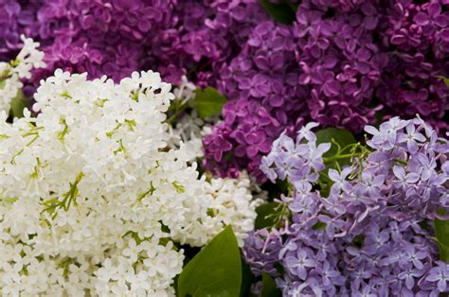
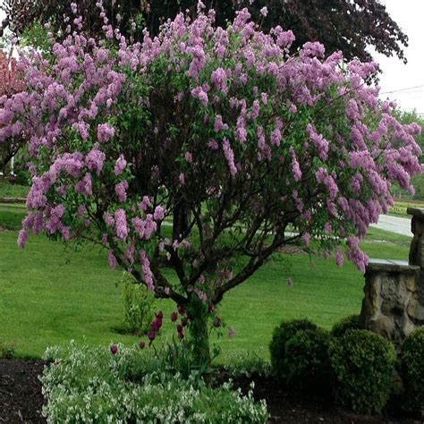
Lilac (*Syringa spp.*)
Bloom Time: May to June
Pollinators: Bees and butterflies

Slide 21
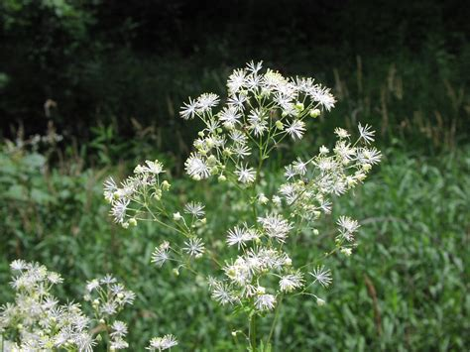
Meadow Rue (*Thalictrum spp.*)
Bloom Time: May to June
Pollinators: Bees and flies

Slide 22
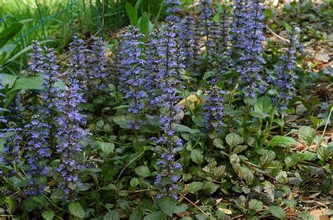
Bugleweed (*Ajuga reptans*)
Bloom Time: May to June
Pollinators: Bees and butterflies

Slide 23
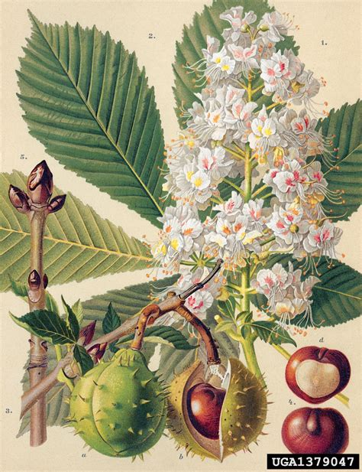
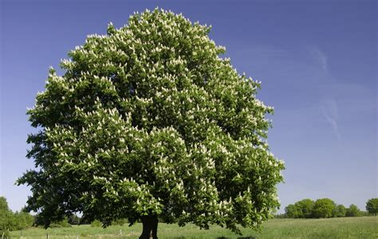
Horse Chestnut
(*Aesculus hippocastanum*)
Bloom Time: May to June
Pollinators: Bees and other insects

Slide 24
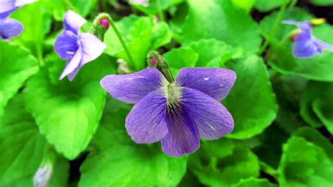
Violet (*Viola spp.*)
Bloom Time: April to June
Pollinators: Bees

Slide 25
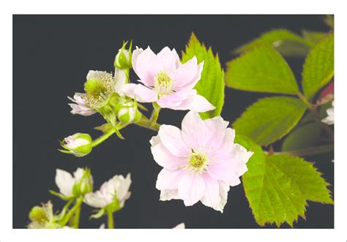
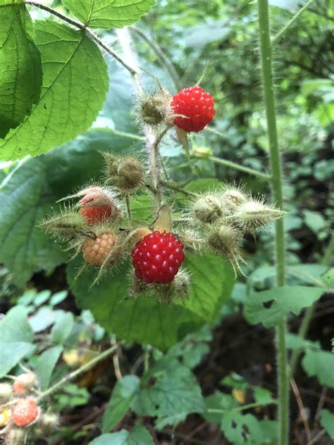
Raspberries and Blackberries (*Rubus spp.*)
Bloom Time: May to July
Pollinators: Bees

Slide 26
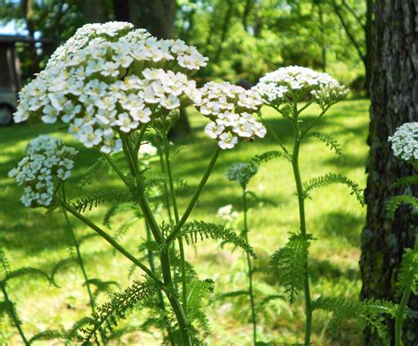
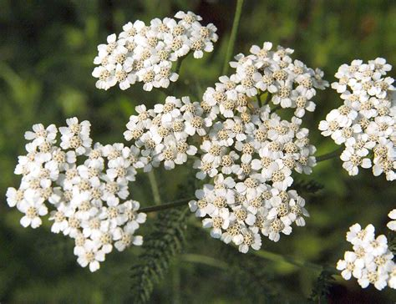
Yarrow (Achillea millefolium)
Bloom Time: June to September
Pollinators: Bees, Butterflies, Moths, Beetles, Flies

Slide 27
Yarrow (Achillea millefolium)
Common Names:
- Yarrow
- Common Yarrow
- Milfoil
- Soldier's Woundwort
- Thousand-leaf
Images:
![Yarrow Flowers](https://upload.wikimedia.org/wikipedia/commons/thumb/f/f2/Achillea_millefolium_-_Keila.jpg/800px-Achillea_millefolium_-_Keila.jpg)
![Yarrow Plant](https://upload.wikimedia.org/wikipedia/commons/thumb/6/6f/Achillea_millefolium_plants.jpg/800px-Achillea_millefolium_plants.jpg)
Identifying Characteristics:
- Leaves: Finely divided, feathery leaves that are aromatic and resemble ferns.
- Flowers: Flat-topped clusters of small, white to pink flowers.
- Height: Typically grows 1 to 3 feet (30 to 90 cm) tall.
- Stems: Erect, hairy stems.
Distribution:
- Native Range: Northern Hemisphere, including Europe, Asia, and North America.
- Habitat: Prefers well-drained soils in meadows, grasslands, roadsides, and disturbed areas. Thrives in full sun to partial shade.
Flowering Dates:
- Flowering Time: Typically from June to September.
Known Pollinators:
- Bees
- Butterflies
- Moths
- Beetles
- Flies
Resources Provided to Pollinators:
- Nectar: Provides nectar for a variety of pollinators.
- Pollen: Offers pollen for bees and other insects.
Therapeutic Actions:
- Anti-inflammatory: Reduces inflammation.
- Astringent: Tightens and tones tissues.
- Antiseptic: Prevents infection.
- Antispasmodic: Relieves muscle spasms.
- Digestive tonic: Supports digestive health.
Historical Uses:
- Medicinal: Used traditionally to treat wounds, digestive issues, respiratory conditions, and menstrual problems.
- Culinary: Young leaves occasionally used in salads and soups.
- Dye: Flowers and leaves used to produce yellow and green dyes.
Cultivation Methods:
- Soil: Prefers well-drained soils; tolerates poor and sandy soils.
- Light: Thrives in full sun but can tolerate partial shade.
- Watering: Drought-tolerant once established; requires minimal watering.
- Propagation: Easily propagated by seed, division, or cuttings.
Constituents:
- Flowers and Leaves: Contain flavonoids, sesquiterpene lactones, tannins, essential oils, and alkaloids.
Parts Used:
- Flowers and Leaves: Used for their medicinal properties.
Toxicity Level:
- Low: Generally considered safe for most people; can cause skin irritation in sensitive individuals.
Origin:
- Northern Hemisphere: Native to Europe, Asia, and North America.
Culinary Applications:
- Leaves: Occasionally used in salads, soups, and stews.
Solvents Used:
- Water: For making infusions and teas.
- Alcohol: For tinctures and extracts.
- Oil: For making infused oils and salves.
Uses for Animals:
- Livestock: Sometimes used in herbal medicine for livestock to treat wounds and digestive issues.
Diseases and Treatments:
- For the Plant: Generally resistant to pests and diseases; may occasionally suffer from powdery mildew.
- For Humans: Traditionally used to treat wounds, digestive issues, respiratory conditions, and menstrual problems.
Chinese Medicinal Use:
- Achillea millefolium is not commonly used in traditional Chinese medicine but is valued in Western herbal medicine.
Edibility:
- Leaves and Flowers: Edible and used in various culinary and medicinal applications.
Environmental Considerations:
- Pros: Supports pollinators, improves soil health, and is easy to grow.
- Cons: Can spread aggressively and become invasive in some areas.
Contraindications:
- Pregnancy and Breastfeeding: Consult a healthcare provider before use.
- Allergy: Avoid use if allergic to plants in the Asteraceae family.
Homeopathic Uses:
- Homeopathic Remedies: Used in homeopathy for treating wounds, fever, and menstrual disorders.
Pollinators:
- Attracts bees, butterflies, moths, beetles, and flies.
Harvesting Practices:
- Flowers and Leaves: Harvest during the flowering season for medicinal use.
- Drying: Flowers and leaves can be dried for later use in teas, tinctures, and other preparations.
Medicinal Properties:
- Anti-inflammatory: Reduces inflammation.
- Astringent: Tightens and tones tissues.
- Antiseptic: Prevents infection.
- Antispasmodic: Relieves muscle spasms.
- Digestive tonic: Supports digestive health.
Disease Treatments:
- For Humans: Used traditionally to treat wounds, digestive issues, respiratory conditions, and menstrual problems.
References:
- "The Complete Medicinal Herbal" by Penelope Ody.
- "The Herbal Medicine-Maker's Handbook" by James Green.
- "The Green Pharmacy Herbal Handbook" by James A. Duke.
This detailed listing provides comprehensive information on Yarrow (Achillea millefolium), covering its characteristics, uses, and benefits for pollinators and humans.

Slide 28
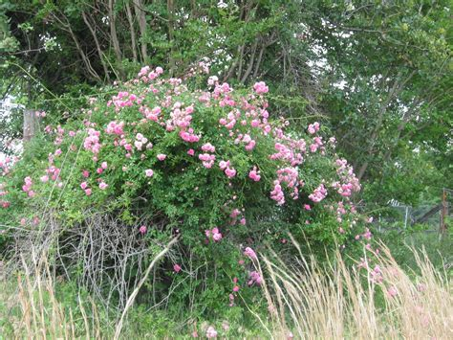
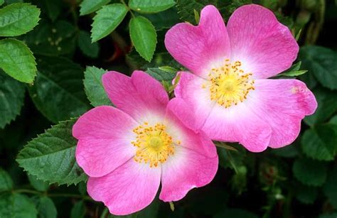
Roses (*Rosa spp.*)
Bloom Time: June to August
Pollinators: Bees, butterflies, and other insects

Slide 29
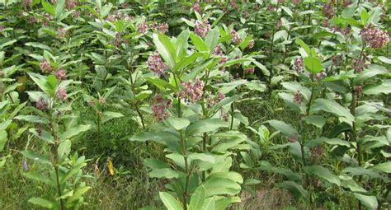
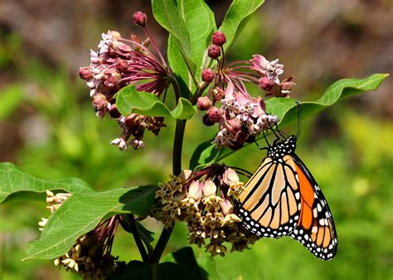
Milkweeds (*Asclepias spp.*)
Bloom Time: June to August
Pollinators: Bees, butterflies, especially monarchs

Slide 30
Milkweed (Asclepias spp.)
Milkweed (Asclepias spp.)
Botanical Name:
- Asclepias spp.
Common Names:
- Milkweed
- Butterfly Weed
- Silkweed
- Silkweed Vine
Images:
![Milkweed Flowers](https://www.gardenia.net/storage/app/public/guides/detail/Milkweed-Flowers.jpg)
![Monarch on Milkweed](https://www.gardenia.net/storage/app/public/guides/detail/Monarch-Butterfly-on-Milkweed.jpg)
Identifying Characteristics:
- Leaves: Generally broad and opposite, sometimes whorled, with a milky sap.
- Flowers: Small, star-shaped flowers, usually in clusters (umbels) ranging in color from white, green, pink, to orange.
- Fruits: Long, narrow seed pods (follicles) that split open when ripe to release seeds attached to silky hairs (comas).
- Height: Can range from 1 to 6 feet (30 cm to 1.8 meters) depending on the species.
Distribution:
- Native Range: Widely distributed across North America.
- Habitat: Common in fields, meadows, prairies, and along roadsides; prefers well-drained soils and full sun.
Flowering Dates:
- Flowering Time: Typically from June to August, varying slightly with species and local climate.
Known Pollinators:
- Bees
- Butterflies (especially Monarch butterflies)
- Moths
- Beetles
Resources Provided to Pollinators:
- Nectar: Provides abundant nectar, especially attractive to Monarch butterflies.
- Pollen: Offers pollen for various insects.
Therapeutic Actions:
- Traditional Uses: Used in Native American medicine for a variety of ailments, including respiratory issues and skin conditions.
Historical Uses:
- Medicinal: Used traditionally by Native Americans for treating warts, rheumatism, and respiratory conditions.
- Culinary: Young shoots, leaves, and pods of some species were traditionally boiled and eaten.
Cultivation Methods:
- Soil: Prefers well-drained soils, ranging from sandy to loamy.
- Light: Thrives in full sun.
- Watering: Drought-tolerant once established; regular watering during dry periods can enhance growth.
- Propagation: Easily propagated from seed; seeds require cold stratification for successful germination.
Constituents:
- Latex: Contains cardenolides (cardiac glycosides) which are toxic if ingested in large quantities.
- Roots and Leaves: Contain alkaloids and other compounds with medicinal properties.
Parts Used:
- Roots, Leaves, Flowers, and Pods: Used for various medicinal purposes.
Toxicity Level:
- Moderate: Contains toxic compounds that can be harmful if ingested in large quantities. The milky sap can be irritating to the skin and eyes.
Origin:
- North America: Native to various regions across the continent, particularly common in the central and eastern United States.
Culinary Applications:
- Young Shoots and Pods: Edible when properly prepared (boiled and cooked).
Solvents Used:
- Water: For making infusions and teas.
- Alcohol: For tinctures and extracts.
Uses for Animals:
- Monarch Butterflies: Critical food source for Monarch larvae (caterpillars), which feed exclusively on Milkweed.
Diseases and Treatments:
- For the Plant: Can be affected by aphids, milkweed beetles, and fungal diseases. Treatments include manual removal of pests and the use of organic insecticides.
- For Humans: Used in traditional medicine to treat respiratory issues, skin conditions, and digestive problems.
Chinese Medicinal Use:
- Milkweed (Asclepias spp.) is not commonly used in traditional Chinese medicine.
Edibility:
- Young Shoots and Pods: Edible when properly prepared to remove toxic compounds.
- Flowers: Sometimes used to make fritters or teas.
Environmental Considerations:
- Pros: Provides essential habitat and food for pollinators, especially Monarch butterflies.
- Cons: Can be toxic to livestock if ingested in large quantities; may become invasive in certain areas.
Contraindications:
- Pregnancy and Breastfeeding: Use with caution and consult a healthcare professional before use.
- Heart Conditions: Due to its content of cardiac glycosides, should be used cautiously in individuals with heart conditions.
Homeopathic Uses:
- Homeopathic Remedies: Used in homeopathy for treating respiratory and digestive issues.
Pollinators:
- Monarch butterflies, bees, moths, and beetles.
Harvesting Practices:
- Seeds: Collect seeds from mature pods in late summer to early fall.
- Leaves and Flowers: Harvest leaves and flowers during the blooming season for medicinal use.
Medicinal Properties:
- Expectorant: Helps clear mucus from the respiratory tract.
- Diuretic: Promotes urine production.
- Emetic: Can induce vomiting in large doses.
Disease Treatments:
- For Humans: Traditionally used to treat warts, respiratory issues, and digestive problems.
References:
- "Milkweed, Monarchs and More: A Field Guide to the Invertebrate Community in the Milkweed Patch" by Ba Rea, Karen Oberhauser, and Michael A. Quinn.
- "The Uses of Wild Plants: Using and Growing the Wild Plants of the United States and Canada" by Frank Tozer.
- "Edible Wild Plants: Wild Foods from Dirt to Plate" by John Kallas.
This detailed listing provides comprehensive information on Milkweed (Asclepias spp.), covering its characteristics, uses, and benefits for pollinators and humans.

Slide 31
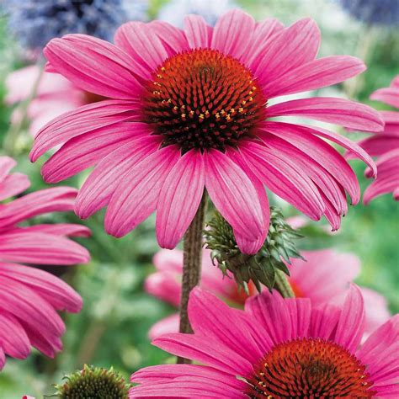
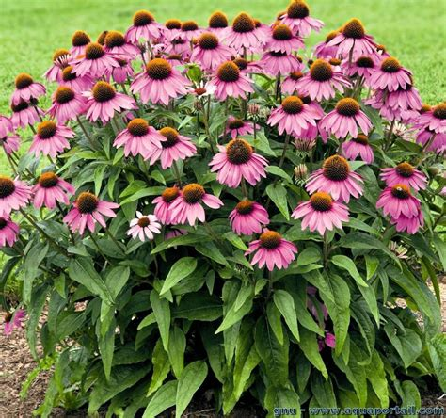
Coneflowers
(*Echinacea spp.*)
Bloom Time: June to August
Pollinators: Bees, butterflies

Slide 32
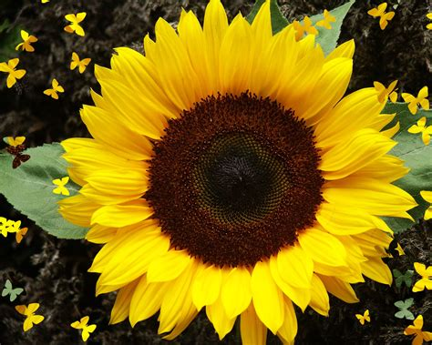
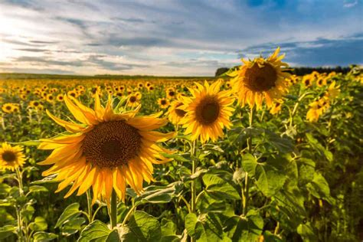
Sunflowers
(*Helianthus spp.*)
Bloom Time: July to September
Pollinators: Bees, butterflies, and other insects

Slide 33
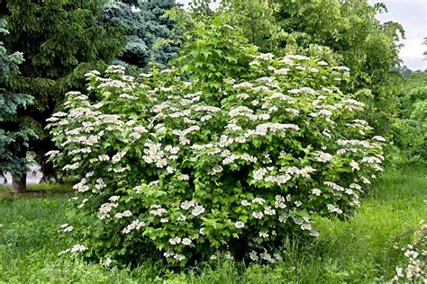
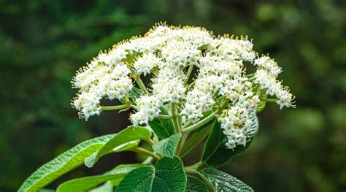
Viburnum spp.
Bloom Time: May to June
Pollinators: Bees and butterflies

Slide 34
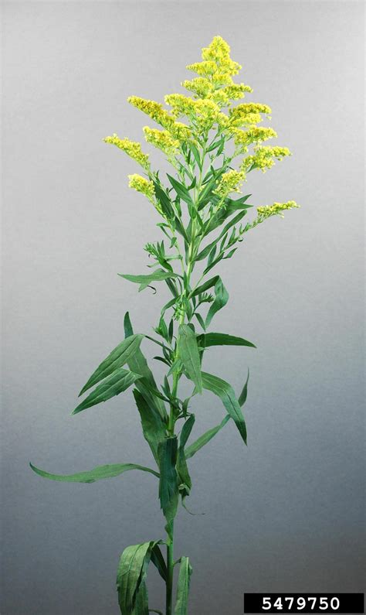
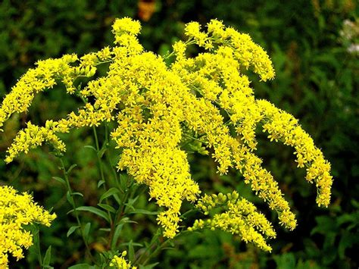
Goldenrods (*Solidago spp.*)
Bloom Time: August to October
Pollinators: Bees, butterflies, and other insects

Slide 35
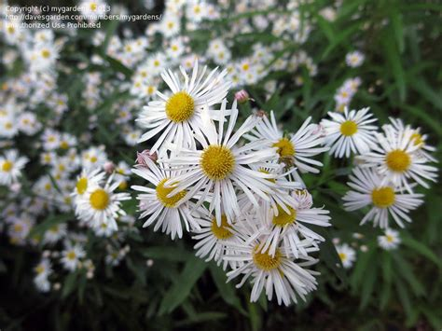
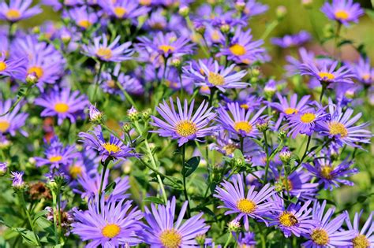
Asters (*Symphyotrichum spp.*)*
Bloom Time: August to October
Pollinators: Bees, butterflies, and other insects

Slide 36
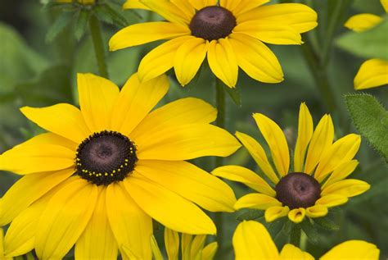
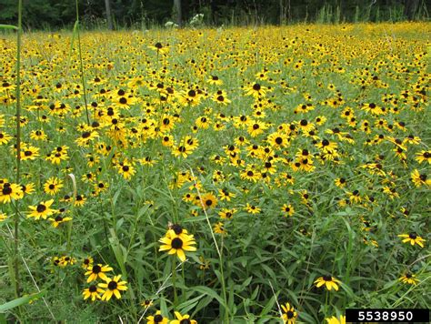
Black-eyed Susan (*Rudbeckia spp.*)
Bloom Time: June to September
Pollinators: Bees and butterflies

Slide 37
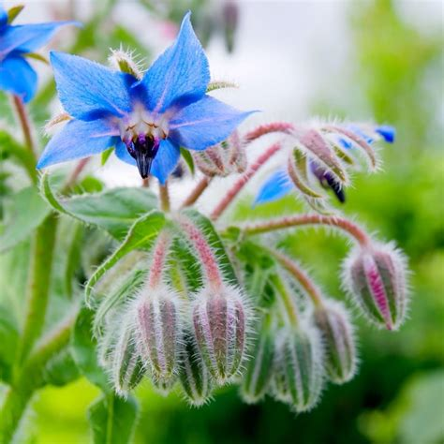
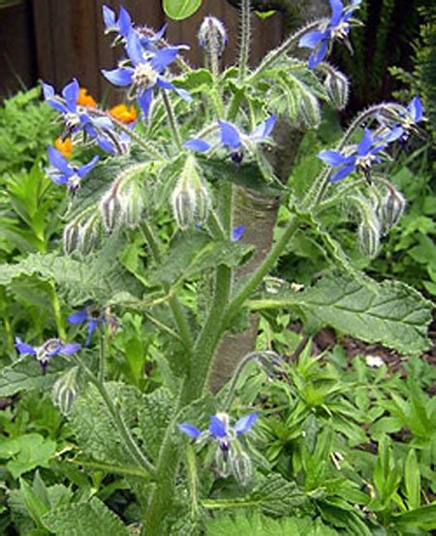
Borage (*Borago officinalis*)
Bloom Time: Late Spring to Fall
Pollinators: Honeybees, bumblebees, butterflies

Slide 38
Borage (Borago officinalis)
Borage (Borago officinalis)
Botanical Name:
- Borago officinalis
Common Names:
- Borage
- Starflower
- Bee Bread
- Bugloss
Images:
![Borage Flowers](https://www.gardenia.net/storage/app/public/guides/detail/Borage-Flowers.jpg)
![Borage Plant](https://www.gardenia.net/storage/app/public/guides/detail/Borage-Plant.jpg)
Identifying Characteristics:
- Leaves: Large, oval, rough, and hairy leaves with a cucumber-like flavor.
- Flowers: Bright blue, star-shaped flowers with five petals, occasionally pink or white.
- Height: Typically grows to a height of 2-3 feet (60-90 cm).
- Stem: Hollow, hairy stems that are easily broken.
Distribution:
- Native Range: Mediterranean region.
- Habitat: Prefers well-drained soils and full sun; often found in gardens, fields, and disturbed areas.
Flowering Dates:
- Flowering Time: Usually from late spring to early fall (May to September).
Known Pollinators:
- Bees (especially honeybees and bumblebees)
- Butterflies
- Other beneficial insects
Resources Provided to Pollinators:
- Nectar: Produces a copious amount of nectar, highly attractive to bees.
- Pollen: Offers pollen for bees and other pollinators.
Therapeutic Actions:
- Anti-inflammatory: Used traditionally to reduce inflammation.
- Diuretic: Promotes urine production.
- Galactagogue: Stimulates milk production in nursing mothers.
Historical Uses:
- Medicinal: Traditionally used to treat fevers, coughs, and depression.
- Culinary: Leaves and flowers used in salads, drinks, and as a garnish.
Cultivation Methods:
- Soil: Prefers well-drained, fertile soil.
- Light: Thrives in full sun.
- Watering: Requires regular watering but is drought-tolerant once established.
- Propagation: Easily grown from seed; self-seeds readily.
Constituents:
- Leaves and Flowers: Contain pyrrolizidine alkaloids (in small quantities), mucilage, tannins, and essential fatty acids.
- Seeds: Rich in gamma-linolenic acid (GLA), an essential fatty acid.
Parts Used:
- Leaves, Flowers, and Seeds: Used for their medicinal and culinary properties.
Toxicity Level:
- Low to Moderate: Contains pyrrolizidine alkaloids, which can be harmful in large quantities over time. Use in moderation.
Origin:
- Mediterranean: Native to the Mediterranean region, but now widely cultivated and naturalized in many parts of the world.
Culinary Applications:
- Leaves: Young leaves are used in salads, soups, and as a cooked vegetable.
- Flowers: Edible flowers used as a garnish, in salads, and to flavor beverages (e.g., Pimms).
Solvents Used:
- Water: For infusions and teas.
- Alcohol: For tinctures and extracts.
Uses for Animals:
- Bees: Borage is an excellent nectar source for bees, particularly honeybees.
- Livestock: Leaves can be used as a forage plant for livestock, though in moderation due to pyrrolizidine alkaloids.
Diseases and Treatments:
- For the Plant: Susceptible to powdery mildew, downy mildew, and aphids. Organic treatments include neem oil and insecticidal soaps.
- For Humans: Used traditionally for treating respiratory issues, skin conditions, and to promote lactation.
Chinese Medicinal Use:
- Borage (Borago officinalis) is not commonly used in traditional Chinese medicine.
Edibility:
- Leaves: Edible and used in various culinary dishes.
- Flowers: Edible and used as a garnish and flavoring.
Environmental Considerations:
- Pros: Supports pollinators, improves soil fertility, and can be used in companion planting.
- Cons: Can self-seed aggressively and become weedy if not managed.
Contraindications:
- Pregnancy and Breastfeeding: Consult a healthcare professional before use due to pyrrolizidine alkaloids.
- Liver Conditions: Use cautiously in individuals with liver disease due to pyrrolizidine alkaloids.
Homeopathic Uses:
- Homeopathic Remedies: Used in homeopathy for stress relief and to promote a sense of well-being.
Pollinators:
- Honeybees, bumblebees, and butterflies are the primary pollinators of Borage.
Harvesting Practices:
- Leaves and Flowers: Harvest young leaves and flowers as needed throughout the growing season.
- Seeds: Collect seeds from mature plants in late summer to early fall.
Medicinal Properties:
- Anti-inflammatory: Reduces inflammation and helps soothe irritated tissues.
- Diuretic: Promotes urination and helps in detoxification.
- Galactagogue: Enhances milk production in nursing mothers.
Disease Treatments:
- For Humans: Used traditionally to treat respiratory issues, reduce inflammation, and promote lactation.
References:
- "The Borage Handbook" by Ellen Spector Platt.
- "Herbal Medicine: Biomolecular and Clinical Aspects" by Iris F. F. Benzie and Sissi Wachtel-Galor.
- "Edible and Medicinal Plants of the West" by Gregory L. Tilford.
This detailed listing provides comprehensive information on Borage (Borago officinalis), covering its characteristics, uses, and benefits for pollinators and humans.

Slide 39
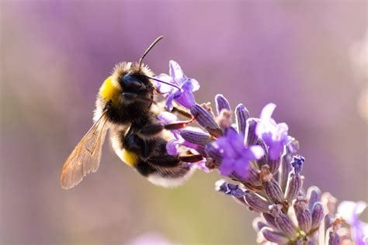
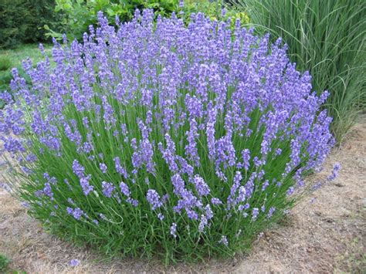
Lavender (*Lavandula spp.*)
Bloom Time: Late Spring to Summer
Pollinators: Bees and butterflies

Slide 40


Comfrey (*Symphytum officinale*)
Bloom Time: May to August
Pollinators: Bees, bumblebees, butterflies, and moths

Slide 41

Bugleweed (*Ajuga reptans*)
Bloom Time: April to June
Pollinators: Bees, Butterflies, Moths

Slide 42


Dead Nettle (*Lamium spp.*)
Bloom Time: April to June
Pollinators: Bees

Slide 43


Lungwort (*Pulmonaria spp.*)
Bloom Time: March to May
Pollinators: Bees

Slide 44


Mint (*Mentha spp.*)
Bloom Time: June to September
Pollinators: Bees and butterflies

Slide 45


Thyme (*Thymus spp.*)
Bloom Time: June to August
Pollinators: Bees and butterflies

Slide 46


Oregano (*Origanum vulgare*)
Bloom Time: July to September
Pollinators: Bees and butterflies

Slide 47


Marigold (*Tagetes spp.*)
Bloom Time: Spring to Fall
Pollinators: Bees and butterflies

Slide 48

Calendula
(Calendula officinalis)
Bloom Time: Spring to Fall
Pollinators: Bees, butterflies, hoverflies, and other beneficial insects

Slide 49
Calendula
(Calendula officinalis)
Common Names:
- Calendula
- Pot Marigold
- Garden Marigold
- English Marigold
Images:
![Calendula Flowers](https://upload.wikimedia.org/wikipedia/commons/thumb/6/6a/Calendula_officinalis_%28cropped%29.jpg/800px-Calendula_officinalis_%28cropped%29.jpg)
![Calendula Plant](https://upload.wikimedia.org/wikipedia/commons/thumb/4/4a/Calendula_officinalis-plant.jpg/800px-Calendula_officinalis-plant.jpg)
Identifying Characteristics:
- **Leaves:** Bright green, lance-shaped, slightly hairy leaves arranged alternately along the stem.
- **Flowers:** Bright orange or yellow, daisy-like flowers with a slight aromatic scent. The flowers can be single or double and are about 2-4 inches in diameter.
- **Height:** Typically grows 1 to 2 feet (30 to 60 cm) tall.
- **Stems:** Green, slightly hairy, and branched.
Distribution:
- **Native Range:** Southern Europe and Mediterranean region.
- **Habitat:** Prefers well-drained, moderately rich soil and full sun. Commonly grown in gardens and as a border plant.
Flowering Dates:
- **Flowering Time:** Typically from early spring to late fall (March to October), depending on the climate.
Known Pollinators:
- Bees
- Butterflies
- Hoverflies
- Other beneficial insects
Resources Provided to Pollinators:
- **Nectar:** Provides nectar, attracting a variety of pollinators.
- **Pollen:** Offers pollen for bees and other insects.
Therapeutic Actions:
- **Anti-inflammatory:** Reduces inflammation.
- **Antiseptic:** Prevents infection.
- **Antifungal:** Inhibits the growth of fungi.
- **Antibacterial:** Prevents the growth of bacteria.
- **Wound Healing:** Promotes the healing of wounds and skin conditions.
Historical Uses:
- **Medicinal:** Traditionally used to treat skin conditions, wounds, and digestive issues.
- **Culinary:** Petals used in salads, as a garnish, and to color and flavor foods.
- **Dye:** Flowers used to produce a yellow dye for fabrics and cosmetics.
Cultivation Methods:
- **Soil:** Prefers well-drained, moderately fertile soil.
- **Light:** Thrives in full sun but can tolerate partial shade.
- **Watering:** Requires regular watering, especially during dry periods.
- **Propagation:** Easily grown from seed; self-seeds readily.
Constituents:
- **Flowers and Leaves:** Contain flavonoids, carotenoids, triterpenoids, saponins, and volatile oils.
Parts Used:
- **Flowers:** Used primarily for their medicinal and culinary properties.
- **Leaves:** Occasionally used in herbal preparations.
Toxicity Level:
- **Low:** Generally considered safe for most people. Rarely causes allergic reactions when used topically.
Origin:
- **Southern Europe and Mediterranean:** Native to these regions but widely cultivated elsewhere.
Culinary Applications:
- **Petals:** Used to add color and flavor to salads, soups, stews, and rice dishes. Sometimes called "poor man's saffron" for its ability to impart a saffron-like color to dishes.
Solvents Used:
- **Water:** For making infusions, teas, and washes.
- **Alcohol:** For tinctures and extracts.
- **Oil:** For making infused oils and salves.
Uses for Animals:
- **Pets and Livestock:** Calendula flowers can be used in salves and ointments to treat minor cuts, abrasions, and skin irritations.
Diseases and Treatments:
- **For the Plant:** Susceptible to powdery mildew and aphids. Control with appropriate organic treatments such as neem oil or insecticidal soap.
- **For Humans:** Used traditionally for treating skin conditions, wounds, digestive issues, and menstrual discomfort.
Chinese Medicinal Use:
- **Calendula officinalis** is not commonly used in traditional Chinese medicine but is valued in Western herbal medicine.
Edibility:
- **Petals:** Edible and used in various culinary applications.
- **Leaves:** Occasionally used in herbal preparations but less commonly consumed.
Environmental Considerations:
- **Pros:** Supports pollinators, improves soil health, and is easy to grow.
- **Cons:** Can self-seed and spread, but generally not invasive.
Contraindications:
- **Allergy:** Avoid use if allergic to plants in the Asteraceae/Compositae family.
- **Pregnancy and Breastfeeding:** Generally considered safe but consult a healthcare provider before use.
Homeopathic Uses:
- **Homeopathic Remedies:** Used in homeopathy for treating wounds, skin conditions, and inflammation.
Pollinators:
- Attracts bees, butterflies, hoverflies, and other beneficial insects.
Harvesting Practices:
- **Flowers:** Harvest fresh flowers throughout the growing season for medicinal and culinary use.
- **Drying:** Flowers can be dried for later use in teas, salves, and other preparations.
Medicinal Properties:
- **Anti-inflammatory:** Reduces inflammation and soothes irritated tissues.
- **Antiseptic:** Prevents infection and aids in wound healing.
- **Antifungal:** Helps to treat fungal infections.
- **Antibacterial:** Inhibits the growth of bacteria.
Disease Treatments:
- **For Humans:** Used traditionally to treat skin conditions, wounds, digestive issues, and menstrual discomfort.
References:
- **"The Complete Medicinal Herbal" by Penelope Ody.**
- **"The Herbal Medicine-Maker's Handbook" by James Green.**
- **"The Green Pharmacy Herbal Handbook" by James A. Duke.**
This detailed listing provides comprehensive information on Calendula (Calendula officinalis), covering its characteristics, uses, and benefits for pollinators and humans.

Slide 50


Mustard (Brassica spp.)
Pollinators:
Bloom Time: March to September
Pollinators: Bees, Butterflies, Hoverflies, Beetles

Slide 51


Snapdragon (*Antirrhinum spp.*)
Bloom Time: Spring to Fall
Pollinators: Bees

Slide 52


Butterfly Bush
(*Buddleja spp.*)
Bloom Time: Summer to Fall
Pollinators: Butterflies and bees

Slide 53


Cow Parsnip
(*Heracleum maximum*)
Bloom Time: Late Spring to Summer
Pollinators: Bees and flies

Slide 54

Cow parsnip vs hemlock
These two plants are easily mistaken Don't harvest hemlock it is poisonous

Slide 55


Dahlia (*Dahlia spp.*)
Bloom Time: Summer to Fall
Pollinators: Bees and butterflies

Slide 56


English Daisy
(*Bellis perennis*)
Bloom Time: Spring to Fall
Pollinators: Bees

Slide 57
Comfrey
(Symphytum officinale)
Botanical Name:
- Symphytum officinale
Common Names:
- Comfrey
- Knitbone
- Boneset
- Common Comfrey
Images:
![Comfrey Flowers](https://upload.wikimedia.org/wikipedia/commons/4/47/Symphytum_officinale_001.JPG)
![Comfrey Plant](https://upload.wikimedia.org/wikipedia/commons/d/d9/Symphytum_officinale.jpg)
Identifying Characteristics:
- Leaves: Large, hairy, lance-shaped leaves that grow in a rosette pattern near the base and alternate up the stem.
- Flowers: Bell-shaped, typically purple, blue, or white flowers that hang in clusters.
- Height: Can grow up to 3 feet (1 meter) tall.
- Roots: Thick, black, and branching with a mucilaginous texture when broken.
Distribution:
- Native Range: Europe and parts of Asia.
- Habitat: Prefers moist, fertile soils and is commonly found in meadows, along riverbanks, and in ditches. Thrives in partial to full sun.
Flowering Dates:
- Flowering Time: Typically from May to August.
Known Pollinators:
- Bees
- Bumblebees
- Butterflies
- Moths
Resources Provided to Pollinators:
- Nectar: Provides abundant nectar, particularly attractive to bees and bumblebees.
- Pollen: Offers pollen for various insects.
Therapeutic Actions:
- Anti-inflammatory: Used to reduce inflammation.
- Astringent: Helps tighten and tone tissues.
- Vulnerary: Promotes wound healing.
Historical Uses:
- Medicinal: Used traditionally to treat broken bones, sprains, bruises, and skin conditions.
- Agricultural: Used as a green manure and compost activator due to its high nutrient content.
Cultivation Methods:
- Soil: Prefers moist, fertile, well-drained soils.
- Light: Grows well in partial to full sun.
- Watering: Requires regular watering, especially during dry periods.
- Propagation: Easily propagated by root cuttings or division; can also be grown from seed.
Constituents:
- Roots and Leaves: Contain allantoin (promotes cell regeneration), mucilage, tannins, and pyrrolizidine alkaloids (which can be toxic in large amounts).
Parts Used:
- Roots and Leaves: Used for their medicinal properties.
Toxicity Level:
- Moderate: Contains pyrrolizidine alkaloids, which can be toxic to the liver if ingested in large quantities or used long-term. Topical use is generally considered safe.
Origin:
- Europe and Asia: Native to these regions but widely naturalized in other parts of the world.
Culinary Applications:
- Leaves: Used sparingly in herbal teas and as a pot herb in some traditional recipes, though not recommended due to potential toxicity.
Solvents Used:
- Water: For making infusions and decoctions.
- Alcohol: For tinctures and extracts.
- Oil: For making infused oils and salves.
Uses for Animals:
- Livestock Feed: Leaves can be used as a high-protein feed supplement for livestock.
- Poultry: Comfrey leaves are sometimes added to poultry feed for their nutritional benefits.
Diseases and Treatments:
- For the Plant: Susceptible to rust and powdery mildew; control with appropriate fungicides or organic treatments.
- For Humans: Traditionally used to treat wounds, skin conditions, and bone fractures.
Chinese Medicinal Use:
- Symphytum officinale is not commonly used in traditional Chinese medicine.
Edibility:
- Leaves and Roots: Edible but not recommended due to potential toxicity from pyrrolizidine alkaloids.
Environmental Considerations:
- Pros: Excellent for composting and soil improvement due to its high nutrient content.
- Cons: Can be invasive and difficult to eradicate once established.
Contraindications:
- Pregnancy and Breastfeeding: Avoid use due to potential toxicity.
- Liver Conditions: Use cautiously in individuals with liver disease due to pyrrolizidine alkaloids.
Homeopathic Uses:
- Homeopathic Remedies: Used in homeopathy for treating bone and tissue injuries.
Pollinators:
- Attracts bees, bumblebees, butterflies, and moths.
Harvesting Practices:
- Leaves: Harvest young leaves throughout the growing season.
- Roots: Harvest roots in the fall or early spring for medicinal use.
Medicinal Properties:
- Anti-inflammatory: Reduces inflammation and promotes healing.
- Astringent: Tightens and tones tissues.
- Vulnerary: Accelerates wound healing and tissue regeneration.
Disease Treatments:
- For Humans: Used traditionally for treating wounds, sprains, bruises, and bone fractures.
References:
- "Herbal Medicine: Biomolecular and Clinical Aspects" by Iris F. F. Benzie and Sissi Wachtel-Galor.
- "The Complete Herbal Tutor" by Anne McIntyre.
- "The Herbal Handbook" by David Hoffmann.
This detailed listing provides comprehensive information on Comfrey (Symphytum officinale), covering its characteristics, uses, and benefits for pollinators and humans.

Slide 58
Cultivation and Maintenance Tips:
Plant Diversity**:
- **Native Plants**: Prioritize native species as they are better adapted to the local climate and more beneficial to local pollinators.
- **Avoid Pesticides**: Use organic or natural pest control methods to protect pollinators.
- **Water Sources**: Provide shallow water sources for pollinators to drink.
- **Habitat Features**: Create habitats such as bee hotels, nesting boxes, and undisturbed ground for nesting.

