Slide 1
ASEP PROJECT 1-PPT FOR END SEMESTER ASSESSMENT- 1ST MARCH 2025
ASEP 1 PROJECT_TITLE:-
ESP32-Based Smart Air Purifier with IOT Integration
DIV :- B
ASEP_GROUP NO. :- 2
DAY :- Saturday
DATE :-1/03/2025
STUDENT NAME(PRN) :-
●PRATIBHA CHAVAN(12410892)
●PURVA CHAVAN (12410698)
●SRUSHTI CHAVAN(12411932)
●SHANTANU CHAVRE(12412955)
●RIDHAM CHHAJER(12413703)
●MANTHAN CHIDREWAR(12414267)
PROJECT GUIDE
Prof. VISHWESH DESHMUKH
_________________________________________________________________________________________________________
DEPARTMENT OF ENGINEERING SCIENCES AND HUMANITIES (DESH) VISHWARKARMA INSTITUTE OF TECHNOLOGY, PUNE

Slide 2
INTRODUCTION
Air pollution is a growing concern, significantly impacting both living conditions and workplace environments.
This Air Purifier project aims to develop a filtration system integrated with real-time air quality monitoring.
The system utilizes a *DH11 sensor* to detect environmental parameters and wirelessly transmit data to a custom mobile application.
Polluted air is drawn in using an exhaust fan, filtered, and then released as purified air.
The IoT-based system allows users to monitor air quality trends and optimize filtration settings accordingly.
It is especially beneficial in areas where hazardous pollutants like *PM, VOCs, and CO2* are prevalent.
Adaptive airflow control ensures efficient purification by adjusting fan speed based on pollution levels.

Slide 3
OBJECTIVES
The goal is to create a smart, cost-effective, and energy-efficient device that helps improve air quality and safety.
This system will monitor the Air Quality Index (AQI) and send alerts when pollution levels become unsafe.
It will also detect harmful gas leaks, such as carbon monoxide and methane, to prevent health hazards.
In case of a fire, the device will automatically exhaust toxic fumes, making the environment safer.
Using IoT technology, it will optimize energy consumption while providing real-time updates through a mobile app, ensuring better air quality and safety in homes, offices, and industries.

Slide 4
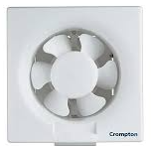

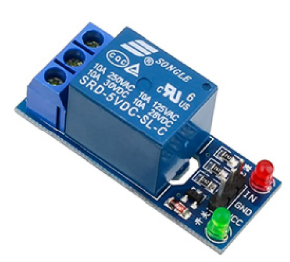

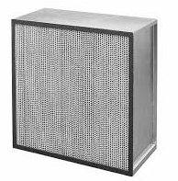
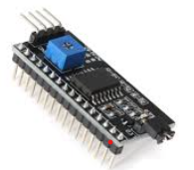
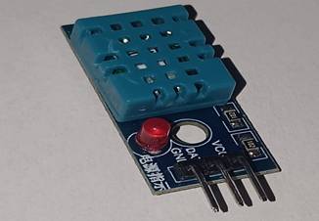
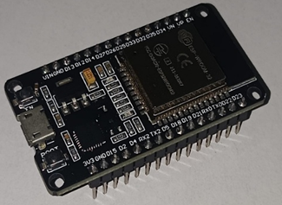
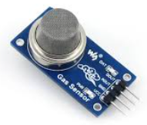
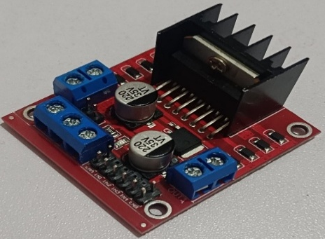
Components Used
Exhaust fan
Relay module
HEPA filter
MQ2 sensor
DHT11 sensor
ESP32 Dev module
I2c module
Servo motor
L298 Motor driver
LCD
Breadboard
Wifi module
Components Used

Slide 5
USES
Exhaust Fan – Used for air circulation and ventilation, helps remove pollutants or excess heat.
MQ2 Gas Sensor – Detects gases like LPG, CO, smoke, and methane.
DHT11 Temperature & Humidity Sensor – Measures temperature and humidity with decent accuracy
L298 Motor Driver – A stepper motor controller that provides control signals for precise motor movement in automation systems.
ESP32 Dev Module V1 – A microcontroller with WiFi and Bluetooth capabilities, ideal for IoT and real-time data processing
Servo Motor – A motor with precise angular control.

Slide 6
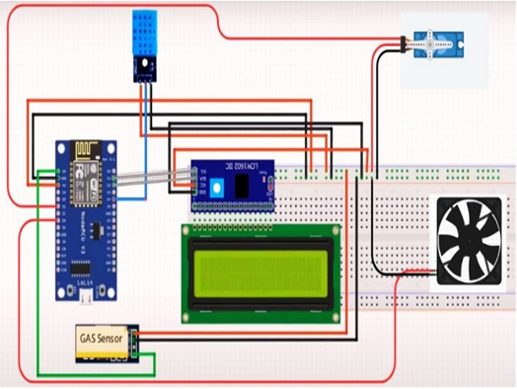
REASULTS AND DISCUSSION
As soon as the air purification system is on the detection the temperature and air quality is displayed on LCD. Along with that exhausting the harmful air had started and the changes before and after the clearing of the gas can be seen on the IoT Platform.

Slide 7
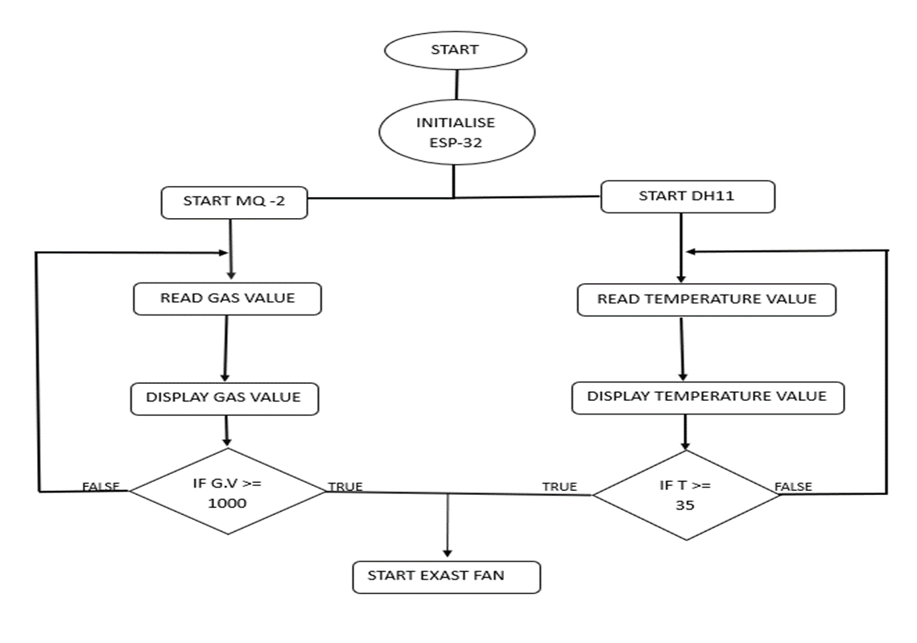
FLOW CHART

Slide 8
FEATURES
Integration of ESP32 with AQI monitoring and Auto ON/OFF based on pollution level.
DIY filter for air purification and Exhaust Fan that adjust its airflow rates dynamically based on pollution concentration and temperature.
Optimized power consumption as compared to traditional air purifiers.
Utilizes WiFi and Bluetooth for real-time data transmission for better analysis and tracking.
Can be monitored remotely via a mobile application.
Temperature readings from the DHT11 sensor can help in early fire detection.

Slide 9
CONCLUSION
In conclusion, air pollution severely impacts health, reducing life expectancy and increasing respiratory diseases.
This IoT-based air purifier, equipped with MQ-2 and DH-11 sensors and an ESP32 microcontroller, detects harmful gases and displays them along with AQI levels. By temperature reading fire detection can be easy.
By providing real-time air quality monitoring and filtration along with smart automation, it enhances indoor air quality in homes, offices, hospitals, and industries.

Slide 10
THANK YOU

