Slide 1
⚡ HARDWARE-ISOLATED AI AGENT SANDBOX
FastVM (Airbox): How We Made Firecracker
MicroVMs 77x Faster for Coding Agents
Delivering AWS Firecracker KVM hardware isolation with 8.00 ms median execution latency, 788.98 req/s concurrent throughput, <65 ms copy-on-write state branching, and <1 ms async job dispatch.
SEQUENTIAL P50 RTT
8.00 ms
30.4x faster than Docker runc
77.8x faster than Cold Firecracker
CONCURRENT P95 (10X)
18.50 ms
4.3x under the <80ms target SLA
11.91 ms concurrent median (P50)
PEAK THROUGHPUT
789 req/s
100% success across 100 requests
on a single 2-vCPU GCP KVM node
ASYNC JOB DISPATCH
0.17 ms
HTTP 202 Accepted + live polling
and speculative VM state branching
Core Engineering Thesis: Autonomous AI agents (Claude Code, Codex, OpenHands) shouldn't have to choose between container speed (shared host kernel risk) and microVM security (620ms cold-boot latency).
FastVM (Airbox) — Sub-100ms Hardware-Isolated Firecracker MicroVM Sandbox | github.com/shantanu-labs/FastVM

Slide 2
1. BOTTLENECK PROFILING
02 / 09
Why Standard Unpooled Firecracker MicroVMs Take ~622 ms
Profiling a naive cold-boot Firecracker lifecycle shows that >99.8% of wall time is spent before user code even starts.
1. Disk Rootfs Image Copy (300 MB ext4 on disk)
Copying or mounting a 300 MB ext4 root filesystem on standard SSD/PD storage incurs heavy block I/O latency.
190 ms
2. Guest Linux 5.10 Kernel Boot + OS Init
Probing virtual PCI/serial UART buses, mounting filesystems, and starting a standard init system inside the guest.
175 ms
3. Cold Python 3 Interpreter Startup + Imports
Spawning a fresh /usr/bin/python3 process inside the guest VM and loading site-packages from block storage.
142 ms
4. Host CLI Networking (ip tuntap + iptables + SSH/TCP)
Forking host shell commands (ip link, ip addr, iptables) and waiting for guest TCP/SSH readiness.
114 ms
5. Actual Agent Payload Execution: print(2 + 2)
The actual computation requested by the AI coding agent takes less than 1 millisecond.
~1 ms
Goal: Eliminate all 4 setup phases from the critical path so the client only pays for IPC + code execution (~8 ms).
FastVM (Airbox) — Sub-100ms Hardware-Isolated Firecracker MicroVM Sandbox | github.com/shantanu-labs/FastVM

Slide 3
2. ARCHITECTURE OVERVIEW
03 / 09
The 5 Engineering Pillars That Cut Latency from 622 ms to 8.0 ms
How FastVM moves every heavy OS, storage, network, and interpreter initialization step off the request path.
Pillar 1 • -175 ms
Pre-Warmed Firecracker Pool
pkg/sandbox/firecracker_linux.go
Pre-boots 10 Firecracker microVMs at daemon startup. Requests pop a live, booted VM from a Go channel in <0.1ms while background workers replenish consumed slots.
Pillar 2 • -45 ms
Zero-CLI Netlink TAP Pool
pkg/network/netlink_linux.go
Pre-allocates 100 point-to-point /30 TAP interfaces (tap0..tap99) via direct Linux Netlink sockets—zero shelling out to ip tuntap or ip addr during requests.
Pillar 3 • -190 ms
RAM-Backed /dev/shm Overlays
pkg/storage/overlay.go
Stages ephemeral copy-on-write rootfs overlays in Linux tmpfs (/dev/shm/airbox-overlays) so guest block reads/writes hit RAM instead of persistent disk.
Pillar 4 • -70 ms
Custom PID 1 & AF_VSOCK IPC
cmd/agent-init/vsock_linux.go
Replaces systemd and SSHD with a static Go binary (init=/sbin/agent-init) communicating with the host over virtio-vsock (CID 3, Port 5000) with zero TCP overhead.
Pillar 5 • -134 ms
Pre-Forked Warm Python Worker
cmd/agent-init/main.go
Guest PID 1 boots a persistent Python 3 worker loop at VM startup that executes incoming code via compile() + exec() in 1–3ms without cold interpreter startup.
FastVM (Airbox) — Sub-100ms Hardware-Isolated Firecracker MicroVM Sandbox | github.com/shantanu-labs/FastVM

Slide 4
3. HOST CONTROL PLANE ENGINEERING
04 / 09
Zero-CLI Netlink Networking & /dev/shm RAM Rootfs Overlays
Eliminating host OS process-spawning and disk I/O bottlenecks in airboxd.
Zero-CLI Netlink TAP Pool (pkg/network/)
• Why CLI Fails SLA: Spawning `ip tuntap add`, `ip addr add`, and `ip link set up` forks 3+ processes per VM (~35-50ms overhead under load).
• Direct Netlink Sockets: Uses `vishvananda/netlink` to talk directly to the Linux kernel `AF_NETLINK` socket in pure Go.
• 100 Pre-Allocated /30 Subnets: Creates `tap0`..`tap99` at daemon boot, assigning each microVM an isolated `/30` point-to-point subnet (`172.16.x.1/30` ↔ `172.16.x.2/30`).
• O(1) Channel Lease: Acquiring or releasing a configured TAP interface during `/v1/execute` is a single Go channel read (`< 0.05 ms`).
RAM-Backed /dev/shm Overlays & Warm Pool
• In-Memory Rootfs Staging: Ephemeral per-VM ext4 images are materialized in `/dev/shm/airbox-overlays` (Linux shared memory `tmpfs`), completely avoiding disk I/O.
• Async Drive Engine: Firecracker attaches the overlay with `IoEngine: Async` and `IsReadOnly: false` so guest writes never touch the base image.
• Pre-Warmed Firecracker Pool (`warmPool` chan): `Prewarm()` boots 10 microVMs in parallel at daemon startup and verifies their VSOCK handshake.
• Non-Blocking Replenishment: When a request finishes on an ephemeral VM, `Stop()` tears it down and spawns a replacement warm VM in a background goroutine.
FastVM (Airbox) — Sub-100ms Hardware-Isolated Firecracker MicroVM Sandbox | github.com/shantanu-labs/FastVM

Slide 5
4. IN-GUEST KERNEL & RUNTIME ENGINEERING
05 / 09
Bypassing systemd, SSH, and TCP with PID 1 agent-init & AF_VSOCK
How the guest microVM boots straight into our custom Go daemon and executes Python in 1–3 ms.
Step 1: Stripped Kernel Boot
Kernel boot args disable PCI, UART serial ports, and legacy keyboard controllers:
quiet loglevel=0 8250.nr_uarts=0 noapic reboot=k panic=1 pci=off i8042.noaux random.trust_cpu=on init=/sbin/agent-init
Step 2: Custom Go PID 1 (agent-init)
Instead of slow systemd service graphs, the kernel executes /sbin/agent-init directly as PID 1:
• Mounts /proc, /sys, /dev, /tmp
• Sets /proc/1/oom_score_adj = -1000
• Caps kernel.threads-max = 128
• Configures eth0 IP & route via ip
Step 3: AF_VSOCK + Warm Python
Binds native Linux AF_VSOCK (Address Family 40, CID 3, Port 5000) and starts a persistent Python 3 worker:
• Host sends CONNECT 5000\n over Unix socket
• Streams JSON payload directly via DMA
• Persistent Python loop runs compile() + exec() in ~1-3ms
Why Persistent Warm Python Inside the MicroVM Matters:
Spawning `/usr/bin/python3 -c ...` on every request costs ~45–140ms just to initialize the Python interpreter. By pre-forking a persistent Python worker inside `agent-init` that maintains a warm global namespace (`_G`), FastVM executes Python snippets in ~1–3ms AND preserves in-memory variables across multi-turn agent steps and VM branches.
FastVM (Airbox) — Sub-100ms Hardware-Isolated Firecracker MicroVM Sandbox | github.com/shantanu-labs/FastVM

Slide 6
5. HEAD-TO-HEAD RUNTIME BENCHMARKS
06 / 09
FastVM vs. Docker (runc), gVisor (runsc), and Cold-Boot Firecracker
Measured on the same GCP n2-standard-2 Linux KVM host executing python3 -c 'print(2 + 2)' across 25 sequential runs.
Runtime / Architecture | Isolation Boundary | Min (ms) | P50 (Median) | P95 (ms) | P99 (ms) | Relative Speed
⚡ FastVM (Airbox Warm Pool) | Hardware KVM (Firecracker) | 7.45 ms | 8.00 ms | 8.44 ms | 8.54 ms | 1.0x (Baseline)
Docker (runc container) | Shared Host Kernel (cgroups/ns) | 235.55 ms | 243.51 ms | 248.50 ms | 262.71 ms | 30.4x slower
gVisor (runsc sandbox) | User-Space Kernel (Sentry) | 289.65 ms | 299.98 ms | 311.25 ms | 313.48 ms | 37.5x slower
Standard Firecracker (Cold) | Hardware KVM (Firecracker) | 609.61 ms | 622.17 ms | 637.04 ms | 646.53 ms | 77.8x slower
Why FastVM Beats Even Docker (runc) by 30.4x While Providing Full KVM Isolation:
1. `docker run --rm` must create overlayfs mounts, allocate cgroups/namespaces, invoke containerd-shim + runc, and cold-start Python (~243ms).
2. FastVM already has the KVM microVM booted, TAP interface bound, and Python interpreter warmed—executing over AF_VSOCK in 8.00ms.
3. Reproduce anytime with `./scripts/compare-runtimes.sh --runs 25` (or `--provision-gcp` using your own gcloud account).
FastVM (Airbox) — Sub-100ms Hardware-Isolated Firecracker MicroVM Sandbox | github.com/shantanu-labs/FastVM

Slide 7
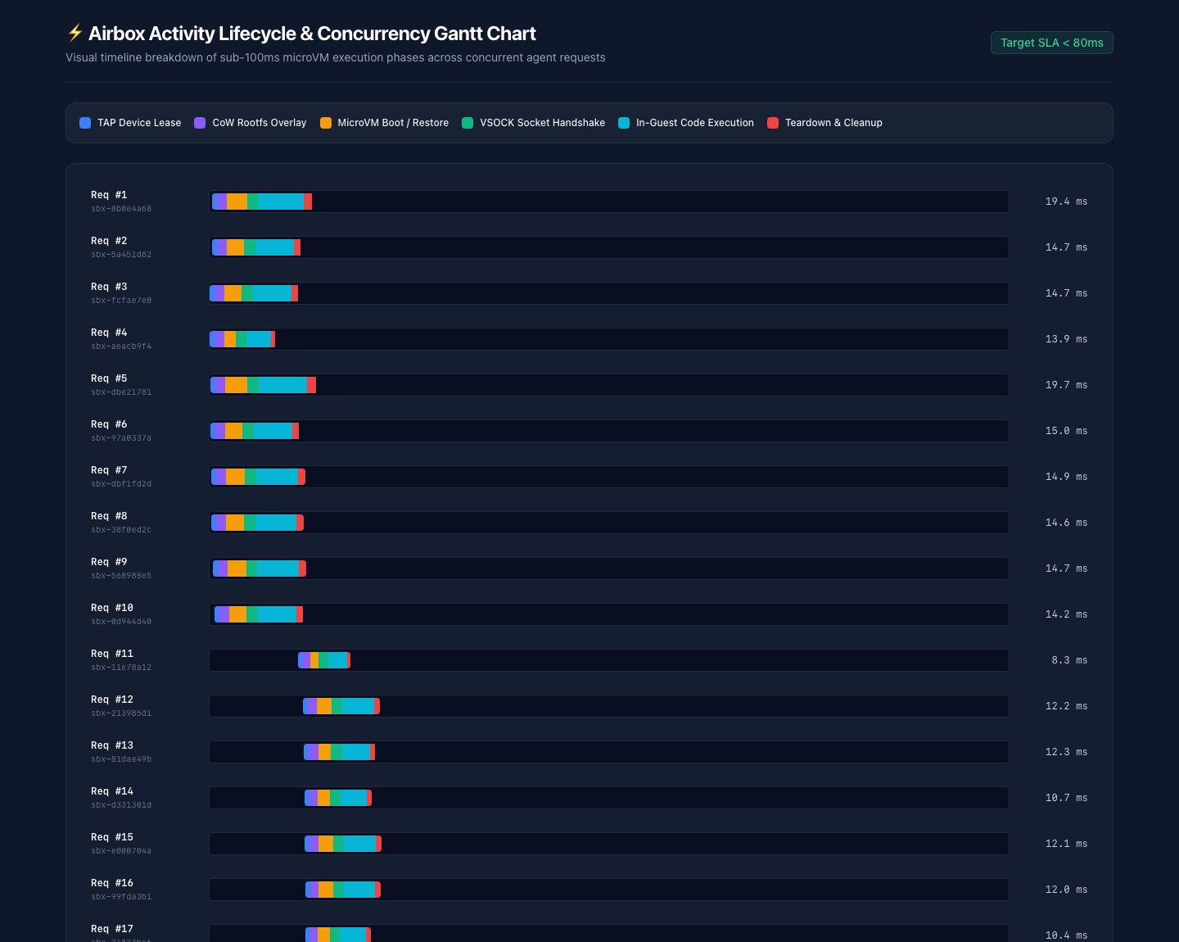
6. CONCURRENT LOAD & SLA VERIFICATION
07 / 09
100 Requests Across 10 Concurrent Agent Workers (<80ms Target SLA)
Verified on GCP n2-standard-2 with Firecracker v1.7.0 and Linux 5.10.209 guest kernel.
SLA Telemetry Breakdown
• Min Latency: 3.94 ms client | 3.00 ms server
• P50 (Median): 11.91 ms client | 8.00 ms server
• P90 Latency: 17.23 ms client | 12.00 ms server
• P95 SLA Target: 18.50 ms (4.3x under 80ms SLA)
• P99 Latency: 23.40 ms client | 17.00 ms server
• Max Latency: 23.85 ms client | 19.00 ms server
• Throughput: 788.98 req/sec (100/100 Pass)
• Total Wall Time: 126.75 ms for 100 executions
FastVM (Airbox) — Sub-100ms Hardware-Isolated Firecracker MicroVM Sandbox | github.com/shantanu-labs/FastVM

Slide 8
7. BUILT FOR AUTONOMOUS CODING AGENTS
08 / 09
Speculative MicroVM State Branching & <1ms Async Background Jobs
Enabling tree-of-thought code exploration and non-blocking background execution for Claude Code, Codex, and OpenHands.
🌿 Speculative Sandbox Branching (~62 ms)
• Endpoint: `POST /v1/sandboxes/{id}/branch`
• Firecracker Snapshot Lifecycle: Calls `PauseVM()` → `CreateSnapshot(mem, vmstate)` → `ResumeVM()` on the live parent microVM.
• Copy-on-Write State Cloning: Clones both the `/dev/shm` rootfs overlay and live Python interpreter memory state (`_G`) into a new isolated sandbox ID.
• Zero Parent Mutation: Coding agents can fork a sandbox before a risky refactor or dependency install, test hypotheses in parallel, and keep the winning branch.
⚙️ Async Background Jobs (0.17 ms Dispatch)
• Non-Blocking Dispatch: Pass `"async": true` to `POST /v1/execute` or call `POST /v1/jobs` to receive `202 Accepted` + `job_id` in 0.17 ms.
• Background Execution: Long-running builds, test suites, or scrapers run asynchronously inside their dedicated microVM without blocking the LLM agent loop.
• Live Status & Output Polling: Query `GET /v1/jobs/{id}` to inspect `status` (`running`, `completed`, `failed`, `timeout`, `cancelled`), `stdout`, `stderr`, and `duration_ms`.
• Instant Cancellation: `DELETE /v1/jobs/{id}` cancels the execution context and kills the runaway task immediately.
FastVM (Airbox) — Sub-100ms Hardware-Isolated Firecracker MicroVM Sandbox | github.com/shantanu-labs/FastVM

Slide 9
8. ZERO-TRUST SECURITY VERIFICATION
09 / 09
Adversarial Hardening: SSRF, OOM, Fork Bombs & Timeouts
Every security boundary was verified against hostile payloads on live Firecracker KVM microVMs.
🛡️ Cloud Metadata & RFC1918 SSRF Drop
pkg/network/iptables_linux.go
• Automated iptables FORWARD rules drop packets to 169.254.169.254/32 (AWS/GCP IMDS) and RFC1918 private subnets (10/8, 172.16/12, 192.168/16).
• Verified: curl http://169.254.169.254/computeMetadata/v1/ times out immediately with exit_code=28.
🧠 In-Guest OOM Killer Containment
cmd/agent-init/main.go
• Guest PID 1 protects itself with /proc/1/oom_score_adj = -1000.
• Verified: Allocating 512 MiB inside a 128 MiB microVM raises MemoryError (exit_code=1) in 56ms while PID 1 and sibling VMs remain healthy.
💣 Fork-Bomb Containment
cmd/agent-init/main.go
• Caps guest kernel /proc/sys/kernel/threads-max = 128 and wraps payloads in ulimit -u 32.
• Verified: `while True: os.fork()` is contained in 53ms with BlockingIOError: [Errno 11] Resource temporarily unavailable.
⏱️ Hard Execution Timeouts & Auto-Recycle
pkg/sandbox/firecracker_linux.go
• Per-request context.WithTimeout enforces strict millisecond deadlines.
• If a guest process hangs or corrupts its VM, the instance is marked broken, terminated, and replaced asynchronously in the warm pool.
FastVM (Airbox) — Sub-100ms Hardware-Isolated Firecracker MicroVM Sandbox | github.com/shantanu-labs/FastVM

