Slide 1
Broadcasting in Ad-hoc Wireless Sensor Networks Using 4-Hop Neighbor Information
Supervisor:
Dr. Sadia Sharmin
Assistant Professor,
Department of CSE, BUET
Students’ Name:
Shantanu Dutta (1405092)
Dipto Roy (1405104)
Aunabil Chakma (1405107)

Slide 2
Outline:
Introduction
Technical Terms
Related Work
Present State of the Problem
Proposed Methodology
Experimental Analysis
Conclusion
References

Slide 3
Introduction:
Broadcasting of packets in mobile ad-hoc wireless networks (MANETs) without proper framework of network infrastructure is one kind of major challenges
Without fixed infrastructure, mobile hosts may not communicate with each other in the network in a single hop fashion
While forwarding packets many problems may occur like more power consumption, increase of bandwidth overhead, redundant transmissions, etc.
Therefore, it is necessary to build multi-hop wireless networks to maintain communication among mobile hosts using intermediate nodes as routers

Slide 4
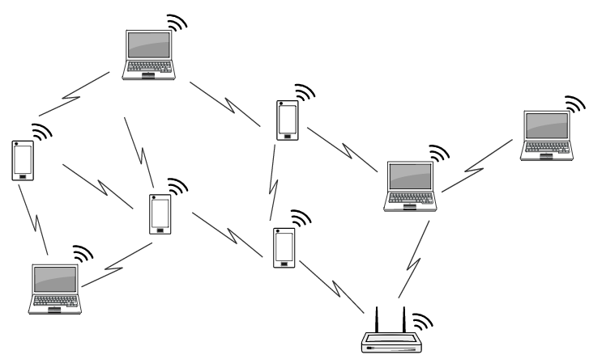
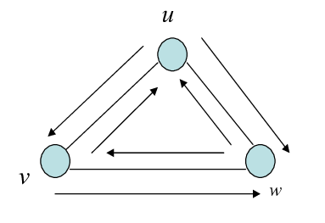
Background Studies:
Blind Flooding
MANET: Mobile Ad-hoc Network
Every node forwards packet to all
of its neighbors multiple times
Causes redundant transmissions
No fixed Base Station
Demand based Network
Host Mobility

Slide 5
Background Studies:
BBBlind Flooding
Leads to
BBroadcast Storm Problem
ContentionContention
Redundancy
Collision

Slide 6
Technical Terms:
Ad-hoc Network : Mobile hosts can communicate among them forming a temporary network known as ad-hoc network.
Hop: One portion of the path between source and destination.
Forwarding Nodes: Nodes those can forward messages.
U(u,v): Set of nodes that v will forward packet.
N(N(v)): All the nodes that are within the 2 –hop from v.
N(N(N(v))): All the nodes that are within the 3 –hop from v.

Slide 7
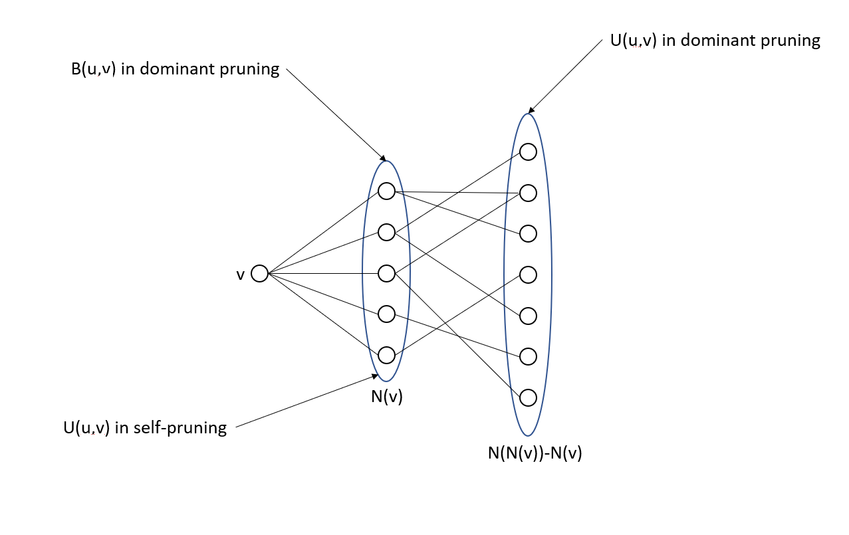
Technical Terms:

Slide 8
Related Work:
Blind Flooding:
Firstly, flooding technique proposed by Tseng etal. was performed blindly to broadcast information to all of the nodes of an entire network
Leads to broadcast storm problems like contention, collision, redundancy, etc
Moreover, resource consumptions are occurred frequently
In order to mitigate those situations, researchers have proposed a number of schemes which are bit capable for solving the problems.

Slide 9
Related Work (contending……)
Cluster Based Scheme:
In this method, M. Gerla and J. Kwon have proposed that there is a formation of cluster in the network having several nodes.
A cluster head with lowest ID is selected and member nodes of a cluster can maintain communication through a gateway number.
Counter Based Scheme:
K. Utsu and H.Ishii propose a timer is considered to determine how many times the same packets has been received.
This method helps reduce the redundant transmissions and works for 1-hop neighbor information.

Slide 10
Related Work (contending……)
Congestion Detection and Avoidance:
.Two heuristics approaches have been suggested named CODEM (congestion detection and mitigation) and COTA (congestion aware traffic allocation).
Helps in reducing traffic load in a wireless network
Increases the network reliability
Use of Directional Antennas:
Three schemes are suggested- on/off directional broadcast, relay-node-based directional broadcast and location-based directional broadcast.
Forwards packets in directional approach
Improves latency, coverage, reliability in the network

Slide 11
Related Work (contending……)
Total Dominant Pruning (TDP):
This method is a heuristic approximation algorithm of DP
Moreover, it is better than DP and uses 2-hop neighborhood information
Proposed algorithm uses the following formula:
U_{v=} N(N(v))- N(N(u))
Extended Dominant Pruning (ExDP):
Requires three hop neighbor information
forwards packets upto three hops instead of two hop
Reduces number of forwarding nodes, saves energy consumption, etc.
ExDP uses the following formula:
U_{v=} N(N(v))- N(N(u)) - Qv

Slide 12
Related Work (contending……)
Neighbor Knowledge Methods:
Actually, these are approximation algorithms and use neighborhood knowledge to broadcast data packets in a wireless sensor network.
Proactive Approach:
In this approach, source node sends packets with a forwarding list to receiving node.
Dominant Pruning (DP):
In this method, Lim and Kim propose an algorithm which helps in reducing redundant transmissions.
This method uses 2-hop neighborhood information.
Proposed algorithm uses the following formula:
U_{v=} N(N(v))- N(v)-N(u)
v
x
y
u

Slide 13
Related Work (contending……)
Reactive Approach:
In this approach, receiving nodes take decision to forward a packet or not.
Self Pruning (SP):
Proposed by Lim and Kim .
Formula U(u,v)=N(v) –N(u)
Not better than DP.
Redundant re-transmissions may occur.
v
x
y
u

Slide 14
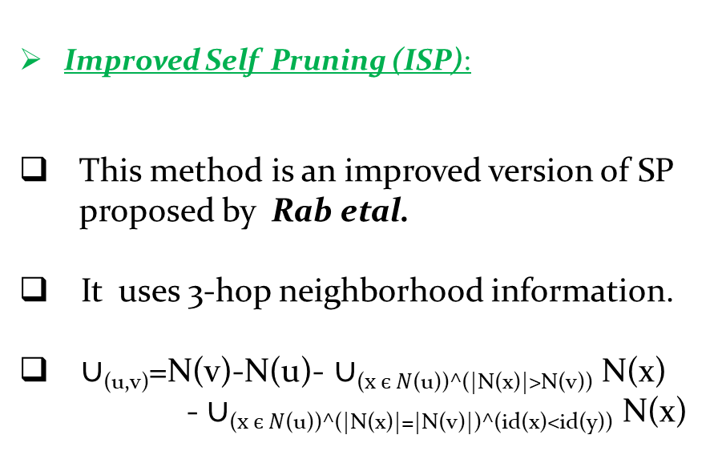
Related Work (contending……)
Improved Self Pruning (ISP):
This method is an improved version of SP proposed by Rab etal.
It uses 3-hop neighborhood information.
$∪$_{(u,v)}=N(v)-N(u)- $∪$₍$x є N$_{(u))^(|N(x)|>N(v))} N(x)
- $∪$₍$x є N$(u))^(|N(x)|=|N(v)|)^(id(x)<id(y)) N(x)
y
v
x
u

Slide 15
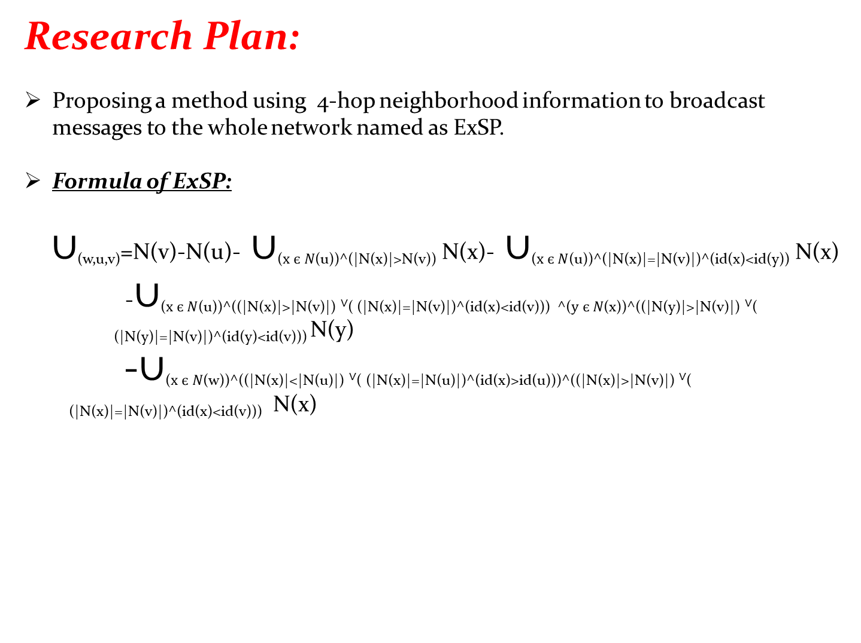
Research Plan:
Proposing a method using 4-hop neighborhood information to broadcast messages to the whole network named as ExSP.
Formula of ExSP:
$∪$_{(w,u,v)}=N(v)-N(u)- $∪$₍$x є N$_{(u))^(|N(x)|>N(v))} N(x)- $∪$₍$x є N$(u))^(|N(x)|=|N(v)|)^(id(x)<id(y)) N(x)
-$∪$₍$x є N$_{(u))^((|N(x)|>|N(v)|)} ∨( (|N(x)|=|N(v)|)^(id(x)<id(v))) ^($y є N$_{(x))^((|N(y)|>|N(v)|)} ∨( (|N(y)|=|N(v)|)^(id(y)<id(v))) N(y)
-$∪$₍$x є N$_{(w))^((|N(x)|<|N(u)|)} ∨( (|N(x)|=|N(u)|)^(id(x)>id(u)))^((|N(x)|>|N(v)|) ∨( (|N(x)|=|N(v)|)^(id(x)<id(v))) N(x)
y
v
x
u

Slide 16
Simulation of ISP & ExSP

Slide 17
9
9
Unvisited
Forwarder
Non-forwarder
8
6
7
8
6
7
5
2
4
5
2
4
3
1
3
1
0
0
ISP
Extended ISP

Slide 18
9
9
Unvisited
Forwarder
Non-forwarder
8
6
7
8
6
7
5
2
4
5
2
4
3
1
3
1
0
0
ISP
Extended ISP

Slide 19
Experimental Domains
An ideal MAC layer was assumed i.e. there is no contention and collision
Deployed random networks distributed over 650 m X 650m
Transmission range was from 120 m to 240m
Data packet size – 1000 byte
Transmission rate -2 Mbps
Average values were taken from 10 scenarios for each case

Slide 20
Experimental Results Of
ExSP

Slide 21
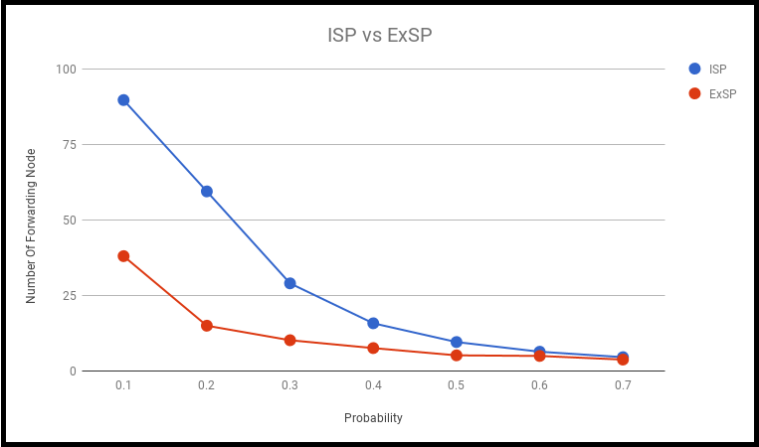
Performance Comparison between ISP and ExISP :
Fig : Performance Comparison between ISP and ExISP for 100 nodes

Slide 22
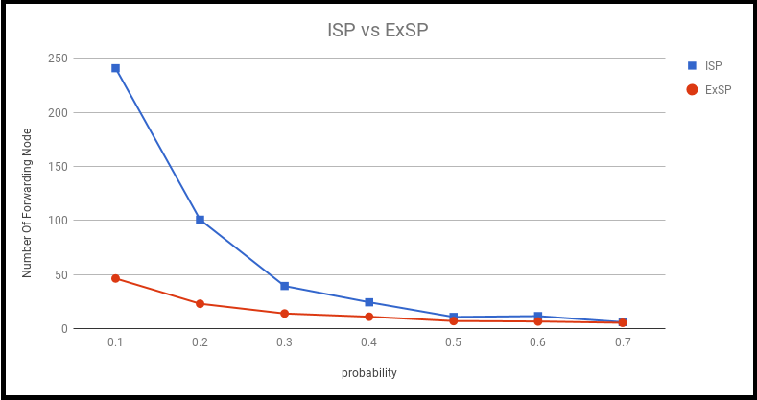
Performance Comparison between ISP and ExISP :
Fig : Performance Comparison between ISP and ExISP for 300 nodes

Slide 23
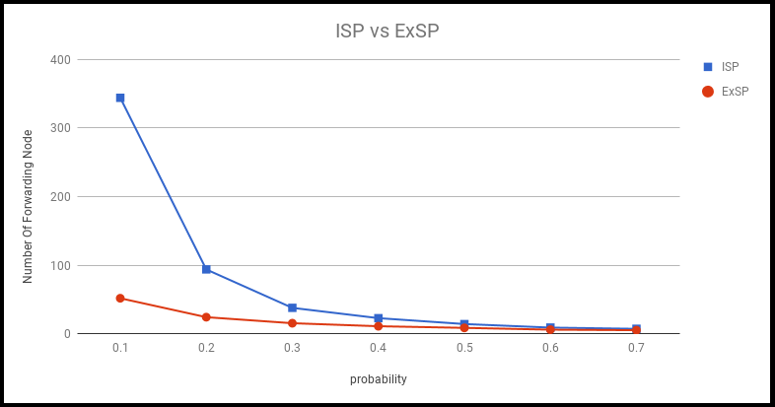
Performance Comparison between ISP and ExISP :
Fig : Performance Comparison between ISP and ExISP for 500 nodes

Slide 24
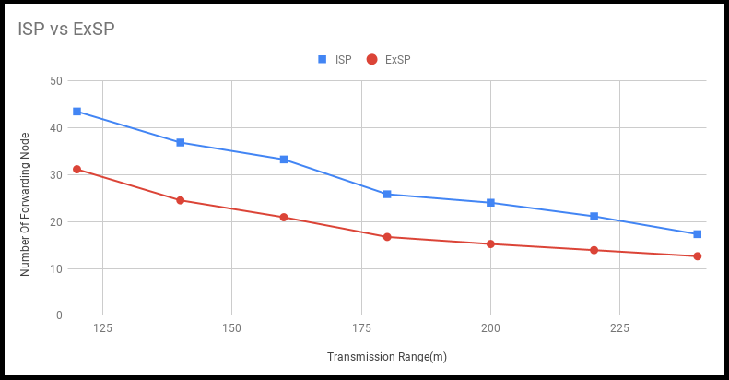
Effect of transmission range over ISP and ExSP :
Fig : Effect of transmission range over ISP and ExSP on 100 node

Slide 25
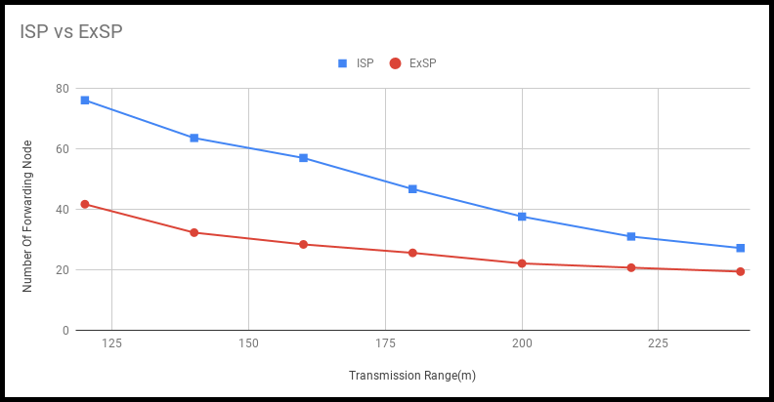
Effect of transmission range over ISP and ExSP :
Fig : Effect of transmission range over ISP and ExSP on 200 node

Slide 26
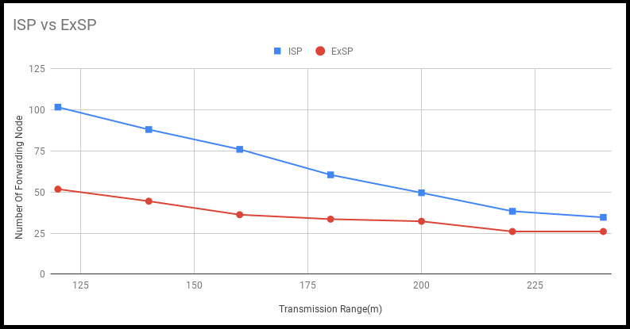
Effect of transmission range over ISP and ExSP :
Fig : Effect of transmission range over ISP and ExSP on 300 node

Slide 27
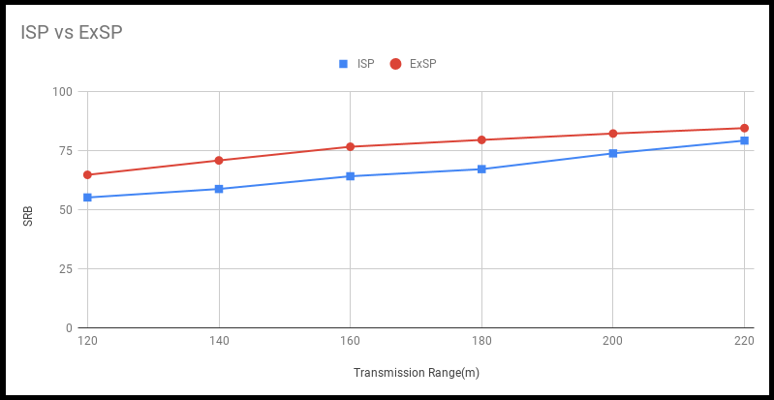
Effect of transmission range over ISP and ExSP :
Saved Rebroadcast
Fig : Effect of transmission range over ISP and ExSP on 100 node

Slide 28
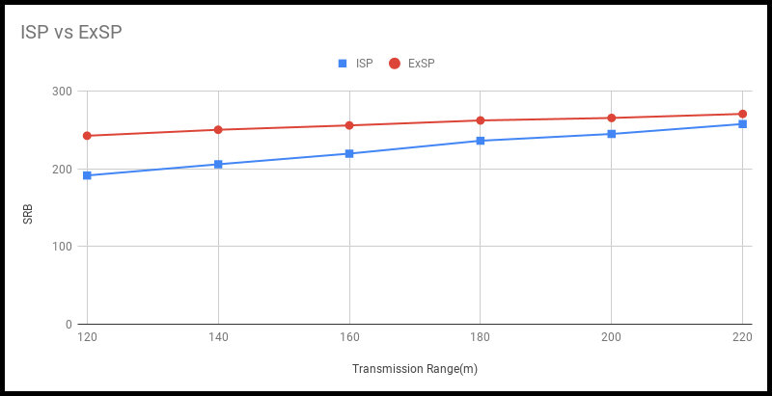
Effect of transmission range over ISP and ExSP :
Saved Rebroadcast
Fig : Effect of transmission range over ISP and ExSP on 300 node

Slide 29
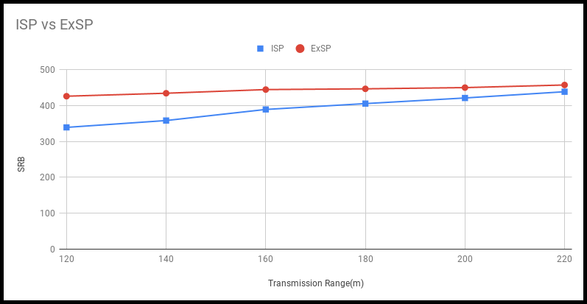
Effect of transmission range over ISP and ExSP :
Saved Rebroadcast
Fig : Effect of transmission range over ISP and ExSP on 500 node

Slide 30
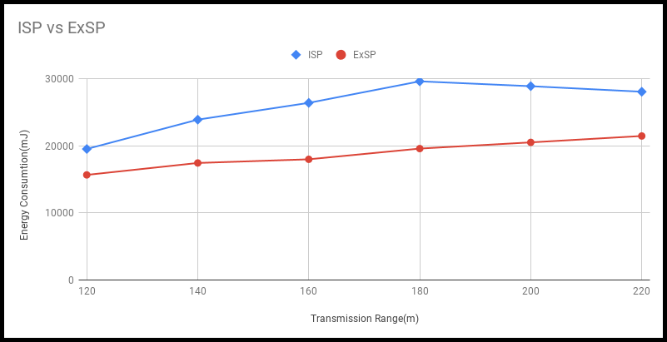
Effect of transmission range over ISP and ExSP :
Energy Consumption for Data Packet
Fig : Effect of transmission range over ISP and ExSP on 100 node

Slide 31
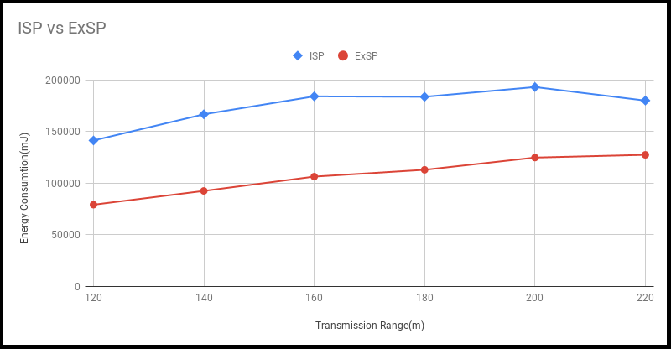
Effect of transmission range over ISP and ExSP :
Energy Consumption
Energy Consumption for Data Packet
Fig : Effect of transmission range over ISP and ExSP on 300 node

Slide 32
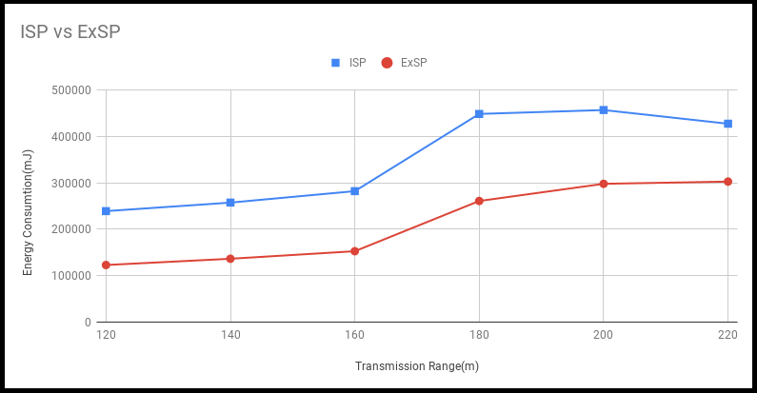
Effect of transmission range over ISP and ExSP :
Energy Consumption
Energy Consumption for Data Packet
Fig : Effect of transmission range over ISP and ExSP on 500 node

Slide 33
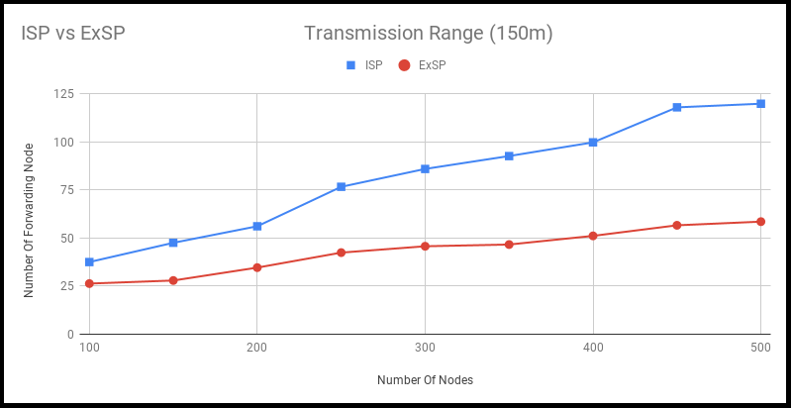
Effect of node density over ISP and ExSP :
Energy Consumption
Energy Consumption for Data Packet
Fig : Effect of node density over ISP and ExSP on Transmission Range(150m)

Slide 34
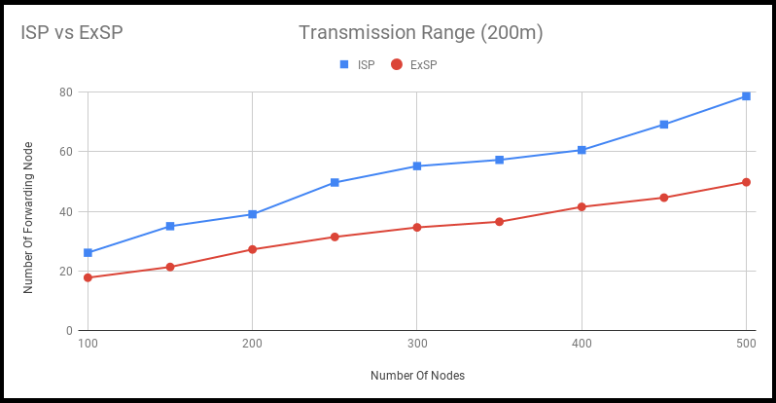
Effect of node density over ISP and ExSP :
Energy Consumption
Energy Consumption for Data Packet
Fig : Effect of node density over ISP and ExSP on Transmission Range(200)

Slide 35
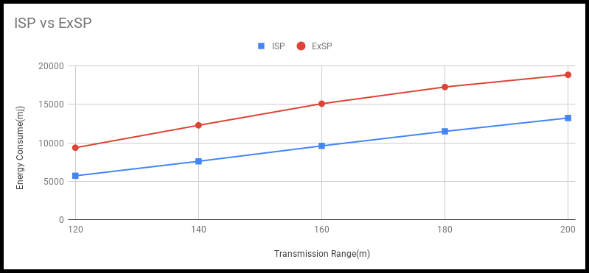

Slide 36
Experimental Result Of
IDP

Slide 37
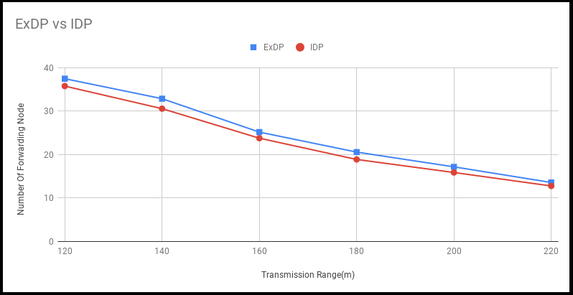
Effect of transmission range over ExDP and IDP :
Fig : Effect of transmission range over ExDP and IDP on 100 node

Slide 38
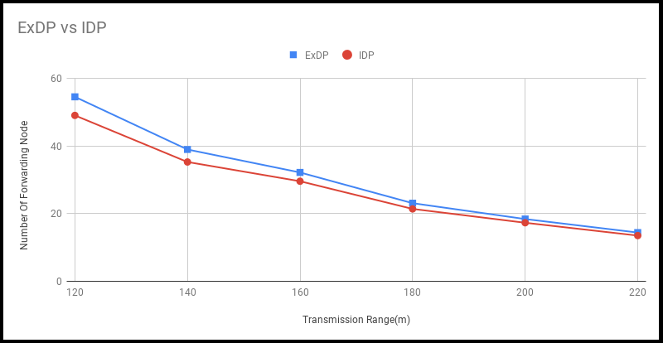
Effect of transmission range over ExDP and IDP :
Fig : Effect of transmission range over ExDP and IDP on 200 node

Slide 39
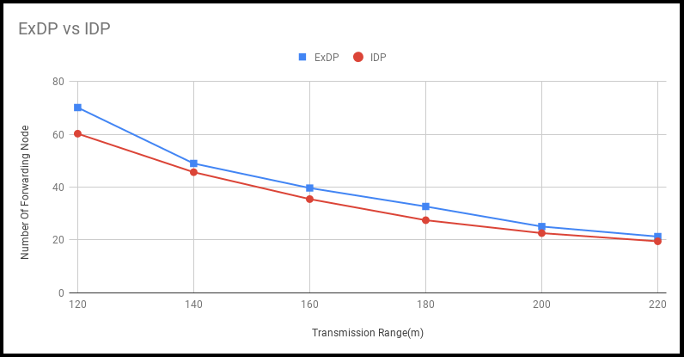
Effect of transmission range over ExDP and IDP :
Fig : Effect of transmission range over ExDP and ISP on 300 node

Slide 40
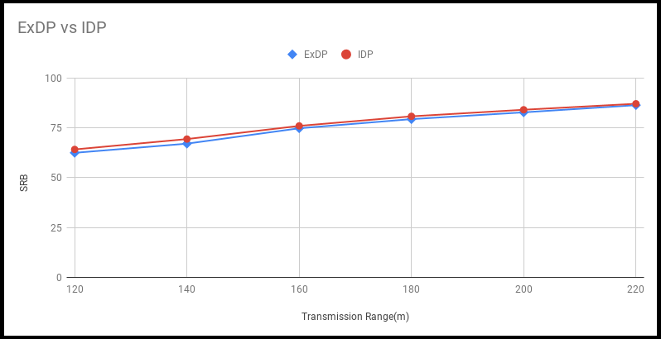
Effect of transmission range over ExDP and IDP :
Saved Rebroadcast
Fig : Effect of transmission range over ExDP and IDP on 100 node

Slide 41
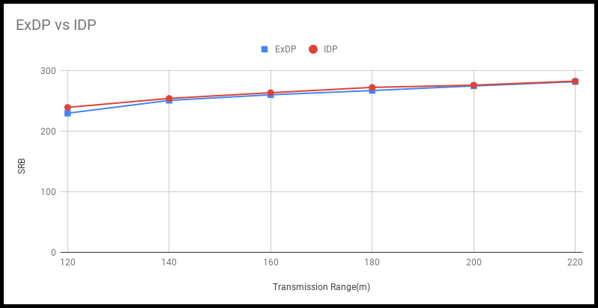
Effect of transmission range over ExDP and IDP :
Saved Rebroadcast
Fig : Effect of transmission range over ExDP and IDP on 300 node

Slide 42
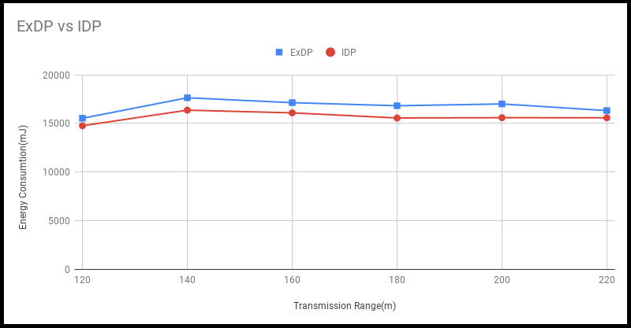
Effect of transmission range over ExDP and IDP :
Energy Consumption for Data Packet
Fig : Effect of transmission range over ExDP and IDP on 100 node

Slide 43
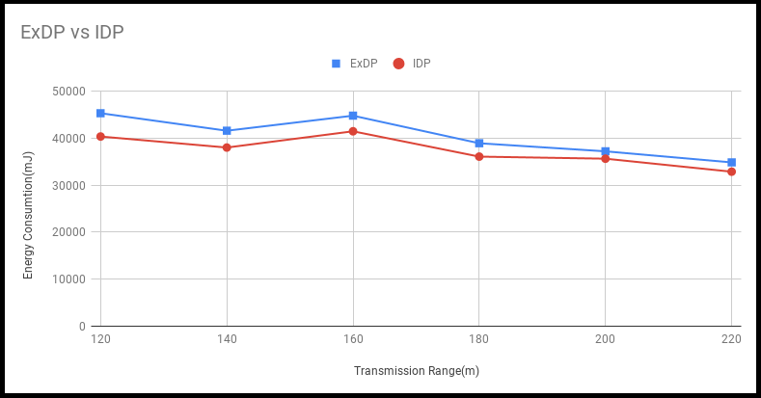
Effect of transmission range over ExDP and IDP :
Energy Consumption for Data Packet
Fig : Effect of transmission range over ExDP and IDP on 200 node

Slide 44
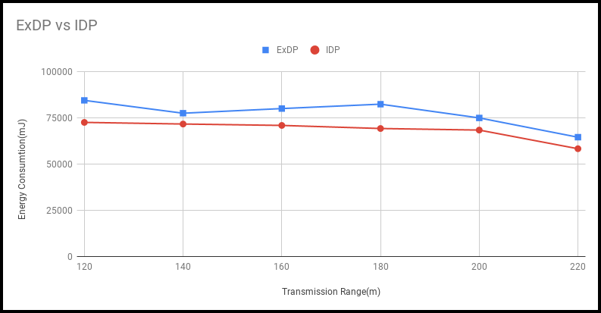
Effect of transmission range over ExDP and IDP :
Energy Consumption for Data Packet
Fig : Effect of transmission range over ExDP and IDP on 300 node

Slide 45
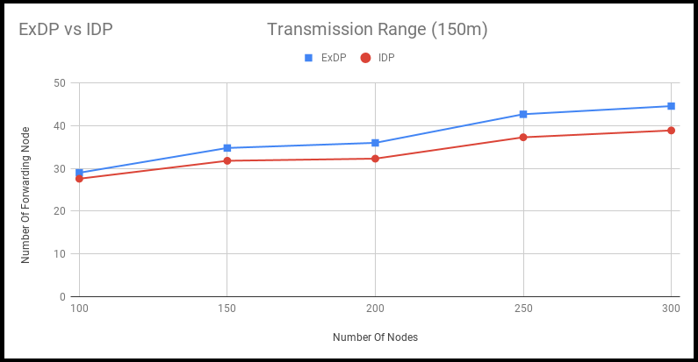
Effect of node density over ExDP and IDP :
Energy Consumption
Energy Consumption for Data Packet
Fig : Effect of node density over ExDP and IDP on Transmission Range(150)

Slide 46
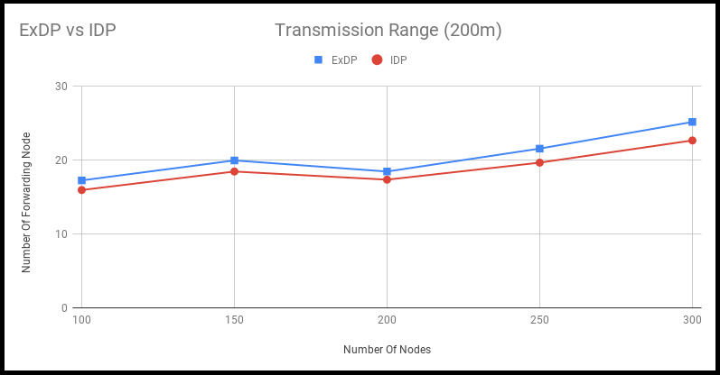
Effect of node density over ExDP and IDP :
Energy Consumption
Energy Consumption for Data Packet
Fig : Effect of node density over ExDP and IDP on Transmission Range(200)

Slide 47
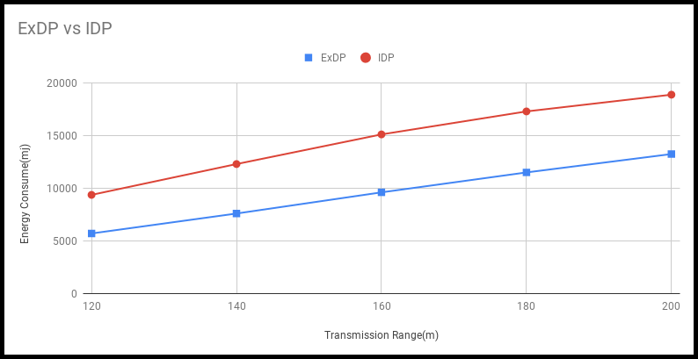

Slide 48
Future work
Neighbor knowledge method can be extended from 4-hop to k-hop.
Although our approaches require more time complexity and overhead, further research is possible to reduce in a better way
Information may be stolen . So security steps need to be taken
Trying to develop approaches using 4-hop neighbor knowledge for dynamic and unconnected network
More better approaches may be discovered to forward data packets in a wireless network

Slide 49
Conclusion:
Broadcasting packets in a wireless sensor network becomes challenging due to broadcast storm problem.
Previous schemes and techniques are not too much effective to lessen the storm problem, number of forwarding nodes, resource consumption, etc.
A number of work on Self-Pruning and Dominant Pruning methods based on upto 3-hop neighborhood information while we use the 4-hop neighborhood information.
Our developed algorithms work far better than previous developed research work to broadcast messages.

Slide 50
References:
[1] H. Lim and C. Kim, “Flooding in wireless ad hoc networks,” Computer Communications, vol. 24, no. 3, pp. 353–363, 2001.
[2] A A. Rahman, M. E. Hoque, F. Rahman, S. K. Kundu, and P. Gburzynski, “Enhanced partial dominant pruning (EPDP) based broadcasting in ad hoc wireless networks.,” Journal of Networks, vol. 4, no. 9, pp. 895–904, 2009
[3] K. Utsu and H. Ishii, “Load-aware flooding over ad hoc networks enabling high message reachability and traffic reduction,” in International conference on mobile computing and ubiquitous networking (ICMU) Seattle, U.S.A April 26-28, 2010.
[4] I. Hur, T.-D. Le, M.-H. Jo, and H.-S. Choo, “Regular tiling based flooding scheme for energy efficiency in wireless ad hoc networks,” Journal of Internet Technology, vol. 13, no. 2, pp. 257–271, 2012.
[5] G.-X. Kok, C.-O. Chow, and H. Ishii, “Reducing broadcast redundancy in wireless ad-hoc networks with implicit coordination among forwarding nodes,” Wireless Personal Communications, vol. 81, no. 1, pp. 253–278, 2015.
[6] R. Rab, S. A. D. Sagar, N. Sakib, A. Haque, M. Islam, and A. Rahman, “Improved selfpruning for broadcasting in ad hoc wireless networks,” Wireless Sensor Network, vol. 9, 2017.

Slide 51
References:
[7] D. B. J. D. A. Maltz and J. Broch, “Dsr: The dynamic source routing protocol for multihop wireless ad hoc networks,” Computer Science Department Carnegie Mellon University Pittsburgh, PA, pp. 15213–3891, 2001.
[8]M. T. Thai, F. Wang, D. Liu, S. Zhu, and D.-Z. Du, “Connected dominating sets in wireless networks with different transmission ranges,” IEEE transactions on mobile computing, vol. 6, no. 7, pp. 721–730, 2007.
[9] L. Shanshan, L. Xiangke, Z. Peidong, and X. Nong, “Congestion avoidance, detection and mitigation in wireless sensor networks,” Journal of Computer Research and Development, vol. 44, no. 8, pp. 1348–1356, 2007.
[10] T. J. Kwon and M. Gerla, “Efficient flooding with passive clustering (pc) in ad hoc networks,” ACM SIGCOMM Computer Communication Review, vol. 32, no. 1, pp. 44–56, 2002
[11] T. T. Anannya and A. Rahman, “Extended neighborhood knowledge based dominant pruning (exdp),” in 2018 5th International Conference on Networking, Systems and Security (NSysS), pp. 1–9, IEEE, 2018.
[12 ] M. Q. Rieck and S. Dhar, “A new pruning method for efficient broadcasting in ad hoc networks,” International Journal of Mobile Network Design and Innovation, vol. 3, no. 4, pp. 209–217, 2011

Slide 52
Thank you ☺
Question and Answer Session

