Slide 1
SIMPUTER

Slide 3
A Thought
A rapid growth of knowledge can only happen in an environment which admits free exchange of thought of information.
Nothing else can explain the astounding progress of science in the last three hundred years.
Several rounds of intends discussions among the trustees convinced them that the only way to break out the current absurdities is to foster a spirit of co-operation in inventing new technologies.
The common mistake of treating to-operation as a synonym of charity poses its own challenges.
The Simputer Licensing Framework is the Trust's responds to these challenges.

Slide 4
“Simputer,what is that ?”
A Simputer is a multilingual, mass access, low cost, portable alternative to PC's by which the benefits of IT can reach the common man.
It has a special role in the third world because it is ensures that illiteracy is no longer barrier in handling a computer.
The key to bridging the digital divide is to have shared devices that permit truly simple and natural users interfaces based on sight, touch and studio.
The Simputer meets these demands through a browser for the Information Markup Language (IML)..

Slide 5
Specifications
CPU | Intel PXA 255 processor @ 200 MHz
Memory | 64MB of SDRAM 32 MB Flash memory
Display Options | Advanced TFT Colour with white LED backlight
Input Device | Touch tablet overlay on LCD
Audio Interface | Audio Codec with integrated speaker & microphone
Smartcard Interface | Integrated Smartcard Reader/Writer
Connectivity | Debug Serial USB Slave USB Master
Connectivity Options | IrDA Integrated 56 Kbps Modem (V.90) RS232 Communication
Power Supply | Li Polymer rechargeable batteries Internal charge management External AC adapter
System Software | Linux Kernel 2.x.x XWindows GTK Support TCP/IP, FTP, Telnet, HTTP (Dillo Web browser) SCEZ Smartcard Framework Indian Language support, PC Sync Software

Slide 6
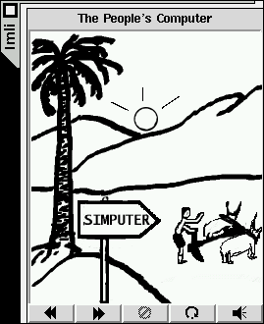
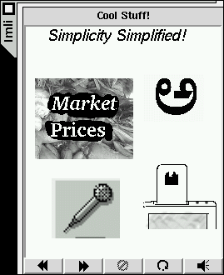
Simputer Demos

Slide 7
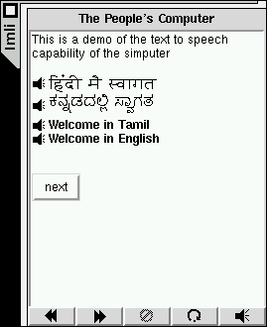
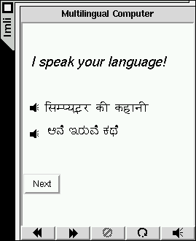
The Simputer is Multi-lingual

Slide 8

Prices at the local markets

Slide 9
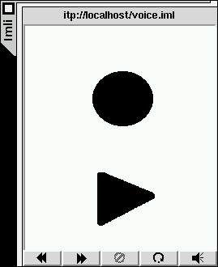
Voice Recording and Playback
Voice Mail !
Record
Playback

Slide 10
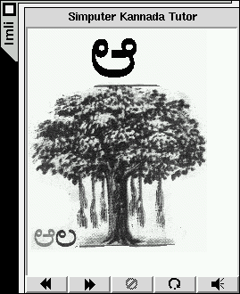
A Portable Literacy Instructor

Slide 11
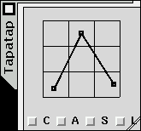
Text Editing
Graffiti: single stroke encoding is patented !
A

Slide 12
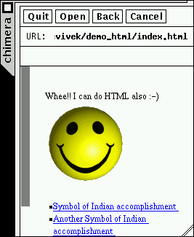
Chimera Browser

Slide 13
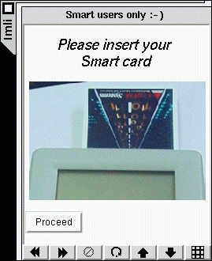
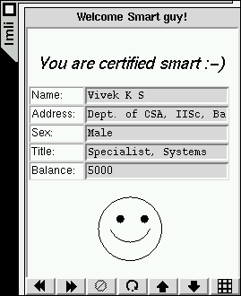
Smart Card Personaliser and Transactor

Slide 14
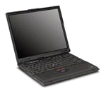
Infra Red Data Access

Slide 15
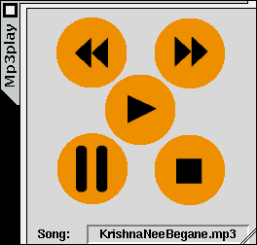
MP3 Player

