Slide 1
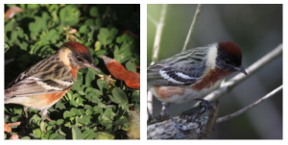
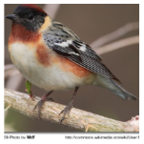
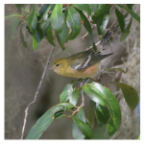
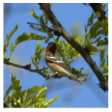
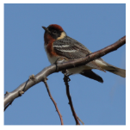
Notes:
\usepackage[dvipsnames]{xcolor}
%Expert 1
\textbf{BayBreastedWarbler} $\leftrightarrow$ \big(\textcolor{blue}{back\_pattern\_striped} $\land$ upperparts\_color\_black $\land$ \textcolor{BrickRed}{wing\_color\_white} $\land$ $\neg$ \textcolor{BrickRed}{nape\_color\_grey} $\land$ $\neg$ throat\_color\_black \big)
$\boldsymbol{\lor}$
\big(belly\_pattern\_solid $\land$ forehead\_color\_black $\land$ \textcolor{BrickRed}{shape\_perchinglike} $\land$ upperparts\_color\_black $\land$ \textcolor{BrickRed}{wing\_color\_white} $\land$ $\neg$\textcolor{BrickRed}{nape\_color\_grey} $\land$
$\neg$\textcolor{BrickRed}{primary\_color\_black} $\land$ $\neg$primary\_color\_white $\land$ $\neg$throat\_color\_black $\land$ $\neg$\textcolor{BrickRed}{under\_tail\_color\_black}\big)
% Expert 2
\textbf{BayBreastedWarbler} $\leftrightarrow$ \textcolor{blue}{back\_pattern\_striped} $\land$ bill\_shape\_allpurpose $\land$ \textcolor{BrickRed}{shape\_perchinglike} $\land$ \textcolor{BrickRed}{wing\_color\_white} $\land$ $\neg$back\_pattern\_multicolored $\land$ $\neg$nape\_color\_black $\land$ $\neg$ nape\_color\_blue $\land$ $\neg$\textcolor{BrickRed}{nape\_color\_grey} $\land$ $\neg$ \textcolor{BrickRed}{primary\_color\_black} $\land$ $\neg$ primary\_color\_grey $\land$ $\neg$\textcolor{BrickRed}{under\_tail\_color\_black}
\text{\textbf{BayBreastedWarbler}} \leftrightarrow & \text{\textcolor{blue}{back\_pattern\_striped}} \hspace{2pt} \land\\
& \text{leg\_color\_grey}
%&\text{\textbf{BayBreastedWarbler}} \\
%&\qquad \qquad \updownarrow \\
%&\text{\textcolor{blue}{back\_pattern\_striped}} \hspace{2pt}\land \\
%&\text{leg\_color\_grey}
% Baseline CBM
%\textbf{BayBreastedWarbler} $\leftrightarrow$ forehead\_color\_black $\land$ leg\_color\_grey $\land$ upper\_tail\_color\_grey $\land$ upperparts\_color\_white
& \quad \qquad \quad \quad \text{\textbf{BayBreastedWarbler}} \leftrightarrow \text{forehead\_color\_black} \hspace{2pt} \land \\
& \qquad \qquad \quad \text{leg\_color\_grey} \hspace{2pt} \land \text{upper\_tail\_color\_grey } \hspace{2pt} \land \\
& \qquad \qquad \quad \text{upperparts\_color\_white}

Slide 2
Notes:
\usepackage[dvipsnames]{xcolor}
%Expert 1
\textbf{BayBreastedWarbler} $\leftrightarrow$ \big(\textcolor{blue}{back\_pattern\_striped} $\land$ upperparts\_color\_black $\land$ \textcolor{BrickRed}{wing\_color\_white} $\land$ $\neg$ \textcolor{BrickRed}{nape\_color\_grey} $\land$ $\neg$ throat\_color\_black \big)
$\boldsymbol{\lor}$
\big(belly\_pattern\_solid $\land$ forehead\_color\_black $\land$ \textcolor{BrickRed}{shape\_perchinglike} $\land$ upperparts\_color\_black $\land$ \textcolor{BrickRed}{wing\_color\_white} $\land$ $\neg$\textcolor{BrickRed}{nape\_color\_grey} $\land$
$\neg$\textcolor{BrickRed}{primary\_color\_black} $\land$ $\neg$primary\_color\_white $\land$ $\neg$throat\_color\_black $\land$ $\neg$\textcolor{BrickRed}{under\_tail\_color\_black}\big)
% Expert 2
\textbf{BayBreastedWarbler} $\leftrightarrow$ \textcolor{blue}{back\_pattern\_striped} $\land$ bill\_shape\_allpurpose $\land$ \textcolor{BrickRed}{shape\_perchinglike} $\land$ \textcolor{BrickRed}{wing\_color\_white} $\land$ $\neg$back\_pattern\_multicolored $\land$ $\neg$nape\_color\_black $\land$ $\neg$ nape\_color\_blue $\land$ $\neg$\textcolor{BrickRed}{nape\_color\_grey} $\land$ $\neg$ \textcolor{BrickRed}{primary\_color\_black} $\land$ $\neg$ primary\_color\_grey $\land$ $\neg$\textcolor{BrickRed}{under\_tail\_color\_black}
\text{\textbf{BayBreastedWarbler}} \leftrightarrow & \text{\textcolor{blue}{back\_pattern\_striped}} \hspace{2pt} \land\\
& \text{leg\_color\_grey}
%&\text{\textbf{BayBreastedWarbler}} \\
%&\qquad \qquad \updownarrow \\
%&\text{\textcolor{blue}{back\_pattern\_striped}} \hspace{2pt}\land \\
%&\text{leg\_color\_grey}
% Baseline CBM
%\textbf{BayBreastedWarbler} $\leftrightarrow$ forehead\_color\_black $\land$ leg\_color\_grey $\land$ upper\_tail\_color\_grey $\land$ upperparts\_color\_white
& \quad \qquad \quad \quad \text{\textbf{BayBreastedWarbler}} \leftrightarrow \text{forehead\_color\_black} \hspace{2pt} \land \\
& \qquad \qquad \quad \text{leg\_color\_grey} \hspace{2pt} \land \text{upper\_tail\_color\_grey } \hspace{2pt} \land \\
& \qquad \qquad \quad \text{upperparts\_color\_white}

Slide 3
Route Interpret Repeat
Notes:
\usepackage[dvipsnames]{xcolor}
%Expert 1
\textbf{BayBreastedWarbler} $\leftrightarrow$ \big(\textcolor{blue}{back\_pattern\_striped} $\land$ upperparts\_color\_black $\land$ \textcolor{BrickRed}{wing\_color\_white} $\land$ $\neg$ \textcolor{BrickRed}{nape\_color\_grey} $\land$ $\neg$ throat\_color\_black \big)
$\boldsymbol{\lor}$
\big(belly\_pattern\_solid $\land$ forehead\_color\_black $\land$ \textcolor{BrickRed}{shape\_perchinglike} $\land$ upperparts\_color\_black $\land$ \textcolor{BrickRed}{wing\_color\_white} $\land$ $\neg$\textcolor{BrickRed}{nape\_color\_grey} $\land$
$\neg$\textcolor{BrickRed}{primary\_color\_black} $\land$ $\neg$primary\_color\_white $\land$ $\neg$throat\_color\_black $\land$ $\neg$\textcolor{BrickRed}{under\_tail\_color\_black}\big)
% Expert 2
\textbf{BayBreastedWarbler} $\leftrightarrow$ \textcolor{blue}{back\_pattern\_striped} $\land$ bill\_shape\_allpurpose $\land$ \textcolor{BrickRed}{shape\_perchinglike} $\land$ \textcolor{BrickRed}{wing\_color\_white} $\land$ $\neg$back\_pattern\_multicolored $\land$ $\neg$nape\_color\_black $\land$ $\neg$ nape\_color\_blue $\land$ $\neg$\textcolor{BrickRed}{nape\_color\_grey} $\land$ $\neg$ \textcolor{BrickRed}{primary\_color\_black} $\land$ $\neg$ primary\_color\_grey $\land$ $\neg$\textcolor{BrickRed}{under\_tail\_color\_black}
\text{\textbf{BayBreastedWarbler}} \leftrightarrow & \text{\textcolor{blue}{back\_pattern\_striped}} \hspace{2pt} \land\\
& \text{leg\_color\_grey}
%&\text{\textbf{BayBreastedWarbler}} \\
%&\qquad \qquad \updownarrow \\
%&\text{\textcolor{blue}{back\_pattern\_striped}} \hspace{2pt}\land \\
%&\text{leg\_color\_grey}
% Baseline CBM
%\textbf{BayBreastedWarbler} $\leftrightarrow$ forehead\_color\_black $\land$ leg\_color\_grey $\land$ upper\_tail\_color\_grey $\land$ upperparts\_color\_white
& \quad \qquad \quad \quad \text{\textbf{BayBreastedWarbler}} \leftrightarrow \text{forehead\_color\_black} \hspace{2pt} \land \\
& \qquad \qquad \quad \text{leg\_color\_grey} \hspace{2pt} \land \text{upper\_tail\_color\_grey } \hspace{2pt} \land \\
& \qquad \qquad \quad \text{upperparts\_color\_white}

Slide 4
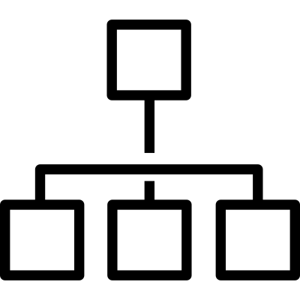
Route Interpret Repeat
Expert1
Notes:
\usepackage[dvipsnames]{xcolor}
%Expert 1
\textbf{BayBreastedWarbler} $\leftrightarrow$ \big(\textcolor{blue}{back\_pattern\_striped} $\land$ upperparts\_color\_black $\land$ \textcolor{BrickRed}{wing\_color\_white} $\land$ $\neg$ \textcolor{BrickRed}{nape\_color\_grey} $\land$ $\neg$ throat\_color\_black \big)
$\boldsymbol{\lor}$
\big(belly\_pattern\_solid $\land$ forehead\_color\_black $\land$ \textcolor{BrickRed}{shape\_perchinglike} $\land$ upperparts\_color\_black $\land$ \textcolor{BrickRed}{wing\_color\_white} $\land$ $\neg$\textcolor{BrickRed}{nape\_color\_grey} $\land$
$\neg$\textcolor{BrickRed}{primary\_color\_black} $\land$ $\neg$primary\_color\_white $\land$ $\neg$throat\_color\_black $\land$ $\neg$\textcolor{BrickRed}{under\_tail\_color\_black}\big)
% Expert 2
\textbf{BayBreastedWarbler} $\leftrightarrow$ \textcolor{blue}{back\_pattern\_striped} $\land$ bill\_shape\_allpurpose $\land$ \textcolor{BrickRed}{shape\_perchinglike} $\land$ \textcolor{BrickRed}{wing\_color\_white} $\land$ $\neg$back\_pattern\_multicolored $\land$ $\neg$nape\_color\_black $\land$ $\neg$ nape\_color\_blue $\land$ $\neg$\textcolor{BrickRed}{nape\_color\_grey} $\land$ $\neg$ \textcolor{BrickRed}{primary\_color\_black} $\land$ $\neg$ primary\_color\_grey $\land$ $\neg$\textcolor{BrickRed}{under\_tail\_color\_black}
\text{\textbf{BayBreastedWarbler}} \leftrightarrow & \text{\textcolor{blue}{back\_pattern\_striped}} \hspace{2pt} \land\\
& \text{leg\_color\_grey}
%&\text{\textbf{BayBreastedWarbler}} \\
%&\qquad \qquad \updownarrow \\
%&\text{\textcolor{blue}{back\_pattern\_striped}} \hspace{2pt}\land \\
%&\text{leg\_color\_grey}
% Baseline CBM
%\textbf{BayBreastedWarbler} $\leftrightarrow$ forehead\_color\_black $\land$ leg\_color\_grey $\land$ upper\_tail\_color\_grey $\land$ upperparts\_color\_white
& \quad \qquad \quad \quad \text{\textbf{BayBreastedWarbler}} \leftrightarrow \text{forehead\_color\_black} \hspace{2pt} \land \\
& \qquad \qquad \quad \text{leg\_color\_grey} \hspace{2pt} \land \text{upper\_tail\_color\_grey } \hspace{2pt} \land \\
& \qquad \qquad \quad \text{upperparts\_color\_white}

Slide 5
Route Interpret Repeat
Expert1
Notes:
\usepackage[dvipsnames]{xcolor}
%Expert 1
\textbf{BayBreastedWarbler} $\leftrightarrow$ \big(\textcolor{blue}{back\_pattern\_striped} $\land$ upperparts\_color\_black $\land$ \textcolor{BrickRed}{wing\_color\_white} $\land$ $\neg$ \textcolor{BrickRed}{nape\_color\_grey} $\land$ $\neg$ throat\_color\_black \big)
$\boldsymbol{\lor}$
\big(belly\_pattern\_solid $\land$ forehead\_color\_black $\land$ \textcolor{BrickRed}{shape\_perchinglike} $\land$ upperparts\_color\_black $\land$ \textcolor{BrickRed}{wing\_color\_white} $\land$ $\neg$\textcolor{BrickRed}{nape\_color\_grey} $\land$
$\neg$\textcolor{BrickRed}{primary\_color\_black} $\land$ $\neg$primary\_color\_white $\land$ $\neg$throat\_color\_black $\land$ $\neg$\textcolor{BrickRed}{under\_tail\_color\_black}\big)
% Expert 2
\textbf{BayBreastedWarbler} $\leftrightarrow$ \textcolor{blue}{back\_pattern\_striped} $\land$ bill\_shape\_allpurpose $\land$ \textcolor{BrickRed}{shape\_perchinglike} $\land$ \textcolor{BrickRed}{wing\_color\_white} $\land$ $\neg$back\_pattern\_multicolored $\land$ $\neg$nape\_color\_black $\land$ $\neg$ nape\_color\_blue $\land$ $\neg$\textcolor{BrickRed}{nape\_color\_grey} $\land$ $\neg$ \textcolor{BrickRed}{primary\_color\_black} $\land$ $\neg$ primary\_color\_grey $\land$ $\neg$\textcolor{BrickRed}{under\_tail\_color\_black}
\text{\textbf{BayBreastedWarbler}} \leftrightarrow & \text{\textcolor{blue}{back\_pattern\_striped}} \hspace{2pt} \land\\
& \text{leg\_color\_grey}
%&\text{\textbf{BayBreastedWarbler}} \\
%&\qquad \qquad \updownarrow \\
%&\text{\textcolor{blue}{back\_pattern\_striped}} \hspace{2pt}\land \\
%&\text{leg\_color\_grey}
% Baseline CBM
%\textbf{BayBreastedWarbler} $\leftrightarrow$ forehead\_color\_black $\land$ leg\_color\_grey $\land$ upper\_tail\_color\_grey $\land$ upperparts\_color\_white
& \quad \qquad \quad \quad \text{\textbf{BayBreastedWarbler}} \leftrightarrow \text{forehead\_color\_black} \hspace{2pt} \land \\
& \qquad \qquad \quad \text{leg\_color\_grey} \hspace{2pt} \land \text{upper\_tail\_color\_grey } \hspace{2pt} \land \\
& \qquad \qquad \quad \text{upperparts\_color\_white}

Slide 6
Route Interpret Repeat
Expert1
Expert2
Notes:
\usepackage[dvipsnames]{xcolor}
%Expert 1
\textbf{BayBreastedWarbler} $\leftrightarrow$ \big(\textcolor{blue}{back\_pattern\_striped} $\land$ upperparts\_color\_black $\land$ \textcolor{BrickRed}{wing\_color\_white} $\land$ $\neg$ \textcolor{BrickRed}{nape\_color\_grey} $\land$ $\neg$ throat\_color\_black \big)
$\boldsymbol{\lor}$
\big(belly\_pattern\_solid $\land$ forehead\_color\_black $\land$ \textcolor{BrickRed}{shape\_perchinglike} $\land$ upperparts\_color\_black $\land$ \textcolor{BrickRed}{wing\_color\_white} $\land$ $\neg$\textcolor{BrickRed}{nape\_color\_grey} $\land$
$\neg$\textcolor{BrickRed}{primary\_color\_black} $\land$ $\neg$primary\_color\_white $\land$ $\neg$throat\_color\_black $\land$ $\neg$\textcolor{BrickRed}{under\_tail\_color\_black}\big)
% Expert 2
\textbf{BayBreastedWarbler} $\leftrightarrow$ \textcolor{blue}{back\_pattern\_striped} $\land$ bill\_shape\_allpurpose $\land$ \textcolor{BrickRed}{shape\_perchinglike} $\land$ \textcolor{BrickRed}{wing\_color\_white} $\land$ $\neg$back\_pattern\_multicolored $\land$ $\neg$nape\_color\_black $\land$ $\neg$ nape\_color\_blue $\land$ $\neg$\textcolor{BrickRed}{nape\_color\_grey} $\land$ $\neg$ \textcolor{BrickRed}{primary\_color\_black} $\land$ $\neg$ primary\_color\_grey $\land$ $\neg$\textcolor{BrickRed}{under\_tail\_color\_black}
\text{\textbf{BayBreastedWarbler}} \leftrightarrow & \text{\textcolor{blue}{back\_pattern\_striped}} \hspace{2pt} \land\\
& \text{leg\_color\_grey}
%&\text{\textbf{BayBreastedWarbler}} \\
%&\qquad \qquad \updownarrow \\
%&\text{\textcolor{blue}{back\_pattern\_striped}} \hspace{2pt}\land \\
%&\text{leg\_color\_grey}
% Baseline CBM
%\textbf{BayBreastedWarbler} $\leftrightarrow$ forehead\_color\_black $\land$ leg\_color\_grey $\land$ upper\_tail\_color\_grey $\land$ upperparts\_color\_white
& \quad \qquad \quad \quad \text{\textbf{BayBreastedWarbler}} \leftrightarrow \text{forehead\_color\_black} \hspace{2pt} \land \\
& \qquad \qquad \quad \text{leg\_color\_grey} \hspace{2pt} \land \text{upper\_tail\_color\_grey } \hspace{2pt} \land \\
& \qquad \qquad \quad \text{upperparts\_color\_white}

Slide 7
Route Interpret Repeat
Expert1
Expert2
Notes:
\usepackage[dvipsnames]{xcolor}
%Expert 1
\textbf{BayBreastedWarbler} $\leftrightarrow$ \big(\textcolor{blue}{back\_pattern\_striped} $\land$ upperparts\_color\_black $\land$ \textcolor{BrickRed}{wing\_color\_white} $\land$ $\neg$ \textcolor{BrickRed}{nape\_color\_grey} $\land$ $\neg$ throat\_color\_black \big)
$\boldsymbol{\lor}$
\big(belly\_pattern\_solid $\land$ forehead\_color\_black $\land$ \textcolor{BrickRed}{shape\_perchinglike} $\land$ upperparts\_color\_black $\land$ \textcolor{BrickRed}{wing\_color\_white} $\land$ $\neg$\textcolor{BrickRed}{nape\_color\_grey} $\land$
$\neg$\textcolor{BrickRed}{primary\_color\_black} $\land$ $\neg$primary\_color\_white $\land$ $\neg$throat\_color\_black $\land$ $\neg$\textcolor{BrickRed}{under\_tail\_color\_black}\big)
% Expert 2
\textbf{BayBreastedWarbler} $\leftrightarrow$ \textcolor{blue}{back\_pattern\_striped} $\land$ bill\_shape\_allpurpose $\land$ \textcolor{BrickRed}{shape\_perchinglike} $\land$ \textcolor{BrickRed}{wing\_color\_white} $\land$ $\neg$back\_pattern\_multicolored $\land$ $\neg$nape\_color\_black $\land$ $\neg$ nape\_color\_blue $\land$ $\neg$\textcolor{BrickRed}{nape\_color\_grey} $\land$ $\neg$ \textcolor{BrickRed}{primary\_color\_black} $\land$ $\neg$ primary\_color\_grey $\land$ $\neg$\textcolor{BrickRed}{under\_tail\_color\_black}
\text{\textbf{BayBreastedWarbler}} \leftrightarrow & \text{\textcolor{blue}{back\_pattern\_striped}} \hspace{2pt} \land\\
& \text{leg\_color\_grey}
%&\text{\textbf{BayBreastedWarbler}} \\
%&\qquad \qquad \updownarrow \\
%&\text{\textcolor{blue}{back\_pattern\_striped}} \hspace{2pt}\land \\
%&\text{leg\_color\_grey}
% Baseline CBM
%\textbf{BayBreastedWarbler} $\leftrightarrow$ forehead\_color\_black $\land$ leg\_color\_grey $\land$ upper\_tail\_color\_grey $\land$ upperparts\_color\_white
& \quad \qquad \quad \quad \text{\textbf{BayBreastedWarbler}} \leftrightarrow \text{forehead\_color\_black} \hspace{2pt} \land \\
& \qquad \qquad \quad \text{leg\_color\_grey} \hspace{2pt} \land \text{upper\_tail\_color\_grey } \hspace{2pt} \land \\
& \qquad \qquad \quad \text{upperparts\_color\_white}

Slide 8
Route Interpret Repeat
Expert1
Expert2
Notes:
\usepackage[dvipsnames]{xcolor}
%Expert 1
\textbf{BayBreastedWarbler} $\leftrightarrow$ \big(\textcolor{blue}{back\_pattern\_striped} $\land$ upperparts\_color\_black $\land$ \textcolor{BrickRed}{wing\_color\_white} $\land$ $\neg$ \textcolor{BrickRed}{nape\_color\_grey} $\land$ $\neg$ throat\_color\_black \big)
$\boldsymbol{\lor}$
\big(belly\_pattern\_solid $\land$ forehead\_color\_black $\land$ \textcolor{BrickRed}{shape\_perchinglike} $\land$ upperparts\_color\_black $\land$ \textcolor{BrickRed}{wing\_color\_white} $\land$ $\neg$\textcolor{BrickRed}{nape\_color\_grey} $\land$
$\neg$\textcolor{BrickRed}{primary\_color\_black} $\land$ $\neg$primary\_color\_white $\land$ $\neg$throat\_color\_black $\land$ $\neg$\textcolor{BrickRed}{under\_tail\_color\_black}\big)
% Expert 2
\textbf{BayBreastedWarbler} $\leftrightarrow$ \textcolor{blue}{back\_pattern\_striped} $\land$ bill\_shape\_allpurpose $\land$ \textcolor{BrickRed}{shape\_perchinglike} $\land$ \textcolor{BrickRed}{wing\_color\_white} $\land$ $\neg$back\_pattern\_multicolored $\land$ $\neg$nape\_color\_black $\land$ $\neg$ nape\_color\_blue $\land$ $\neg$\textcolor{BrickRed}{nape\_color\_grey} $\land$ $\neg$ \textcolor{BrickRed}{primary\_color\_black} $\land$ $\neg$ primary\_color\_grey $\land$ $\neg$\textcolor{BrickRed}{under\_tail\_color\_black}
\text{\textbf{BayBreastedWarbler}} \leftrightarrow & \text{\textcolor{blue}{back\_pattern\_striped}} \hspace{2pt} \land\\
& \text{leg\_color\_grey}
%&\text{\textbf{BayBreastedWarbler}} \\
%&\qquad \qquad \updownarrow \\
%&\text{\textcolor{blue}{back\_pattern\_striped}} \hspace{2pt}\land \\
%&\text{leg\_color\_grey}
% Baseline CBM
%\textbf{BayBreastedWarbler} $\leftrightarrow$ forehead\_color\_black $\land$ leg\_color\_grey $\land$ upper\_tail\_color\_grey $\land$ upperparts\_color\_white
& \quad \qquad \quad \quad \text{\textbf{BayBreastedWarbler}} \leftrightarrow \text{forehead\_color\_black} \hspace{2pt} \land \\
& \qquad \qquad \quad \text{leg\_color\_grey} \hspace{2pt} \land \text{upper\_tail\_color\_grey } \hspace{2pt} \land \\
& \qquad \qquad \quad \text{upperparts\_color\_white}

Slide 9
Route Interpret Repeat
Expert1
Expert2
Expert4
Notes:
\usepackage[dvipsnames]{xcolor}
%Expert 1
\textbf{BayBreastedWarbler} $\leftrightarrow$ \big(\textcolor{blue}{back\_pattern\_striped} $\land$ upperparts\_color\_black $\land$ \textcolor{BrickRed}{wing\_color\_white} $\land$ $\neg$ \textcolor{BrickRed}{nape\_color\_grey} $\land$ $\neg$ throat\_color\_black \big)
$\boldsymbol{\lor}$
\big(belly\_pattern\_solid $\land$ forehead\_color\_black $\land$ \textcolor{BrickRed}{shape\_perchinglike} $\land$ upperparts\_color\_black $\land$ \textcolor{BrickRed}{wing\_color\_white} $\land$ $\neg$\textcolor{BrickRed}{nape\_color\_grey} $\land$
$\neg$\textcolor{BrickRed}{primary\_color\_black} $\land$ $\neg$primary\_color\_white $\land$ $\neg$throat\_color\_black $\land$ $\neg$\textcolor{BrickRed}{under\_tail\_color\_black}\big)
% Expert 2
\textbf{BayBreastedWarbler} $\leftrightarrow$ \textcolor{blue}{back\_pattern\_striped} $\land$ bill\_shape\_allpurpose $\land$ \textcolor{BrickRed}{shape\_perchinglike} $\land$ \textcolor{BrickRed}{wing\_color\_white} $\land$ $\neg$back\_pattern\_multicolored $\land$ $\neg$nape\_color\_black $\land$ $\neg$ nape\_color\_blue $\land$ $\neg$\textcolor{BrickRed}{nape\_color\_grey} $\land$ $\neg$ \textcolor{BrickRed}{primary\_color\_black} $\land$ $\neg$ primary\_color\_grey $\land$ $\neg$\textcolor{BrickRed}{under\_tail\_color\_black}
\text{\textbf{BayBreastedWarbler}} \leftrightarrow & \text{\textcolor{blue}{back\_pattern\_striped}} \hspace{2pt} \land\\
& \text{leg\_color\_grey}
%&\text{\textbf{BayBreastedWarbler}} \\
%&\qquad \qquad \updownarrow \\
%&\text{\textcolor{blue}{back\_pattern\_striped}} \hspace{2pt}\land \\
%&\text{leg\_color\_grey}
% Baseline CBM
%\textbf{BayBreastedWarbler} $\leftrightarrow$ forehead\_color\_black $\land$ leg\_color\_grey $\land$ upper\_tail\_color\_grey $\land$ upperparts\_color\_white
& \quad \qquad \quad \quad \text{\textbf{BayBreastedWarbler}} \leftrightarrow \text{forehead\_color\_black} \hspace{2pt} \land \\
& \qquad \qquad \quad \text{leg\_color\_grey} \hspace{2pt} \land \text{upper\_tail\_color\_grey } \hspace{2pt} \land \\
& \qquad \qquad \quad \text{upperparts\_color\_white}

Slide 10
Route Interpret Repeat
Expert1
Expert2
Expert4
Notes:
\usepackage[dvipsnames]{xcolor}
%Expert 1
\textbf{BayBreastedWarbler} $\leftrightarrow$ \big(\textcolor{blue}{back\_pattern\_striped} $\land$ upperparts\_color\_black $\land$ \textcolor{BrickRed}{wing\_color\_white} $\land$ $\neg$ \textcolor{BrickRed}{nape\_color\_grey} $\land$ $\neg$ throat\_color\_black \big)
$\boldsymbol{\lor}$
\big(belly\_pattern\_solid $\land$ forehead\_color\_black $\land$ \textcolor{BrickRed}{shape\_perchinglike} $\land$ upperparts\_color\_black $\land$ \textcolor{BrickRed}{wing\_color\_white} $\land$ $\neg$\textcolor{BrickRed}{nape\_color\_grey} $\land$
$\neg$\textcolor{BrickRed}{primary\_color\_black} $\land$ $\neg$primary\_color\_white $\land$ $\neg$throat\_color\_black $\land$ $\neg$\textcolor{BrickRed}{under\_tail\_color\_black}\big)
% Expert 2
\textbf{BayBreastedWarbler} $\leftrightarrow$ \textcolor{blue}{back\_pattern\_striped} $\land$ bill\_shape\_allpurpose $\land$ \textcolor{BrickRed}{shape\_perchinglike} $\land$ \textcolor{BrickRed}{wing\_color\_white} $\land$ $\neg$back\_pattern\_multicolored $\land$ $\neg$nape\_color\_black $\land$ $\neg$ nape\_color\_blue $\land$ $\neg$\textcolor{BrickRed}{nape\_color\_grey} $\land$ $\neg$ \textcolor{BrickRed}{primary\_color\_black} $\land$ $\neg$ primary\_color\_grey $\land$ $\neg$\textcolor{BrickRed}{under\_tail\_color\_black}
\text{\textbf{BayBreastedWarbler}} \leftrightarrow & \text{\textcolor{blue}{back\_pattern\_striped}} \hspace{2pt} \land\\
& \text{leg\_color\_grey}
%&\text{\textbf{BayBreastedWarbler}} \\
%&\qquad \qquad \updownarrow \\
%&\text{\textcolor{blue}{back\_pattern\_striped}} \hspace{2pt}\land \\
%&\text{leg\_color\_grey}
% Baseline CBM
%\textbf{BayBreastedWarbler} $\leftrightarrow$ forehead\_color\_black $\land$ leg\_color\_grey $\land$ upper\_tail\_color\_grey $\land$ upperparts\_color\_white
& \quad \qquad \quad \quad \text{\textbf{BayBreastedWarbler}} \leftrightarrow \text{forehead\_color\_black} \hspace{2pt} \land \\
& \qquad \qquad \quad \text{leg\_color\_grey} \hspace{2pt} \land \text{upper\_tail\_color\_grey } \hspace{2pt} \land \\
& \qquad \qquad \quad \text{upperparts\_color\_white}

Slide 11
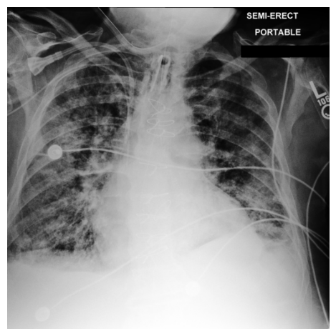
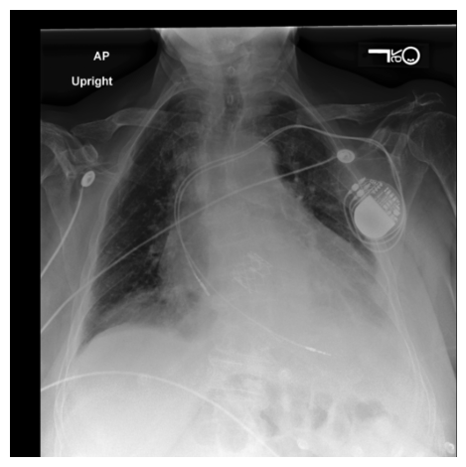
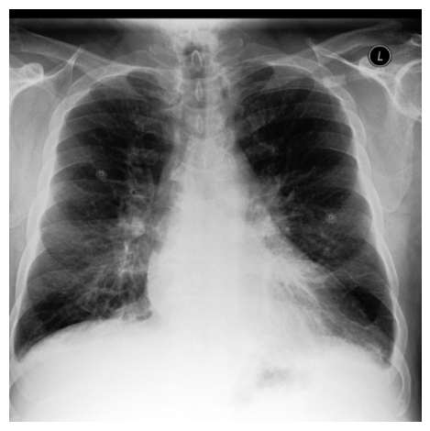
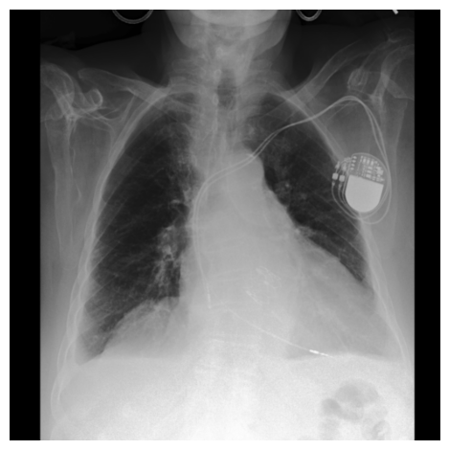
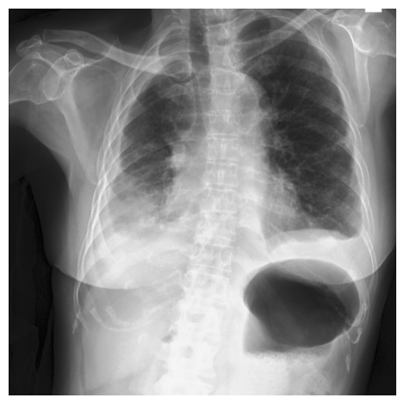
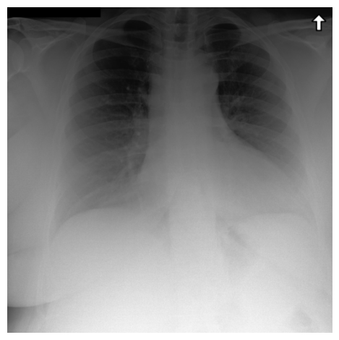
Notes:
\usepackage[dvipsnames]{xcolor}
%Expert 1
\textbf{Effusion} $\leftrightarrow$ left\_pleural $\land$ pleural\_unpec $\land$ right\_plural $\land$retrocardiac $\land$ right\_costophrenic $\land$ costophrenic\_unspec $\land$ cardiophrenic\_sulcus $\land$ wire $\land$ fluid $\land$ distention
% Expert 2
\textbf{Effusion} $\leftrightarrow$ left\_pleural $\land$ pleural\_unpec $\land$ right\_plural $\land$ costophrenic\_unspec $\land \neg$ cardiophrenic\_sulcus
% Expert 3

Slide 12
Notes:
\usepackage[dvipsnames]{xcolor}
%Expert 1
\textbf{Effusion} $\leftrightarrow$ left\_pleural $\land$ pleural\_unpec $\land$ right\_plural $\land$retrocardiac $\land$ right\_costophrenic $\land$ costophrenic\_unspec $\land$ cardiophrenic\_sulcus $\land$ wire $\land$ fluid $\land$ distention
% Expert 2
\textbf{Effusion} $\leftrightarrow$ left\_pleural $\land$ pleural\_unpec $\land$ right\_plural $\land$ costophrenic\_unspec $\land \neg$ cardiophrenic\_sulcus
% Expert 3

Slide 13
Route Interpret Repeat
Notes:
\usepackage[dvipsnames]{xcolor}
%Expert 1
\textbf{Effusion} $\leftrightarrow$ left\_pleural $\land$ pleural\_unpec $\land$ right\_plural $\land$retrocardiac $\land$ right\_costophrenic $\land$ costophrenic\_unspec $\land$ cardiophrenic\_sulcus $\land$ wire $\land$ fluid $\land$ distention
% Expert 2
\textbf{Effusion} $\leftrightarrow$ left\_pleural $\land$ pleural\_unpec $\land$ right\_plural $\land$ costophrenic\_unspec $\land \neg$ cardiophrenic\_sulcus
% Expert 3

Slide 14
Route Interpret Repeat
Expert1
Notes:
\usepackage[dvipsnames]{xcolor}
%Expert 1
\textbf{Effusion} $\leftrightarrow$ left\_pleural $\land$ pleural\_unpec $\land$ right\_plural $\land$retrocardiac $\land$ right\_costophrenic $\land$ costophrenic\_unspec $\land$ cardiophrenic\_sulcus $\land$ wire $\land$ fluid $\land$ distention
% Expert 2
\textbf{Effusion} $\leftrightarrow$ left\_pleural $\land$ pleural\_unpec $\land$ right\_plural $\land$ costophrenic\_unspec $\land \neg$ cardiophrenic\_sulcus
% Expert 3

Slide 15
Route Interpret Repeat
Expert1
Notes:
\usepackage[dvipsnames]{xcolor}
%Expert 1
\textbf{Effusion} $\leftrightarrow$ left\_pleural $\land$ pleural\_unpec $\land$ right\_plural $\land$retrocardiac $\land$ right\_costophrenic $\land$ costophrenic\_unspec $\land$ cardiophrenic\_sulcus $\land$ wire $\land$ fluid $\land$ distention
% Expert 2
\textbf{Effusion} $\leftrightarrow$ left\_pleural $\land$ pleural\_unpec $\land$ right\_plural $\land$ costophrenic\_unspec $\land \neg$ cardiophrenic\_sulcus
% Expert 3

Slide 16
Route Interpret Repeat
Expert1
Expert2
Notes:
\usepackage[dvipsnames]{xcolor}
%Expert 1
\textbf{Effusion} $\leftrightarrow$ left\_pleural $\land$ pleural\_unpec $\land$ right\_plural $\land$retrocardiac $\land$ right\_costophrenic $\land$ costophrenic\_unspec $\land$ cardiophrenic\_sulcus $\land$ wire $\land$ fluid $\land$ distention
% Expert 2
\textbf{Effusion} $\leftrightarrow$ left\_pleural $\land$ pleural\_unpec $\land$ right\_plural $\land$ costophrenic\_unspec $\land \neg$ cardiophrenic\_sulcus
% Expert 3

Slide 17
Route Interpret Repeat
Expert1
Expert2
Notes:
\usepackage[dvipsnames]{xcolor}
%Expert 1
\textbf{Effusion} $\leftrightarrow$ left\_pleural $\land$ pleural\_unpec $\land$ right\_plural $\land$retrocardiac $\land$ right\_costophrenic $\land$ costophrenic\_unspec $\land$ cardiophrenic\_sulcus $\land$ wire $\land$ fluid $\land$ distention
% Expert 2
\textbf{Effusion} $\leftrightarrow$ left\_pleural $\land$ pleural\_unpec $\land$ right\_plural $\land$ costophrenic\_unspec $\land \neg$ cardiophrenic\_sulcus
% Expert 3

Slide 18
Route Interpret Repeat
Expert1
Expert2
Notes:
\usepackage[dvipsnames]{xcolor}
%Expert 1
\textbf{Effusion} $\leftrightarrow$ left\_pleural $\land$ pleural\_unpec $\land$ right\_plural $\land$retrocardiac $\land$ right\_costophrenic $\land$ costophrenic\_unspec $\land$ cardiophrenic\_sulcus $\land$ wire $\land$ fluid $\land$ distention
% Expert 2
\textbf{Effusion} $\leftrightarrow$ left\_pleural $\land$ pleural\_unpec $\land$ right\_plural $\land$ costophrenic\_unspec $\land \neg$ cardiophrenic\_sulcus
% Expert 3

Slide 19
Route Interpret Repeat
Expert1
Expert2
Expert4
Notes:
\usepackage[dvipsnames]{xcolor}
%Expert 1
\textbf{Effusion} $\leftrightarrow$ left\_pleural $\land$ pleural\_unpec $\land$ right\_plural $\land$retrocardiac $\land$ right\_costophrenic $\land$ costophrenic\_unspec $\land$ cardiophrenic\_sulcus $\land$ wire $\land$ fluid $\land$ distention
% Expert 2
\textbf{Effusion} $\leftrightarrow$ left\_pleural $\land$ pleural\_unpec $\land$ right\_plural $\land$ costophrenic\_unspec $\land \neg$ cardiophrenic\_sulcus
% Expert 3

Slide 20
Route Interpret Repeat
Expert1
Expert2
Expert4
Final Residual (Unexplained)
Notes:
\usepackage[dvipsnames]{xcolor}
%Expert 1
\textbf{Effusion} $\leftrightarrow$ left\_pleural $\land$ pleural\_unpec $\land$ right\_plural $\land$retrocardiac $\land$ right\_costophrenic $\land$ costophrenic\_unspec $\land$ cardiophrenic\_sulcus $\land$ wire $\land$ fluid $\land$ distention
% Expert 2
\textbf{Effusion} $\leftrightarrow$ left\_pleural $\land$ pleural\_unpec $\land$ right\_plural $\land$ costophrenic\_unspec $\land \neg$ cardiophrenic\_sulcus
% Expert 3

Slide 21
Route Interpret Repeat
Expert1
Expert2
Expert4
Final Residual (Unexplained)
Notes:
\usepackage[dvipsnames]{xcolor}
%Expert 1
\textbf{Effusion} $\leftrightarrow$ left\_pleural $\land$ pleural\_unpec $\land$ right\_plural $\land$retrocardiac $\land$ right\_costophrenic $\land$ costophrenic\_unspec $\land$ cardiophrenic\_sulcus $\land$ wire $\land$ fluid $\land$ distention
% Expert 2
\textbf{Effusion} $\leftrightarrow$ left\_pleural $\land$ pleural\_unpec $\land$ right\_plural $\land$ costophrenic\_unspec $\land \neg$ cardiophrenic\_sulcus
% Expert 3

Slide 22
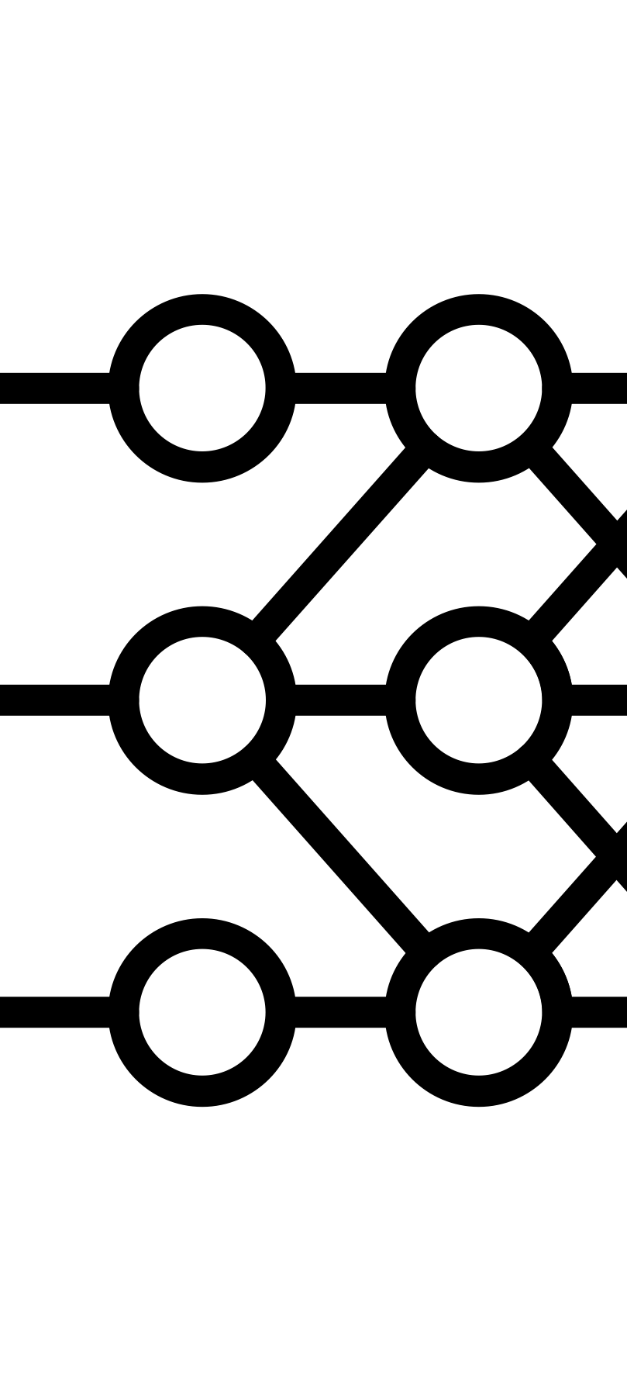




Residual ($r^{0}$)
Blackbox Model
Symbolic Model
Selector

Slide 23
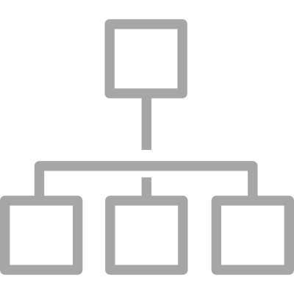
Residual ($r^{0}$)
Blackbox Model
Symbolic Model
Selector

Slide 24

Fix
Residual ($r^{0}$)
Residual ($r^{1}$)
Blackbox Model
Symbolic Model
Selector

Slide 25
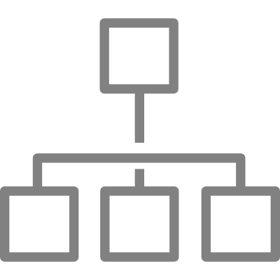
Fix
Residual ($r^{0}$)
Residual ($r^{1}$)
Blackbox Model
Symbolic Model
Selector

Slide 26

Fix
Residual ($r^{0}$)
Residual ($r^{1}$)
Residual ($r^{2}$)
Blackbox Model
Symbolic Model
Selector

Slide 27
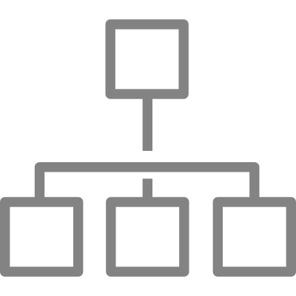
Fix
Residual ($r^{0}$)
Residual ($r^{1}$)
Residual ($r^{2}$)
Blackbox Model
Symbolic Model
Selector

Slide 28

Fix
Residual ($r^{0}$)
Residual ($r^{1}$)
Residual ($r^{2}$)
Residual ($r^{3}$)
Blackbox Model
Symbolic Model
Selector

Slide 29




Fix
Residual ($r^{0}$)
Residual ($r^{1}$)
Residual ($r^{2}$)
Residual ($r^{3}$)
Blackbox Model
Symbolic Model
Selector

