Slide 1

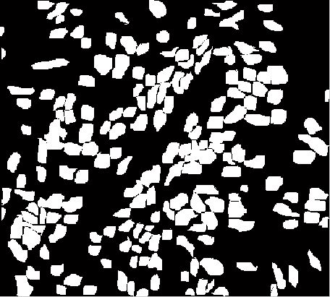
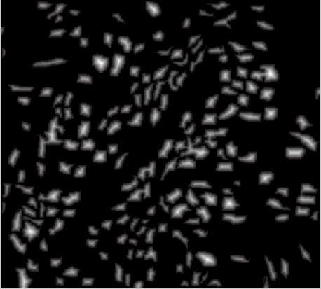

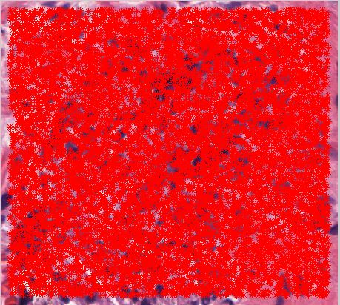
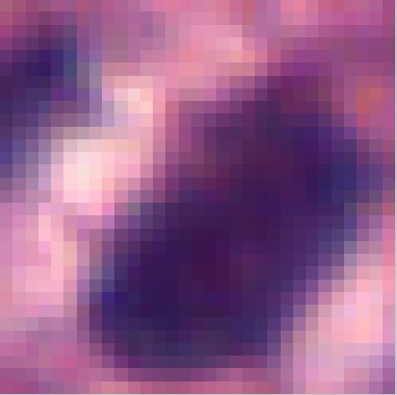

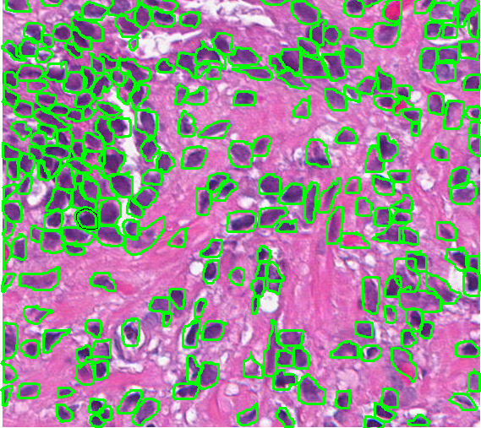
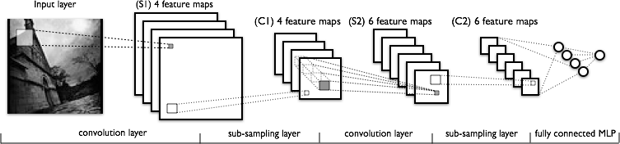
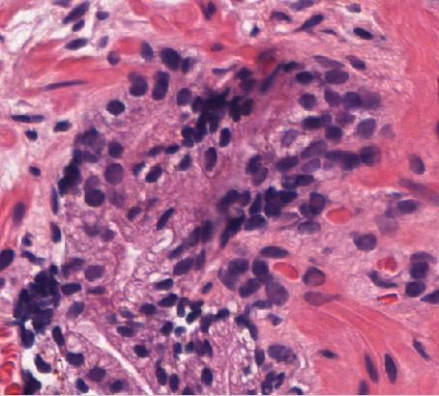
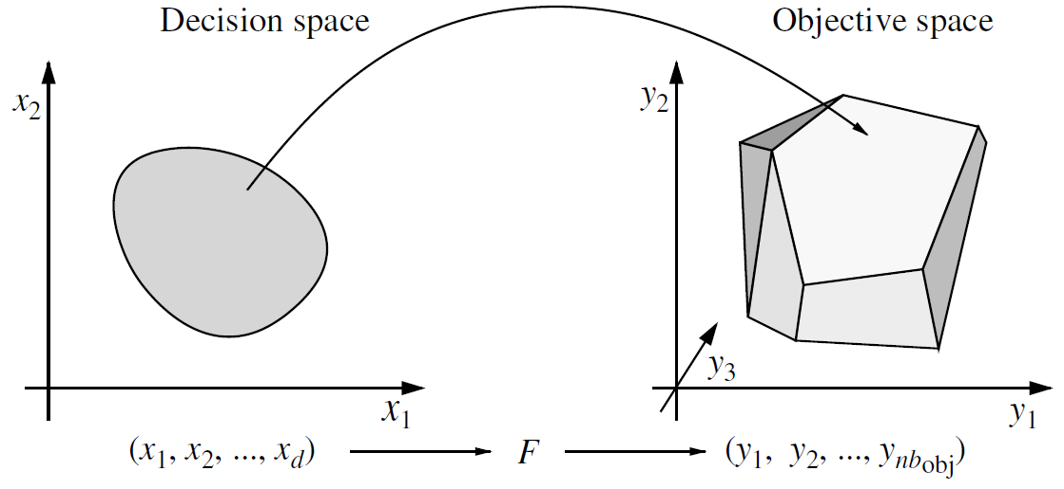
NUCLEI DETECTION & CLASSIFICATION USING CONVOLUTION NEURAL NETWORKS FOR HSI DATA
Sanchit Gupta, Abhay Kumar
, Indian Institute of Technology Guwahati, Assam, India
sanchit257@gmail.com,kabhay518@gmail.com
ABSTRACT
METHOD
RESULTS
In pathology nuclei segmentation and detection presents one of the most important problem for cancer detection. In this paper we propose a convolutional neural network based algorithm to extract deep features for solving the detection problem for cancer treatment. Our approach work on training the convolution network on annotated dataset created using tissue slides provided. Four regions of varying nuclei density are annotated and from each regions random patches of size 31x31 were selected equally for zero and non-zero values of the distance transform applied on that entire region. Each patch is bootstrapped for removing variance to rotation in the trained network. The network is trained for predicting the value of the distance transform of the center pixel for a given region input. This architecture in future scope of the project would lead to detection of the nuclei and the cancer prediction.
NUCLEI DETECTION & SEGMENTATION IN H&E STAINED IMAGES
After completion of the optimization, best validation score of 30.760000 % obtained after 100 epoch, with test performance 31.040000 %
After completion of the optimization, best validation score of 84.590000 % obtained after 100 epoch, with test performance 84.590000
Creating the dataset for training and testing the architecture by annotating the slides provided using “Image scope”.
Ended up annotating around 2000 nuclei in four regions. Created Binary Mask of the region.
Logistic Regression:
BACKGROUND
Using annotated nuclei, computed distance transform of pixels inside nuclei from their boundary. This will give a local peak at the center of an isolated nucleus. If two nuclei overlap, and the annotation identified them as separate objects, then we should get two peaks -- one each at the center of the each overlapping nucleus, because our distance transform will take object (individual nucleus) boundary into account instead of class (any nucleus) boundary.
CIFAR-10 DATASET
COST FUNCTION:
“T.mean(T.log(self.p_y_given_x)[T.arange(y.shape[0]), y])”
ERROR FUNCTION:
“T.mean(T.neq(self.y_pred, y))”
LIMITATION OF ORTHOGONAL COORDINATES
For Multi-Dimensional vision, it is not possible to have more than 3 orthogonal axes.
Challenge of high dimension in optimization (both in variable space and objective space)
NUCLEI DATASET:
Cross entropy function :
“-y*log(y_given_x)-(1-y)*log(1-y_given_x)”
Applied the dataset to the logistic regression output convolution network to train but due to very poor training performance of the architecture for our dataset we tested out network for Cifar-10 dataset which gave us satisfactory results
OBJECTIVES
CONCLUSIONS
Nuclei detection & segmentation on H&E images.
Dimensionality Reduction to make the CNN work for HSI images.
We were not able to get satisfactory result on our nuclei dataset but the code ran fine on Cifar-10 dataset.
The problem with our dataset can possibly be removed by trying out following things in our architecture: 1. Increasing the size of datasets. 2. Try adding hidden layers in the architecture. 3. The problem may also lie in the hypothesis function that we are using in the logistic regression section. 4. We also need to work on trying different cost functions in our architecture which can be more compatible with our dataset.
To conclude, we can clearly say that through this project we have been able to develop a great understanding in the field of bio-medical image processing and convolutional neural networks working and developed understanding that will help us to get an optimum and desirable output in future.

