Slide 1
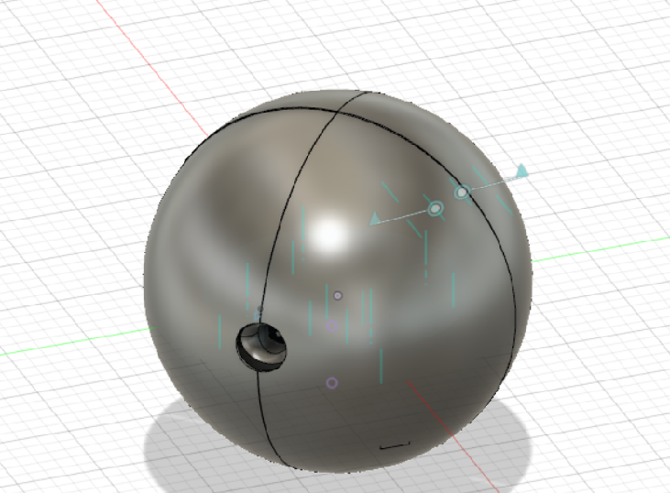
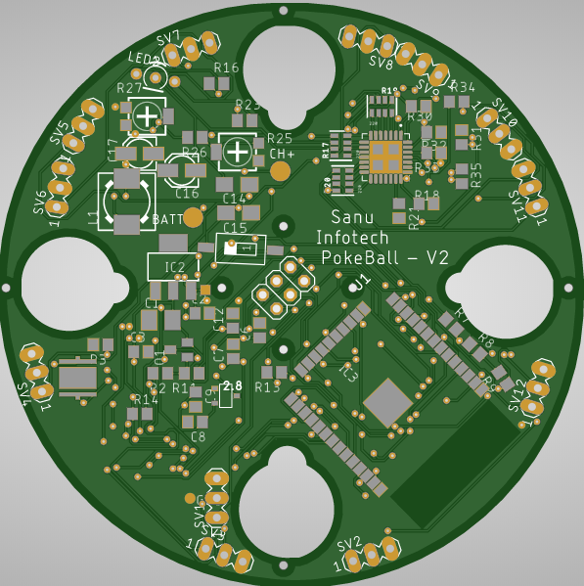
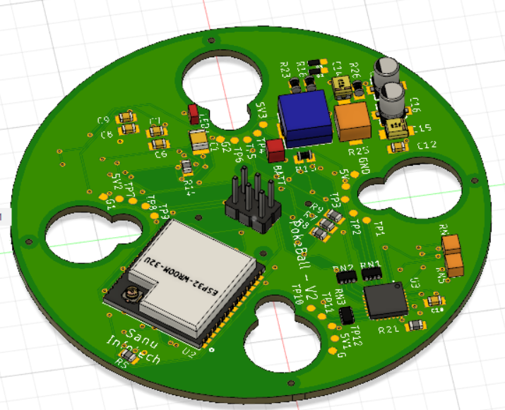
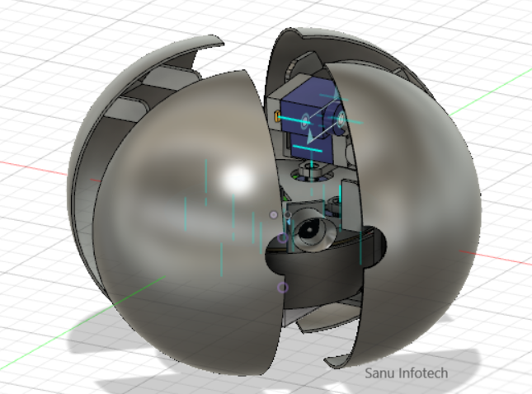
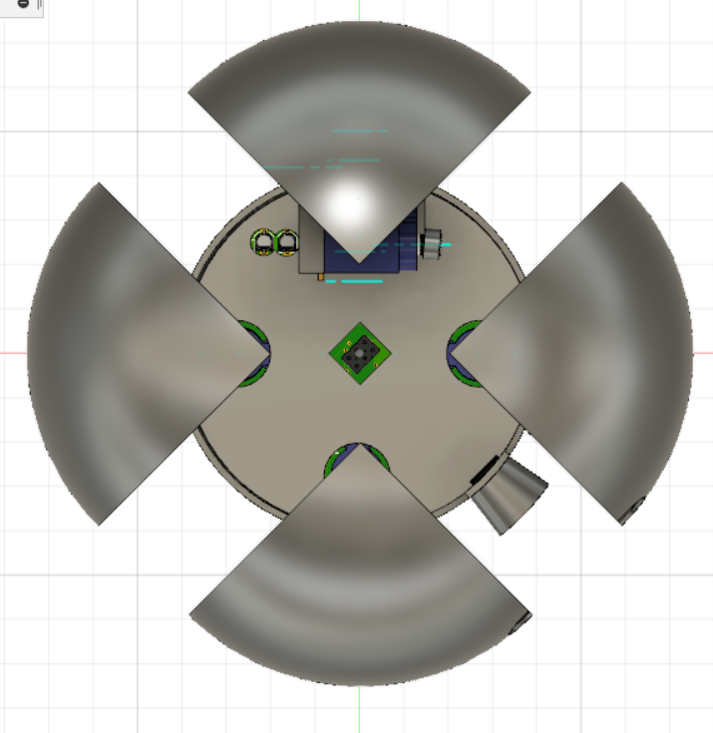
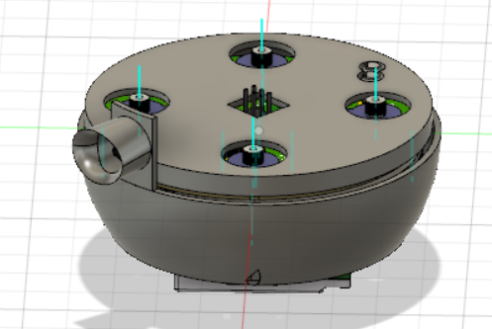
1.1
Some Images of PokeBall :
PCB 2D & 3D
While close
While open
Top View (open)
The Core

Slide 2
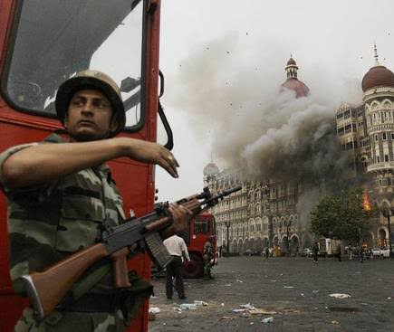
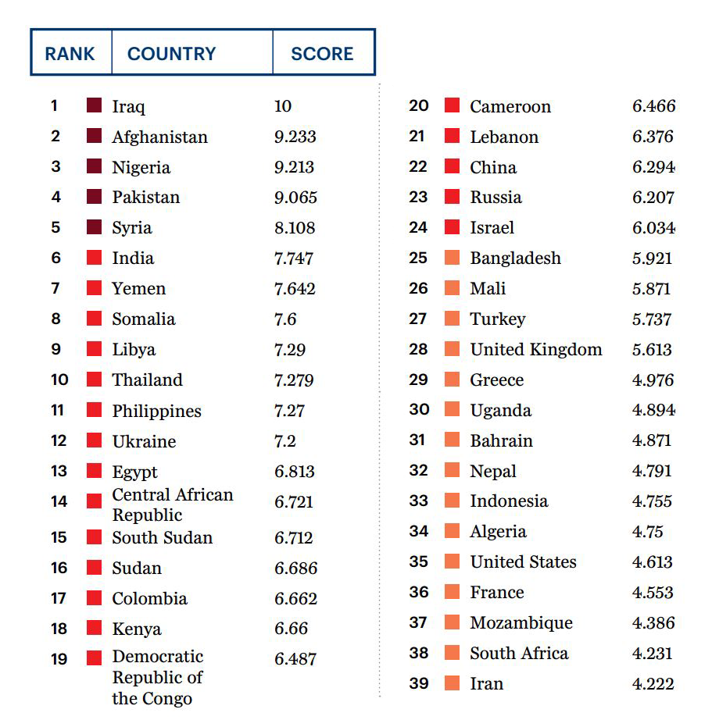

1.2
Purpose of this project :
According to world economic forum , India Rank 6th in The Global Terror Attack Index. Now thinking about a situation where Some terrorists hijack people's with unknown number of weapons , In this critical situation we need to take decision very carefully .
Fusce posuere, magna sed pulvinar ultricies, purus lectus malesuada libero, sit amet commodo magna eros quis urna.
By sending this kind of robots to examine situation is the best way to get information .
Mainly it used for surveillance and spying purpose.

Slide 3
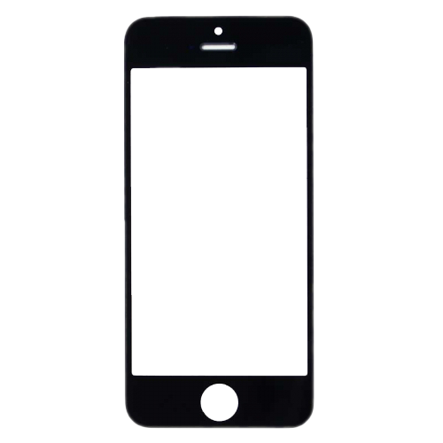
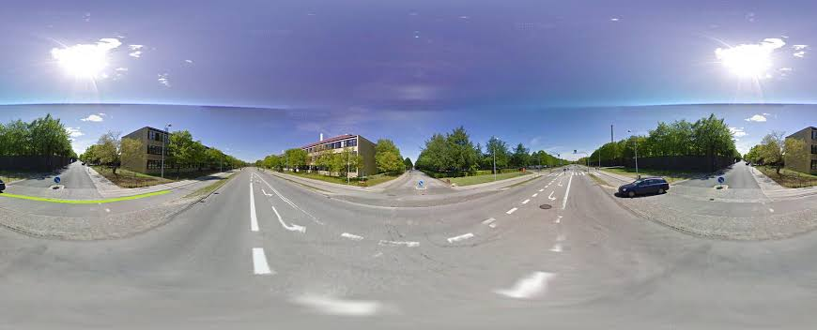
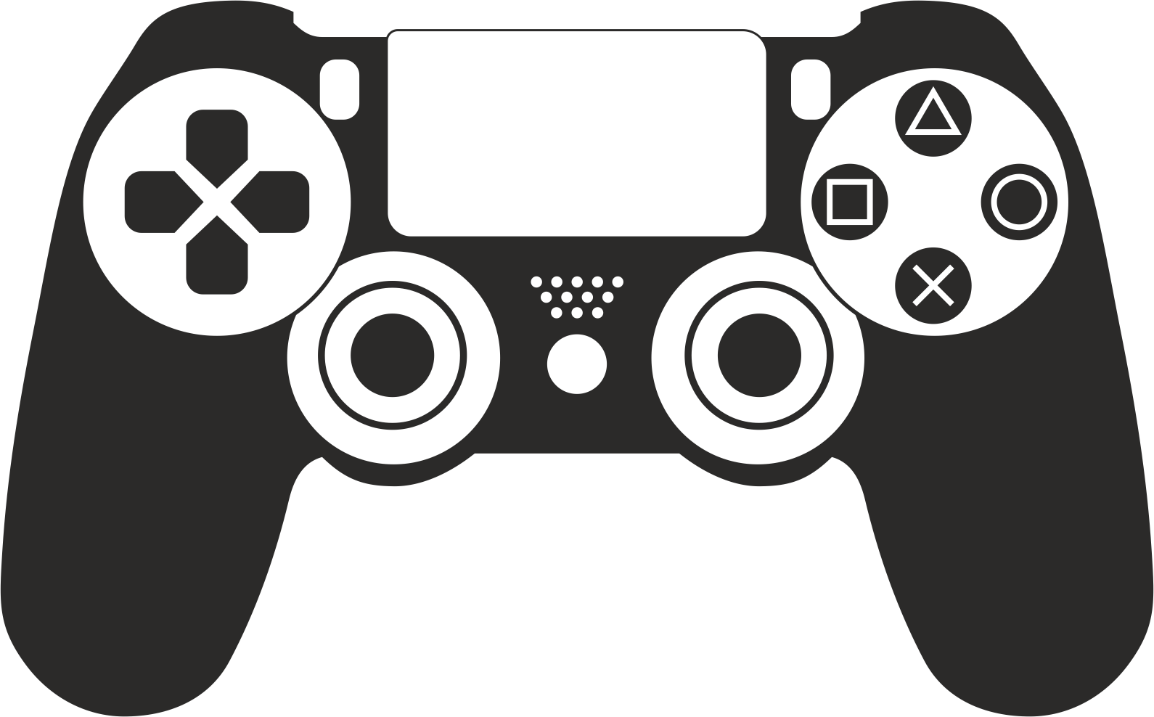
1.2
How To use :
Turning On the device and controller will automatically connect together . Throwing or rolling the ball towards target area , Now we can controlled it by mobile or custom controller and view what front of it .
Mobile Controller Application
Custom Controller

Slide 4




2.1
Cost Of The Robot
A
Assembeled PCB
800/Robot
Just 4000/-
For 1 Robot
B
3dPrinting
1000/Robot
C
Power , Programmer
&Others
2200/Robot

Slide 5

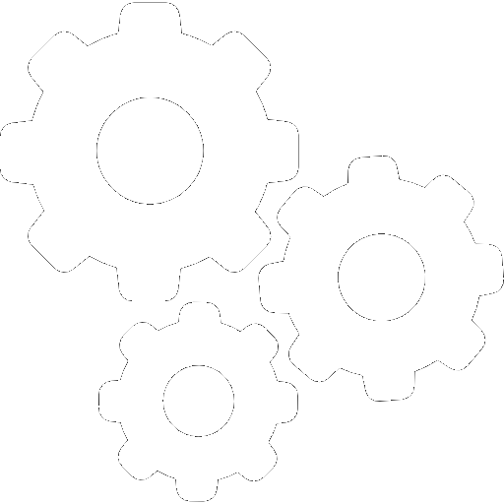
2.2
Our progress
Design PCB and 3D case
Algorithm & Code
Upload
Designing of protype
Assembling Parts
Testing prototype

Slide 6
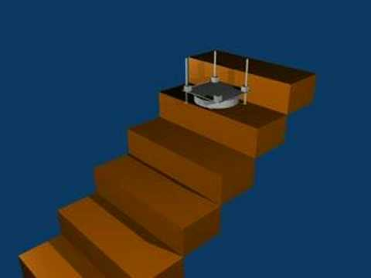
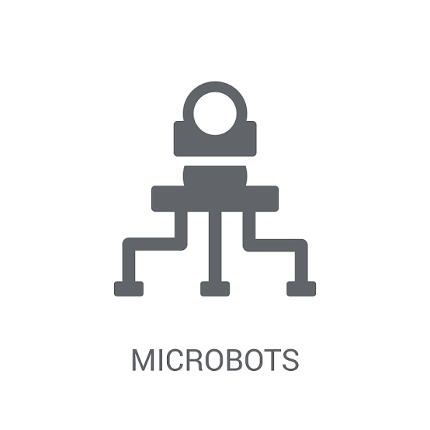
3.1
Some Small Problems That can be solved by testing prototype :
Can't climb stairs above 4 inch height
Need Prototype testing to improve
We Can make more compact design but it will increase the cost

Slide 7

3.2
Supporters For This Project :
NXP Semiconductors is supporting us by giving free semiconductor devices for this project

Slide 8
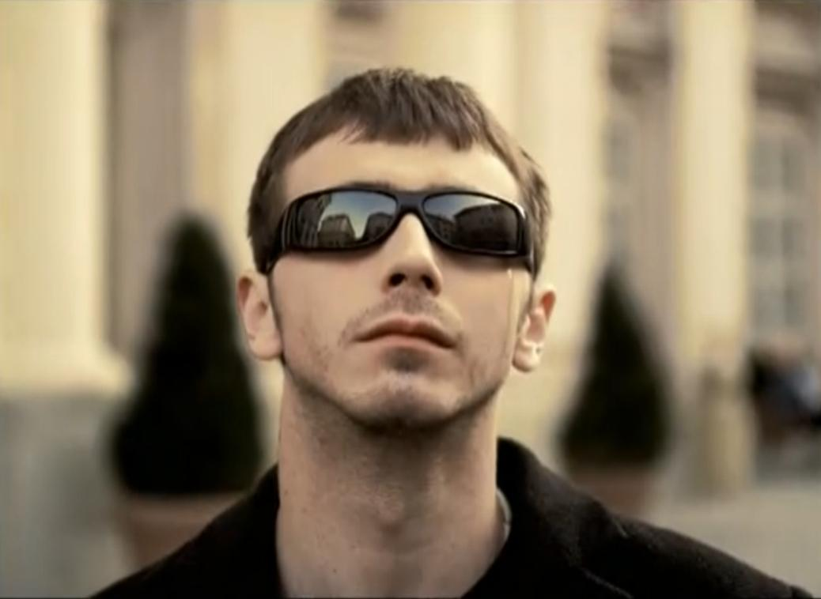
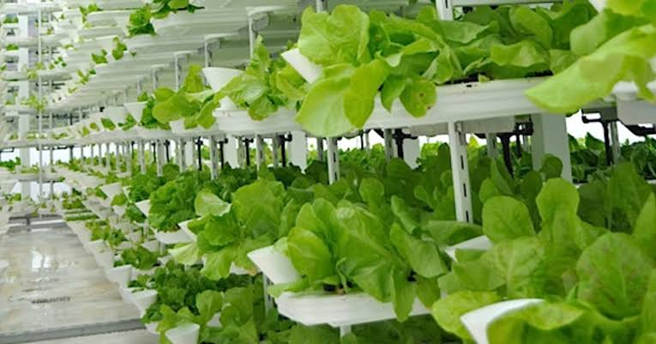
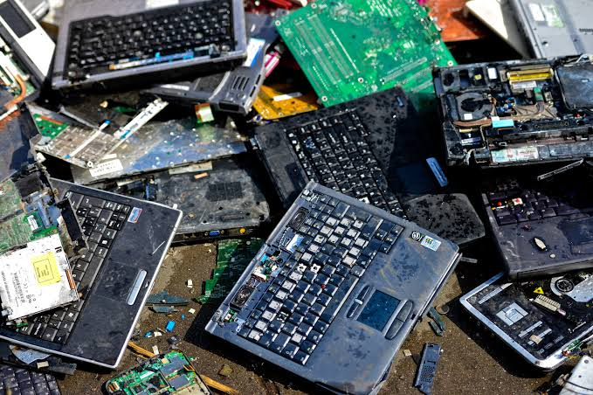
3.2
Some Other Projects Idea's By Our Team :
Ultra Vision : Low cost Smart glacess for blind people (2018)
TazaKhow : Healthy & Hygenic food for every one (2019)
E-Upgrade : E-wast managment & upgrade service (2019)
PokeBall V2 : Transformabel & Flyable Robot (2020)

Slide 9

Thank You
For Giving us this opportunity
We will be glad to help you

