Slide 1
Welcome
to my presentation
Introduce about myself

Slide 2
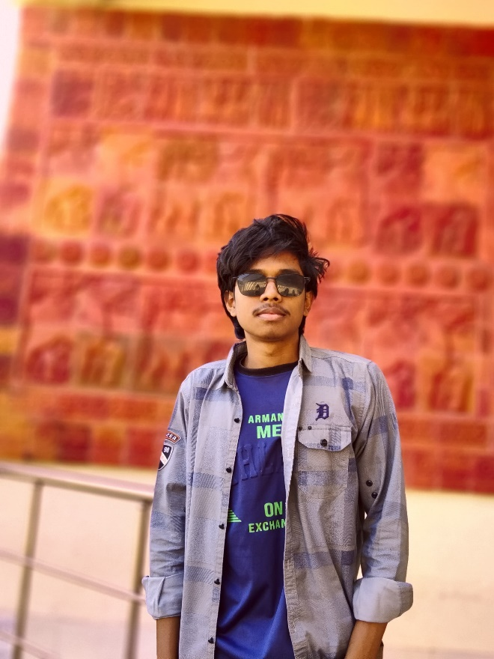
About me
My name is Shantanu Deb sharma. I live in Dinajpur, Bangladesh. I have done my graduation with BA honors in Bangla from Begum Rokeya University, Rangpur in 2025.

Slide 3
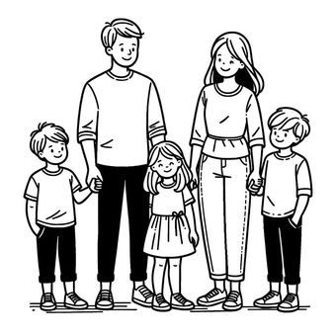
About my family
My father name is karun Chandro Deb Sharma and my mother name is Kamini Rani Deb sharma. I have one brother and one sister. I am the youngest child of my parents.

Slide 4

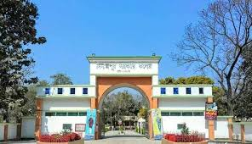
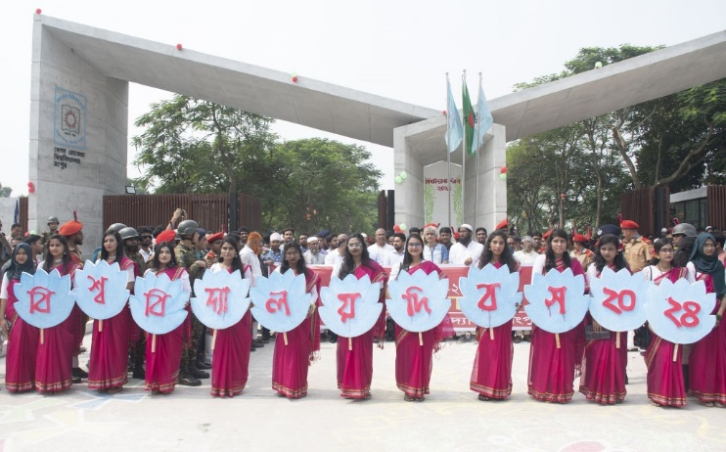
My Educational Qualification
Mohona Mangalpur High Sechool
Birol, Dinajpur
Since 2015-2018
Dinajpur government college
Dinajpur
Since 2019-2020
Begum Rokeya University,Rangpur
Since -2021-2025

Slide 5
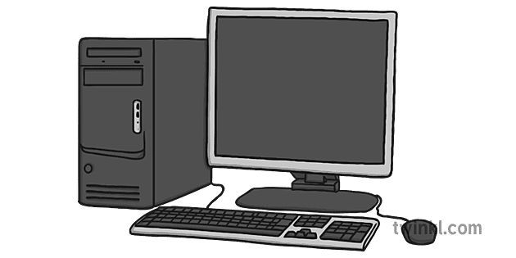
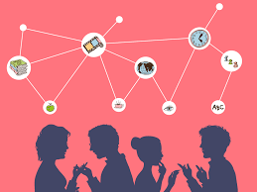
My skills
1. MS word
2. MS excel
3. Power Point
4. Graphic Design
English
Bangla

Slide 6
Thank you

