Slide 1
2
5
1
3
6
4
8
13
7
9
11
12
14
16
10
15
19
18
20
17
21
22
24
27
31
25
28
32
23
36
25
29
33
26
34
30

Slide 3
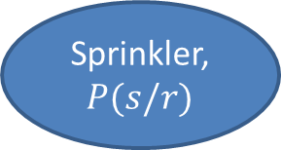
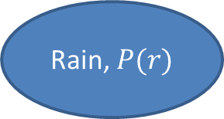


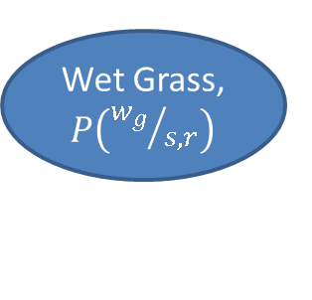
Rain, $P(r)$
Sprinkler, $P(s/r)$
Wet Grass, $P\left({w_{g}}/{s,r}\right)$
$$P(r)$$
$$P(s/r)$$
T
F
T
0.4
T
0.99
0.01
F
0.6
F
0.54
0.46

Slide 4
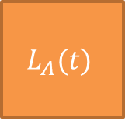
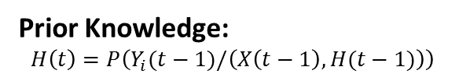
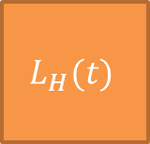
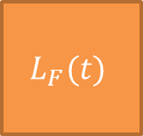
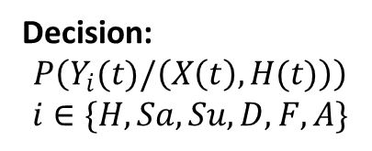
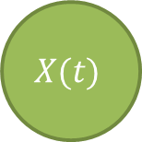
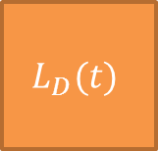
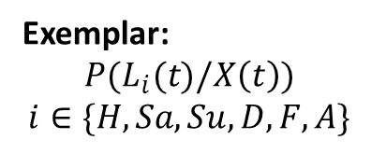


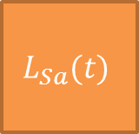
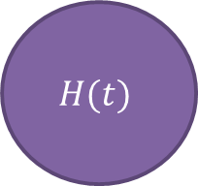
$$H(t)$$
Prior Knowledge:
$$H\left(t\right)=P\left(Y_{i}(t−1)/\left(X\left(t−1\right), H(t−1)\right)\right)$$
Decision:
$$P\left(Y_{i}(t)/\left(X\left(t\right),H(t)\right)\right)$$
$$i∈\{H,Sa, Su, D, F,A\}$$
Happy
Sad
Surprise
Disgust
Fear
Anger
$$L_{H}(t)$$
$$L_{Sa}(t)$$
$$L_{Su}(t)$$
$$L_{D}(t)$$
$$L_{F}(t)$$
$$L_{A}(t)$$
Exemplar:
$$P(L_{i}(t)/X\left(t\right))$$
$$i∈\{H,Sa, Su, D, F,A\}$$
$$X(t)$$
Observation: $P(X\left(t\right))$

Slide 5
























Total Training Space $E(t)$
Distance Ordering
$$Y_{1}$$
$$Y_{2}$$
$$Y_{3}$$
1
k
1
k
1
k
$$Y_{1}$$
$$Y_{2}$$
$$Y_{3}$$
$$Y_{6}$$
$$Y_{4}$$
$$Y_{5}$$
1
k
1
k
1
k
$$Y_{4}$$
$$Y_{5}$$
$$Y_{6}$$
Expression Label $Y_{i}$
$$X_{t}(t)$$
$$w_{ij}$$
1
k
$$L_{Y_{1}}$$
$$L_{Y_{2}}$$
$$L_{Y_{3}}$$
$$L_{Y_{4}}$$
$$L_{Y_{5}}$$
$$L_{Y_{6}}$$
$$X_{t}\left(t\right)= \sum_{i=1}^{6}{\sum_{j=1}^{K}{{w_{ij}L}_{ij}}}$$
Exemplar Layer
Node Selection
Goal: Find $w_{ij}$ such that

Slide 6
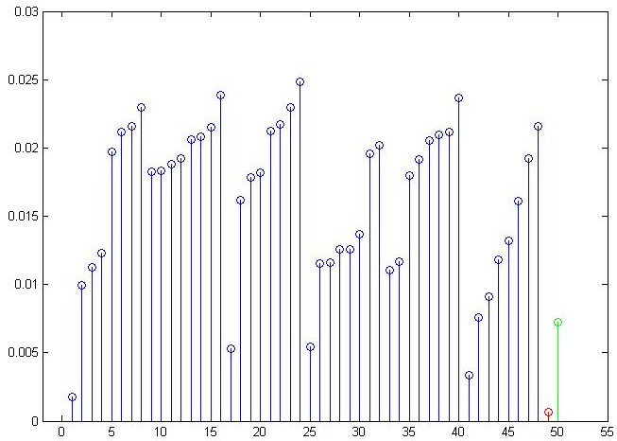
Angry
Surprise
Disgust
Happy
Sad
Fear
Disciplined Convex Optimization
Newton Method

Slide 7
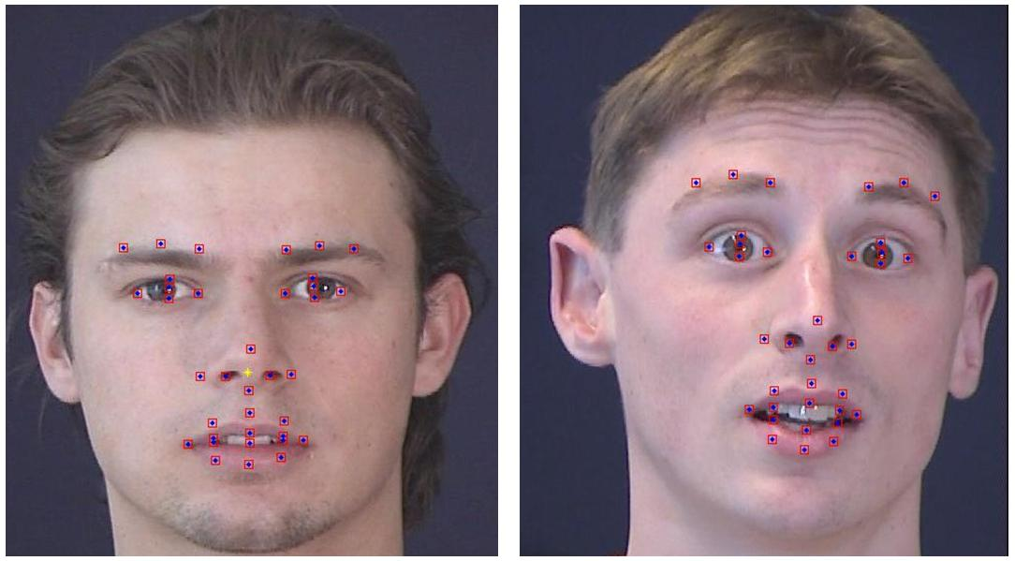

Slide 8
Visual
Audio
Motion
Social Interaction Assistant
Actuator Suite
Sensor Suite
User Input
Haptic
Audio

Slide 9
Insecure
Secure / Erasable
Machine Learning towards Identification/ Verification
Biometric Data
Proprietary Transformation
Transformed Biometric Data
User Specific Key
Encoder
Transformation Parameters

Slide 10
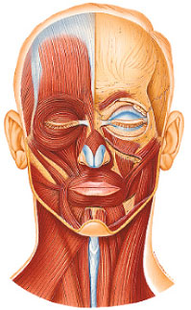
Frontalis
Levator Palpebrae Superioris
Orbicularis Oculi
Zygomaticus Minor
Zygomaticus Major
Orbicularis Oris
Depressor Labii Inferioris
Mentalis

