Slide 1
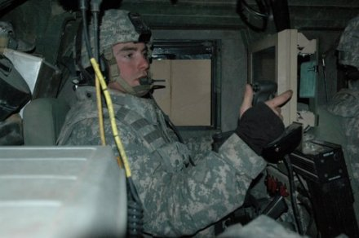
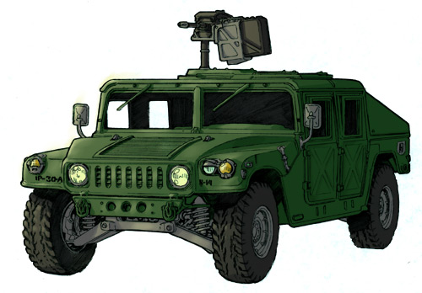
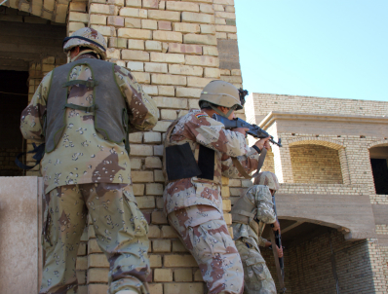

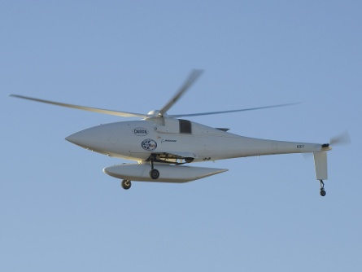
Remotely-located Support Troop
Tactical
Information
Tactical Small Unit Operations
Close Proximity Armored Vehicle Situational Awareness Support
C4ISR
Unmanned Air Vehicle
– Eye in the sky
C4ISR
Strategic Planning Center
Easy Learn
Interaction
Partner
Number
Easy Recall
Haptic
Annunciator
System
Distance
Somatosensory Encoding
Intuitive
Direction
Hard to Overlook

Slide 2
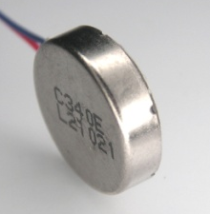
HAS
Threat
Assessment
Direction
Signal
Interpretation and Somatosensory Mapping
Size
Haptic Encodings
Velocity
Device
(a)
(b)
Tactile Patterns for size, distance and velocity
Somatosensory Encoding
Form Factor
Feasibility
Research
Design
& Development
Realization of cues in the device
Material
Parts
Location
Somatosensory Encoding
To Vibration Pattern Mapping
Magnitude
Ease of use
Durability
Integration into BDU
Intuitiveness
Recall rate
Ease of Learning
Evaluation
Rhythm
(c)

Slide 3
Instructional Video
Instructor Demonstration
Practice Assessment
Experiments

Slide 4

Easy Learn
Threat
Assessment
Direction
Easy Recall
Haptic
Annunciator
System
Size
Somatosensory Encoding
Intuitive
Velocity
Hard to Overlook
Warfighter

