Slide 1
2
5
1
3
6
4
8
13
7
9
11
12
14
16
10
15
19
18
20
17
21
22
24
27
31
25
28
32
23
36
25
29
33
26
34
30

Slide 3
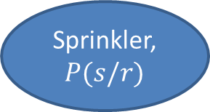
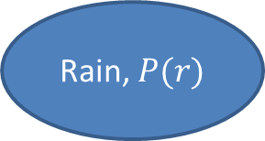


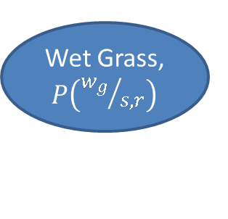
Rain, $P(r)$
Sprinkler, $P(s/r)$
Wet Grass, $P\left({w_{g}}/{s,r}\right)$
$$P(r)$$
$$P(s/r)$$
T
F
T
0.4
T
0.99
0.01
F
0.6
F
0.54
0.46

Slide 4
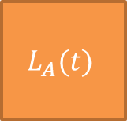
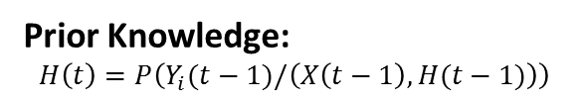
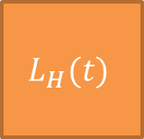
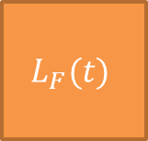
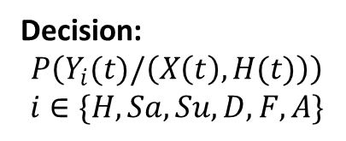
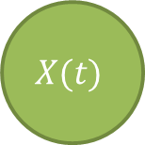
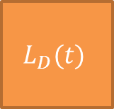
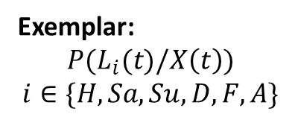


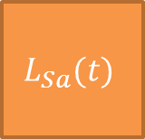
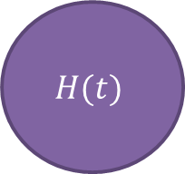
$$H(t)$$
Prior Knowledge:
$$H\left(t\right)=P\left(Y_{i}(t−1)/\left(X\left(t−1\right), H(t−1)\right)\right)$$
Decision:
$$P\left(Y_{i}(t)/\left(X\left(t\right),H(t)\right)\right)$$
$$i∈\{H,Sa, Su, D, F,A\}$$
Happy
Sad
Surprise
Disgust
Fear
Anger
$$L_{H}(t)$$
$$L_{Sa}(t)$$
$$L_{Su}(t)$$
$$L_{D}(t)$$
$$L_{F}(t)$$
$$L_{A}(t)$$
Exemplar:
$$P(L_{i}(t)/X\left(t\right))$$
$$i∈\{H,Sa, Su, D, F,A\}$$
$$X(t)$$
Observation: $P(X\left(t\right))$

Slide 5
























Total Training Space $E(t)$
Distance Ordering
$$Y_{1}$$
$$Y_{2}$$
$$Y_{3}$$
1
k
1
k
1
k
$$Y_{1}$$
$$Y_{2}$$
$$Y_{3}$$
$$Y_{6}$$
$$Y_{4}$$
$$Y_{5}$$
1
k
1
k
1
k
$$Y_{4}$$
$$Y_{5}$$
$$Y_{6}$$
Expression Label $Y_{i}$
$$X_{t}(t)$$
$$w_{ij}$$
1
k
$$L_{Y_{1}}$$
$$L_{Y_{2}}$$
$$L_{Y_{3}}$$
$$L_{Y_{4}}$$
$$L_{Y_{5}}$$
$$L_{Y_{6}}$$
$$X_{t}\left(t\right)= \sum_{i=1}^{6}{\sum_{j=1}^{K}{{w_{ij}L}_{ij}}}$$
Exemplar Layer
Node Selection
Goal: Find $w_{ij}$ such that

Slide 6
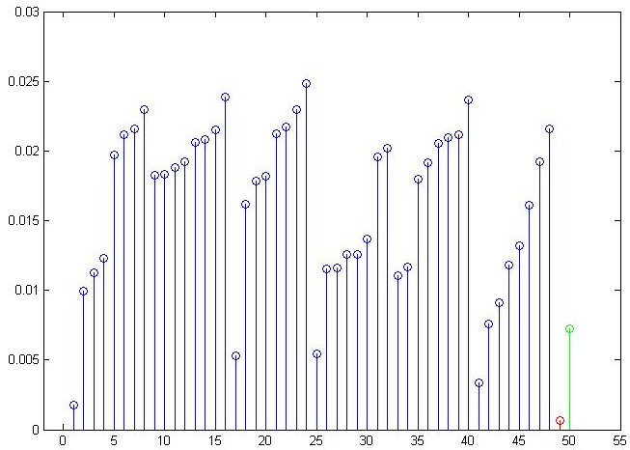
Angry
Surprise
Disgust
Happy
Sad
Fear
Disciplined Convex Optimization
Newton Method

Slide 7
Visual
Audio
Motion
Social Interaction Assistant
Actuator Suite
Sensor Suite
User Input
Haptic
Audio

Slide 8
Insecure
Secure / Erasable
Machine Learning towards Identification/ Verification
Biometric Data
Proprietary Transformation
Transformed Biometric Data
User Specific Key
Encoder
Transformation Parameters

Slide 9
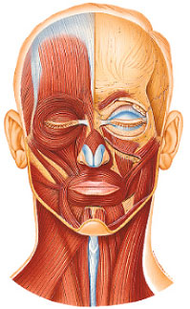
Frontalis
Levator Palpebrae Superioris
Orbicularis Oculi
Zygomaticus Minor
Zygomaticus Major
Orbicularis Oris
Depressor Labii Inferioris
Mentalis

