Slide 1
2
5
1
3
6
4
8
13
7
9
11
12
14
16
10
15
19
18
20
17
21
22
24
27
31
25
28
32
23
36
25
29
33
26
34
30

Slide 2
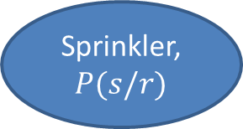
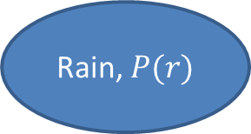


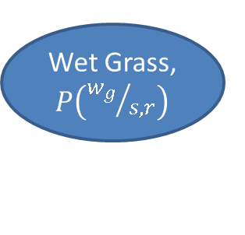
Rain, $P(r)$
Sprinkler, $P(s/r)$
Wet Grass, $P\left({w_{g}}/{s,r}\right)$
$$P(r)$$
$$P(s/r)$$
T
F
T
0.4
T
0.99
0.01
F
0.6
F
0.54
0.46

