Slide 1
I²C (Inter-integrated Circuits)
Haptic Belt team
Informational Presentation

Slide 2
Introduction to I²C (I-squared-C)
I²C is a form of control bus (multi-master) which allows communication between multiple integrated circuits in a system
I²C was developed by Philips in the early 1980s
I²C is extremely commonly used in embedded systems to provide for transfer of information between componenets

Slide 3
Why use I²C?
The bus, although being invented in the early 80s, has kept pace with data transfer speeds, offering three speeds of transfer
100 kbps in standard mode
400 kbps in fast mode
3.4 Mbps in high-speed mode
I²C offers reliable performance, using software-controlled collision detection and arbitration
Extremely easy to implement – 2 wires to control all the ICs in a system
ICs can be addressed by hardware or by software, depending on convenience

Slide 4
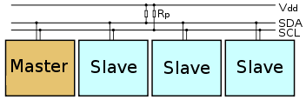
How is I²C set up physically?
I²C is set up by connecting a master (can be more than one) and some number of slaves to two lines
SDA = Serial Data Line, used to send data
SCL = Serial Clock Line, used by master to clock all slaves
The master initiates transmissions, sending information to control slaves (to initiate both sending to and receiving from slaves)

Slide 5
Types of I²C configurations
4 modes of operation
Master transmit— master node is sending data to a slave
Master receive — master node is receiving data from a slave
Slave transmit — slave node is sending data to a master
Slave receive — slave node is receiving data from the master

Slide 6
Addressing Slaves
Each slave on the I²C is set up to have seven addressing bits
Upper four addressing bits are already set according to function of the I²C bus (1010 for serial EEPROM for example)
Lower three addressing bits can be set (programmatically or hardwired) to address slaves, allowing for 8 slaves at each upper address
More than 8 slaves requires multiple types of I²C such that the upper addressing bits are different

Slide 7
Transferring Data on I²C
Data is transferred in sequences of 8 bits over the SDA line (MSB first) by clocking through the SCL line
Extra bits are required for setup/acknowledge
The master initiates the transfers by sending start bit (or restart to continue a transfer)
The receiving device sends acknowledgement bit after every sequence to confirm data has been received
The master ends the transfer via stop bit

Slide 8
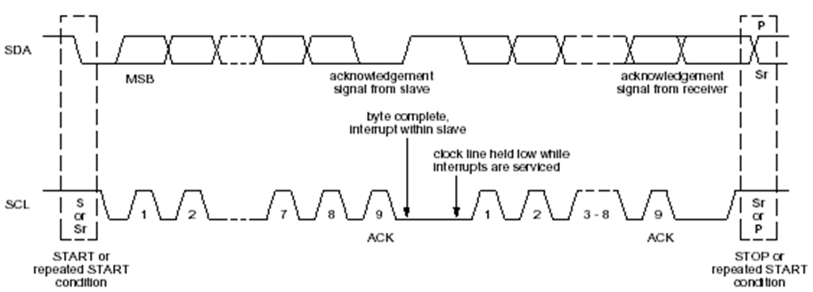
Transferring Data on I²C
We send 8 bits for addressing in the initial transfer. 7 bits to address the slave and the 8th bit to tell the slave if we are sending to or receiving from it. 1 for read, 0 for write.

Slide 9
Method of Transfer on I²C
The master sends the first sequence (start sequence), waking up all slaves so that they listen to the bus
The master sends out the addressing sequence – this tells the slaves which one of them is being addressed along with the bit to tell them whether they are sending or receiving
The master sends all data sequences to the slave, waiting for the acknowledge bit. All slaves receive this transfer but only the one which has been addressed pays any attention
The master then sends the stop bit to end the transfer

Slide 10
I²C in our Project
Reasons for choosing I²C
Simple two-line bus implementation
On our belt, we need a wiring system which provides as much flexibility as possible – fewer wires means more flexibility
Scalability
Our belt size can easily be increased to hold as many slaves as we require, all that is necessary is additional slave addresses – no software changes
Why it is interesting in terms of our project
I²C is primarily used for close range transfer of data, we are moving into untested territory by using I²C over the longer distances present on our belt

Slide 11
References
http://www.coe.uncc.edu/~jmconrad/ECGR6185-2005-01/notes/
http://en.wikipedia.org/wiki/I%C2%B2C
http://www.8051projects.net/i2c-twi-tutorial/i2c-data-transfer.png

