Slide 1
Wireless Haptic Belt
Preliminary Prototype Testing
& Project Status
Kris Blair
Nathan Edwards
Jonathan Lindsay
Daniel Moberly
Jacob Rosenthal
CUbiC Advisors: Sreekar Krishna and Troy McDaniel

Slide 2
Outline
Prototype Testing Results
Current Status of Project
Tasks Remaining to Finish Product

Slide 3
Testing Objectives
To observe behavior of vibrator circuit design
  Individual component behavior
  Integrated system behavior
Validate the design

Slide 4
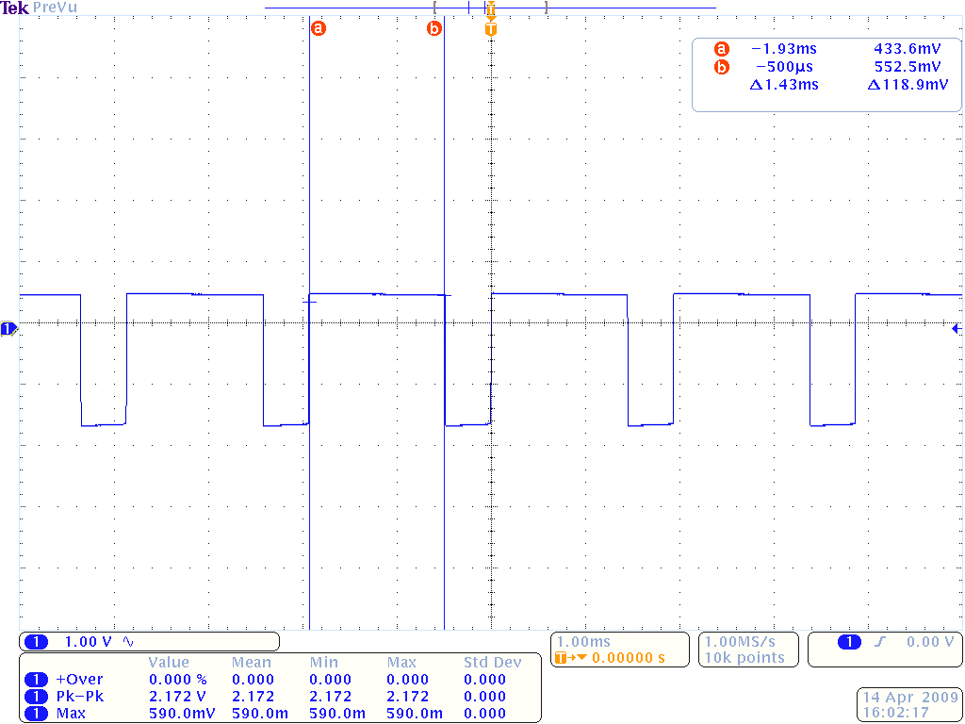
ATtiny48 Pulse Width Modulation
1.43ms pulse width, 2ms period, 2.172V peak

Slide 5
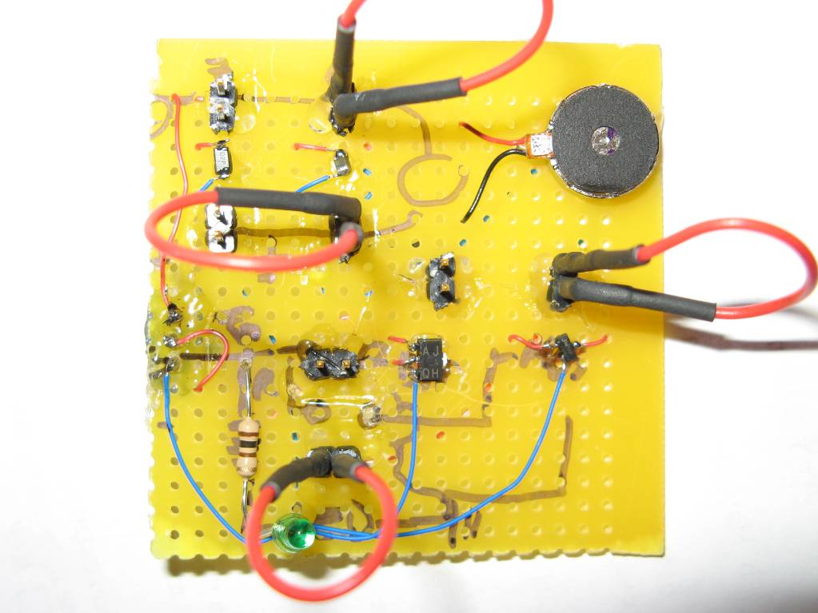
Test Platform
Vibrator – 56.4mH, 75mA, 29.8 Ohm
Diode – 1N4001…………Capacitor – 10μF
MOSFET –80ns Max Propagation Delay (Low to High)

Slide 6
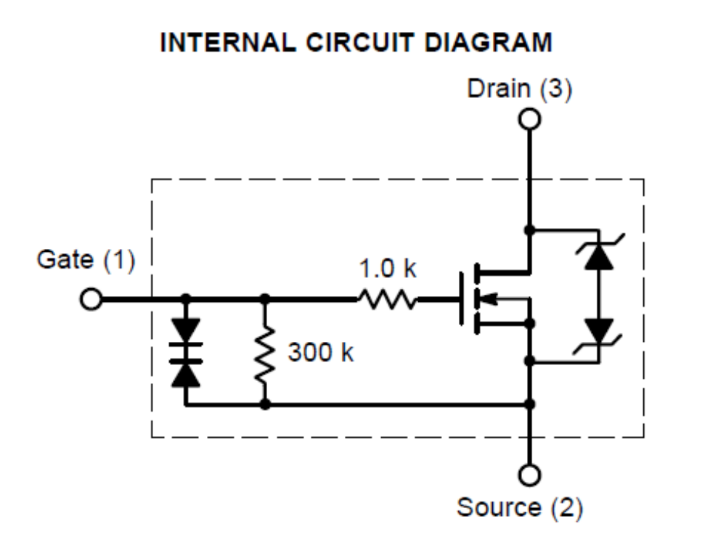
Test Platform - MOSFET
ON Semiconductor NUD3105 Inductive Load Driver
IC protection built in - Clamping Diodes & Resistors
0.5 A Drain Current - continuous, 8.0 V Clamp

Slide 7
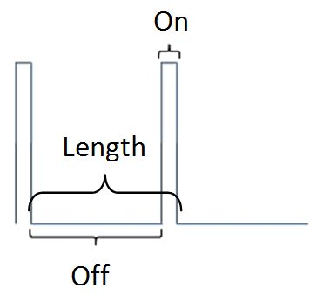
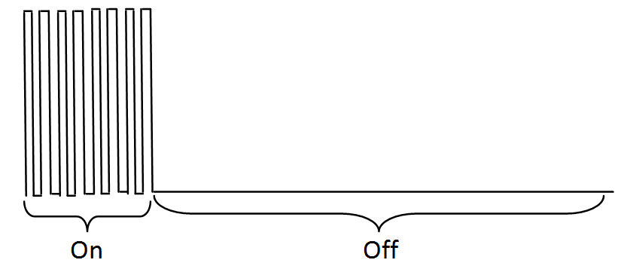
Stimulus Signal
3.0V motor Vcc
2.172V Gate Voltage (to match ATtiny output)
High-Z load Waveform Generator
25kHz Square-Wave, 50% Duty, +1.086V offset
  20μs pulse = 1% magnitude for 2ms Rhythm cycle

Slide 8
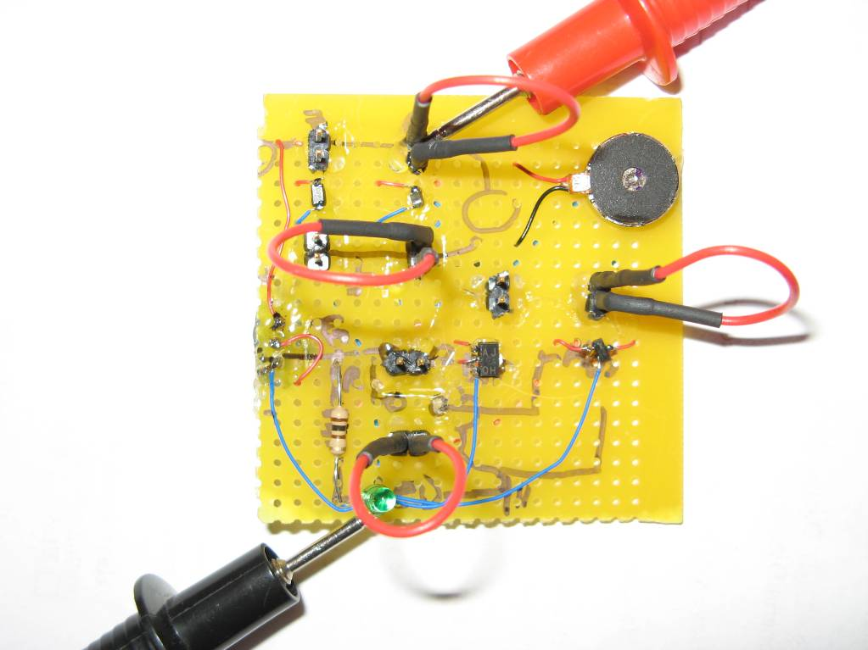
Vibrator Motor Signal
Measured from Vcc to GND

Slide 9
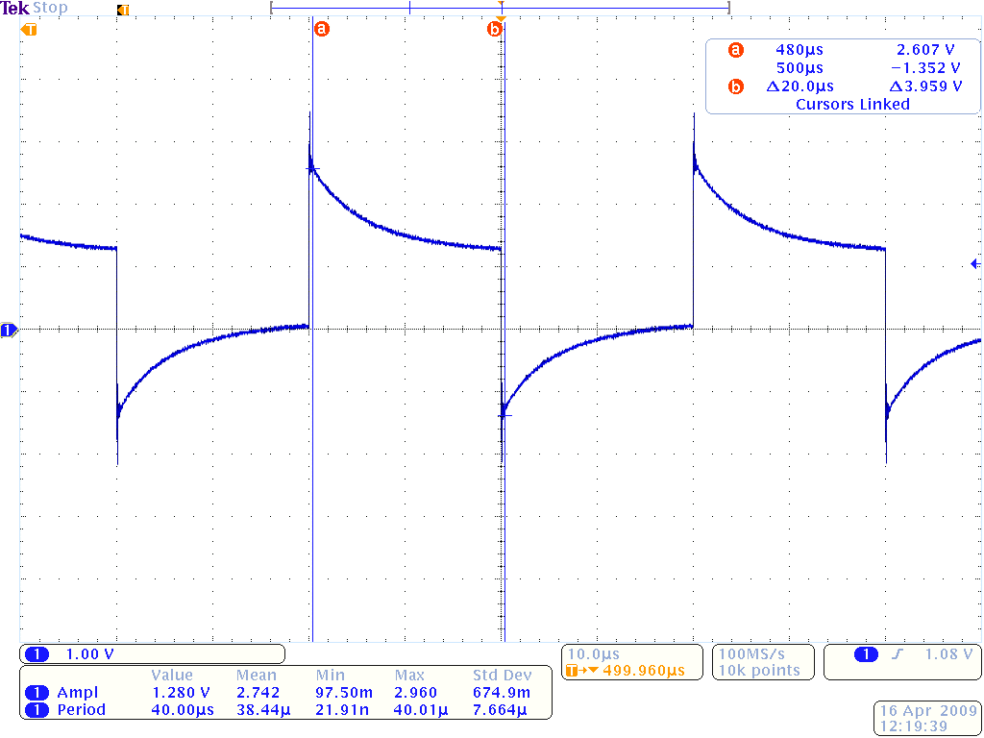
Vibrator Motor Signal
Δ1.730V Voltage fluctuation from motor start
Δ1.352V Back EMF from motor off.

Slide 10
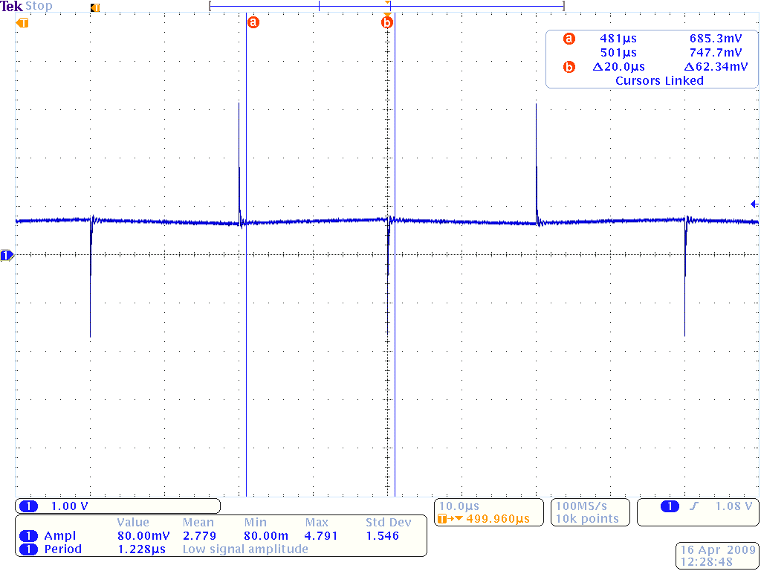
Vibrator Motor Signal - Capacitor
10μF capacitor reduces fluctuation to Δ62.34mV p-p

Slide 11
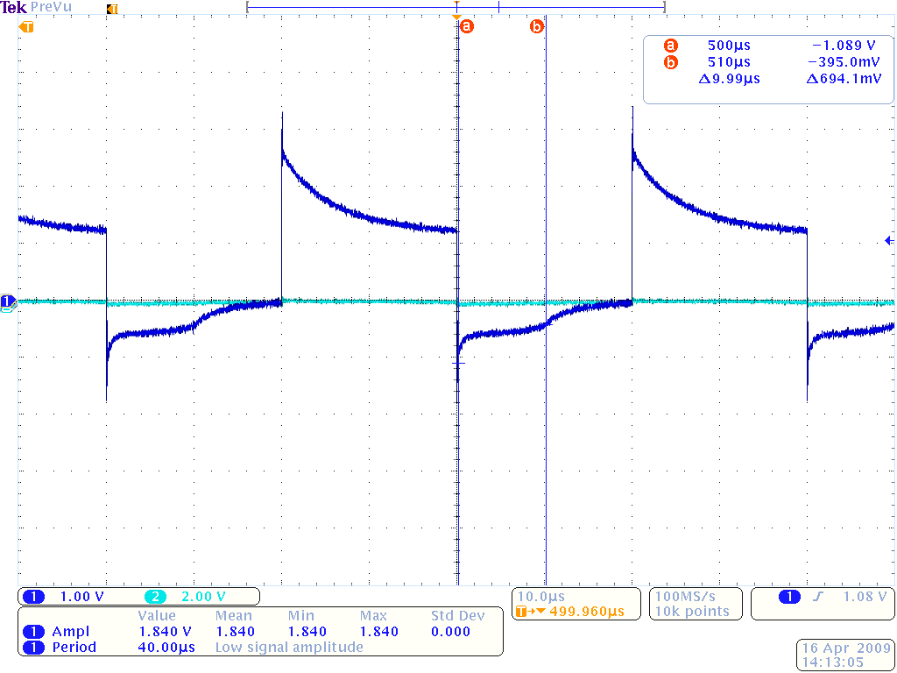
Vibrator Motor Signal - Diode
1N4001 Diode across motor terminals
Reduces Back EMF by 0.263V during motor off.

Slide 12
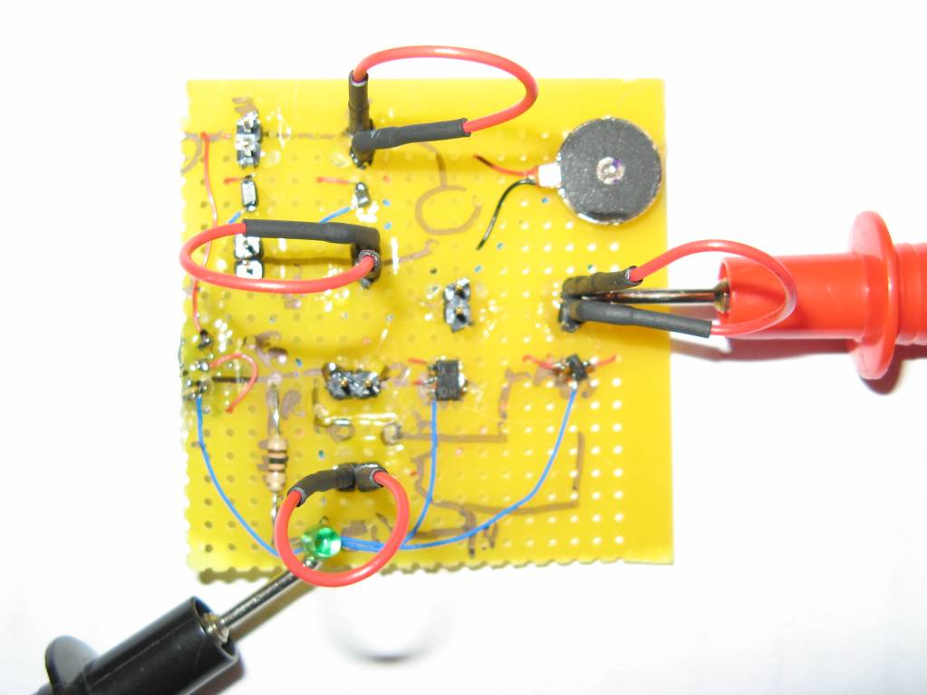
MOSFET Switching Signal
Measured from Drain to Source

Slide 13
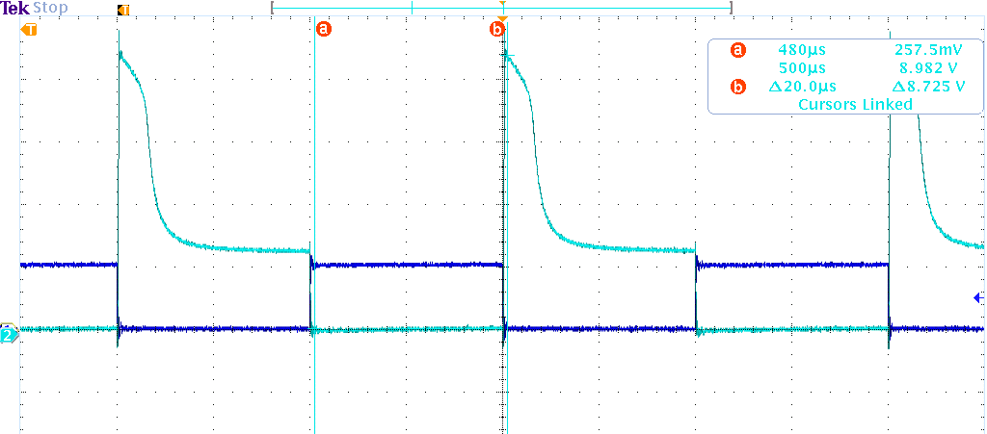
MOSFET Switching Signal
8.982V peak from Back EMF during motor off

Slide 14
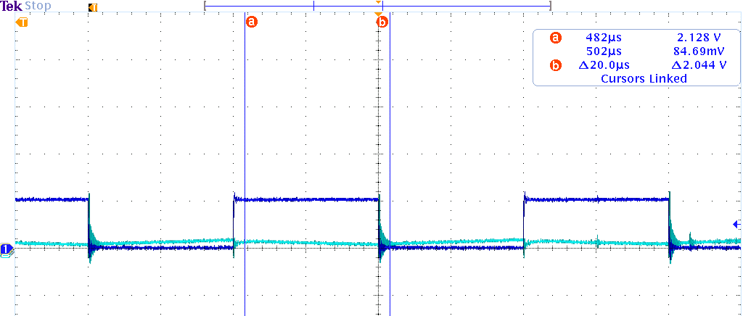
MOSFET Switch Signal - Capacitor
Minimizes Back EMF (measured from (-) terminal)
But Capacitor at 25kHz is constantly powering
motor (not enough time to discharge)

Slide 15
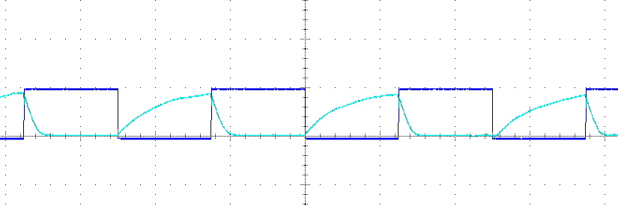
MOSFET Switch Signal - Capacitor
At 1kHz capacitor has enough time to discharge
100μs to discharge with Motor resistive load (29.8Ω)

Slide 16
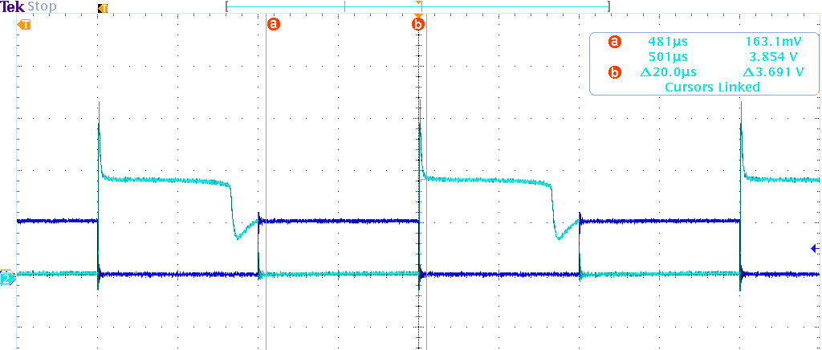
MOSFET Switch Signal - Diode
3.854V peak from Back EMF during motor off
Handles multiple frequencies

Slide 17
Summary of Circuit Results
Drain Current depends on Freq and EMF design
  22mA without protection at 25kHz (20μs pulse)
  20mA with Diode at 25kHz (20μs pulse)
  33mA with Diode at 1kHz (0.5 ms pulse)
Gate Current – consistent at 0.981mA
Back EMF/transient signal suppression works
1N4001 Diode dynamically handles PWM
Motor cannot handle less than 20μs pulse
Verified actual values – can fine tune design

Slide 18
Where Are We Today?
Debug/Terminal Menu
Vibrator Circuit Design
PWM at Vibrator Module
Belt
ZigBee & Bluetooth Communication
Documentation
  System Requirements
  Design Analysis
  Firmware Design Notes

Slide 19
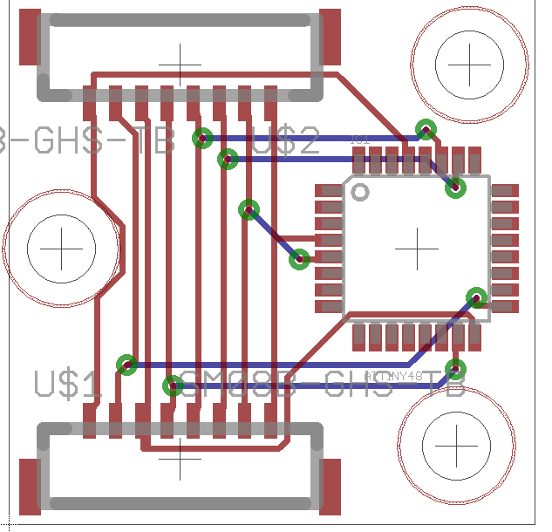
Where Are We Today?

Slide 20
Fully Integrated Prototype
Items Needed:
Firmware Parse Function
I²C Slave Receiver/Transmitter (ATtiny48)
I²C and Fuel Gauge** Breakout Board
Connectors & Cabling
DLL and Basic GUI
Integrated Prototype testing
** HW will be implemented, SW support delayed

Slide 21
Finished Product – Version 1
Items Needed:
Vibrator PCB order
Enclosures (depend on PCB layout)
Manufacturer & Install Vibrator Modules
Target Completion: Early summer (May – June)

Slide 22
Items Postponed for Version 2
Error Handling at all levels
Battery Fuel Gauge
Wireless Signal Status
Status LEDs for all hardware
Complete Design Documentation
  Design specs and Hardware justification
  Apply for Patent???
Code Review & Refactor
  Documentation for code should be within code
Perform Research & Publish Studies

