Slide 1

Kris Blair
Nathan Edwards
Jon Lindsay
Daniel Moberly
Jacob Rosenthal

Slide 2
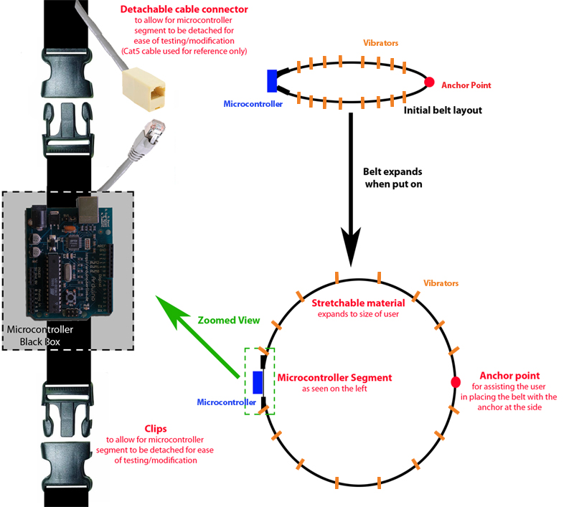
Design Option One
Expandable belt fabric
Pros:
- belt automatically adjusts to user
Vibrators can be initially positioned and require no adjustment
Cons:
-Material can wear over time causing uneven belt expansion
-Vibrators cannot be replaced
-Makes testing more difficult

Slide 3
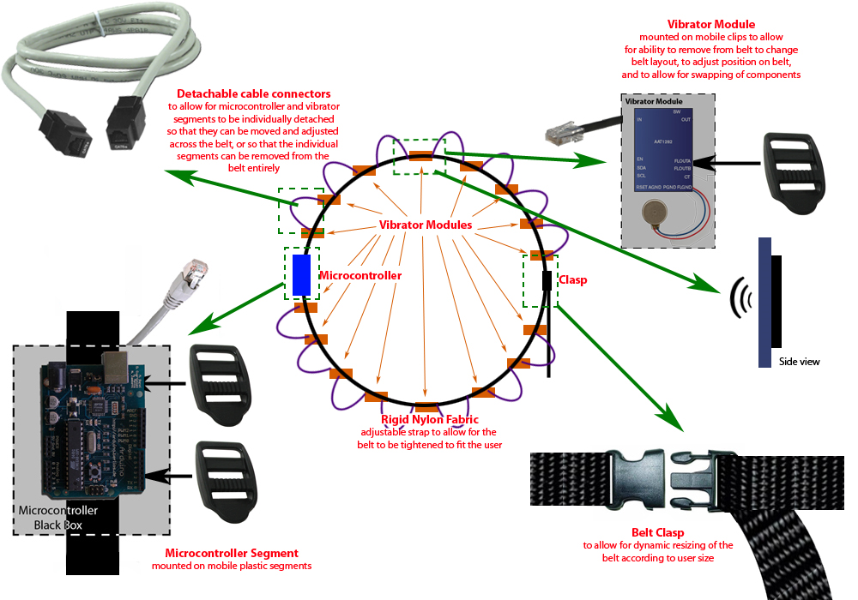
Design Option Two
Adjustable fabric with clips
Pros:
Vibrators mounted on clips allow for dynamic repositioning
Easier to test as multiple pieces allow for multiple tests
Broken segments can be replaced
Vibrators can be removed to dynamically alter the way the belt works (multiple configurations)
Sturdier design
Cons:
-More difficult to initially position vibrators when using
-Mobile vibrators requires unusual wiring methods to allow for movement

Slide 4
Wiring Options
CAT5 strand cable to allow for each vibrator to have its own individual power
  Not as dynamic
  More bulky
  Guaranteed to work
I²C cable design
  Unusual design (long distance application)
  Much less bulky
  Allows for more modules to be easily attached
Wireless modules
  Ideal
  May require too much power
  Additional “grid” programming/setup

