Slide 1
Performance Evaluation of Transcoding Proxy Systems
IMPACT lab. School of Informatics and computing

Slide 2

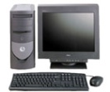





Introduction
High Bandwidth
Wired modem
Server
Transcoding is the process by which a data object is converted from one representation into another one
Example: resizing images, converting one standard data type to another one
Web Transcoding Proxy
Acts between web server and web client
The requests of a client will be forwarded to a proxy
The proxy requests the content from a desired web server
Transcodes it to fit the client’s requirement
Sends it back to the client.
can be collocated with web servers or located on the internet access nodes
Wireless LAN
Cellular
Notes:
The requests of a client will be forwarded to a proxy from client’s wireless base station. The proxy requests the content from a desired web server, transcodes it to fit the client’s requirement and sends it back to the client.

Slide 3
Motivation
Growing market of Mobile Internet Devices (MIDs)
[Forecaster Study,2008]: by 2013, one-quarter of mobile phone users will have 3.5G-capable device. And 38% of mobile subscribers will use mobile Internet services
SDK, Intel atom, 3G mobile phones …
MIDs demand for new applications/protocol/web content compatible with their limitations
Small screen, Limited bandwidth, low computing power, low battery
Web transcoding proxies is a solution to avoid drastic internet content changes for MIDs
The efficient design of transcoding system presents a research challenge
Low performance proxies even would degrade the client/server communication performance

Slide 4
General internal architecture of image transcoding proxy [Richard et al, 98]Richard Han, Pravin Bhagwat, Richard LaMaire, Todd Mummert, Veronique Perret, and Jim Rubas. Dynamic adaptation in an image transcoding proxy for mobile web browsing. IEEE Mobile Communications Magazine, 5(6):8–17, December 1998.
Web Server
Internet
Web Proxy
Internet
Web browser
Key design goals
Improving latency experienced by user at heterogeneous devices (Consumeing less BW)
Network/Platform/Transcoding functions
Quality
Transcoding functions
Tradeoff of Quality/Latency (Cost)
Scalability
Server-side input
Policy Module
Client-side input
Client device capability
Adaptive transcoding
Policies
Server-Proxy bw
User preference
Content characteristic
Proxy-Client bw
Whether to transcode?
How much to transcode?
Outputs
Content Analysis
Text modification
Modified Text/HTML
HTTP
Decode
Compress
Transcoded Image
Middleware: Services between transport layer and application layer commonly used by applications to function well in network environments

Slide 5
Related Works
Feasibility of transcoding proxy system through theoretical analysis
[Richard et al, 98]Richard Han, Pravin Bhagwat, Richard LaMaire, Todd Mummert, Veronique Perret, and Jim Rubas. Dynamic adaptation in an image transcoding proxy for mobile web browsing. IEEE Mobile Communications Magazine, 5(6):8–17, December 1998.
Quality aware transcoding proxies
Minhee Chae and Jinwoo Kim and Hoyoung Kim and Hosung Ryu. Information Quality for Mobile Internet Services: A Theoretical Model with Empirical Validation. Electronic Markets, 12(1), 2002.
S. Chandra and C.S. Ellis, “JPEG Compression Metric as a Quality Aware Image Transcoding,” in Second Usenix Symposium on Internet Technologies and Systems (USITS '99), Oct 12, 1999
Khalil El-Khatib , Gregor v. Bochmann and Abdulmotaleb El- Saddik , A QoS-based Service Composition for Content Adaptation, 2007
Efficient transcoding function
Kuei-Chung Chang and Tien-Fu Chen. Efficient segment-based video transcoding proxy for mobile multimedia services. J. Syst. Archit., 53(11):833–845, 2007.
W.Y. Lum and F.C.M. Lau, "On Balancing Between Transcoding Overhead and Spatial Consumption in Content Adaptation," Mobicom 2002, Atlanta, USA, September 2002, 239-250.

Slide 6


Transcoding Design Scenarios and Feasibility [Richard et al, 98]Richard Han, Pravin Bhagwat, Richard LaMaire, Todd Mummert, Veronique Perret, and Jim Rubas. Dynamic adaptation in an image transcoding proxy for mobile web browsing. IEEE Mobile Communications Magazine, 5(6):8–17, December 1998.
B_{sp}
B_{pc}
proxy
server
S: original file size
G: original stream size
Gp: transcoded stream size
client
Sp: transcoded size
Dp: Proxy delay
Dmax: Max tolerable delay by user
Streamed or on-the-fly transcoding
Perform transcoding under two stability conditions:
No buffer overflow:
Output transmission link is not saturated
Store-and-forward transcoding
Test for feasibility: IF
Then search for Optimality
Search space of transcoding parameters to find optimal set that maximize the quality with subject to the determined response-time
Else “return original image”

Slide 7
Contributions
Experimental analysis to discover delay bottlenecks and feasible conditions for using proxy transcoding systems
Network delay overhead with respect to file sizes
Transcoding scenario
Experimental analysis to measure throughput and find bottlenecks for scalability and resource utilization

Slide 8
Our Approach
Appropriate experimental setup which resembles the situation of proxy transcoding system in the internet
Monitoring (delay/resource utilization) of different parts of the system
Evaluating the performance of the system
Turnaround time
Throughput
Response time

Slide 9
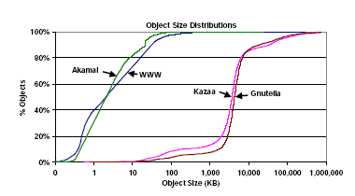
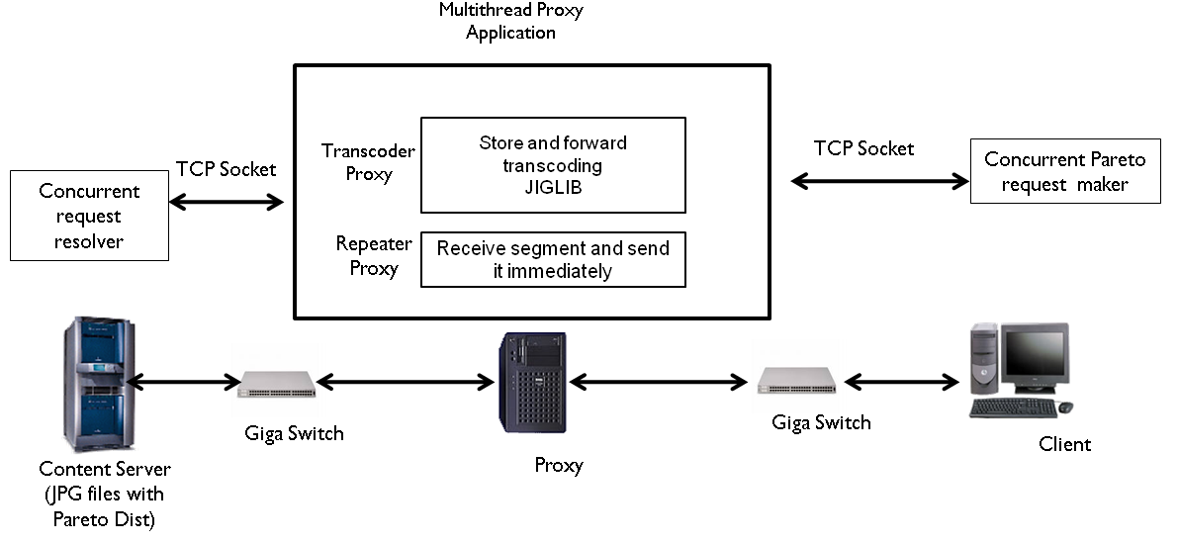
Test Bed Setup Considerations
Hardware Platform
Intel’s latest Harpertown processor based IU blade server Supermicro SYS 6015B-NTV (3.16 GHz processor speed)
Traffic
Type : 30% of the total internet content accessed by mobile devices is multimedia [Maryam Kamvar and Shumeet Baluja. A large scale study of wireless search behavior: Google mobile search. pages 701–709, New York, NY, USA, 2006. ACM. CHI ’06: Proceedings of the SIGCHI conference on Human Factors in computing systems.]
Size distribution [300B-70KB]
Proxy Transcoding Application
Rabitt3 + ImageMagic
Native Transcoding Proxy System (NTPS) + IJGLIB
Store and forward transcoding
Repeater
Traffic generation
Dynamic thread based traffic generation
Static threads & concurrent connection
Performance metric monitoring
top utility / time measuring syscall
Stefan Saroiu, Krishna P. Gummadi, Richard J. Dunn, Steven D. Gribble, and Henry M. Levy. An analysis of internet content delivery systems. pages 315–327, 2002.

Slide 10
Client-Proxy-Server Socket based Communication
JPG files with Pareto Dist.
Client
Intel-Proxy
Server
Client
Proxy-server
web-server
Client-Thread (1)
Proxy-Thread(1)
Server-Thread(1)
Client-Thread (i)
Proxy-Thread(i)
Server-Thread(i)
Client-Thread (i)
Proxy-Thread(i)
Server-Thread(i)
Client-Thread (i)
Proxy-Thread(i)
Server-Thread(i)
Client-Thread (i)
Proxy-Thread(i)
Server-Thread(i)
Client-Thread (i)
Proxy-Thread(i)
Server-Thread(i)
Client-Thread (i)
Proxy-Thread(i)
Server-Thread(i)
Client-Thread (i)
Proxy-Thread(i)
Server-Thread(i)
Drawback: When load increases turnaround time of requests raise(Threads), consequently # of live threads exceed system’s limit
A hybrid of static threads and concurrent connections generate higher load

Slide 11
Communication of Client-Proxy-Server
Connect()
Send() [a request]
Accept()
Recv() [The req.]
Connect()
Accept()
Send()
Recv() [The req.]
Send() [The file.]
Recv()
Send()
Recv() [The file]
Client
Proxy
Server

Slide 12
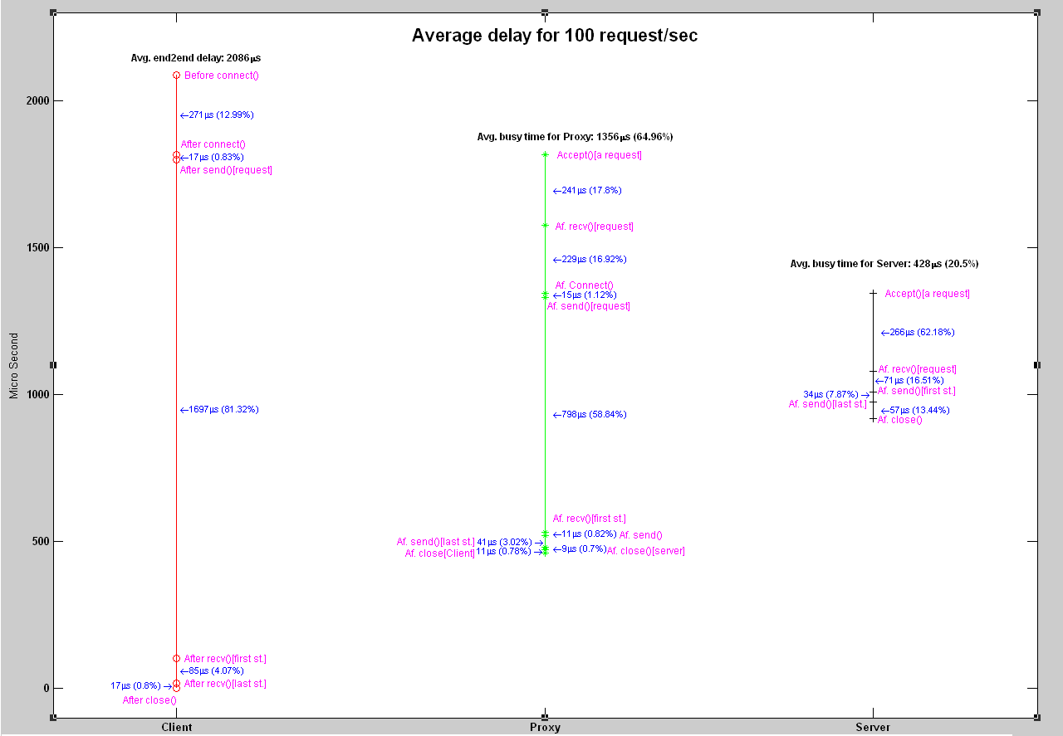

Slide 13
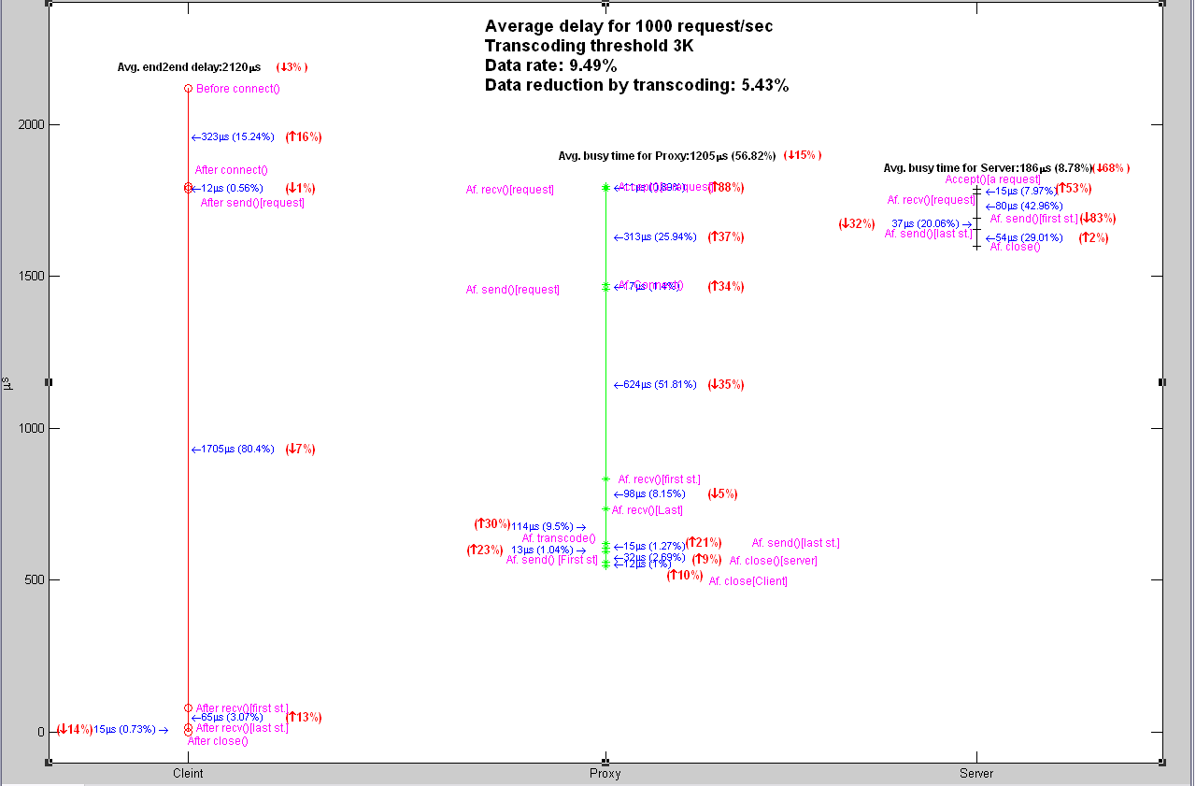
Mbps

Slide 14
Design Challenges
Memory Management
Kernel (Synchronization, I/O)
Network
Transcoding scenario

Slide 15
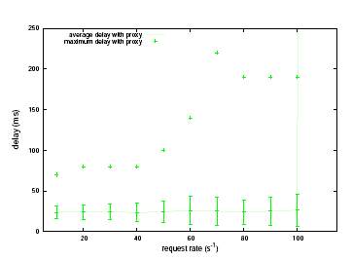
Performance evaluation using Rabitt3

Slide 16
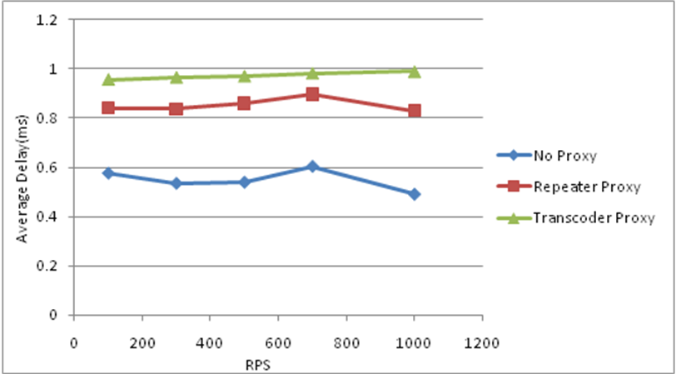
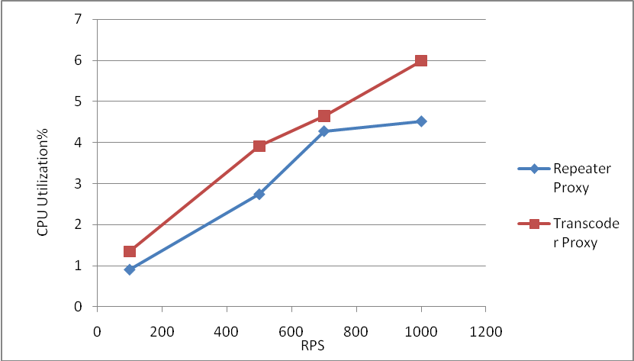
Performance evaluation using NTPS
Higher performance than Rabitt
Insignificant performance difference between repeater proxy and transcoder proxy (12% of files were worth to transcode, 30% compression rate)
Fluctuation of turnaround time

Slide 17
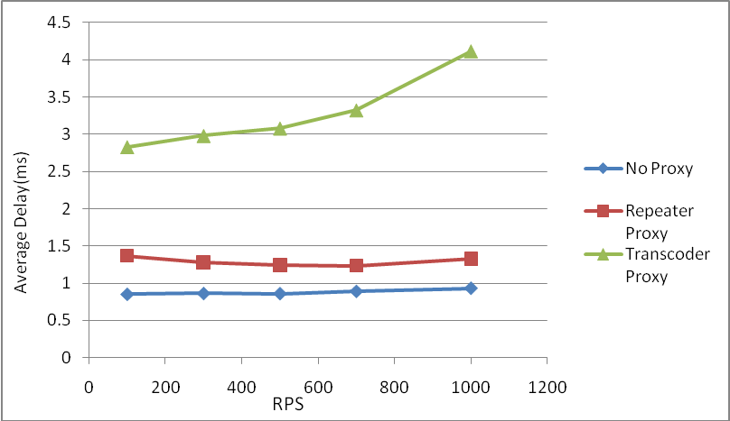
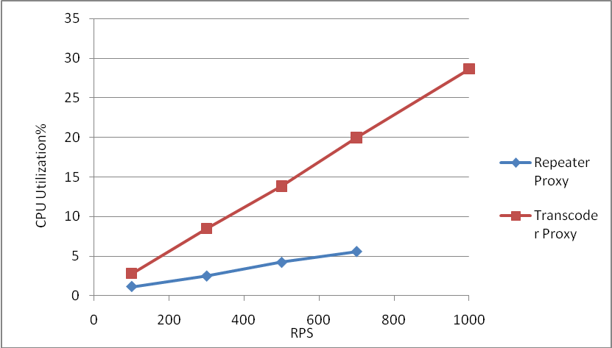
Performance evaluation of files [3K-700k]
Latency difference between repeater proxy and transcoder proxy
Compression latency
Store and forward scenario
Latency difference between repeater proxy and no proxy
Network delay overhead including communication and TCP delay overhead

Slide 18
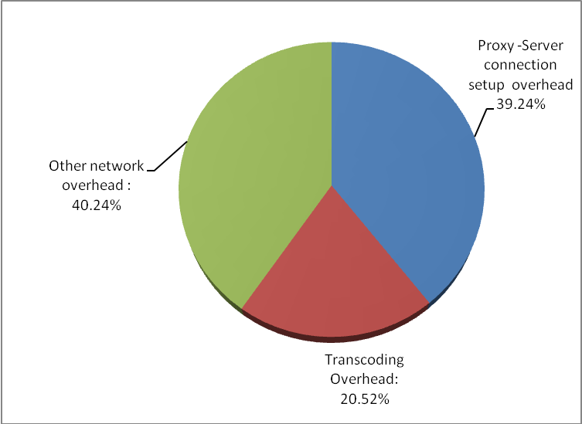
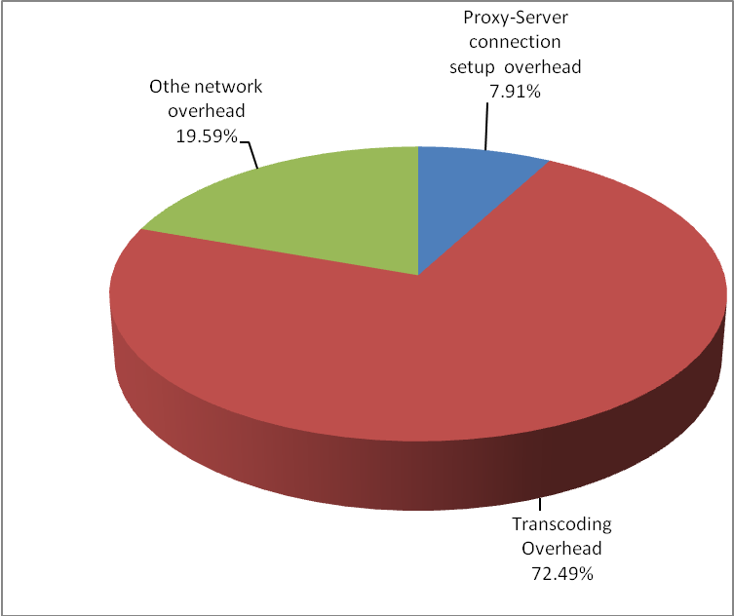
Network Delay Overhead
Delay overhead of different parts of Proxy tanscoding. Left: File sizes ranging [300B-70KB](0.5 ms), right:File sizes ranging [3KB-700KB] (2.5 ms)
More than 50% of overhead delay is imposed by TCP and other parts of network for small files
Another performance question: Whether proxy or not?
Long Live TCP connection between proxy/web server

Slide 19
Store & Forwarding Transcoding Scenario botteleneck
Process Delay type | Small Files (ranging [300B-70KB] |  | Large files(ranging[3K-700K]
 | Repeater Proxy | Transcoder Proxy | Repeater Proxy | Transcoder Proxy
Turnaround time increasing rate | 55.97% | 78.14% | 47.00% | 270.30%
Response time increasing rate | 64.40% | 91.87% | 73.19% | 500.56%
Store and forwarding scenario presents a botteleneck for large files
Due to architecture of JPEG files (Blocks are not placed sequentially ) and overhead of multiple execution of compression another performance question is raised:
Whether stream-based transcoding always is better than Store and forwarding

Slide 20
Resource Utilization Bottlenecks -Scenarios
Requirements
Designing applications to measure the maximum capacity of hardware both for compression and communication
Generating high load traffic (Maximum affordable)
Using static thread & concurrent connections
Set the # of thread and # of concurrent connections by try and error
Scenario
Multithread compression application: each thread sequentially choose a file from a pool of Pareto-like file sizes, read and then compress it
(2-side communication)Collocated client –proxy (Avoiding hardware communication latency)
(2-side communication) Client-proxy
Client-Proxy-Server communication

Slide 21
Resource Utilization Bottlenecks -Results
Scenario File Size | Stand alone “Compression” application |  |  | Collocated Client/Proxy |  |  | Separated Client/Proxy-server |  |  | Client/Proxy/ Server
 | Avg. RPS | Proxy CPU Util% | Avg Compression delay | Avg. RPS | Proxy CPU Util% | Avg. end2end delay | Avg. RPS | Proxy CPU Util% | Avg. end2end delay | Avg. RPS | Proxy CPU Util% | Avg. end2end delay
30k-7M | 716 | 100% | 10ms | 540 | 81% | 20 ms | 562 | 82% | 22 ms | 511 | 84% | 44 ms
3K-700K | 4875 | 100% | 1.6 ms | 2000 | 49% | 4 ms | 2000 | 46-50% | 5.3 ms | 1800 | 50% | 10 ms
300B-70K | 24191 | 46.40% | 0.73 ms | 8300 | 40% | 0.8 ms | 8000 | 27% | 1.9 ms | 3821 | 26.30% | 5 ms
Whether low throughput is because of low load or low resource utilization?

Slide 22
Proxy CPU Utilization Kernel Space/User Space
 | Operation Type | Compression application | Client/Proxy | Compression application | Client/Proxy | Compression application | Client/Proxy
User Space CPU U% | Memory/CPU intensive( CPI=0.65) | 70% | 27% | 89% | 73.20% | 97% | 83%
Kernel Space CPU U% | Network/Synchronization / I-O intensive CPI (compression)=2.5-3.5 CPI(client/proxy=4-6) | 30% | 33% | 11% | 11.60% | 3% | 9%
Software interrupt CPU% |  |  | 37% |  | 14.30% |  | 8%
CPI (Clock Per Instruction): Large value means low resource utilization

Slide 23
Vtune –based Performance Analysis
 | Operation Type | 300B-70KB |  | 3k-700KB |  | 30K-7M
 |  | Compression application | Collocated Client/Proxy | Compression application | Collocated Client/Proxy | Compression application | Collocated Client/Proxy
CPI |  | 1.13 | 1.47 | 0.774 | 0.86 | 0.73 | 0.78
JPEG lib CPU% | CPU-intensive (CPI=0.65) | 49% |  | 90.30% |  | 89% | 88%
Kernel CPU% | memory/IO/Network intensive (CPI=[2.5-6] | 33% |  | 5.55% |  | 7.46% | 10.00%
Libc-2.8.so CPU% | Memory intensive (CPI=3) | 15% |  | 3.95% |  | 3.34% | 1.75%
CPI (Clock Per Instruction)
Large value means low resource utilization
CPU –CLK-UNHALTED_CORE%
How percentage of a CPU for a process/thread is consumed by each module of a process

Slide 24
Discussion
Network latency overhead (especially TCP) for small file size is significant
Long live TCP connection
Redirecting some connections
Network stack as well as Kernel impose latency and low resource utilization overhead
Kernel spaced based design
Store and forwarding transcdoing scenario degrades the performance of large files transcoding
Performance analysis to figure out whether stream based transcoding scenario is always worth or not

