Slide 1
Stinger: Network Scanner as a Service
Team Name: Black Sun
Team Members:
Shantanu Bhusari
Chandramouli Janakiraman
Raghuveer Gowda H

Slide 2
Content
Introduction
System Model
Requirements
Project Description
Technical Details
Benefits
Future work & Conclusion

Slide 3
Introduction
Cloud systems are easily vulnerable to security issues as the user has control to install vulnerable applications, which may give the attacker an option to deny any of our services or gain access to our system using remote code execution.
Why these problems are important?
Security is the major concern in current internet standards. There are various vulnerabilities which possesses threat to the complex structure of cloud system. Any misconfiguration or malicious behavior can affect a huge number of systems and users on that cloud network.
Applied technologies and solutions to address these problems.
To develop this module, we are using OpenStack to create the virtual topology of cloud network. We will be using Nmap wrapper and OpenVAS scanner to scan for available/running services, open ports and network vulnerabilities. Network Monitoring will be performed using Nova API tool. The information will be stored in a database using MongoDB.

Slide 4
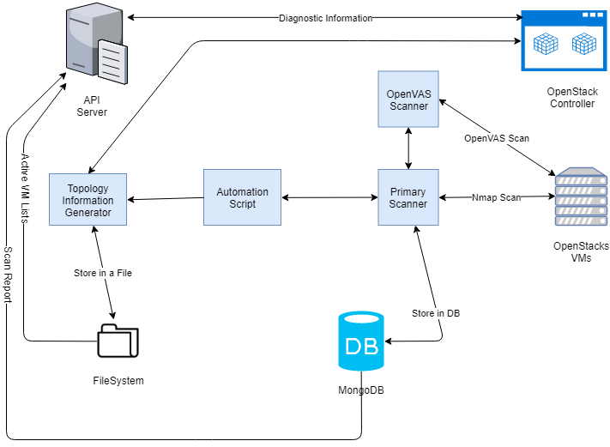
Block Diagram
Tasks allocation

Slide 5
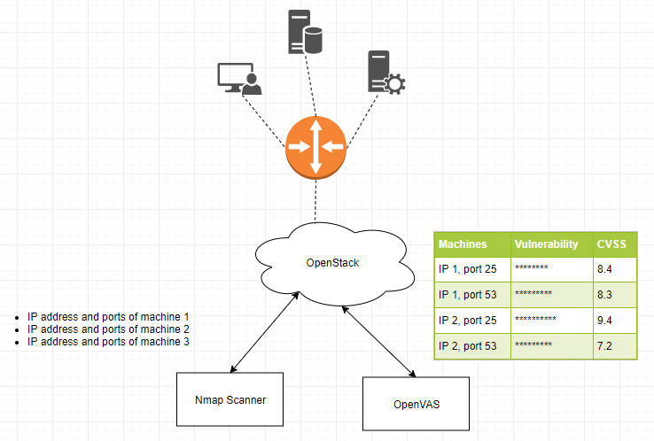
System Model

Slide 6
Requirements
Software
OpenStack (DevStack), OpenVAS, Nmap, OpenStack APIs, OpenStack SDK, Python, Flask, and MongoDB.
Hardware
Ubuntu Server16.04 machine with more than 8GB RAM.

Slide 7
Group Project Description
Task 1: Setup OpenStack with latest version.
Task 2: Use OpenStack REST API’s to fetch network topology information
Task 3: Automating Scanning Process - Scan network for services running on virtual machines
Task 4: Automating Scanning Process – Scanning the network for services which are vulnerable using OpenVAS
Task 5: FLASK server – Providing vulnerability information, Network information and diagnostics through REST APIs
Task 6: Using Open stack APIs to show information such as CPU usage, network traffic volume on each VM
Task 7: Persistent Storage of information - MongoDB
Task 8: Automation of scanning, monitoring, topology change updates in Cloud Network.

Slide 8
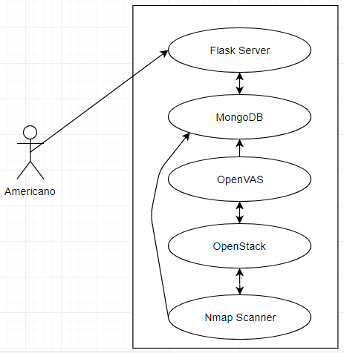
Use Case Diagram

Slide 9
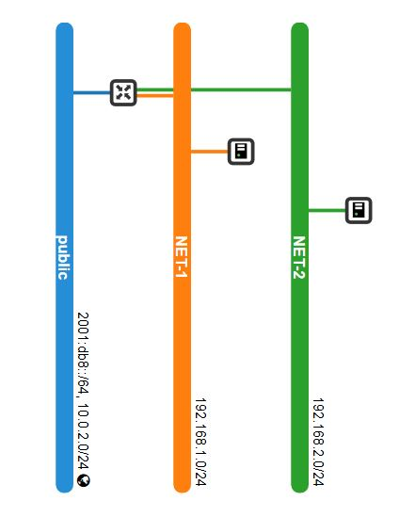
Network Topology

Slide 10
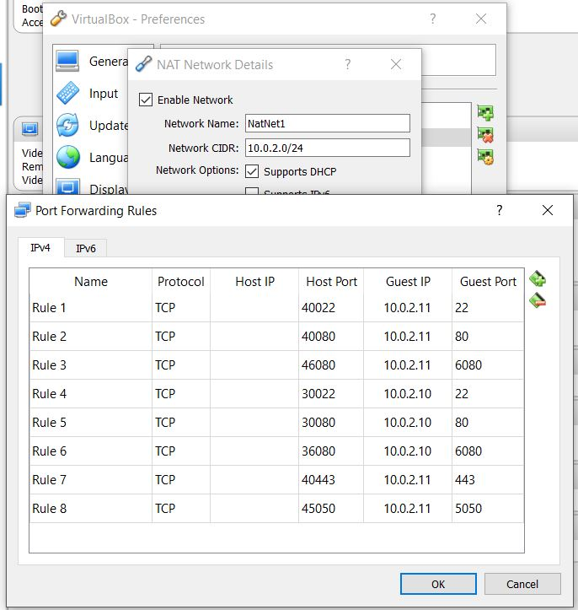
Port Forwarding Configuration

Slide 11
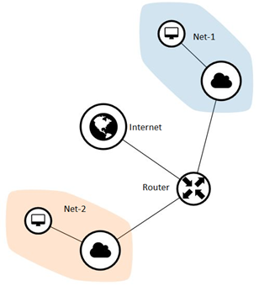
Network Topology

Slide 12
Technical Details
Project setup
OpenStack is used to create this cloud network topology.
Nova APIs provided by OpenStack SDK is used to fetch the network topology information periodically.
Automation Scripts are created to scan the entire using Nmap scanner to fetch the information of running services on open ports, possible vulnerabilities in the network.
Scripts were written to automate the process of scanning a given range of IP addresses for services and vulnerabilities information
FLASK server was created to provide vulnerability information, Network information and diagnostics through REST APIs
Nova APIs provided by OpenStack SDK is used to show information such as CPU usage, network traffic volume on each VM.
MongoDB is used for persistent storage of information.

Slide 13
Technical Details(Cont.)
Used OpenVAS scanner to scan the network for network misconfigurations.
Used Nmap Wrapper to scan network topology and running services.
Automated the topology, vulnerability scanning and stored the obtained results in xml or in JSON format in a database for later lookup.
Gathered Network and CPU usage information by VMs.
Performed periodic scan and provided RESTful APIs for querying specific IP’s scan results.

Slide 14
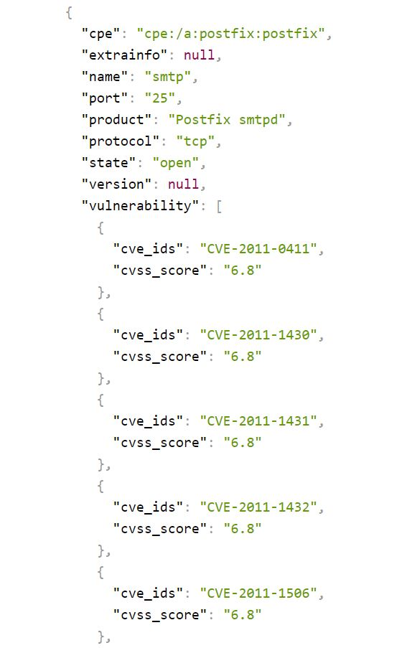
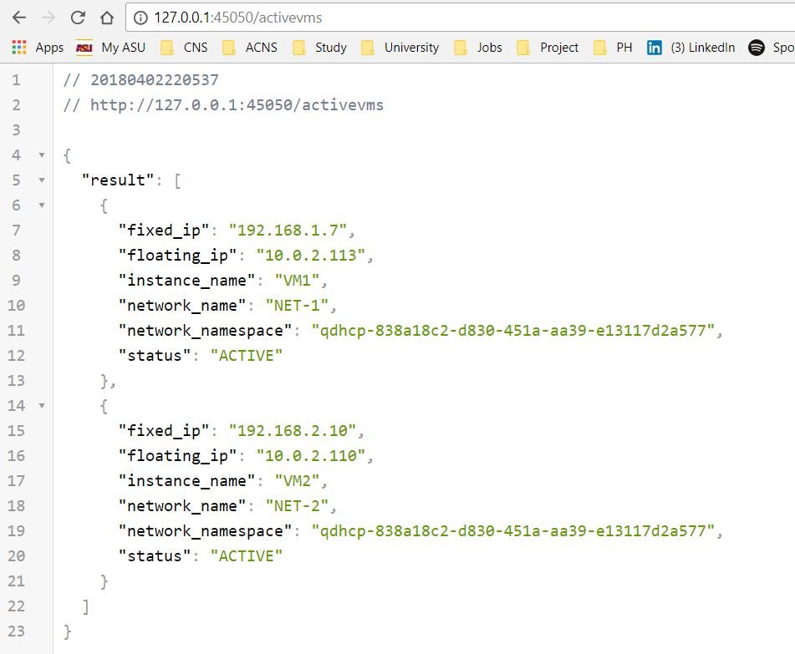

Slide 15
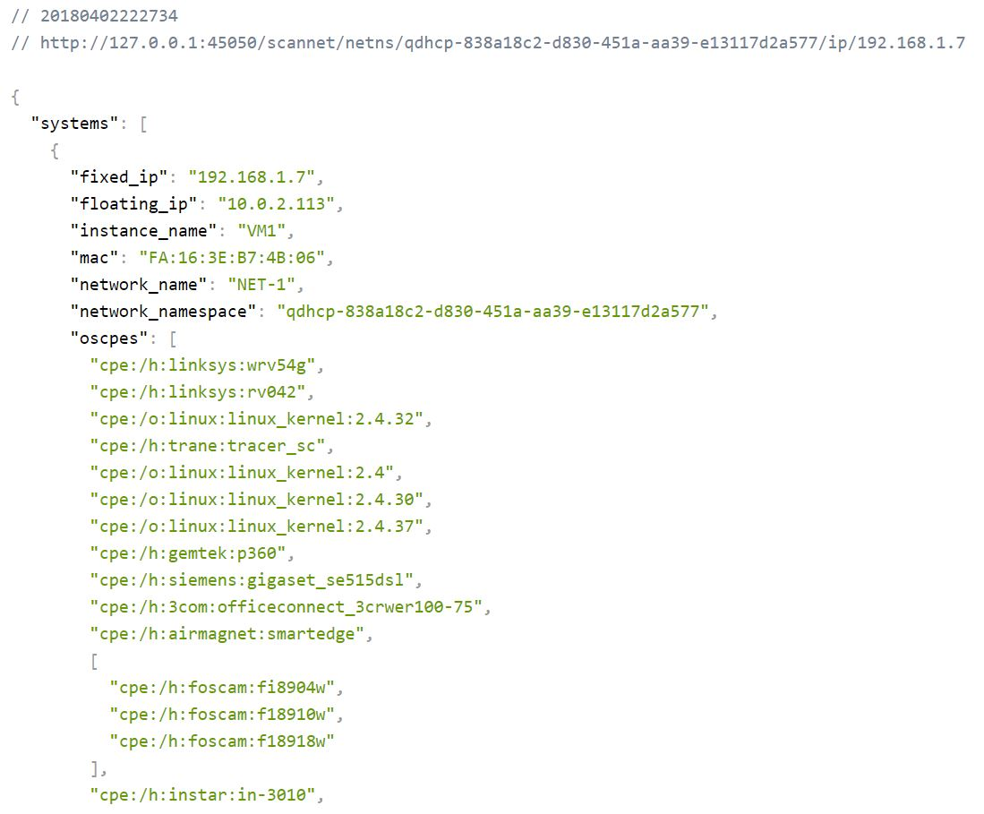

Slide 16
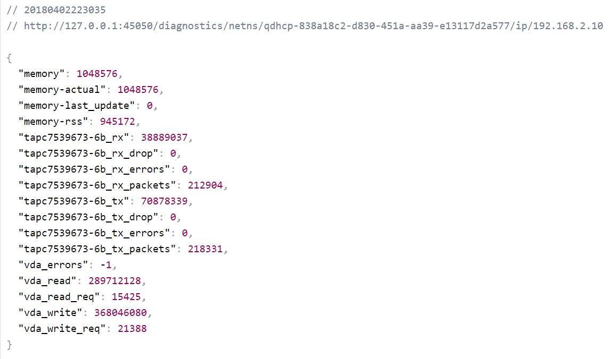

Slide 17
Benefits
Novel aspects of this project:
Abstracting Adhoc scanning(Performing regular periodic scanning of entire topology, storing it in a database and fetching the result whenever required)
2. Potential applications & benefits:
  Applications include getting real time data of your network, services and vulnerabilities information
  Containers are used to respond to these requests making the system less CPU intensive. Abstraction of Adhoc scan makes it less network intensive as well

Slide 18
Project Tasks allocation
Member | Task | Percent
Shantanu Bhusari | Task1,Task2,Task3, Task7 | 33.33%
Chandramouli J | Task1,Task2,Task4, Task8 | 33.33%
Raghuveer Gowda H | Task1,Task2,Task5, Task6 | 33.33%

Slide 19
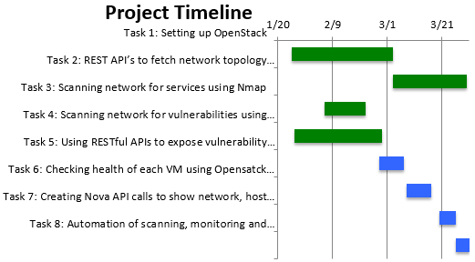
Project Timeline

Slide 20
Future Scope
The following describes some future improvements which could be made:
Implement better telemetry using ceilometer
Use of opensource controller, such as Open Daylight controller, for fetching network.
Implement scanner to scan for UDP ports as well.

Slide 21
Conclusion
We have successfully developed an automated network scanner module as a service to collect the network topology information which will help in identifying and mitigating the vulnerabilities present in the network.
We have successfully enhanced the accessibility of our module wherein we have integrated this module with Americano module which will result in an Intelligent Software Defined Secure System.

Slide 22
Video Demonstration Link
https://youtu.be/hzyPjB0sF8M

Slide 23
References
https://pythonadventures.wordpress.com/2014/12/29/xml-to-dict-xml-to-json/
https://netaddr.readthedocs.io/en/latest/tutorial_01.html#support-for-non-standard-address-ranges
https://docs.mongodb.com/manual/tutorial/install-mongodb-on-ubuntu/
https://en.wikipedia.org/wiki/MongoDB
https://en.wikipedia.org/wiki/OpenVAS
https://en.wikipedia.org/wiki/Flask(web_framework)
https://wiki.OpenStack.org/wiki/DevStack
https://docs.OpenStack.org/python-OpenStacksdk/latest/
https://docs.OpenStack.org/python-novaclient/pike/
https://flask-restful.readthedocs.io/en/latest/

