Slide 1
Bringing Thoughts to Life: A Personal Blog App Django Formative Assessment
- By Shantanu Deshpande (124M1H009)

Slide 2
Introduction
This is a personal blog application built with Django, where I can share my thoughts and experiences through blog posts.
Each post includes a title, an image, an excerpt and a descriptive paragraph about the topic.
The blog also supports tagging, allowing me to categorize posts as Featured, Hot, or New using the admin panel.
The homepage highlights the latest posts, making it easy for visitors to stay updated.

Slide 3
Functionalities
1. Home Page (Latest Posts)
Displays the latest three blog posts to keep the homepage fresh and engaging.
Each post includes a title, excerpt, and a "Read More" link to view the full content.
2. Viewing All Posts
Shows a list of all blog posts, ordered from newest to oldest.
Includes a "Saved Posts" button to access posts marked for later reading.

Slide 4
Functionality
3. Viewing a Single Post:
Displays the full content of a selected post, including -
Title, tags, author details, and publication date.
A "Read Later" button to save or remove the post.
A comment section where users can leave feedback.
4. Saving and Removing Posts for Later:
Users can save posts without an account using session storage.
Clicking "Read Later" adds the post to the saved list.
Clicking it again removes the post from the list

Slide 5
Functionality
5. Viewing Saved Posts
The "Saved Posts" page displays all posts the user has marked for later reading.
If no posts are saved, the page informs the user.
Users can open a saved post and remove it if they choose.
6. Commenting on a Post
Users can leave comments on any post.
Comments are stored and displayed beneath the post.

Slide 6
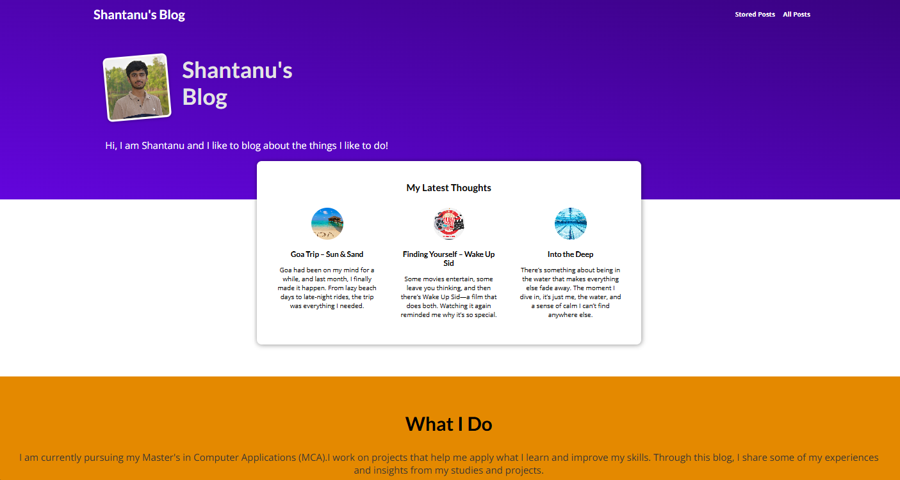
User Interface Screenshots
Home Page

Slide 7
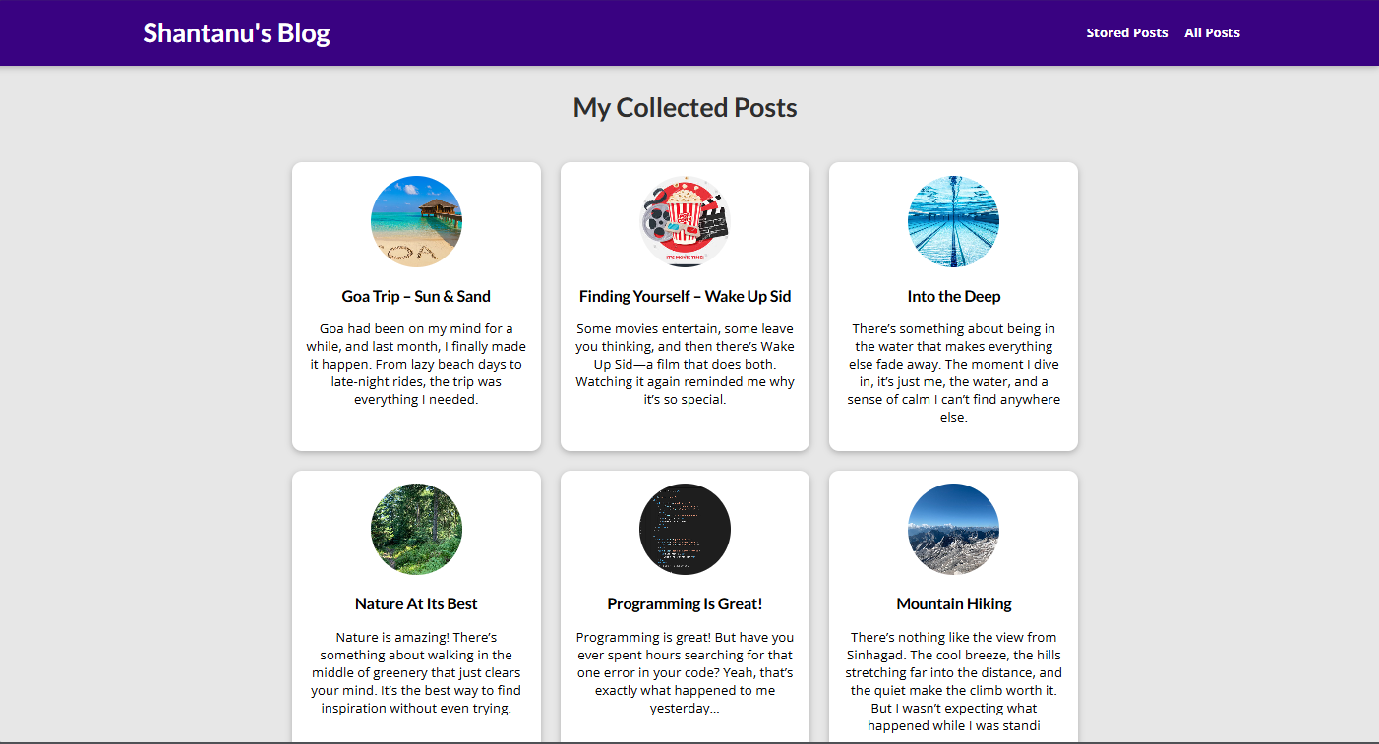
All Posts Page

Slide 8
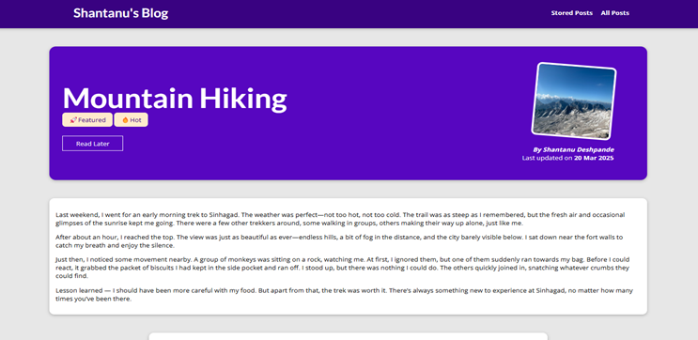
Specific Post Page

Slide 9
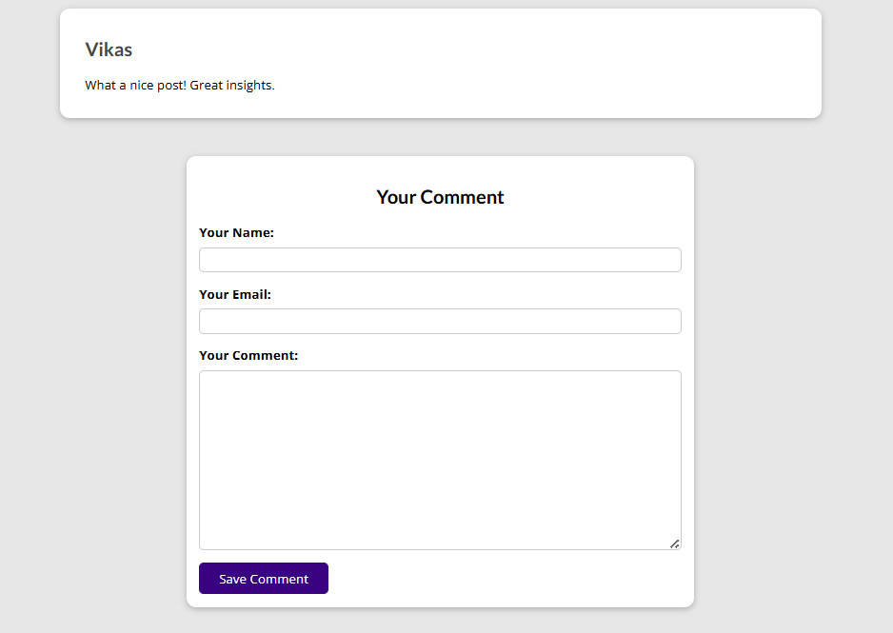
Comment on a Post Page

Slide 10
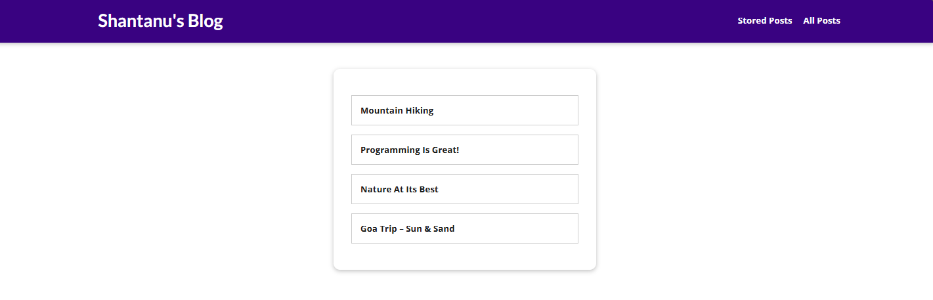
Read Later List

Slide 11
Conclusion
This blog application provides an intuitive and user-friendly experience for reading and managing posts. The homepage shows the latest three posts, ensuring users stay updated.
The "Read Later" feature allows users to save posts for future reference, utilizing session storage for easy access.
Additionally, the commenting system encourages interaction by enabling readers to share their thoughts.
These features collectively enhance user engagement and improve the overall reading experience.

