Slide 1
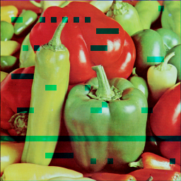
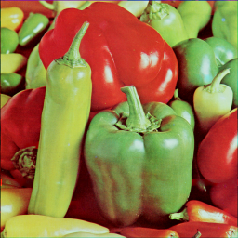
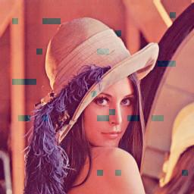
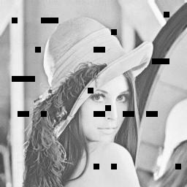
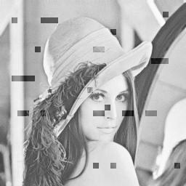
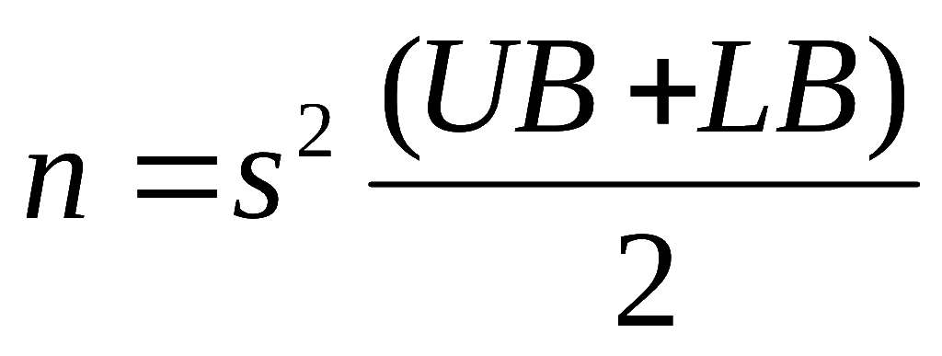


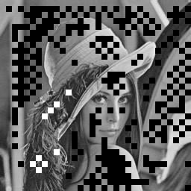

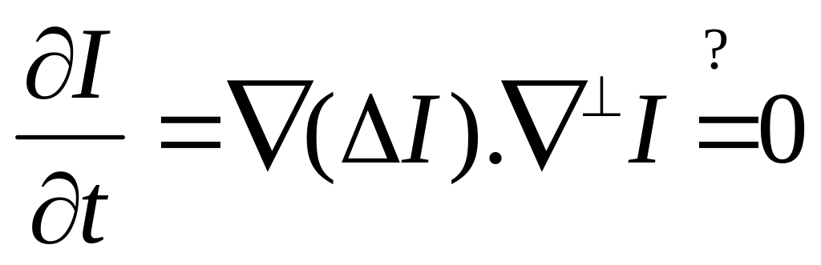
Structure & Texture Filling-in of Missing Blocks in Wireless Transmission & Compression
Shantanu Rane, Marcelo Bertalmio, Guillermo Sapiro
Department of Electrical Engineering, University of Minnesota, Minneapolis
PDEs for Restoration
How to Classify?
Restoration Example
Coarseness Measure = # of Local Extrema
[ Karu, Jain, Bolle (1999) ]
Inpaint
UB = 0.16, LB = 0.04, s = 8 → n = 6.4
→
→
> n extrema ➔ TEXTURE
< n extrema ➔ STRUCTURE
Exception
(Edge between textured regions ➔ Structure forced)
Received
Isolated Red
Available Blue inserted
into lost Red blocks as
initial condition
“ Inpainting is the age-old practice of restoring visual works—a process that until recently was only performed manually by experts. […] A promising new field of mathematical research is the development of algorithms that solve partial differential equations to digitally inpaint with little input or effort from the user.”
Texture Synthesis
Reconstruction &
Recombination of RGB
Template (T)
Best (SSD) match (M)
-American Mathematical Society (Mathematical Moments)
[www.ams.org/mathmoments 2002]
Candidate
Lost
Assisting JPEG Compression
The Problem
8-neighborhood
Copy-and-Paste Approach [Efros, Leung (1999)]
Sum of Squared Differences (SSD) Metric
Select block with minimum Σ [ T(i,j) - M(i,j) ]²
Block-based coding (e.g.. JPEG)
→
→
→
→
Transform
(DCT)
→
Quantize
→
Source coding
+
Channel coding
Image
8x8 Tiling
PDE-based Digital Inpainting
Sample
Mask & Compress
After decompression
and reconstruction
Bursty Block
Loss
Fading
Channel
If a block can be satisfactorily restored, don’t compress it
Remedies
ARQ
Decoder Filling-in
Concept of
Isophote
Propagate (Smoothly!) :
  Color/Gray-level
  Direction of
  Time-dependent
  normal
Image | JPEG (alone) | JPEG+fill-in | PSNR(db)
Lena 256x256 | 6.13 (1.31 bpp) | 6.90 (1.16 bpp) | 36.2
Peppers 256x256 | 5.33 (1.50 bpp) | 6.11 (1.31 bpp) | 33.7
Lena 512x512 | 7.21 (1.11 bpp) | 8.99 (0.89 bpp) | 34.3
Peppers 512x512 | 7.69 (1.04 bpp) | 9.88 (0.81 bpp) | 32.1
IDCT
→
Decode
Received
8-neighborhood
Key Ideas
Reconstruction of lost block from available context
Classification of lost blocks (Karu et al.)
Conclusions
I ^{n+1}(i,j) = I ^{n}(i,j) + Δt I_{t}^{n}(i,j)
For all (i,j) inside inpainting region
Low to Drastic loss correctable by combination of
PDE-based inpainting and texture synthesis
No retransmission overhead
Improves DCT-JPEG compression
Small Artifacts < 8x8 pixels lost
Inheritance from Navier-Stokes Equation
        → (Image Intensity ≡ Stream Function)
Typical Δt = 0.02, n = 3000.
Texture
(Use texture synthesis)
Structure
(Use Image Inpainting)
[Bertalmio, Sapiro, Caselles, Ballester (2000)
Bertalmio, Sapiro, Bertozzi (2001)]

