Slide 1
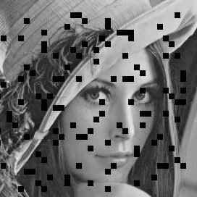

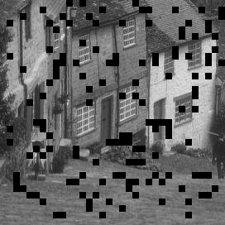
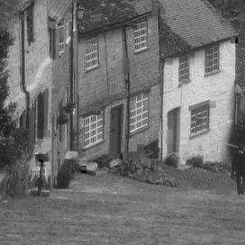
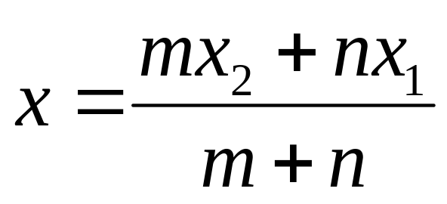

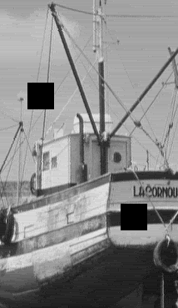
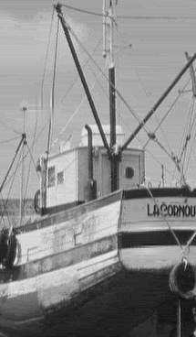




Wavelet Domain Reconstruction of Lost Blocks in Wireless Image Transmission
Shantanu Rane, Jeremiah Remus, Guillermo Sapiro
Department of Electrical Engineering, University of Minnesota, Minneapolis
The Problem
Classification of Lost (Code)Block
Examples
Wavelet Decomposition of Image tile
Magnitude of wavelet coefficient indicates
  Amount of change in image domain
  Spatial location where this change occurs
LL
LH
LH
→
HL
HH
D
T
D
HL
HH
L
R
How to reconstruct lost wavelet coefficients in any
or all subbands ?
D
B
D
Compare coefficients of (code)blocks in 8-neighborhood
with threshold to classify into:
  Edgy → Selectively interpolate along edge direction
  Non-Edgy → Interpolate from all T,L,B,R (possibly D)
Applications
→
Filling-in lost or masked areas in the wavelet domain
Compare with image-domain methods
      ~ nil or fewer iterations
Arbitrary shaped areas
      ~ “wavelet-based inpainting”
JPEG2000
      ~ codeblocks (32x32, 64x64, etc) lost during
      transmission
Interpolation along Edge direction
m
n
x₁
Lost
x
x₂
Reconstruction of JPEG2000 codeblocks
Y : Vector of inner pixels
A : Matrix of outer pixels
X : Vector of coefficients
Get X as least squares solution
Problem → large code-blocks i.e. 32x32, 64x64
  OK if code-blocks in HL,LH lost
  If LL code-blocks lost, reconstruction not always
  possible if too many details are lost
Lost
Key Ideas
Use X to get first inner layer
Worst effect on visual quality
Easier to restore
OK visual quality
Very hard to restore
Need edge direction
Use outer two available layers to get X
First Layer of Lost Block
32x32 blocks
(all subbands lost)
LL
LH
LH
HL
HH
→
HL
HH
Vertical Edge
Conclusions
Contains most edge energy
Easy for perfectly vertical edge
Hard for curved/inclined/fading edges
→
Fast multiscale error concealment algorithm
Applicable to reconstruction of lost JPEG2000 codeblocks
Not very good on diagonal edges and texture
Smooth surface
Interpolation with smoothness constraint at
boundaries of the mask
Problems for
    Diagonal Edges
    Textured Regions
[ Hemami, Meng, (1995) ]

