Slide 1
Notes:
0.5 min.
Good afternoon, My name is SDR. We have already seen two applications of WZ coding in the previous presentations. I shall present a third – WZ coding for error-resilient DVB. This is joint work with …

Slide 2
Limitations of traditional error-resilience methods
Failure of Forward Error Correction (FEC) results in
drastic reduction in video quality at high error probability.
Layered video coding with Priority Encoding
Transmission (PET) gives graceful degradation
but with poor rate-distortion performance.
PSNR
Want graceful degradation with
efficient rate-distortion tradeoff.
Channel Error Probability
Proposed approach : Wyner-Ziv coding of the video signal
Notes:
For layered coding to have zero R(D) penalty, BL-EL-X must form a Markov Chain. [1]

Slide 3
Outline
Systematic source-channel coding
Lossy Forward Error Protection using Wyner-Ziv coding
Results : Comparison of FEP and FEC
Notes:
[0.5]

Slide 4


Systematic Source-Channel Coding
Analog
Channel
Correlation
Channel
Side
info
Decoder
Encoder
Digital
Channel
Wyner-Ziv
Decoder
Wyner-Ziv
Encoder
Digital
Channel
[Shamai, Verdu, Zamir, 1998]
Enhancing analog transmission systems using digital side information [Pradhan, Ramchandran, 2001]
Error-resilient video compression schemes [Sehgal, Ahuja, 2003],[Xu,Xiong, 2004]
Lossy source-channel coding of video waveforms [Aaron, Rane, Girod, 2003]
Notes:
[1.5]
Mentally substitute analog channel by a hypothetical correlation channel, then function of digital channel is error-correction for the analog channel.

Slide 5
Systematic Lossy Forward Error Protection
S
MPEG Encoder
MPEG Decoder with Error Concealment
S’
Error-Prone channel
Side information
Slepian-Wolf Encoder
Slepian-Wolf Decoder
Reconstruction
Coarse Quantizer
S*
Wyner-Ziv Encoder
Wyner-Ziv Decoder
Analogous to systematic source-channel coding
Error corrected up to a distortion introduced by coarse WZ quantizer,
hence lossy protection.
Notes:
[1.5]
Refer to the correlation channel, as the channel between S and S’.

Slide 6

Practical scheme for Forward Error Protection
LEGACY BROADCASTING SYSTEM
MPEG2
Decoder
Input
Video
MPEG2
Encoder
Conventionally encoded stream
Entropy
Decoding
Quantization parameter (Q)
Q⁻¹
T⁻¹
+
MC
Q₁
Error-prone Channel
Entropy
Coding
(motion vecs, mode decisions)
Quantized
transformed
Prediction error
Fallback to coarser version
(motion vectors,
mode decisions)
Side Info
Q₁
Entropy
Coding
RS
Encoder
Parity
only
RS
Decoder
Entropy
Decoding
Coarse
Quantizer
Decoded motion vecs
WYNER-ZIV ENCODER
WYNER-ZIV DECODER
Notes:
[2.5]
Small addition in complexity due to extra quantizer and entropy coders, but significantly less complex that using a video encoder inside the WZ decoder.

Slide 7
Reed-Solomon codes across slices
Transmit only parity symbols
k
X
X
X
X
X
X
X
X
X
X
X
X
X
X
n
Erasure Decoding
RS code across slices
1 byte in slice
filler byte
parity byte
Notes:
[1]

Slide 8
Simulation setup
Codecs:
  Main Codec → MPEG-2 codec
  WZ Codec → MPEG-2 Quantizer + RS Slepian-Wolf codec.
Settings:
  1 Slice = 1 GOB mandatory for MPEG-2
  Identical slice structure for main and WZ stream
  Main and WZ descriptions use same motion vectors and mode-decisions
  MPEG GOP structure : I-B-B-P-B-B-P-…
  Previous-frame error concealment
Notes:
[1]
Identical slice structure (might not be required, might even improve performance by eliminating this restriction). Explain error-concealment : Does not mean replace the lost frame by a previous frame, but replace a lost slice by its colocated slice in the previous frame.

Slide 9
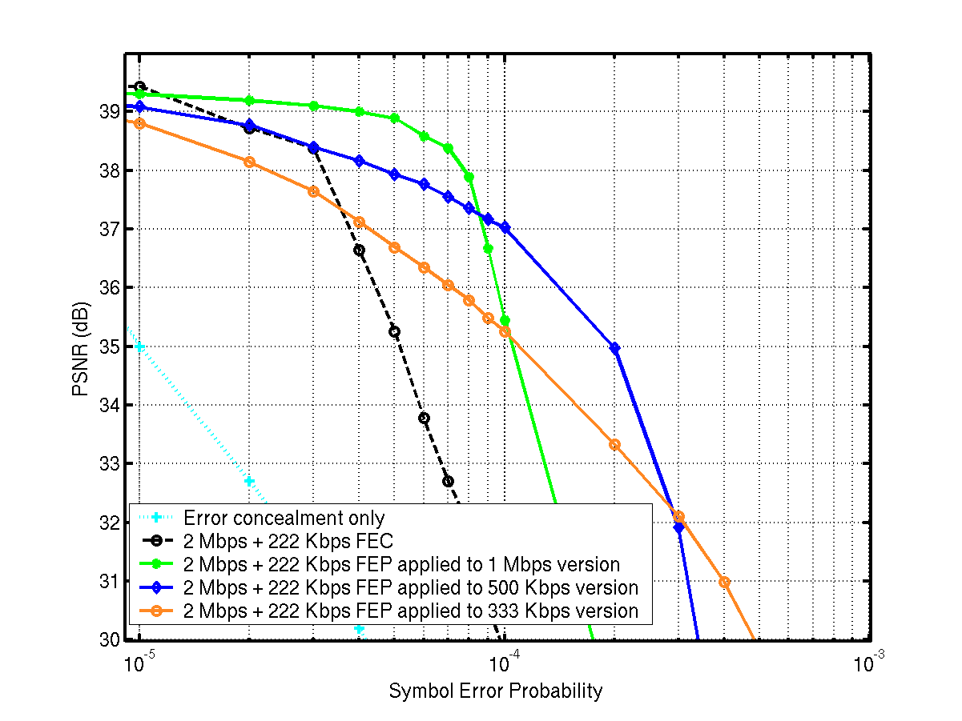
Results (1) Average video quality
foreman.cif @ 2 Mbps
222 Kbps parity
100 frames @ 30 fps
I-B-B-P-B-B-P…
Intra every 30 frames
PSNR avg. over 25 traces
Notes:
[1.5] Graceful degradation

Slide 10
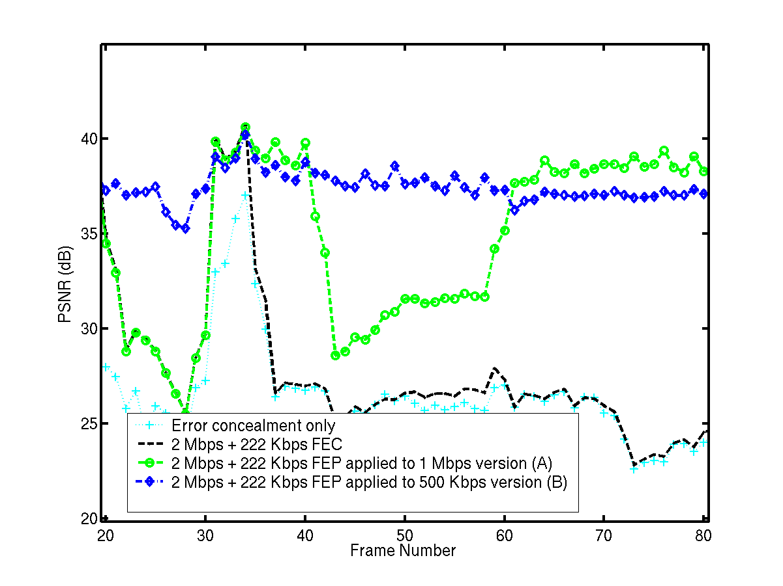
Results (2) Instantaneous video quality
foreman.cif @ 2 Mbps
222 Kbps parity
100 frames @ 30 fps
I-B-B-P-B-B-P…
Intra every 30 frames
Sequence PSNRs
FEP (A) : 37.30 dB
FEP (B) : 35.45 dB
FEC : 29.78 dB
ERC : 26.19 dB
Notes:
[1.5]
Average PSNR not a suitable indicator because errors often occur in bursts, or not at all. Hence frame PSNR plot.

Slide 11

Results (3) Visual Comparison
Foreman 100 CIF frames @ symbol error rate = 10⁻⁴
With FEC
Total : 2 Mbps + 222 Kbps
(29.78 dB)
With WZ description @ 1Mbps
2 Mbps + 222 Kbps
(35.45 dB)
Notes:
[1]
Before running sequences, explain what you are about to compare.

Slide 12
Results (4) Visual Comparison
Foreman 100 CIF frames @ symbol error rate = 10⁻⁴
With WZ desc. @ 1 Mbps
2 Mbps + 222 Kbps
(35.45 dB)
With WZ desc. @ 500 Kbps
2 Mbps + 222 Kbps
(37.03 dB)
Notes:
[1]
Mention clearly that the comparison is between two FEP schemes and that FEC is out of the picture already.

Slide 13
Conclusions
A Wyner-Ziv bitstream can be used to provide error-resilience in a systematic
source-channel setup.
Presented a practical systematic lossy error protection scheme for error-
resilient digital video broadcasting.
Scheme delivers superior decoded picture quality compared to conventional
FEC over a wide range of error rates.
Scheme achieves graceful quality degradation without requiring a layered
signal representation in the systematic transmission.
Notes:
[1]
FEP versus PET/UEP comparison information theoretic and experimental.

