Slide 1
Notes:
0.5 min.

Slide 2
Limitations of traditional error-resilience methods
Forward Error Correction (FEC).
Layered video coding with Priority Encoding
Transmission (PET)
PSNR
Graceful degradation with
efficient rate-distortion tradeoff.
Error Probability
Proposed approach : Wyner-Ziv coding of the video signal
What is the end-to-end video distortion for the chosen
WZ description and WZ bit-rate ?
Notes:
For layered coding to have zero R(D) penalty, BL-EL-X must form a Markov Chain. [1 min]

Slide 3
Outline
Systematic source-channel coding
Systematic Lossy Error Protection using Wyner-Ziv coding
Model for end-to-end video distortion
Comparison of model predictions with simulation results
Notes:
[0.5]

Slide 4


Systematic Source-Channel Coding
Analog
Channel
Side
info
Decoder
Encoder
Digital
Channel
Wyner-Ziv
Decoder
Wyner-Ziv
Encoder
Digital
Channel
[Shamai, Verdύ, Zamir, 1998]
Enhancing analog transmission systems using digital side information [Pradhan, Ramchandran, 2001]
Lossy source-channel coding of video waveforms [Aaron, Rane, Girod, 2003]
Notes:
[1.5 min]

Slide 5
Systematic Lossy Error Protection (SLEP)
“Analog Channel”
S
MPEG Encoder
MPEG Decoder with Error Concealment
S’
Error-Prone channel
Side information
Slepian-Wolf Encoder
Slepian-Wolf Decoder
Reconstruction
Coarse Quantizer
S*
Wyner-Ziv Encoder
Wyner-Ziv Decoder
Analogous to systematic source-channel coding
Error corrected up to a distortion introduced by coarse WZ quantizer, hence lossy protection. [Rane, Aaron, Girod, 2004]
Notes:
[2]

Slide 6

Practical scheme for Lossy Error Protection
LEGACY BROADCASTING SYSTEM
MPEG2
Decoder
Input
Video
MPEG2
Encoder
Conventionally encoded stream
Entropy
Decoding
Quantization parameter (Q)
Q⁻¹
T⁻¹
+
MC
Q₁
Error-prone Channel
Entropy
Coding
(motion vecs, mode decisions)
Quantized
transformed
Prediction error
Fallback to coarser version
(motion vectors,
mode decisions)
Side Info
Q₁
Entropy
Coding
RS
Encoder
Parity
only
RS
Decoder
Entropy
Decoding
Coarse
Quantizer
Decoded motion vecs
WYNER-ZIV ENCODER
WYNER-ZIV DECODER
Notes:
Might skip this entirely.

Slide 7
Reed-Solomon codes across slices
Transmit only parity symbols
k
X
X
X
X
X
X
X
X
X
X
X
X
X
X
n
Erasure Decoding
RS code across slices
1 byte in slice
filler byte
parity byte
Notes:
Might skip this entirely

Slide 8
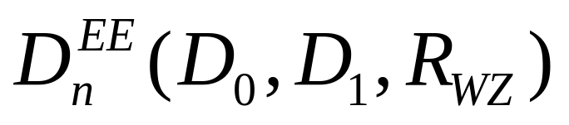
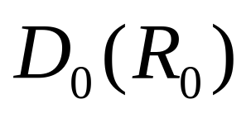
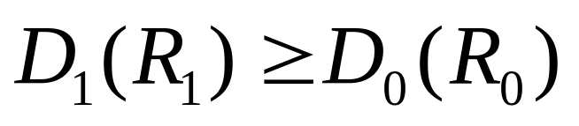
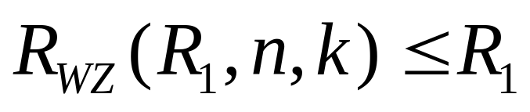
Essential Parameters in Video Distortion Model
LEGACY BROADCASTING SYSTEM
MPEG2
Decoder
Input
Video
MPEG2
Encoder
Conventionally encoded stream
Entropy
Decoding
Quantization parameter (Q)
Q⁻¹
T⁻¹
+
MC
Q₁
Error-prone Channel
Entropy
Coding
(motion vecs, mode decisions)
Quantized
transformed
Prediction error
Fallback to coarser version
(motion vectors,
mode decisions)
Side Info
Q₁
Entropy
Coding
RS
Encoder
Parity
only
RS
Decoder
Entropy
Decoding
Coarse
Quantizer
Decoded motion vecs
WYNER-ZIV ENCODER
WYNER-ZIV DECODER

Slide 9
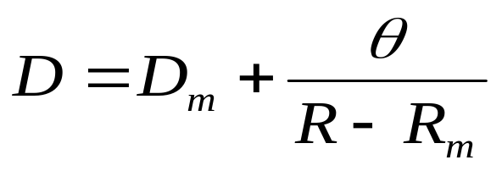
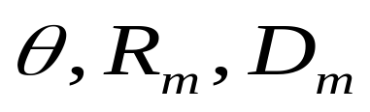
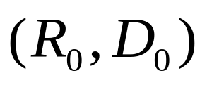
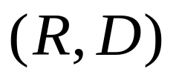
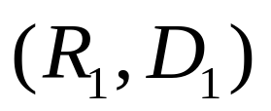
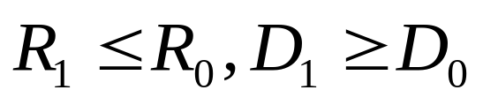
Modeling End-to-End Video Distortion (2)
Distortion at Encoder: [Stuhlmüller et al., 2000]
Parameters
Main (systematic)
video description
Rate-distortion pair
Coarse (Wyner-Ziv)
video description
Notes:
[1 min]

Slide 10
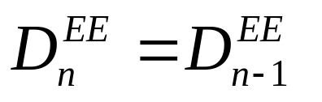
Modeling End-to-End Video Distortion (3)
Case 1: Video bitstream correctly received
systematic
bitstream
Video
Decoder
Error
concealment
Side info
Wyner-Ziv
bitstream
WZ
decoder
Notes:
[0.5 min]

Slide 11
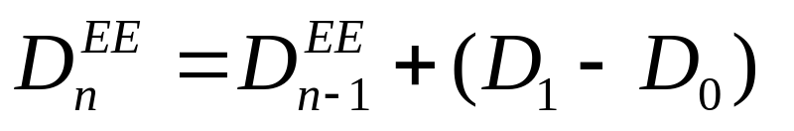
Modeling End-to-End Video Distortion (4)
Case 2: Error in video bitstream but WZ decoding is successful
X
systematic
bitstream
Video
Decoder
Error
concealment
Side info
Wyner-Ziv
bitstream
WZ
decoder
Notes:
[0.5 min]

Slide 12
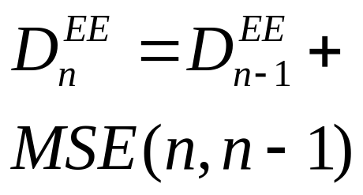
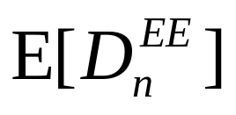
Modeling End-to-End Video Distortion (5)
Case 3: Error in video bitstream and WZ decoding fails
X
systematic
bitstream
Video
Decoder
Error
concealment
Side info
Wyner-Ziv
bitstream
WZ
decoder
X
Average end-to-end distortion in the nth frame =
Notes:
[0.5 min]

Slide 13
Simulation setup
Codecs:
  Main → MPEG-2 codec
  WZ → Coarse Quantizer + RS Slepian-Wolf codec.
[Rane, Aaron, Girod, ICIP2004]
Settings:
  1 Slice = 1 GOB
  Identical slice structure for main and WZ stream
  Main and WZ descriptions use same motion vectors and mode-decisions
  MPEG GOP structure : I-B-B-P-B-B-P-…
  Previous-frame error concealment
Notes:
[1 min] Spend time here because people might not know the system

Slide 14
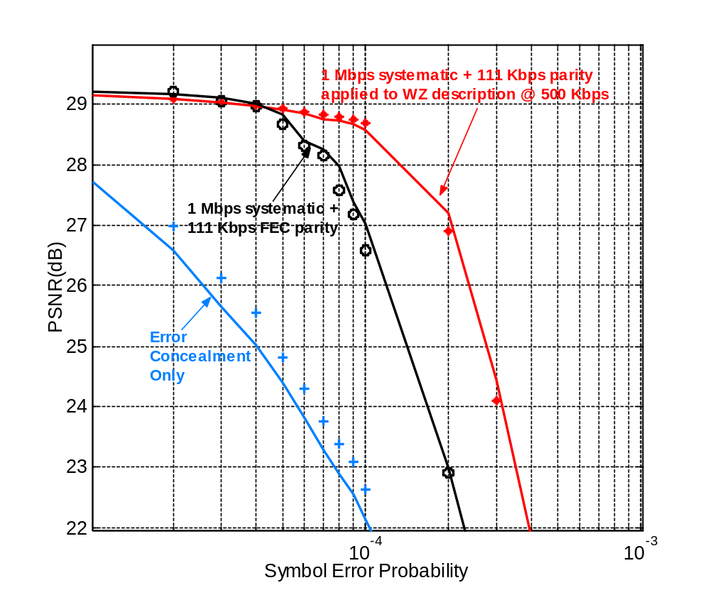
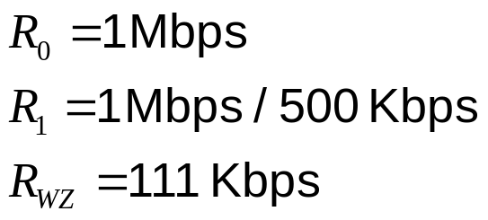
Model vs. Simulation (Bus.CIF)
bus.cif @ 1 Mbps
111 Kbps parity
100 frames @ 30 fps
I-B-B-P-B-B-P…
Intra every 30 frames
PSNR avg. over 25 traces
Notes:
[2 min]

Slide 15

Bus 100 CIF frames @ symbol error rate = 10⁻⁴
With FEC
Total : 1 Mbps + 111 Kbps
(26.58 dB)
With WZ description @ 500Kbps
1 Mbps + 111 Kbps
(28.69 dB)
Notes:
[0.5]
Before running sequences, explain what you are about to compare.

Slide 16
Bus 100 CIF frames @ symbol error rate = 2 x 10⁻⁴
With FEC
1 Mbps + 111 Kbps
(22.90 dB)
With WZ desc. @ 500 Kbps
1 Mbps + 111 Kbps
(26.89 dB)
Notes:
[1]

Slide 17
Conclusions
A Wyner-Ziv bitstream provides error-resilience in a systematic source-
channel setup.
A model for the end-to-end video quality delivered by the SLEP system.
Accounts for:
  Small degradation from Wyner-Ziv decoding at low error rates
  Large degradation from error concealment at high error rates
  Propagation of the above.
Model suggests an optimization scheme to find the best Wyner-Ziv
description and the best Wyner-Ziv bit-rate for given channel condition.
Notes:
[0.5]

