Slide 1
Notes:
Wednesday, Jan 21, 1:30 to 3:10 pm, Session 15 : Image/Video Transmission I (First Talk, Other topics deal with error-resilience and error-concealment)

Slide 2
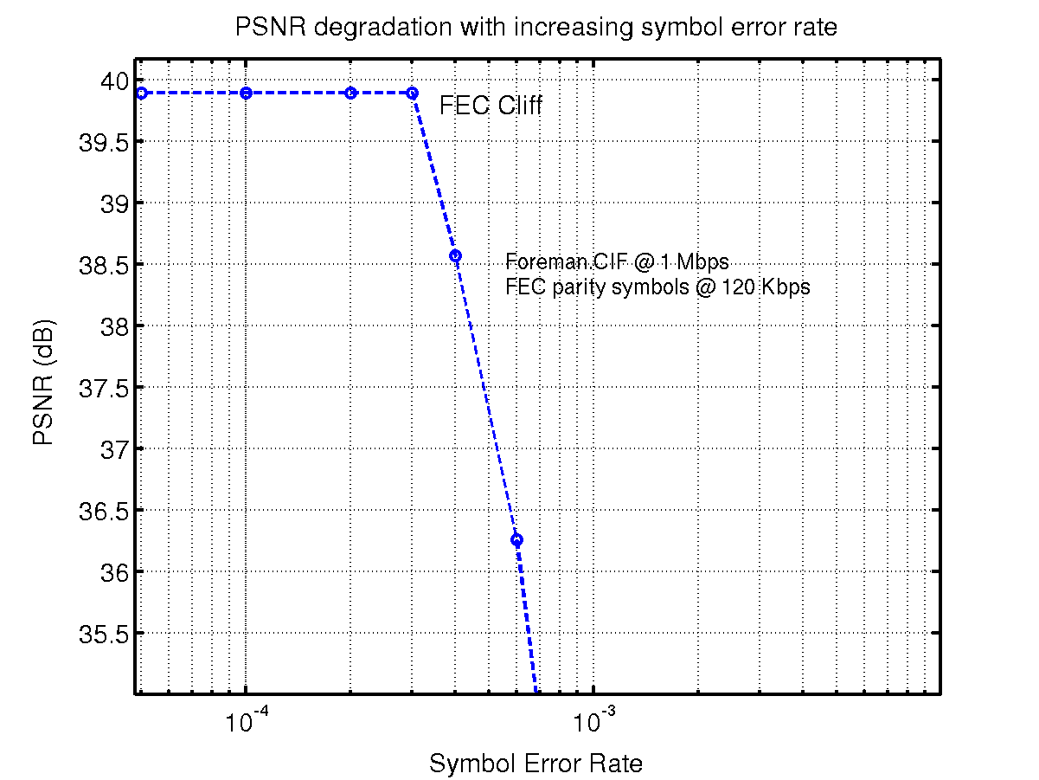
Limitations of traditional error-resilience methods
FEC (“Cliff” effect)
Layered Coding with Priority Encoding Transmission (PET)
(Inferior R-D Performance)
[Albanese et al., 1996]
Notes:
Broadcasting+FEC+PET+FEP

Slide 3
Outline
Systematic source-channel coding framework
Lossy Forward Error Protection using Wyner-Ziv coding
Results and Conclusions
Notes:
The audience will need a little intro on WZ coding. No equations, just the idea.

Slide 4
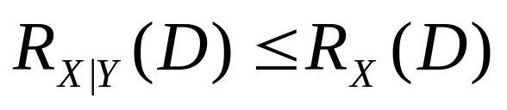
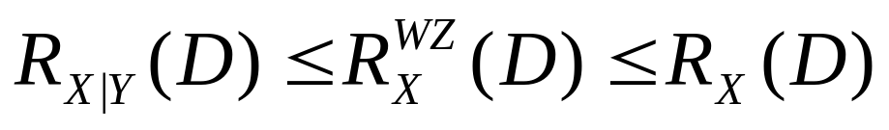
Wyner-Ziv coding background
Side-info at encoder and decoder:
X
encoder
decoder
X’
Y
Side-info at decoder only:
[Wyner and Ziv, 1975-76]
X
encoder
decoder
X’
Y
Can achieve bit-rate savings due to correlation between X and Y

Slide 5


Systematic Source-Channel Coding
Analog
Channel
Side
info
Wyner-Ziv
Encoder
Digital
Channel
Wyner-Ziv
Decoder
[Shamai, Verdu and Zamir, 1998]
Enhancing analog transmission systems using digital side information [Pradhan and Ramchandran, 2001]
Robust predictive coding [Sehgal and Ahuja, 2003]
Lossy source-channel coding of video waveforms
    [Aaron, Rane and Girod, 2003]
Notes:
Channels A and D+WZ relation+Pradhan+Sehgal

Slide 6
Systematic lossy forward error protection
S
MPEG Encoder
MPEG Decoder with Error Concealment
S’
Error-Prone channel
Side information
Slepian-Wolf Encoder
Slepian-Wolf Decoder
Reconstruction
Coarse Quantizer
S*
Wyner-Ziv Encoder
Wyner-Ziv Decoder
Systematic source-channel coding
“Lossy” protection
Fully backward compatible with legacy systems
Notes:
Conventional encoded+decoded+WZ representation (explain later)+decoding+lossy (clear later)

Slide 7
Fallback Scheme for error-resilience
S
+
Q
EC
S*
T
ED
Q⁻¹
T⁻¹
+
-
MC
Q⁻¹
Main
Encoder
T⁻¹
Channel
Fallback when
errors occur
+
MC
+
T
q
EC
ED
q⁻¹
T⁻¹
+
-
MC
q⁻¹
Fallback
Encoder
T⁻¹
+
MC
Notes:
say lossy

Slide 8
Proposed Wyner-Ziv codec
main
S
Video
Encoder
S*
ED
Q⁻¹
T⁻¹
+
MC
Reconstructed
frame at
Encoder
Channel
ED
q⁻¹
T⁻¹
+
MC
Video
Encoder
R-S
Encoder
R-S
Decoder
“coarse”
Video
Encoder
Transmit only
parity symbols
Side
information
“coarse”
Wyner-Ziv encoder
Wyner-Ziv decoder
Notes:
Conventional+fallback+generate side info+send only parity+reason for lossy

Slide 9
Reed-Solomon codes across slices
Transmit along this direction
k
X
X
X
X
X
X
X
X
X
X
X
X
X
X
n
RS code across slices
1 byte in slice
filler byte
Erasure Decoding
parity byte
Notes:
row/block+filler+n,k explanation+erasure+anim play

Slide 10
Simulation setup
Codecs:
  Main Codec → H.26L (JM2.0) codec
  WZ Codec → H.26L codec and R-S codec.
Settings:
  1 Slice = 11 macroblocks = 1/2 GOB for CIF frame
  Identical slice structure for main and WZ stream

Slide 11
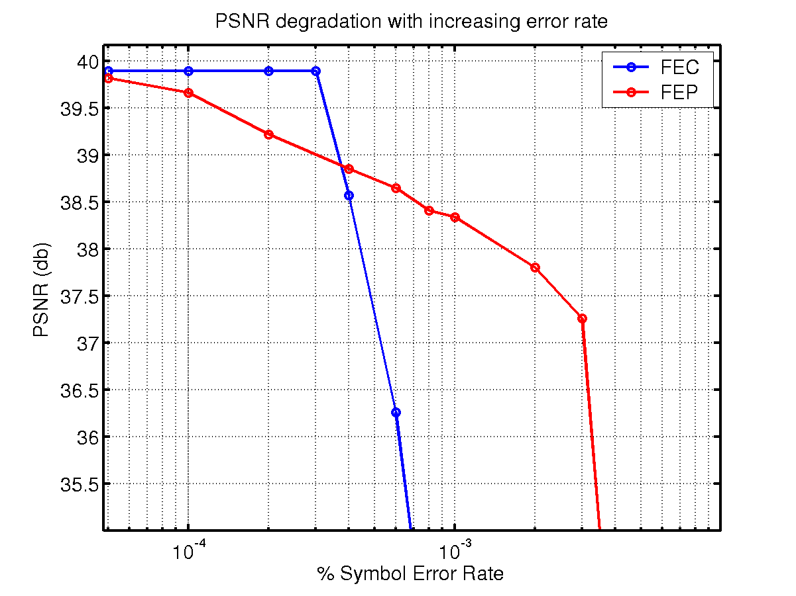
Results (1) Foreman.CIF
Main stream @ 1.092 Mbps
FEC (n,k) = (40,36)
FEC bitrate = 120 Kbps
Total = 1.2 Mbps
Main stream @ 1.092 Mbps
Coarse stream @ 270 Kbps
FEP (n,k) = (52,36)
WZ bitrate = 120 Kbps
Total = 1.2 Mbps
Notes:
Foreman bitrate+FEC bitrate+FEP bitrate+larger range+error concealment versus quantization

Slide 12
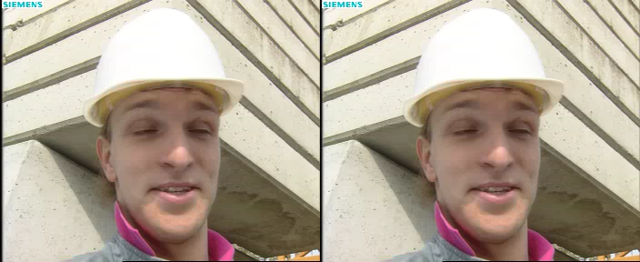
Results (2) Visual Comparison
Foreman 50 CIF frames @ symbol error rate = 4 x 10⁻⁴
With FEC
1.092 Mbps + 120 kbps
(38.32 dB)
With FEP
1.092 Mbps + 120 kbps
(38.78 dB)

Slide 13
Results (3) Visual Comparison
Foreman 50 CIF frames @ symbol error rate = 10⁻³
With FEC
1.092 Mbps + 120 kbps
(33.03 dB)
With FEP
1.092 Mbps + 120 kbps
(38.40 dB)
Notes:
Quantization artifacts invisible

Slide 14
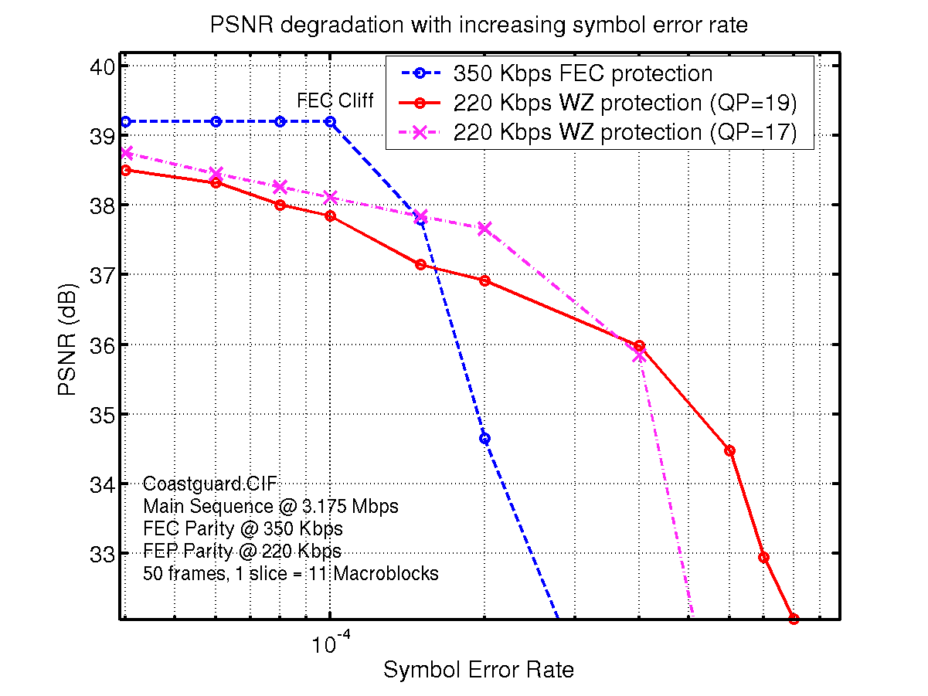
Results (2) Coastguard.CIF
Main stream @ 3.175 Mbps
FEC (n,k) = (40,36)
FEC bitrate = 352.78 Kbps
Total = 3.5 Mbps
Main stream @ 3.175 Mbps
Coarse stream @ 1 Mbps
FEP (n.k) = (44,36)
WZ bitrate = 220 Kbps
Total = 3.4 Mbps
Main stream @ 3.175 Mbps
Coarse stream @ 658 Kbps
FEP (n.k) = (48,36)
WZ bitrate = 220 Kbps
Total = 3.4 Mbps
Notes:
Add the third curve here, as presented in the paper (Important).

Slide 15
Ongoing Work : Embedded WZ codec
S
MPEG
Encoder
MPEG Decoder with Error Concealment
S’
Wyner-Ziv
Encoder A
Error-Prone channel
Wyner-Ziv
Decoder A
S*
Wyner-Ziv
Encoder B
Wyner-Ziv
Decoder B
S**
Graceful degradation of video quality
Does not require layered representation of original video signal

Slide 16
Conclusions
Systematic lossy forward error protection scheme for error-
resilient digital video broadcasting
Outperforms conventional FEC schemes, when SER increases
Fully backward compatible with legacy broadcast systems
Can construct embedded Wyner-Ziv codec which achieves
graceful degradation without layered representation.

