Slide 1
Notes:
Using WZ coding to increase the error-resilience of a transmitted video signal.

Slide 2
Limitations of Traditional Error-Resilience Methods
FEC cliff effect
Layered video coding with Priority Encoding
Transmission (PET)
Video Quality
Systematic Lossy Error Protection
(SLEP) [Rane, Girod, ICIP 2004]
Channel Error Probability
Main idea: Embed Wyner-Ziv descriptions for superior
resilience-quality trade-off
Notes:
FEC cliff
LCUEP
WZ descriptions
Main idea

Slide 3
Outline
Systematic lossy source-channel coding
Systematic Lossy Error Protection (SLEP) scheme with
multiple embedded Wyner-Ziv descriptions
Experimental comparison of SLEP and FEC
Notes:
As is.

Slide 4


Systematic Lossy Source-Channel Coding
Analog
Channel
Side
info
Digital
Channel
Decoder
Encoder
Digital
Channel
Wyner-Ziv
Decoder
Wyner-Ziv
Encoder
[Shamai, Verdú, Zamir, 1998]
Enhancing analog image transmission using digital side information
[Pradhan, Ramchandran, 2001]
Error-resilient distributed video compression schemes
[Sehgal, Ahuja, 2003-04], [Xu, Xiong, 2004]
Lossy source-channel coding of video waveforms
[Aaron, Rane, Girod, 2003-04]
Notes:
[1.5]
Analog channel
Side-info combine (WZ coding integral part)
Separation thm
Applications

Slide 5
Embedded Wyner-Ziv Codec
“Analog Channel”
S
MPEG
Encoder
MPEG Decoder with Error Concealment
S’
side
info
Error-Prone Channel
Wyner-Ziv
Encoder A
Low quality
Easy to decode
Wyner-Ziv
Decoder A
S*
Wyner-Ziv
Encoder B
High quality
Not always decodable
Wyner-Ziv
Decoder B
S**
Choose between coarse WZ description A and fine WZ description B [ICIP 04]
Embed coarse description A inside finer description B. Decode
description A first and use it to decode refined description B, if permissible
Notes:
[1]
1. Repeat previous
2. Role of Analog channel
3. Switching
4. Embedding

Slide 6



CONVENTIONAL VIDEO TRANSMISSION SYSTEM
MPEG2
Decoder
Input
Video
MPEG2
Encoder
Conventionally encoded stream
Entropy
Decoding
Quantization parameter (Q)
q⁻¹
T⁻¹
+
MC
Q₁
Fallback to finer version
Entropy
Coding
Fallback to coarser version
Fallback to coarser version
(motion vectors, mode decisions)
Transformed
prediction error
(motion vectors,
mode decisions)
Side Info
Entropy
Coding
RS
Encoder
Error-prone Channel
Q₁
Parity
only
RS
Decoder
Entropy
Decoding
Coarse
Quantizer
+
-
Decoded
motion vecs
Q₂
WYNER-ZIV ENCODER
WYNER-ZIV DECODER
+
-
+
Entropy
Coding
Side Info
Q₂
Entropy
Coding
RS
Encoder
Parity
only
RS
Decoder
Entropy
Decoding
Notes:
Really slowly thru this one. Crux
Involves WZ coding of the prediction error.
Mention quantization mismatch after the first layer.

Slide 7
Reed-Solomon Codes Across Slices
Transmit only parity symbols
k
X
X
X
X
X
X
X
X
X
X
X
X
X
X
n
Erasure Decoding
RS code across slices
1 byte in slice
filler byte
parity byte
Unequal number of RS parity slices in the two Wyner-Ziv symbol streams
Unequal number of RS parity slices for I,P, and B frames
Notes:
Go with animation
At end:
As in UEP, unequal protection for WZ desriptions
Another level of UEP, unequal protection for I,P,B frames (Time, heuristic)

Slide 8
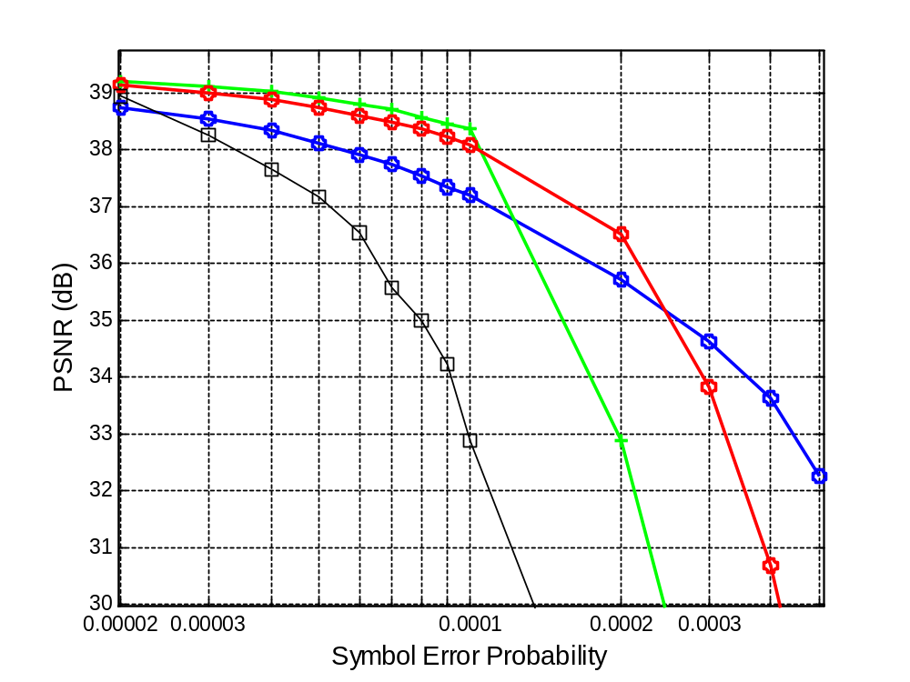
Results (1): Average Video Quality
Foreman CIF @ 2 Mbps
100 frames, 25 traces,
Intra frame every 30 frames
2 embedded WZ
descriptions
FEC
WZ with
coarse Q
Total transmitted WZ or FEC
bit-rate = 222 Kbps
WZ with
fine Q
Embedded scheme uses
166 Kbps for coarse desc
+
56 Kbps for finer desc
Notes:
FEC
Higher quality WZ description – small quantization mismatch, but extend range of operation
Lower quality WZ description – larger overall distortion penalty, but even larger range of operation
For a given error-resilience bit-rate, lower quality WZ description, better error resilience.
EWZ – 1 Mbps WZ description, contains embedded 500 Kbps WZ description.
Lower distortion penalty than the low quality WZ description, higher range of operation than the high-quality desription

Slide 9
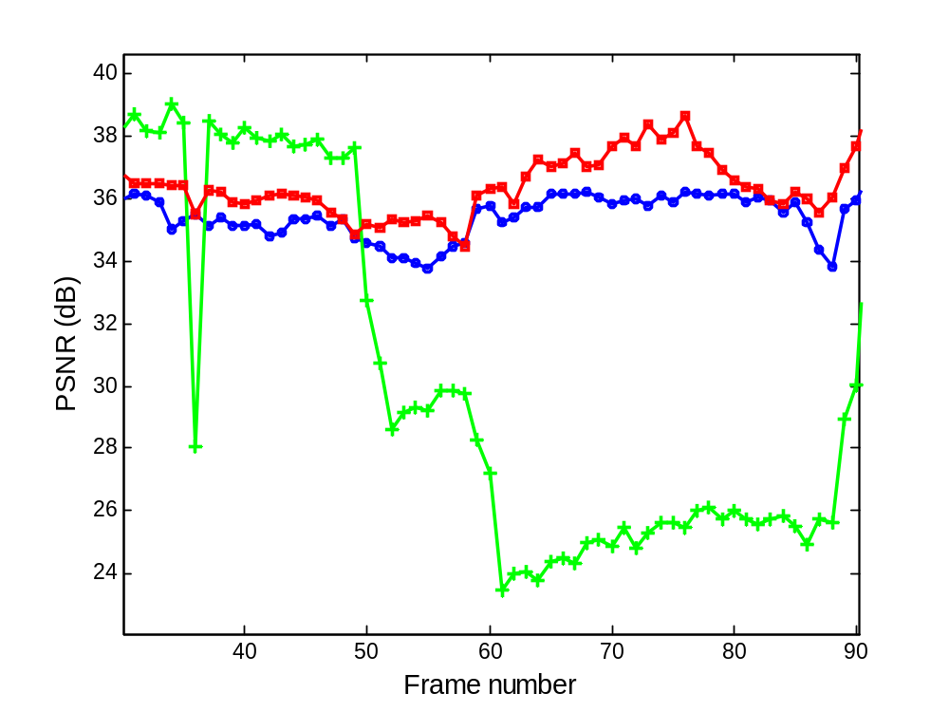
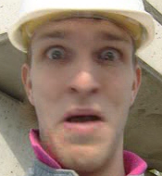
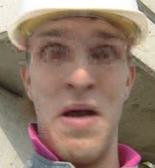
Results (2): Instantaneous Video Quality
2 embedded
WZ descriptions
WZ with
Coarse Q
WZ with
fine Q
Symbol Error Prob = 0.0002
Notes:
Higher quality description: high quality but cannot be sustained due to failure of WZ decoding
Lower quality description: Sustained video quality but overall quality suffers due to quantization mismatch
3. EWZ: video quality atleast as high as the lower quality, and usually better.

Slide 10

WZ bit-rate = 222 Kbps
Only one high-quality WZ description
@ 1 Mbps (fine quantization)
WZ bit-rate = 222 Kbps
High-quality WZ description @ 1 Mbps
containing an embedded
low-quality WZ description @ 500 Kbps

Slide 11
Summary
Practical SLEP scheme for error-resilient digital video transmission
Exploit resilience-quality trade-off with embedded WZ descriptions
Superior picture quality compared to FEC over a wide range of error rates
Graceful quality degradation but without a layered signal representation in the
systematic transmission
Outlook: Efficient implementation of SLEP using H.264 Redundant Slices
Notes:
Back-compatible, implemented at small increase in complexity, redundant slices

