Slide 1
Notes:
0.5

Slide 2
Limitations of traditional error-resilience methods
Forward Error Correction (FEC).
Layered video coding with UEP
PSNR
Systematic Lossy Error Protection
(SLEP) [Rane, Girod, ICIP 2004]
Error Probability
How does SLEP compare with Layered Coding in terms of resilience
to transmission errors ?
Notes:
For layered coding to have zero R(D) penalty, BL-EL-X must form a Markov Chain. [1 min]

Slide 3
Outline
Systematic source-channel coding
Systematic Lossy Error Protection (SLEP) using Wyner-Ziv coding
SLEP versus Layered Coding with Unequal Error Protection
Notes:
[0.5]

Slide 4


Systematic Source-Channel Coding
Analog
Channel
Side
info
Decoder
Encoder
Digital
Channel
Wyner-Ziv
Decoder
Wyner-Ziv
Encoder
Digital
Channel
[Shamai, Verdu, Zamir, 1998]
Enhancing analog transmission systems using digital side information [Pradhan, Ramchandran, 2001]
Lossy source-channel coding of video waveforms [Aaron, Rane, Girod, 2003]
Notes:
[1.5 min]

Slide 5
Systematic Lossy Error Protection (SLEP)
“Analog Channel”
S
MPEG Encoder
MPEG Decoder with Error Concealment
S’
Error-Prone channel
Side information
Slepian-Wolf Encoder
Slepian-Wolf Decoder
Reconstruction
Coarse Quantizer
S*
Wyner-Ziv Encoder
Wyner-Ziv Decoder
Analogous to systematic source-channel coding
Error corrected up to a distortion introduced by coarse WZ quantizer, hence lossy protection. [Rane, Aaron, Girod, 2004]
Notes:
[2]

Slide 6

Practical scheme for Lossy Error Protection
LEGACY BROADCASTING SYSTEM
MPEG2
Decoder
Input
Video
MPEG2
Encoder
Conventionally encoded stream
Entropy
Decoding
Quantization parameter (Q)
Q⁻¹
T⁻¹
+
MC
Q₁
Error-prone Channel
Entropy
Coding
(motion vecs, mode decisions)
Quantized
transformed
Prediction error
Fallback to coarser version
(motion vectors,
mode decisions)
Side Info
Q₁
Entropy
Coding
RS
Encoder
Parity
only
RS
Decoder
Entropy
Decoding
Coarse
Quantizer
Decoded motion vecs
WYNER-ZIV ENCODER
WYNER-ZIV DECODER
Notes:
Might skip this entirely.

Slide 7
Reed-Solomon codes across slices
Transmit only parity symbols
k
X
X
X
X
X
X
X
X
X
X
X
X
X
X
n
Erasure Decoding
RS code across slices
1 byte in slice
filler byte
parity byte
Notes:
Might skip this entirely

Slide 8
Simulation setup
SLEP
  Systematic Transmission → MPEG-2 coded bitstream
  WZ Codec → Coarse Quantizer + RS Slepian-Wolf codec.
  Identical slice structure for main and WZ stream
  Main and WZ descriptions use same motion vectors and mode-decisions
  MPEG GOP structure : I-B-B-P-B-B-P-…
  Previous-frame error concealment
Layered Coding with Unequal Error Protection
  Video Codec → 2 layer MPEG-2 SNR scalable video codec.
  Error protection → RS coding across slices.
  MPEG GOP structure : I-B-B-P-B-B-P-…
  Previous-frame error concealment
Notes:
[1 min] Spend time here because people might not know the system

Slide 9
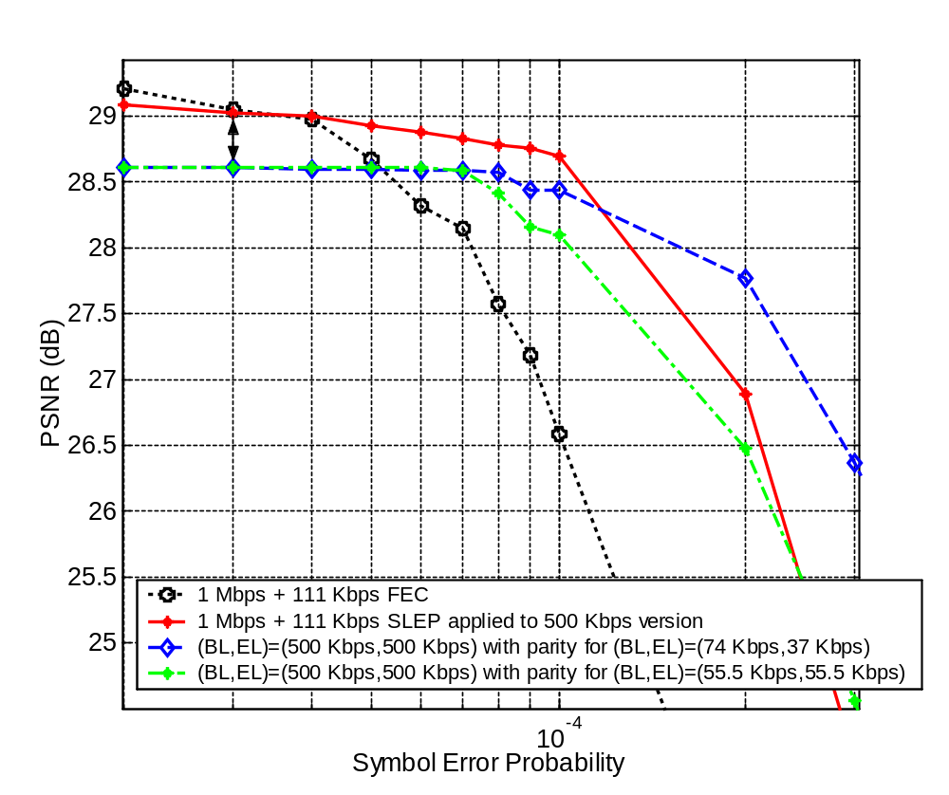
Average Video Quality vs. Error Probability
bus.cif @ 1 Mbps
111 Kbps parity
100 frames @ 30 fps
I-B-B-P-B-B-P…
Intra every 30 frames
PSNR avg. over 25 traces
Notes:
[2 min]

Slide 10

Bus 100 CIF frames @ symbol error rate = 10⁻⁴
With FEC
1 Mbps + 111 Kbps
(26.58 dB)
With (BL, EL) = (500 Kbps, 500 Kbps)
1 Mbps + 74 Kbps + 37 Kbps
(28.4 dB)
Notes:
[1]

Slide 11

Bus 100 CIF frames @ symbol error rate = 10⁻⁴
With FEC
Total : 1 Mbps + 111 Kbps
(26.58 dB)
With WZ description @ 500Kbps
1 Mbps + 111 Kbps
(28.69 dB)
Notes:
[0.5]
Before running sequences, explain what you are about to compare.

Slide 12
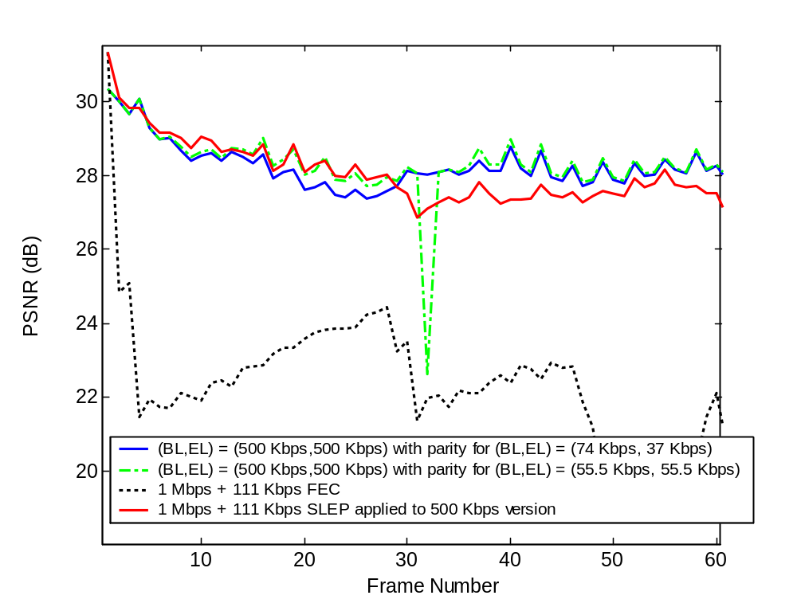
Instantaneous Video Quality (High Error Prob.)
bus.cif @ 1 Mbps
111 Kbps parity
Symbol Err. Prob
= 2 x 10⁻⁴

Slide 13
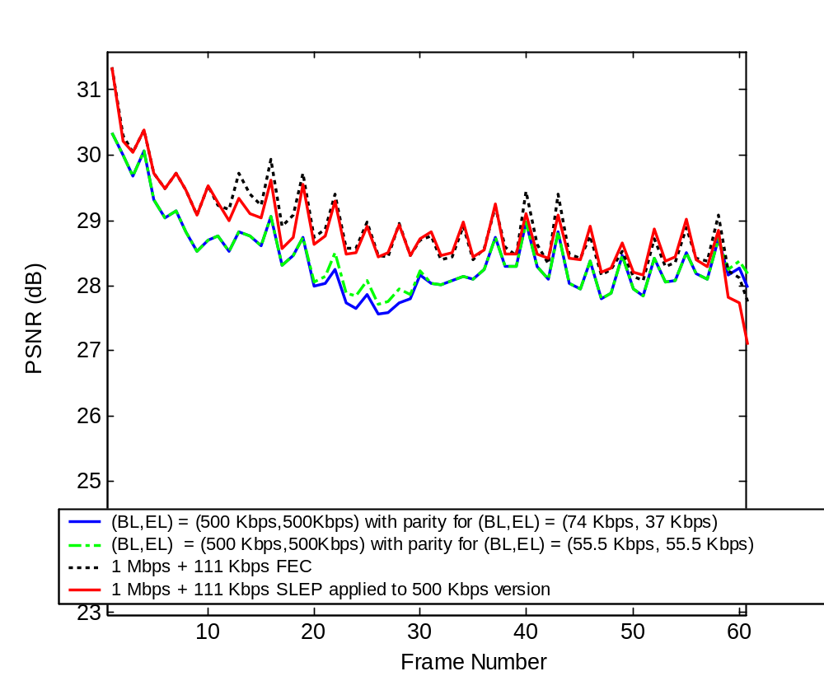
Instantaneous Video Quality (Low Error Prob.)
bus.cif @ 1 Mbps
111 Kbps parity
Symbol Err. Prob
= 6 x 10⁻⁵

Slide 14
Conclusions
A Wyner-Ziv bitstream provides error-resilience in a systematic source-
channel setup.
Like layered coding, SLEP provides graceful degradation of video quality over
a range of error probabilities
Unlike layered coding, SLEP benefits from efficient R-D performance at low
error probabilities.
Notes:
[0.5]

