Slide 1
Modeling and Optimization of a
Systematic Lossy Error Protection System
Based on H.264/AVC Redundant Slices
Shantanu Rane, Pierpaolo Baccichet and Bernd Girod
Information Systems Laboratory
Stanford University
Notes:
Standardization.
April 25, Error Robust Video Coding and Transmission, 12:45-13:00
Kai Kuang Ma → NTU Singapore
MDC,
Attention based Adaptive Intra Refresh
OFDM

Slide 2
Systematic Lossy
Error Protection
Video Quality
FEC
(SLEP)
Error Prob
Error resilience by supplementary parity bit stream
Lossless protection of video
bit stream
Trade-off between:
  source bit rate
  parity bit rate
Severe error cliff
Error resilience by supplementary Wyner-Ziv bit stream
Lossy protection of video waveform
Trade-off between:
  source bit rate
  Wyner-Ziv bit rate
  Loss in Wyner-Ziv decoding
Graceful degradation

Slide 3
Systematic Lossy Error Protection (SLEP)
Video
Encoder
Video Decoder With
Error Concealment
Video
With
Errors
Input
Video
Channel
Side Information
Wyner-Ziv
Encoder
Wyner-Ziv
Decoder
Output
Video
Analogous to systematic lossy source/channel coding
[Shamai, Verdú, Zamir, 1998]
Wyner-Ziv coding by applying Reed-Solomon codes across H.264/AVC redundant slices
[Rane, Baccichet, Girod, 19th JVT mtg, Geneva 2006]

Slide 4
Outline
SLEP implementation using H.264/AVC redundant slices
Model for end-to-end rate-distortion performance
Resilience vs. quality trade-off in SLEP

Slide 5
SLEP Using Redundant Slices
H.264/AVC ENCODER
H.264/AVC DECODER
Output
Video
Input
Video
Encode
Primary Pic
Entropy
Decoding
Q⁻¹
T⁻¹
+
Motion Vecs +
Coding Modes
Motion Vecs +
Coding Modes
MC
Encode
Redundant Pic
(Requantize)
Error-prone Channel
Encode
Redundant Pic
(Requantize)
QP
Side info
RS
Encoder
Parity Slices
QP
Erasure
Decoding
Entropy
Decoding
Decode
Redundant Slice
Recovered motion vectors
for erroneously received primary slices
WYNER-ZIV ENCODER
WYNER-ZIV DECODER

Slide 6
RS Encoding Across Redundant Slices
Redundant Slice
Redundant Slice
redundant slice byte
Redundant Slice
k
filler byte
…
n
parity byte
Redundant Slice
SLEP parity symbols
SLEP parity symbols
Transmit only SLEP slices
in Wyner-Ziv bit stream

Slide 7
RS Decoding Across Redundant Slices
Decode and display
in place of
lost primary slice
Regenerated Redundant Slice
Regenerated Redundant Slice
Recovered Redundant Slice
k
…
n
Regenerated Redundant Slice
SLEP parity symbols
SLEP parity symbols

Slide 8
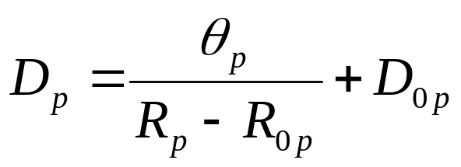
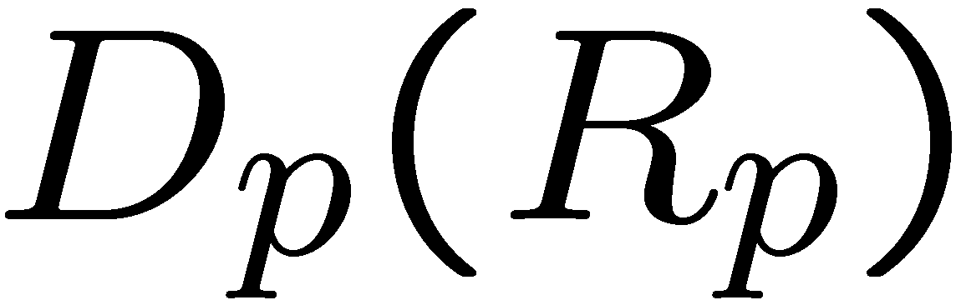
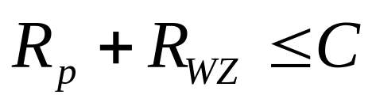
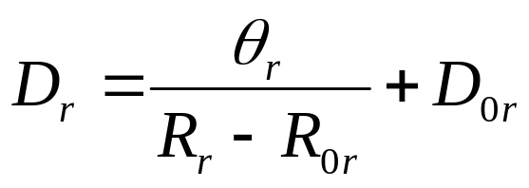
[Stuhlmϋller et al., 2000]
p = Pr{primary slice arrives in error}
H.264/AVC ENCODER
H.264/AVC DECODER
Output
Video
Input
Video
Encode
Primary Pic
Entropy
Decoding
?
Q⁻¹
T⁻¹
+
Motion Vecs +
Coding Modes
Motion Vecs +
Coding Modes
MC
Encode
Redundant Pic
(Requantize)
Error-prone Channel
Encode
Redundant Pic
(Requantize)
QP
Side info
RS
Encoder
Parity Slices
QP
Erasure
Decoding
Entropy
Decoding
Decode
Redundant Slice
Recovered motion vectors
for erroneously received primary slices
WYNER-ZIV ENCODER
WYNER-ZIV DECODER

Slide 9
Distortion in Received Video Packet
After taking expectations of pixel-wise squared errors,
Error propagation from previous frame
Quantization mismatch from Wyner-Ziv decoding
Error concealment distortion

Slide 10
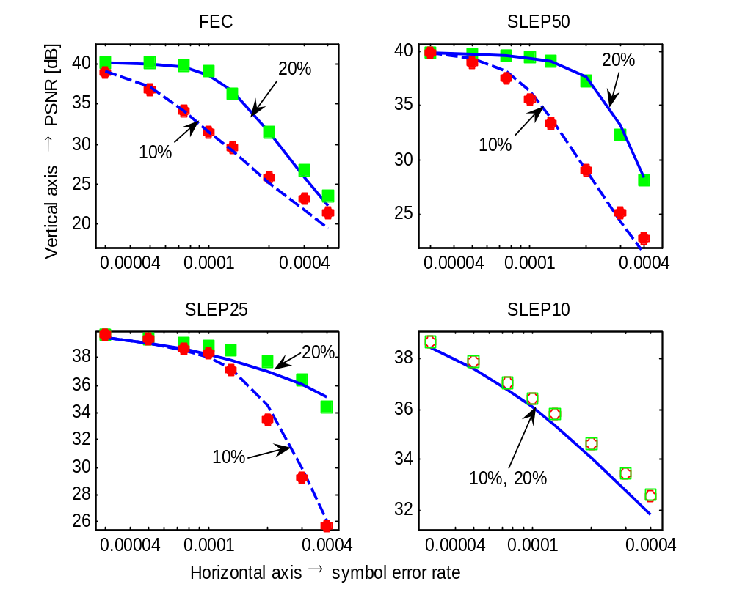
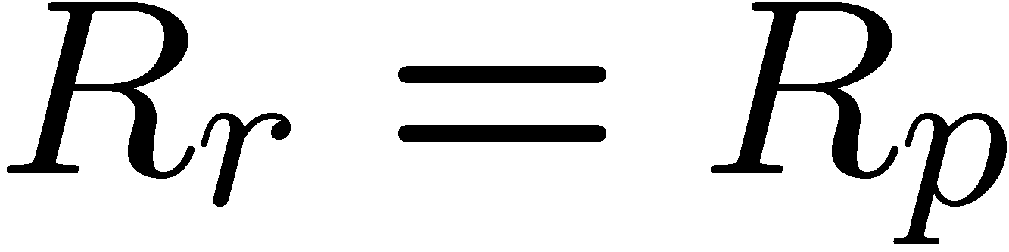
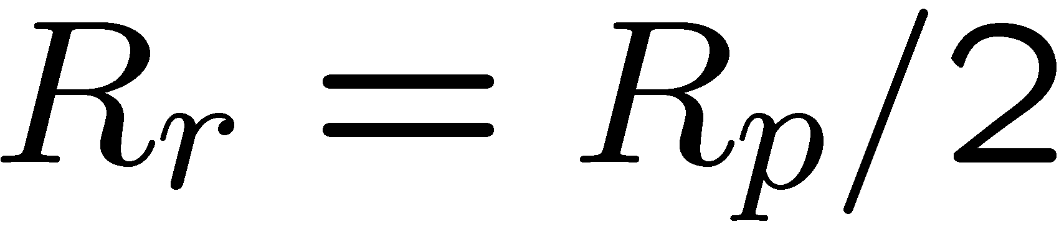
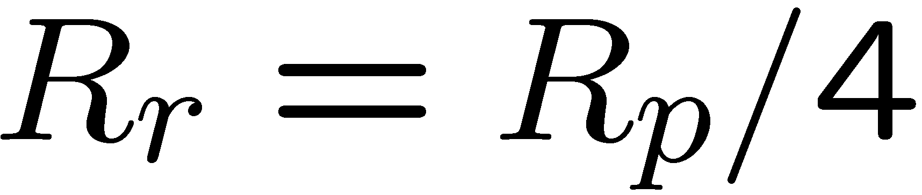
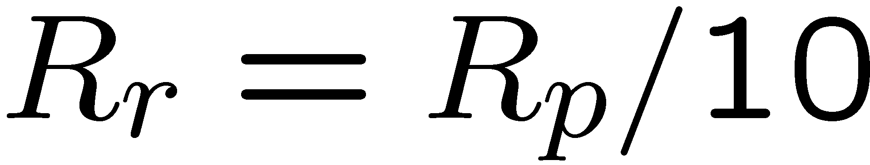
Model Vs. Experimental Simulation
Foreman.CIF
100 frames
R_{p} = 1 Mbps
R_{WZ} =100 kbps,
200 kbps
I-P-P-P…
Previous frame
error concealment
Random symbol
errors
PSNR avg. over
30 traces
PSNR [dB]
Symbol Error Probability
Notes:
Axes
10% error resilience bit rate (red), and 20% error resilience bit rate (green)
Redundant slices encoded at smaller and smaller fractions of the primary slice bit rate
Model solid lines. Fits

Slide 11

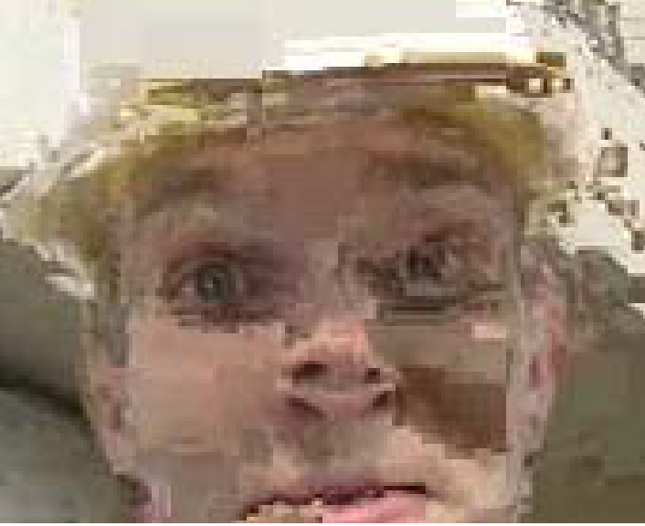




Systematic bit rate 408 kbps, WZ bit rate ~ 40 kbps
Symbol error probability = 5 x 10⁻⁴
Error-free
35.7 dB
QP=28
Error concealment only
SLEP with redundant QP = 36
40 kbps FEC
SLEP with redundant QP = 40
SLEP with redundant QP = 48
20.9 dB
30.9 dB
25.5 dB
34.2 dB
32.9 dB
Notes:
Is a video better?
FEC, residual errors
36, residual errors
40, all errors corrected
48, all errors corrected, but visible quantization mismatch

Slide 12
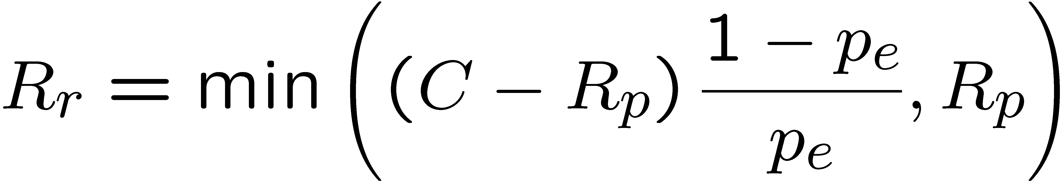
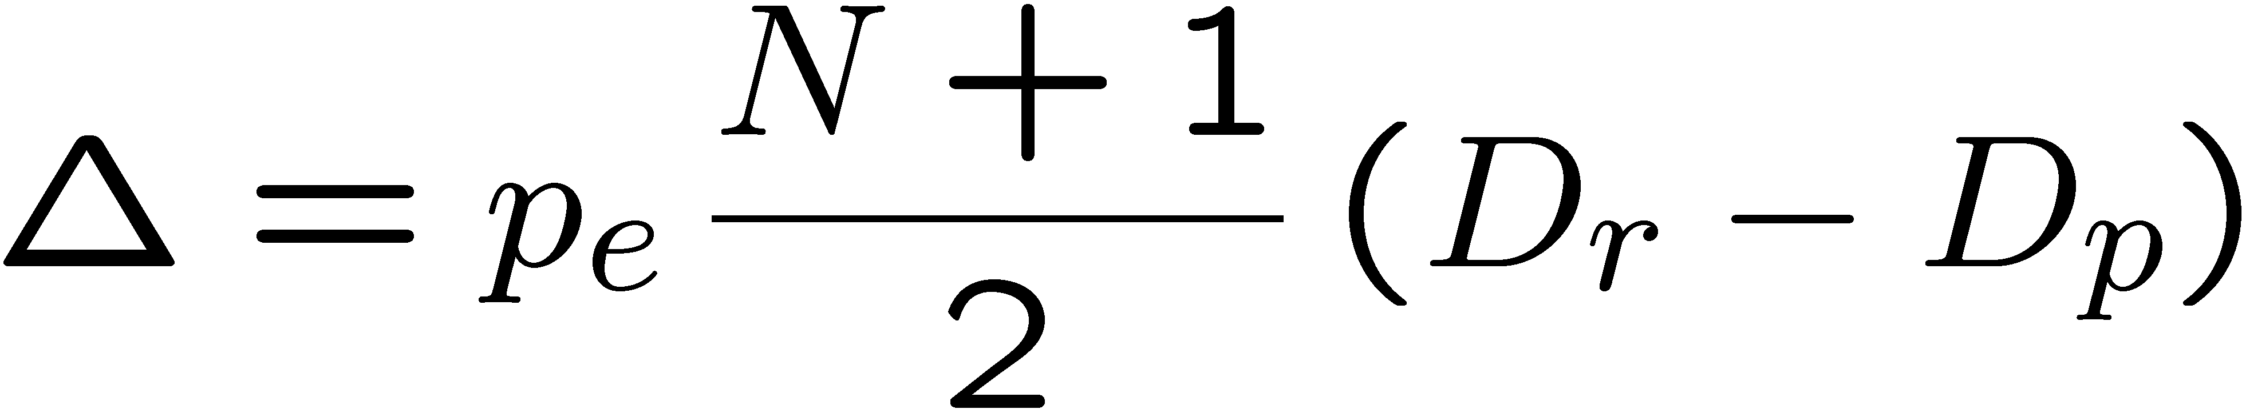
Resilience vs. Quality Trade-Off in SLEP
For a packet loss probability p_{e}
Bit rate of the “best” redundant description:
Quality loss due to best redundant description:

Slide 13
Conclusions
SLEP achieves graceful trade-off between error resilience and video quality, and mitigates FEC cliff
Quality loss from WZ decoding modeled as function of quantization mismatch and extent of error propagation

