Slide 1
Systematic Lossy Error Protection based on
H.264/AVC Redundant Slices and FMO
Pierpaolo Baccichet, Shantanu Rane and Bernd Girod
Information Systems Laboratory
Stanford University

Slide 2
Outline
Systematic Lossy Error Protection
H.264/AVC implementation
ROI-enhancement for low-motion sequences
Simulation results

Slide 3
Systematic Lossy Error Protection (1/5)
S
Video Encoder
Video Decoder with Error Concealment
S’
Error-Prone channel
Side information
Slepian-Wolf Encoder
Slepian-Wolf Decoder
Reconstruction
S*
Coarse Quantizer
Wyner-Ziv Encoder
Wyner-Ziv Decoder
Analogous to systematic source/channel coding [Shamai, Verdù, Zamir, 1998]
Error corrected up to a distortion introduced by coarse WZ quantizer, hence lossy protection [Rane, Aaron, Girod, ICIP 2003]

Slide 4
Systematic Lossy Error Protection (2/5)
- H.264/AVC codec implementation -
H.264/AVC ENCODER
H.264/AVC DECODER
Output
Video
Encode
primary slices
Entropy
Decoding
Q⁻¹
T⁻¹
+
Motion vecs +
Coding modes
Motion vecs +
Coding modes
MC
Determine ROI
Encode
Redund. slice
(Requantize)
Error-prone Channel
Encode
redundant slice
(Requantize)
QP +
Slice boundary
Side info
RS
Encoder
Parity slices + QP +
Slice boundaries
RS
Decoder
Entropy
Decoding
Decode
redundant slice
Recovered motion vectors
for erroneously received primary slices
WYNER-ZIV ENCODER
WYNER-ZIV DECODER

Slide 5
Systematic Lossy Error Protection (3/5)
- Reed-Solomon Encoder -
Redundant Slice
Redundant Slice
redundant slice byte
Redundant Slice
k
filler byte
…
n
parity byte
Redundant Slice
SLEP parity symbols
SLEP parity symbols
Transmit only SLEP slices
in Wyner-Ziv bit stream
(together with some helper information)
Notes:
k redundant slices, filler
SLEP parity data, total of n slices
RS encoding
helper info and RTP header
transmit only SLEP slices

Slide 6
Systematic Lossy Error Protection (4/5)
- Reed-Solomon Decoder -
Decode and display
in place of
lost primary slice
Regenerated Redundant Slice
Regenerated Redundant Slice
Recovered Redundant Slice
k
…
n
Regenerated Redundant Slice
SLEP parity symbols
SLEP parity symbols

Slide 7
Systematic Lossy Error Protection (5/5)
- One more degree of flexibility Vs. FEC -
100%
Primary video
Redundant video
Parity info
Encoding Bit Rate
50%
25%
10%
FEC
SLEP_50_10
SLEP_25_10
SLEP_10_10
or
SLEP_100_10
Possible to model and optimize these parameters
[Rane, Baccichet, Girod, PCS 2006]
Total transmitted bit rate is identical for all schemes
Redundant slices bit rate as % of Primary slices bit rate
Parity slices bit rate as % of Primary slices bit rate

Slide 8
Simulation Results (1/4)
- Experimental setup -
H.264/AVC (JM 10.1) “primary” bitstream at constant bit-rate
WZ Codec → Redundant slice generation tool (Coarse QP) + Reed-Solomon codec
GOP structure : I-P-P-P-… with one forced intra MB line per frame
JVT non-normative error concealment
Two Considered Scenarios
  Wireless transmission with symbol errors
  Internet video transmission with packet losses due to congestion
Average over 30 independent random traces

Slide 9
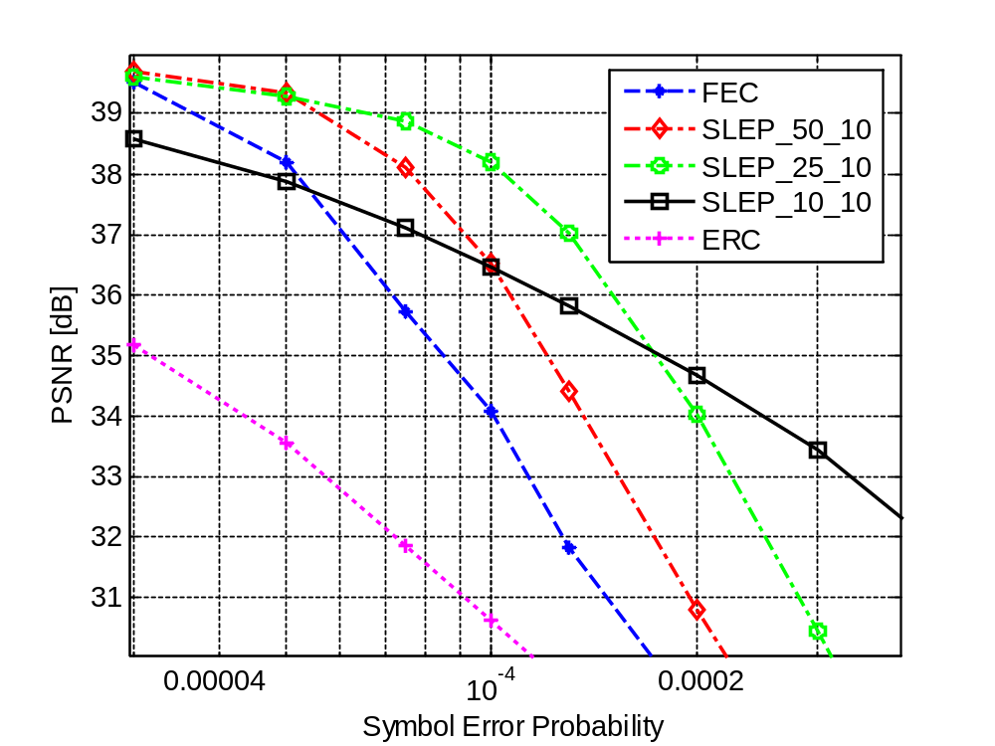
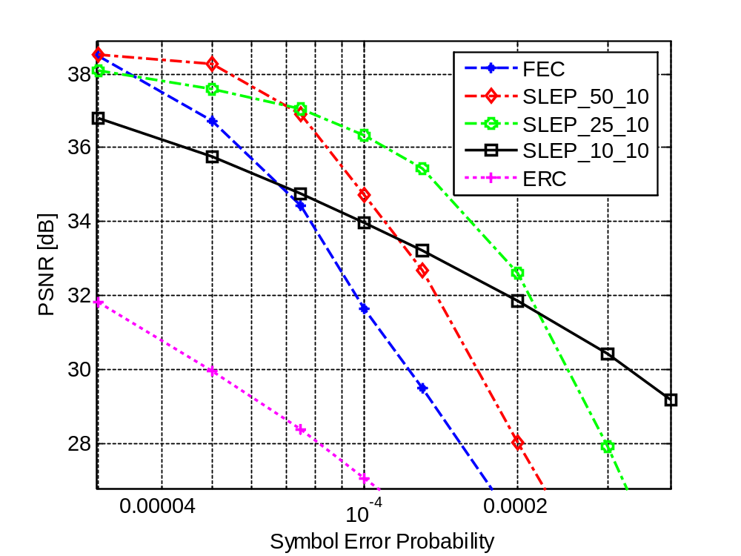
Simulation Results (2/4)
- Wireless Scenario -
Foreman @ 1 Mbps
Bus @ 1.5 Mbps
4 dB
4 dB
Notes:
Explain meaning of SLEPXY
distinguish between XY and % of redundancy
losses due to symbol errors
30 simulations, 150 frames
increase in error resilience or increase in quality at the same error prob

Slide 10
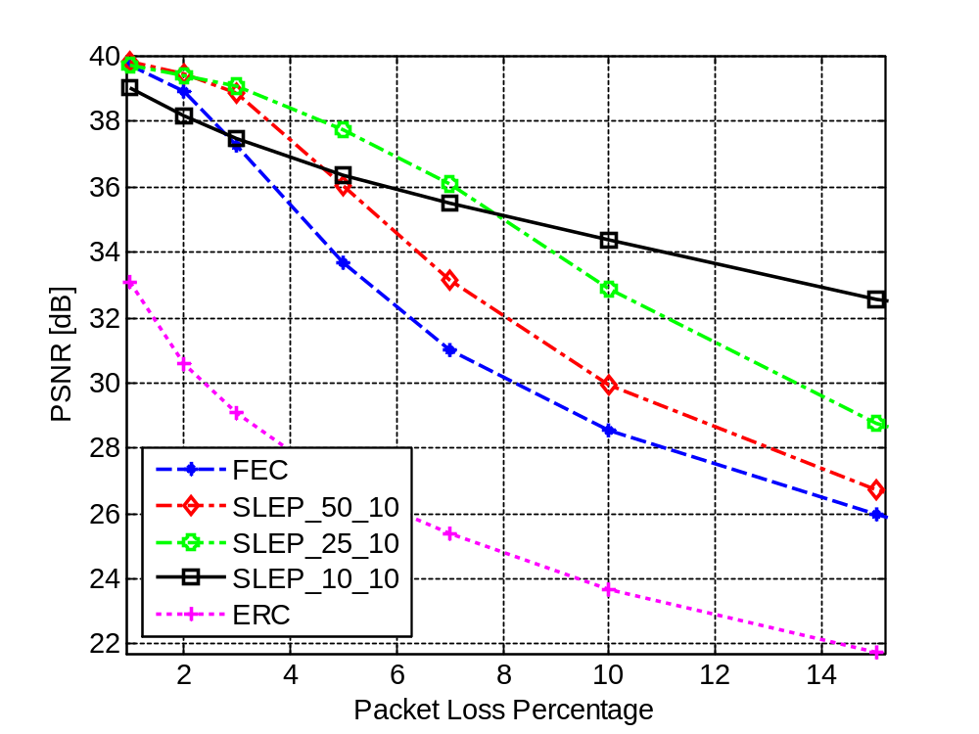
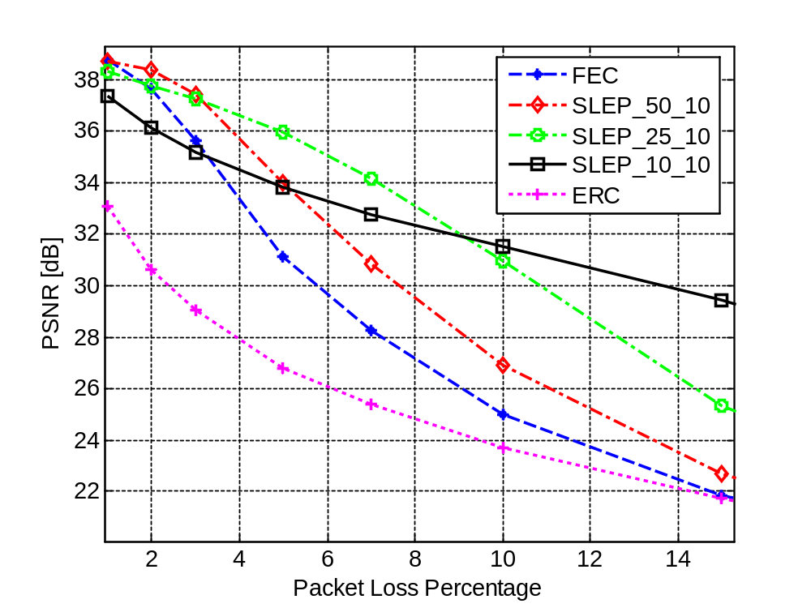
Simulation Results (3/4)
- Internet Scenario -
Foreman @ 1 Mbps
Bus @ 1.5 Mbps
Notes:
1. Losses due to congestion

Slide 11

Simulation Results (4/4)
Primary bit rate 1Mbps, Parity bit rate 100 kbps
Symbol error probability = 2 x 10⁻⁴
FEC
PSNR: 32.5 dB
Recovered MBs: 2539
Erroneous MBs: 2183
SLEP_25_10
PSNR: 38.0 dB
Recovered MBs: 4561
Erroneous MBs: 161

Slide 12



SLEP on ROI for low motion sequences (1/3)
- ROI determination procedure -
Encoded image
ROI
Significance Map
(MAE for each Macroblock)
Error signal
0
1
0
0
0
0
0
0
0
0
0
0
0
1
0
1
4
1
0
0
0
0
0
0
0
0
5
8
3
0
0
0
0
0
0
0
0
14
13
6
0
0
0
0
-
0
0
0
0
4
11
3
0
0
0
0
0
0
0
0
0
4
3
0
0
0
0
0
0
0
0
0
0
1
1
0
0
0
0
0
0
0
0
0
0
1
1
0
0
0
0
0
0
0
0
1
0
1
1
0
Concealed image
0
Slice
Group 0
Slice Group 3
1
0
0
0
0
0
0
Slice
Group 1
0
0
0
0
0
1
0
0
0
0
0
Picture Parameter Set
with the FMO2 mapping
0
0
0
0
0
0
0
0
0
0
0
0
0
0
0
0
0
0
0
0
0
0
0
0
0
0
0
0
0
0
0
0
ROI to WZ-encode
0
0
0
0
0
0
1
1
0
0
0
Slice
Group 2
0
0
0
0
0
0
0
1
1
0
0
0
0
0
0
0
0
1
0
1
1
0

Slide 13
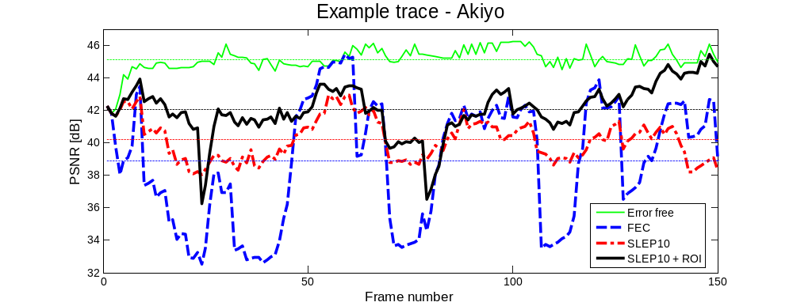
SLEP on ROI for low motion sequences (2/3)
- Benefits of the ROI -
Akiyo @ 400 kbps
Symbol error rate = 3 x 10⁻⁴
Notes:
Go by color.

Slide 14

SLEP on ROI for low motion sequences (3/3)
Primary bit rate 400 kbps, SLEP bit rate 40 kbps
Symbol error rate = 3 x 10⁻⁴
SLEP_10_10
PSNR: 40.2 dB
Recovered MBs: 6826
Unrecovered MBs: 0
SLEP_10_10 + ROI
PSNR: 42.1 dB
Recovered MBs: 737
Unrecovered MBs: 5155

Slide 15
Conclusions
SLEP mitigates the FEC cliff effect and ensures graceful degradation in error-prone environments
Proposed implementation exploits tradeoff between quality of the redundant representation and error resilience
SLEP on a Region-of-Interest improves performance for low motion sequences
SLEP standardization effort

