Slide 1
Systematic Lossy Error Protection based on H.264/AVC Redundant Slices
Shantanu Rane and Bernd Girod
Information Systems Laboratory
Stanford University

Slide 2
Error-Resilient Video Transmission
FEC cliff effect
Layered video coding with Priority Encoding
Transmission (PET)
Video Quality
Systematic Lossy Error Protection
(SLEP) using Wyner-Ziv coding
[Rane, Girod, ICIP 2004-05]
Channel Error Probability
Construct Wyner-Ziv codec using H.264/AVC redundant slices

Slide 3
Outline
Systematic lossy source/channel coding
SLEP implementation based on H.264/AVC redundant slices
Simulation results

Slide 4


Systematic Lossy Source/Channel Coding
Analog
Channel
Side
info
Digital
Channel
Decoder
Encoder
Digital
Channel
Wyner-Ziv
Decoder
Wyner-Ziv
Encoder
[Shamai, Verdú, Zamir, 1998]
Enhancing analog image transmission using digital side information
[Pradhan, Ramchandran, 2001]
Error-resilient distributed video compression schemes
[Sehgal, Ahuja, 2003-04], [Xu, Xiong, 2004]
Systematic lossy source-channel coding of video waveforms
[Aaron, Rane, Girod, 2003-04-05]

Slide 5
SLEP for Video Transmission
“Analog Channel”
S
Video Encoder
Video Decoder with Error Concealment
S’
Error-Prone channel
Side information
Slepian-Wolf Encoder
Slepian-Wolf Decoder
Reconstruction
Coarse Quantizer
S*
Wyner-Ziv Encoder
Wyner-Ziv Decoder
Analogous to systematic source/channel coding
Error corrected up to a distortion introduced by coarse WZ quantizer, hence lossy protection [Rane, Aaron, Girod, ICIP 2003]
Notes:
Conceptual WZ codec
First implementation
Exploit capabilities of hybrid video coding by applying WZ coding to the prediction error signal instead of the video signal itself.

Slide 6
SLEP using H.264/AVC Redundant Slices
H.264/AVC ENCODER
H.264/AVC DECODER
Output
Video
Input
Video
Encode
Primary Pic
Entropy
Decoding
Q⁻¹
T⁻¹
+
Motion vecs +
Coding modes
Motion vecs +
Coding modes
MC
Encode
Redundant Pic
(Requantize)
Error-prone Channel
Encode
Redundant Pic
(Requantize)
QP
Side info
RS
Decoder
Parity slices
QP
RS
Decoder
Entropy
Decoding
Decode
Redundant Slice
Recovered motion vectors
for erroneously received primary slices
WYNER-ZIV ENCODER
WYNER-ZIV DECODER

Slide 7
Reed-Solomon Coding Across Video Slices
Transmit only parity symbols
k
X
X
X
X
X
X
X
X
X
X
X
X
X
X
n
Erasure Decoding
RS code across slices
1 byte in slice
filler byte
parity byte

Slide 8
Experimental Setup
Systematic Transmission → H.264/AVC primary coded bitstream
WZ Codec → Redundant slices + Reed-Solomon Slepian-Wolf codec
Same slice boundaries for primary and redundant slices
GOP structure : I-B-P-B-P-…
Unequal WZ protection for B and P frames
Previous frame concealment

Slide 9
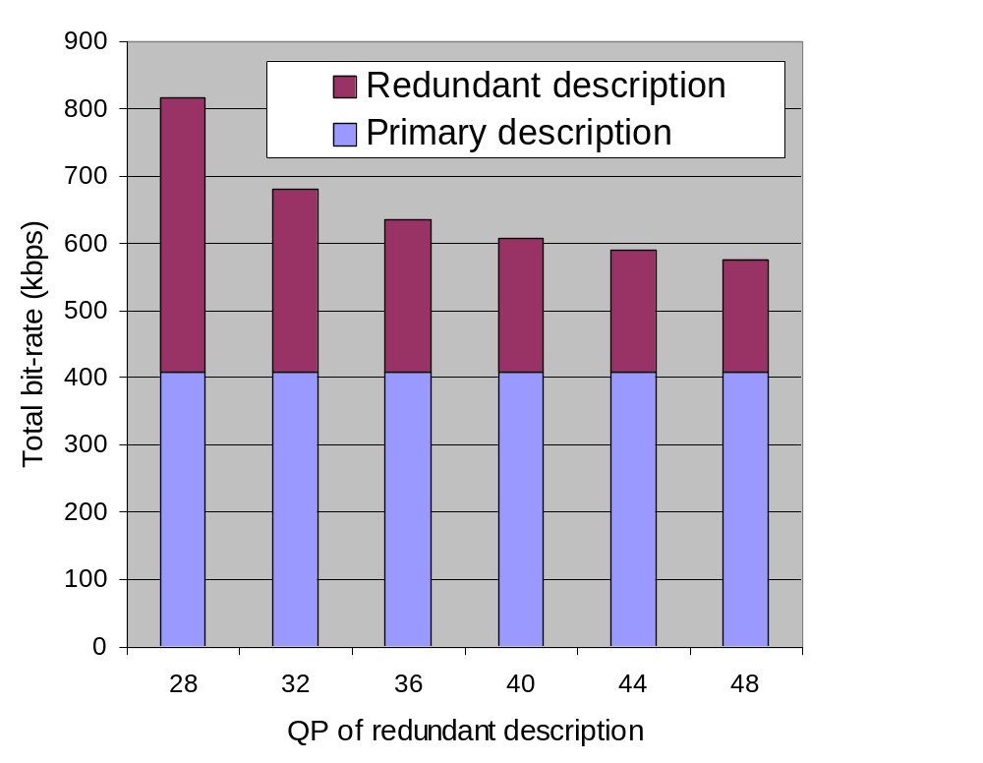
Resilience using Redundant Slices
Video Quality
Total Encoding Rate
36
encoder, QP 28, 408 kbps
35
QP 32
QP 36
34
QP 40
PSNR(dB)
QP 44
33
QP 48
32
31
2
4
6
8
10
% of slices lost
Notes:
Emphasize no WZ coding. Just transmit all redundant slices.

Slide 10
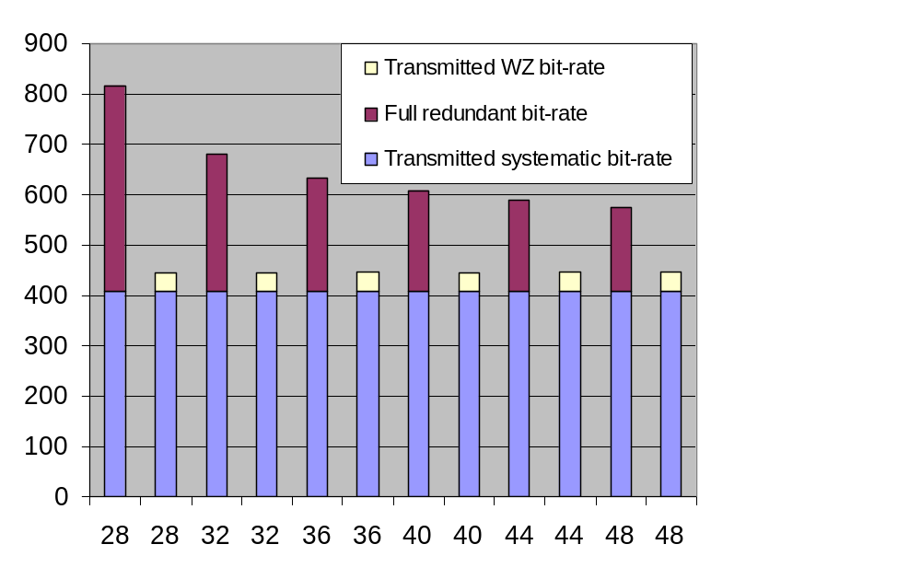
SLEP based on Redundant Slices (Foreman)
Transmit WZ coded version of
the video signal
WZ bit-rate ~ 10% of bit-rate of
the primary description
Coarser redundant description
has stronger error-resilience but
greater quantization mismatch
Total transmitted bit-rate (kbps)
Primary (systematic) description @ 408 kbps with QP 28.
QP of redundant description

Slide 11
SLEP based on Redundant Slices (Foreman)
Video quality for various redundant descriptions
Symbol error probability = 5 x 10⁻⁴
Encoder reconstruction @ 408 kbps
36
QP40
34
32
QP48
PSNR (dB)
30
QP36
28
26
FEC
24
Error concealment only
20
40
60
80
100
Frame number

Slide 12

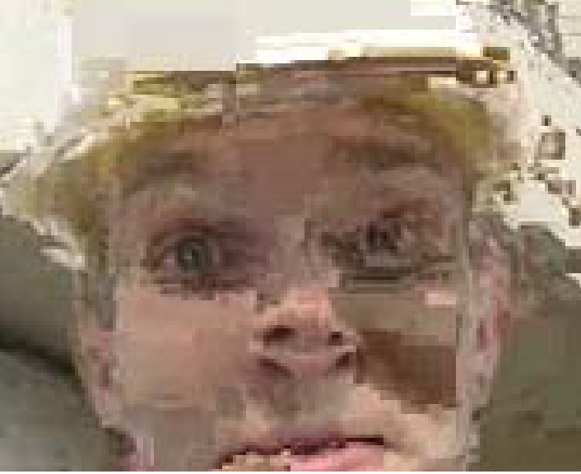




Systematic bit-rate 408 kbps, WZ bit-rate ~ 40 kbps
Symbol error probability = 5 x 10⁻⁴
Error-free
35.7 dB
Error concealment only
SLEP with redundant QP = 36
40 kbps FEC
SLEP with redundant QP = 40
SLEP with redundant QP = 48
20.9 dB
30.9 dB
25.5 dB
34.2 dB
32.9 dB
Notes:
Is a video better?
FEC, residual errors
36, residual errors
40, all errors corrected
48, all errors corrected, but visible quantization mismatch

Slide 13
Summary
SLEP based on H.264/AVC redundant slices support
Trade-off between error resilience and quantization mismatch introduced by redundant description
Graceful degradation of received video quality compared to FEC
Recent work
  H.264/AVC rate control to modulate QP of redundant description
  SLEP on region-of-interest using Flexible Macroblock Ordering (FMO)

