Slide 1
High-Rate Analysis of
Systematic Lossy Error Protection of a Predictively Encoded Source
Shantanu Rane, David Rebollo-Monedero, and Bernd Girod
Information Systems Laboratory
Stanford University

Slide 2


Systematic Lossy Source/Channel Coding
Analog
Channel
Side
info
Wyner-Ziv
Encoder
Digital
Channel
Wyner-Ziv
Decoder
Errors corrected up to a small residual distortion, hence lossy error protection
Information theoretic optimality conditions
[Shamai, Verdú, Zamir, 1998], [Steinberg, Merhav, 2004]

Slide 3
Systematic Lossy Error Protection (SLEP)
“Analog Channel”
Input
Signal
Degraded
Signal
Primary Encoder
Primary Decoder
Side information
Error-Prone Channel
Slepian-Wolf Encoder
Slepian-Wolf Decoder
Reconstruction
Coarse Quantizer
Output
Signal
Wyner-Ziv Encoder
Wyner-Ziv Decoder
Analogous to systematic lossy source/channel coding
Practical Wyner-Ziv coding by applying Reed-Solomon coding across coarsely quantized redundant video descriptions
[Rane, Baccichet, Aaron, Girod, 2004-06]
Notes:
1.Standard overview
2.Analog Channel and therefore analogous to sys lossy source/channel coding
3. Conceptually WZ coding = coarse quantization folloed by Slepian-Wolf coding
4. In our work -> video -. RS codes + redundant descriptions
Want to see the effect of Coarse quantization, slepian-wolf coding on overall RD tradeoff

Slide 4

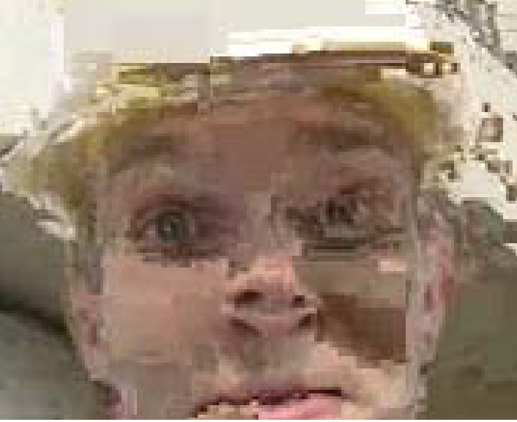




Foreman @ 408 kbps, Wyner-Ziv bit rate = 40 kbps
Symbol error probability = 5 x 10⁻⁴
Error-free (QP = 28)
35.7 dB
Error concealment only
Wyner-Ziv QP = 40
Wyner-Ziv QP = 36
Wyner-Ziv QP = 48
Wyner-Ziv QP = 28
30.9 dB
25.5 dB
34.2 dB
20.9 dB
32.9 dB
Notes:
higher QP implies coarser quantization used in the Wyner-Ziv quantizer. Note the improvement in picture quality.

Slide 5
Outline
Analysis of SLEP for a first-order Markov source
Rate-distortion tradeoffs using high-rate quantization theory
Properties of SLEP
  Graceful degradation of decoded signal quality
  Increased robustness compared to lossless correction
Notes:
Effect of WZ coding on the overall rate-distortion tradeoffs resulting for this system. To facilitate closed-form mathematical analysis, we will consider a simple scheme in which SLEP is applied to ….
derive RD tradeoffs
properties

Slide 6
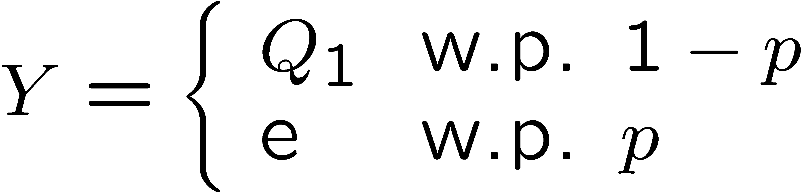
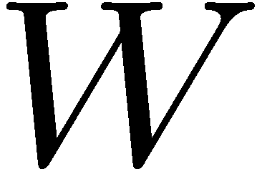
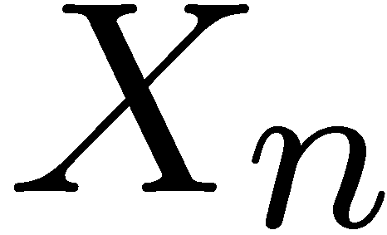
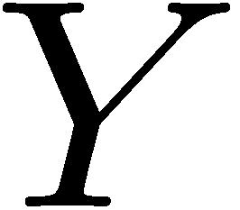

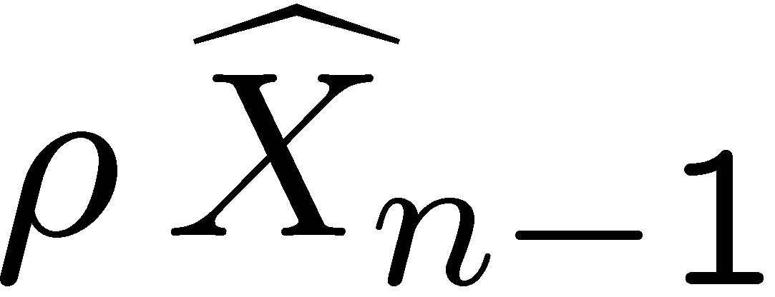
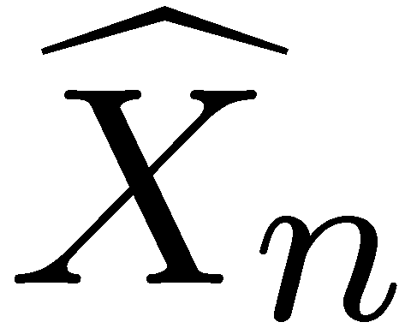
SLEP of a First-Order Markov Source
Wyner-Ziv coding for error resilience
SWE
SWD
Erasure Channel
+
ENC
DEC
+
_
+
DPCM coding and systematic transmission
Find the relation between and
Notes:
Predictive coding DPCM
W are i.i.d.
Entropy code and decode to get Y
In addition, coarse quantization
SWD using side information Y
reconstruction function (Since Q2 coarser, it is optimal reconstruction function)
Objective
Expect question about symbol by symbol versus block coding
Mention stationarity of W

Slide 7

Wyner-Ziv Coding of Prediction Residual W
step size
SWE
SWD
Erasure Channel
ENC
DEC
step size
Notes:
Consider encoding of the prediction error. Highrate result
Slepian Wolf encoding and decoding as explained earlier
Explain reconstruction function
Derived that the optimal quantizer is uniform with step size m delta_1
Distortion relation. We will return to the “loss” in lossy error protection
Possible question: Why m is an integer and not real (at high rates, there is no loss in rd performance by using integer m)
Must mention what m is, and why m can be a positive integer and need not be a positve real number
Reiterate stationarity of W

Slide 8
Bit Rate Required for Erasure Protection
SWE
Erasure Channel
SWD
Minimum bit rate with ideal Slepian-Wolf coding and no erasures
To perform Slepian-Wolf coding with erasure protection, need
Notes:
Can obtain this result by considering that the parity portion of a capacity achieving channel code is used as a Slepian-Wolf code
Replace last formula by full D_2 (R_2) expression

Slide 9
Error Propagation in X
+
reconstruction levels
DPCM
quantizer
Quantization mismatch
Wyner-Ziv
quantizer
Notes:
Express difference in X in terms of error propagation from previous samples and the error in the current sampl
Latter has already been derived D_2
Former, consider the MSE between the reconstructions of the coarse and fine quantizers, the case for m=7

Slide 10
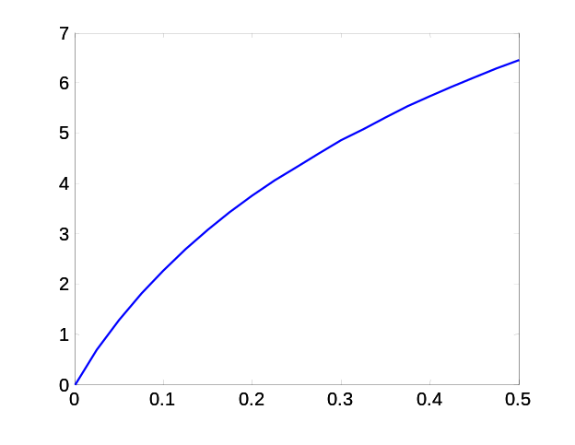
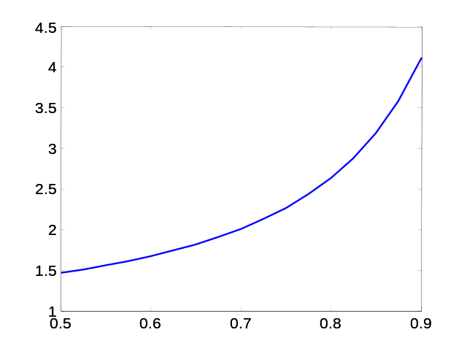




Overall MSE Distortion in X
Alternatively,
Additional distortion after Wyner-Ziv decoding
10
10
8
8
6
6
4
4
2
2
0
0
1
1
2
2
3
3
4
4
5
5

Slide 11
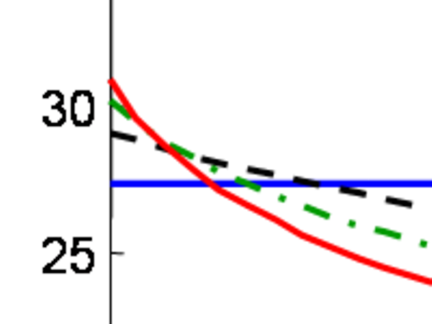
Graceful Degradation
35
30
25
20
15
10
5
0
0
0.1
0.2
0.3
0.4
0.5
Notes:
Fix total bit rate assume the p_cliff is known
Find the best partition for different m
Cliff is same for all
SLEP, coarser quantization in the WZ branch -> higher rate for the source coding -> better errorfree quality
Depending upon the m chosen (how the probability of erasure varies) find corssover probability after which SLEP will be slightly inferior to FEC

Slide 12
Increased Robustness
35
30
25
20
15
10
5
0
0
0.1
0.2
0.3
0.4
0.5
Notes:
Fix source coding bit rate
Fix error resilience bit rate
m=1 lossless correction
All curves start at D_1(R_1)
Different slopes for different m’s and the only difference between the expressions
Cliff occurs where and why

Slide 13
Conclusions
SLEP output distortion depends on quality of redundant description, erasure probability, correlation coefficient of source
Flexible tradeoff between robustness and signal quality by manipulating Wyner-Ziv quantizer
With identical source/channel bit allocation, SLEP is more robust to channel errors than FEC

Slide 14

Shantanu Rane
srane@stanford.edu
http://ivms.stanford.edu/~srane

