Slide 1
SEIS 764-0 Project Identifying Visual Relationships Using Mask R-CNN
Team - James Dedon, Jun Li​, Rajkumar Kolakaluri, Shantanu Hadap

Slide 2
AGENDA
Overview of the Project
Dataset
Model
Model Performance
Pitfalls – Pros & Cons
References
Discussion

Slide 3
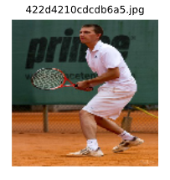
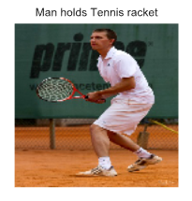
Overview of the Project
Object detection
Instance segmentation
Extracting activations
Identifying visual relationships between objects

Slide 4
Dataset
Open Images V5 (Subset)
Used validation dataset
selected the intersection between relationship and segmentation dataset
Reduced to top 32 class labels
2552 images
https://storage.googleapis.com/openimages/web/index.html
Notes:
Total images in Open CV 9,178,275

Slide 5
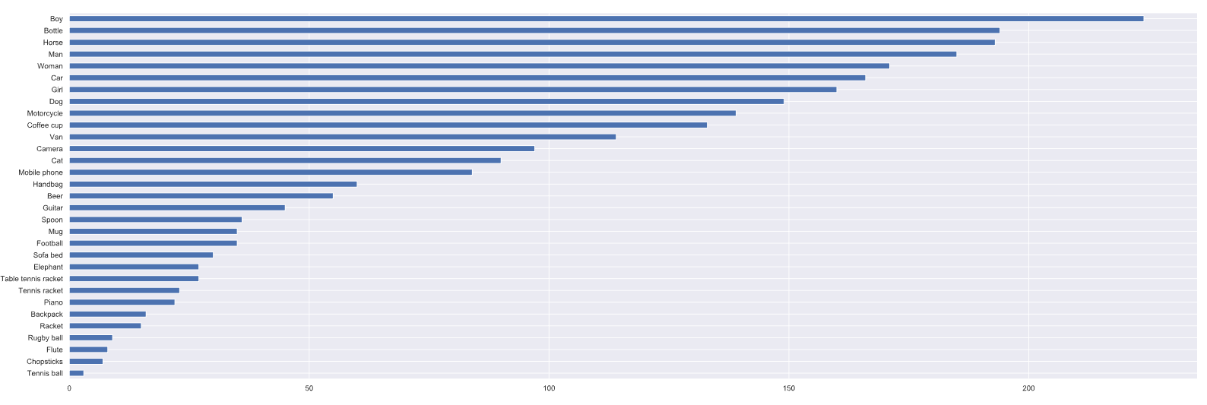
Notes:
How are you handling class imbalance?
Class weights adjusted
Wj =n / k nj
n = total rows
nj = total rows of a jth class
k = number of classes
How are you handling class imbalance?
Split 90, 10
Training
2250
Testing
250

Slide 6
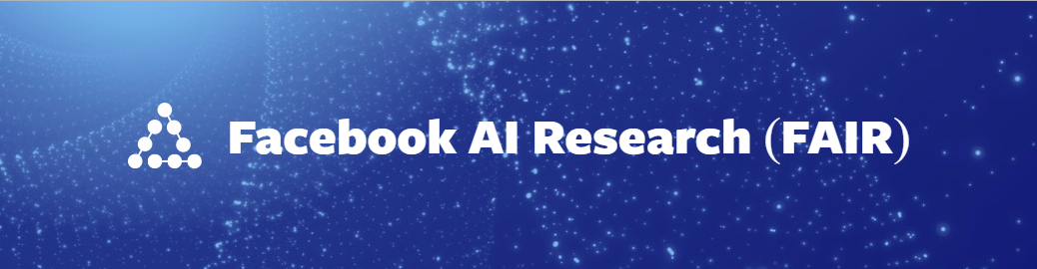
Model – Mask RCNN
Mask RCNN is a deep neural network aimed to solve instance segmentation and object detection problem in machine learning or computer vision
It gives you the object bounding boxes, classes and masks as output
Two stages
1. Generates Proposals – binari class (ROI), bounding box
2. Predicts the class , Refines the bounding box, Generate mask in pixel level
Both stages are connected to the backbone structure
Backbone network consists of a bottom-up pathway , a top-bottom pathway and lateral connections.
Mask R-CNN: https://arxiv.org/abs/1703.06870

Slide 7
Model – Mask RCNN
Bottom-up pathway can be usually ResNet or VGG, which extracts features from raw images
Top-bottom pathway generates feature pyramid map which is similar in size to bottom-up pathway
Lateral connections are convolution and adding operations between two corresponding levels of the two pathways
RPN scans all FPN top-bottom pathway and proposes regions which may contain objects
Anchors are a set of boxes with predefined locations and scales relative to images
Mask R-CNN: https://arxiv.org/abs/1703.06870

Slide 8
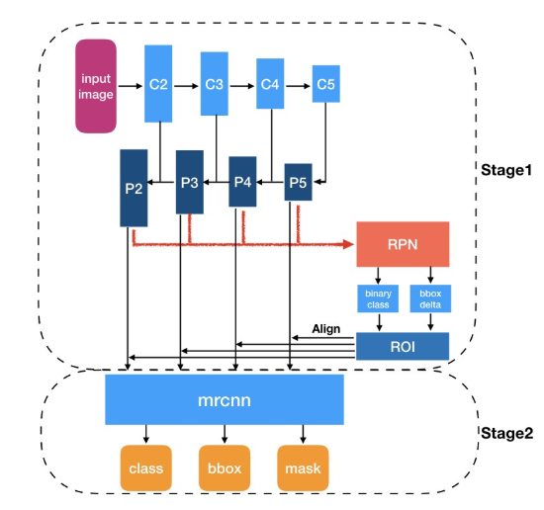
Architecture
Backbone – ResNet 101
Image size 256 x 256
32 output classes
Notes:
Why backbone resnet?
Advantages/Disadvantages if any?
What is model input and model output? Shape of the image.

Slide 9
Configurations and Hyperparameters
IMAGE_SHAPE [256 256 3]
LEARNING_MOMENTUM 0.9
LEARNING_RATE 0.001
LOSS_WEIGHTS rpn_class,rpn_bbox,mrcnn_class,mrcnn_bbox,mrcnn_mask
BATCH_SIZE 8
WEIGHT_DECAY 0.0001
NUM_CLASSES 32
IOU_THRESHOLD 0.5
BACKBONE resnet101

Slide 10
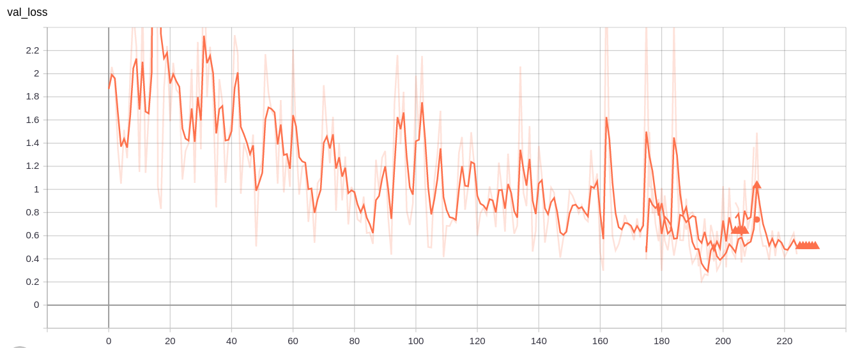
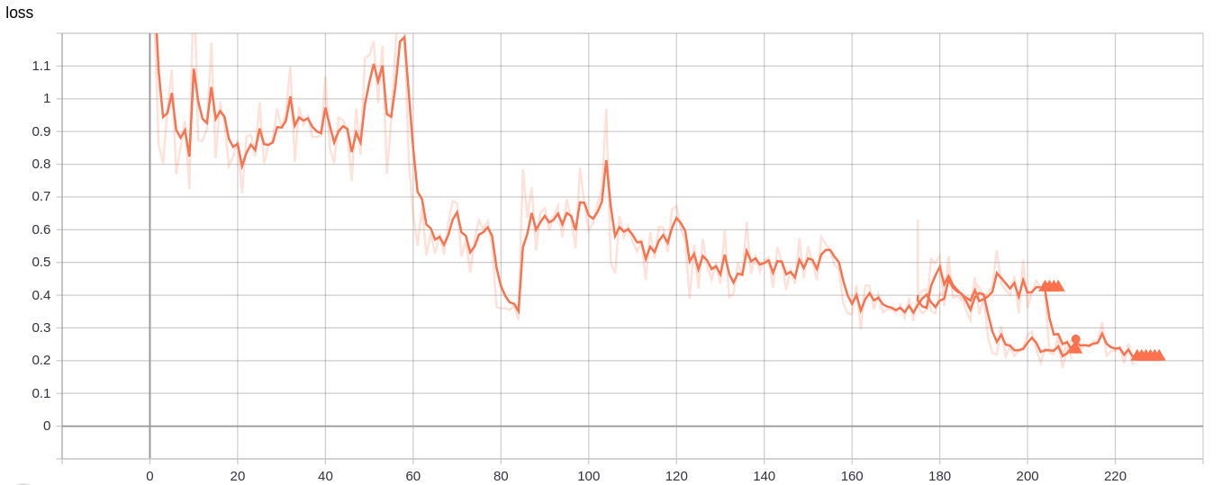
Loss Plots by Epoch
Training Loss
Validation Loss

Slide 11
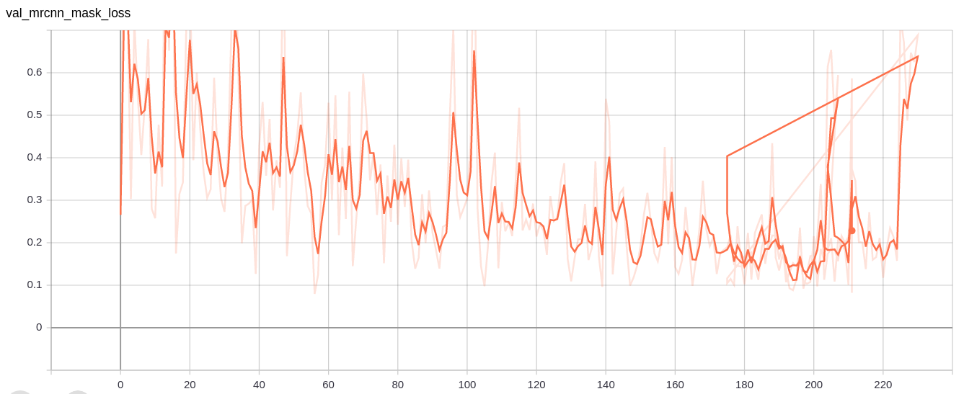
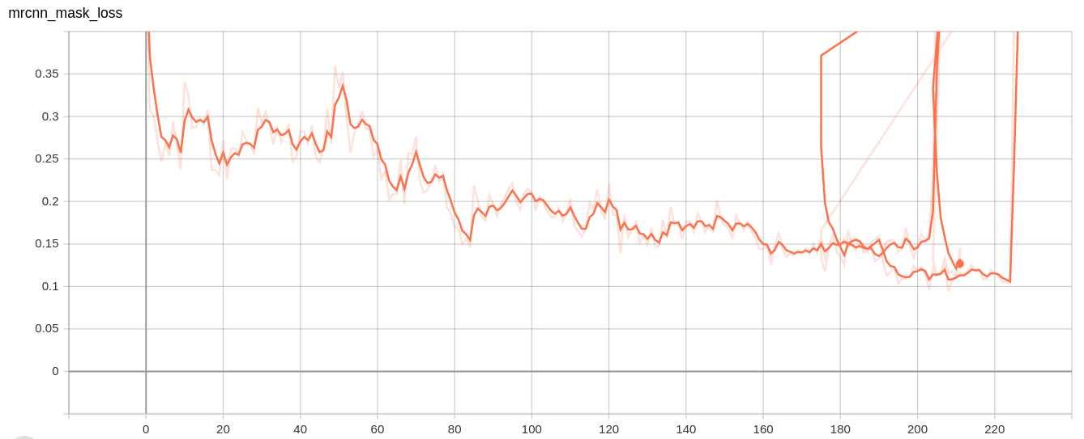
Mask Loss
Training Mask Loss
Validation Mask Loss

Slide 12
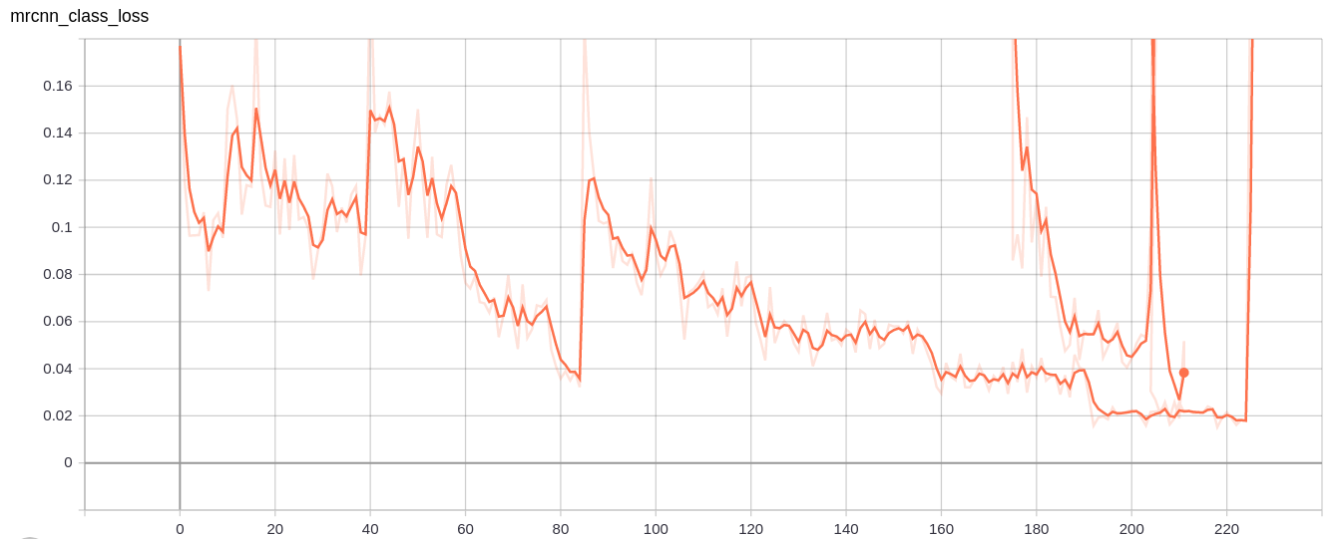
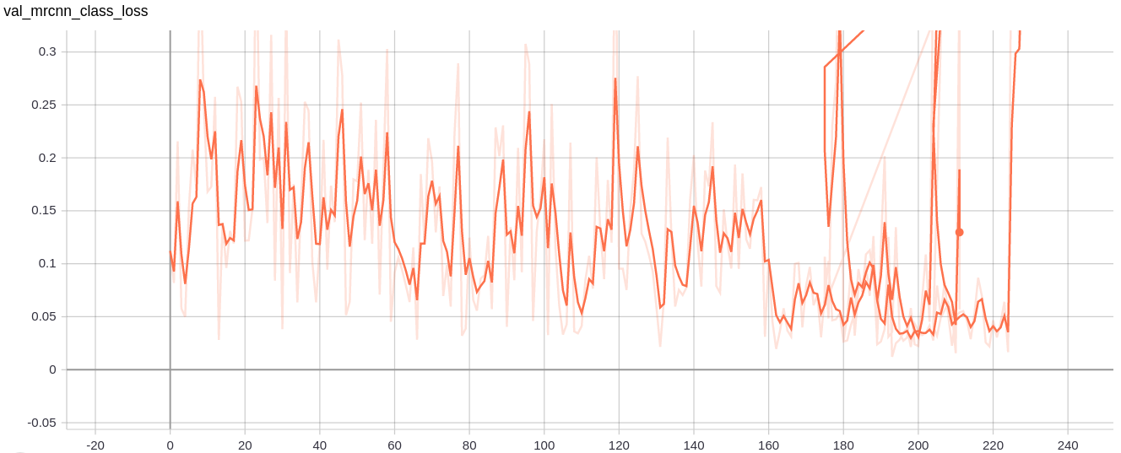
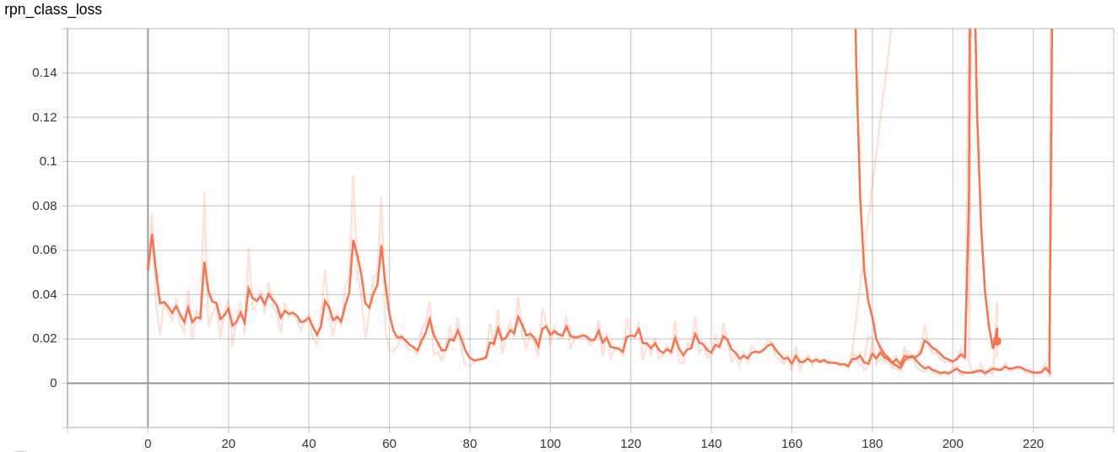
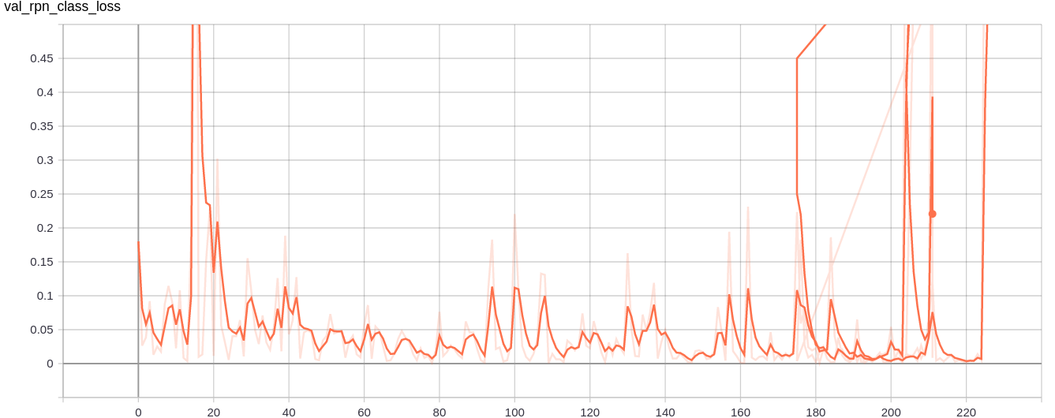
Class Loss

Slide 13
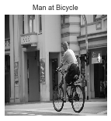

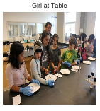
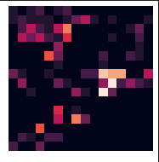
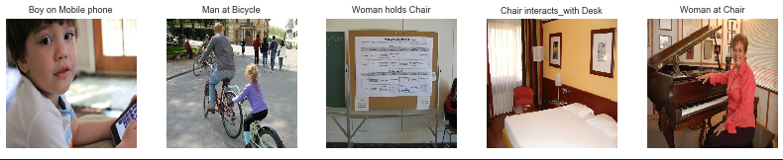
Activations extraction
Relationship Features
TSNE
Random Forest Classifier
3 features
16 x 16

Slide 14
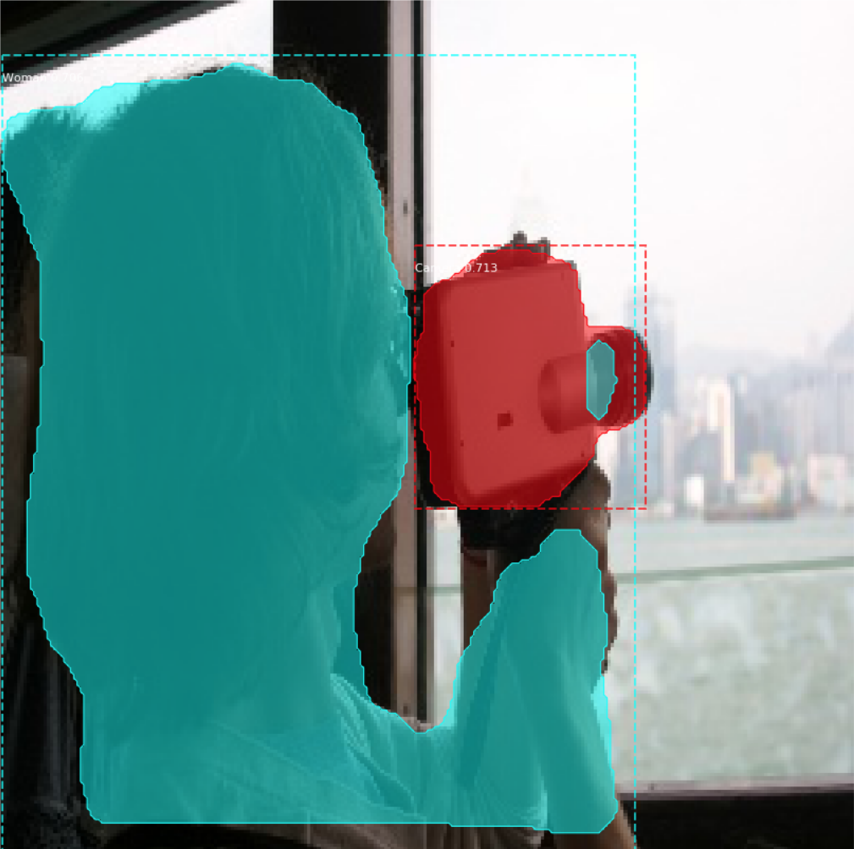
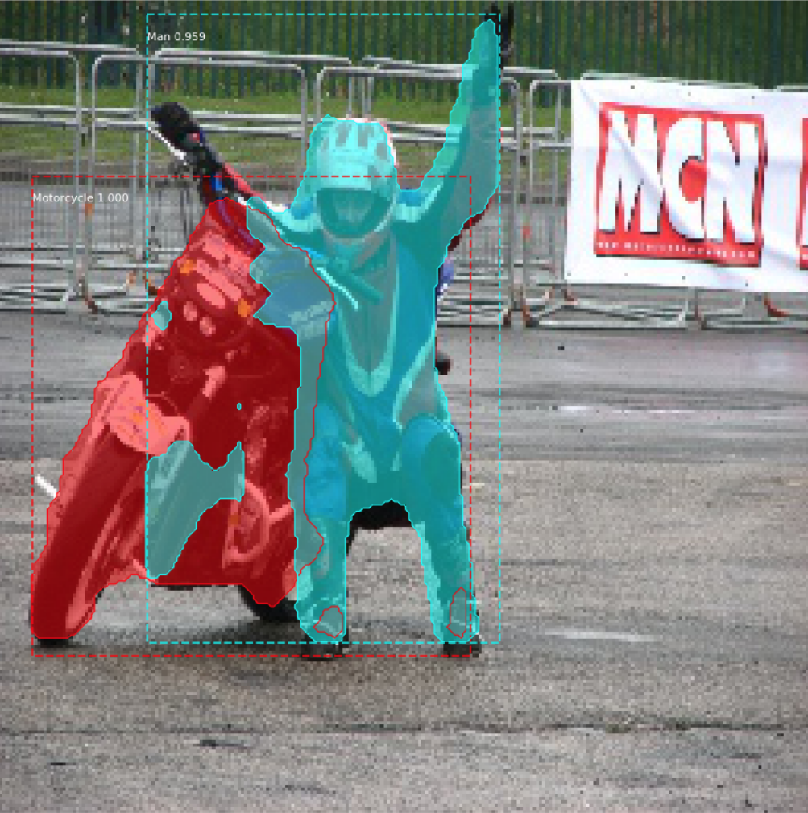
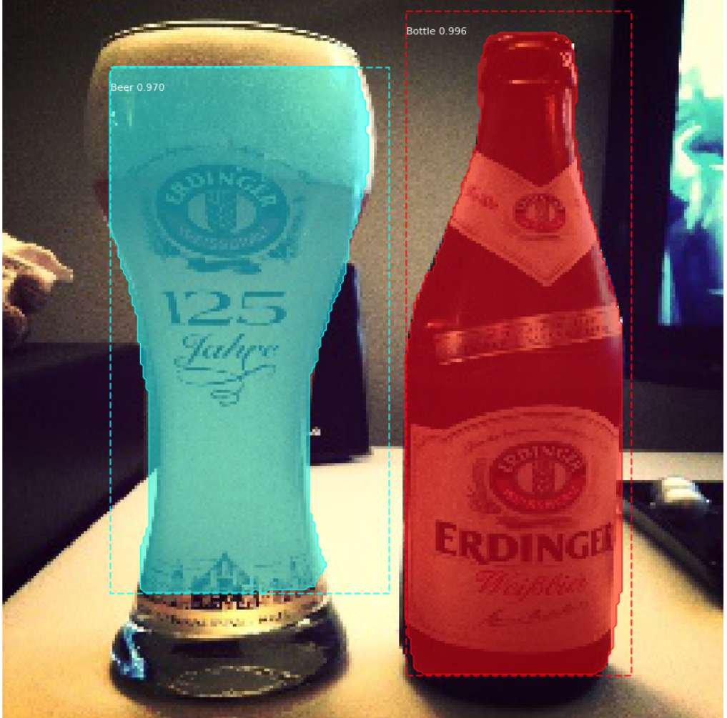
Model Performance
mAP of 0.479 over 1000 images
Class loss: 0.03882(train), .0186(validation)
Mask Loss: 0.12(train), 0.08233(validation)
Visual Relationship 0verall accuracy =79%

Slide 15
Pitfalls – Pros & Cons
Pros
Flexible model with pretrained weights (trained on COCO dataset)
Relatively quick train time for decent results (~200 epochs)
Weights automatically saved at each epoch
Create event logs which can be easily integrated with Tensorboard
Cons
Reordering of labels had us stumped for a while
Memory usage problems with Python caused some issues
Dataset was time consuming to get and storage intensive

Slide 16
References and Links
Mask R-CNN Original Publication
https://arxiv.org/pdf/1504.08083.pdf
https://arxiv.org/pdf/1703.06870.pdf
https://arxiv.org/pdf/1506.01497.pdf
Image segmentation using Mask R-CNN
https://machinelearningmastery.com/how-to-perform-object-detection-in-photographs-with-mask-r-cnn-in-keras/https://github.com/matterport/Mask_RCNN
https://medium.com/@alittlepain833/simple-understanding-of-mask-rcnn-134b5b330e95
https://medium.com/@umerfarooq_26378/from-r-cnn-to-mask-r-cnn-d6367b196cfd
Git Repo
https://github.com/matterport/Mask_RCNN
Open Images 2019: Visual Relationships
https://www.kaggle.com/c/open-images-2019-visual-relationship
Open Images Dataset V5
https://storage.googleapis.com/openimages/web/index.html

Slide 17
Discussion

