Slide 1
Capstone Project
Battle of Neighborhoods

Slide 2
Introduction:
The city of Los Angeles (also known simply as L.A., and nicknamed the "City of Angels") is the most populous city in California.
The people of Los Angeles come from all over the world and are dispersed throughout the city’s many sprawling, unique neighborhoods
Los Angeles is an important center of culture, medicine, agriculture, business, finance, energy, aerospace, science, food processing, media, international trade, and tourism.

Slide 3
Problem statement :
Many people visit city of Los Angeles daily. Many explorers and tourists have constraint over the time and money they can invest in their travels. But any visitor to city would like to experience the different folds of the city without having repetitive and same experiences.
Hence it would be ideal for people if they knew the top locations to visit the in places across the city and having to know the cluster of similar neighborhood and those which are different to other, which they have not visited.

Slide 4
Data description:
To gain the required data we used and scrapped the data from primarily two sites.
1)The first one is the postal codes along with the neighborhoods of the Los Angeles.
2)And the other one is the git containing all the postal codes of USA and their coordinates.
Combining these two data sets gave us the required data set for our analysis.

Slide 5
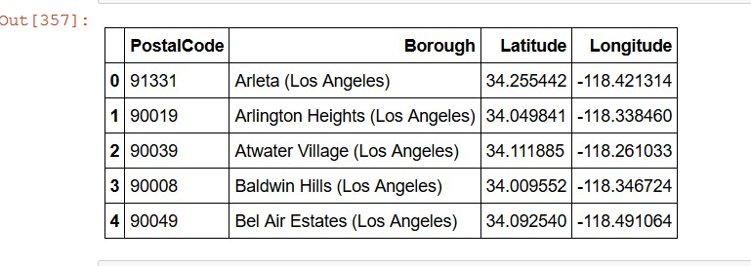
The final required dataset is in format :

Slide 6
Methodology:
Merging the both data-sets gave us final data set upon which we used foursquare API to get the popular venues for each location.
On which we shall apply the k-means clustering algorithm.
Clustering various places around the Los Angeles gave us insight upon various neighborhoods of city.
Further we can also get the most prominent place around each location of the city for travelers and tourists to enjoy.

Slide 7
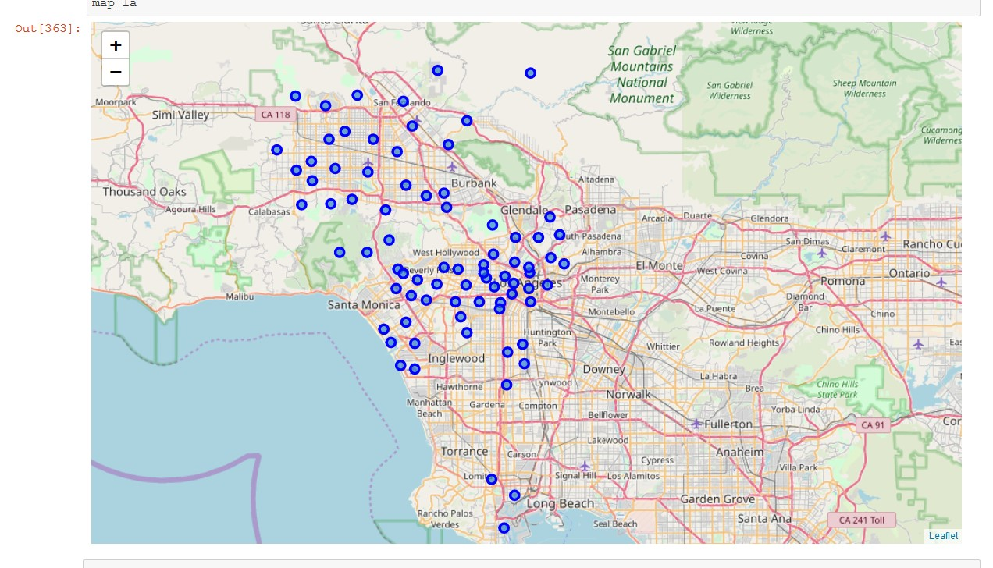
Neighborhoods around the city

Slide 8
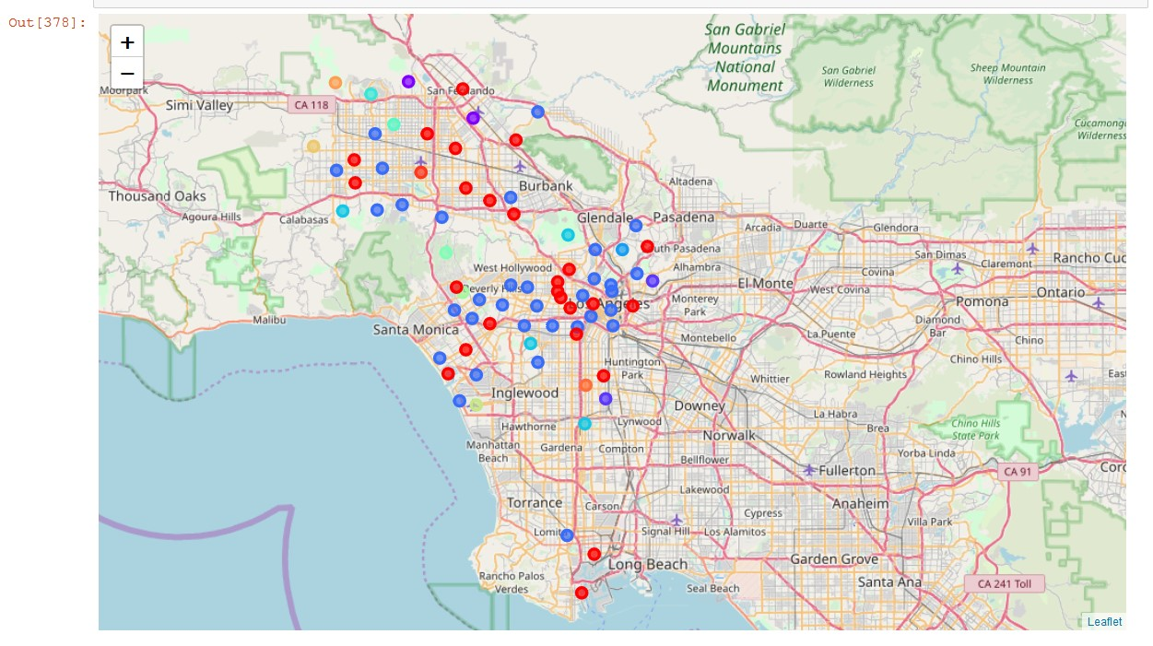
Clustered Neighborhoods around the city

Slide 9
Results:
K means clustering requires the K as input where k defines the number of clusters. Hence we also increase the number of clusters to get the more diverse clusters.
Clustering various places around the Los Angeles gave us insight upon various neighborhoods of city.
Further we can also get the most prominent place around each location of the city for travelers and tourists to enjoy.
This could majorly help the local business and tourism business around the city.

Slide 10
THANK YOU

