Slide 1
Introduction to MOSFETs
Basics and Fundamental Concepts

Slide 2
What is a MOSFET?
MOSFET stands for Metal-Oxide-Semiconductor Field Effect Transistor
A voltage-controlled semiconductor device
Widely used in analog and digital electronics
Used for switching and amplification

Slide 3
Why MOSFETs are Important
(High input impedance)
Low power consumption
High switching speed
Small size and high integration (ICs)

Slide 4
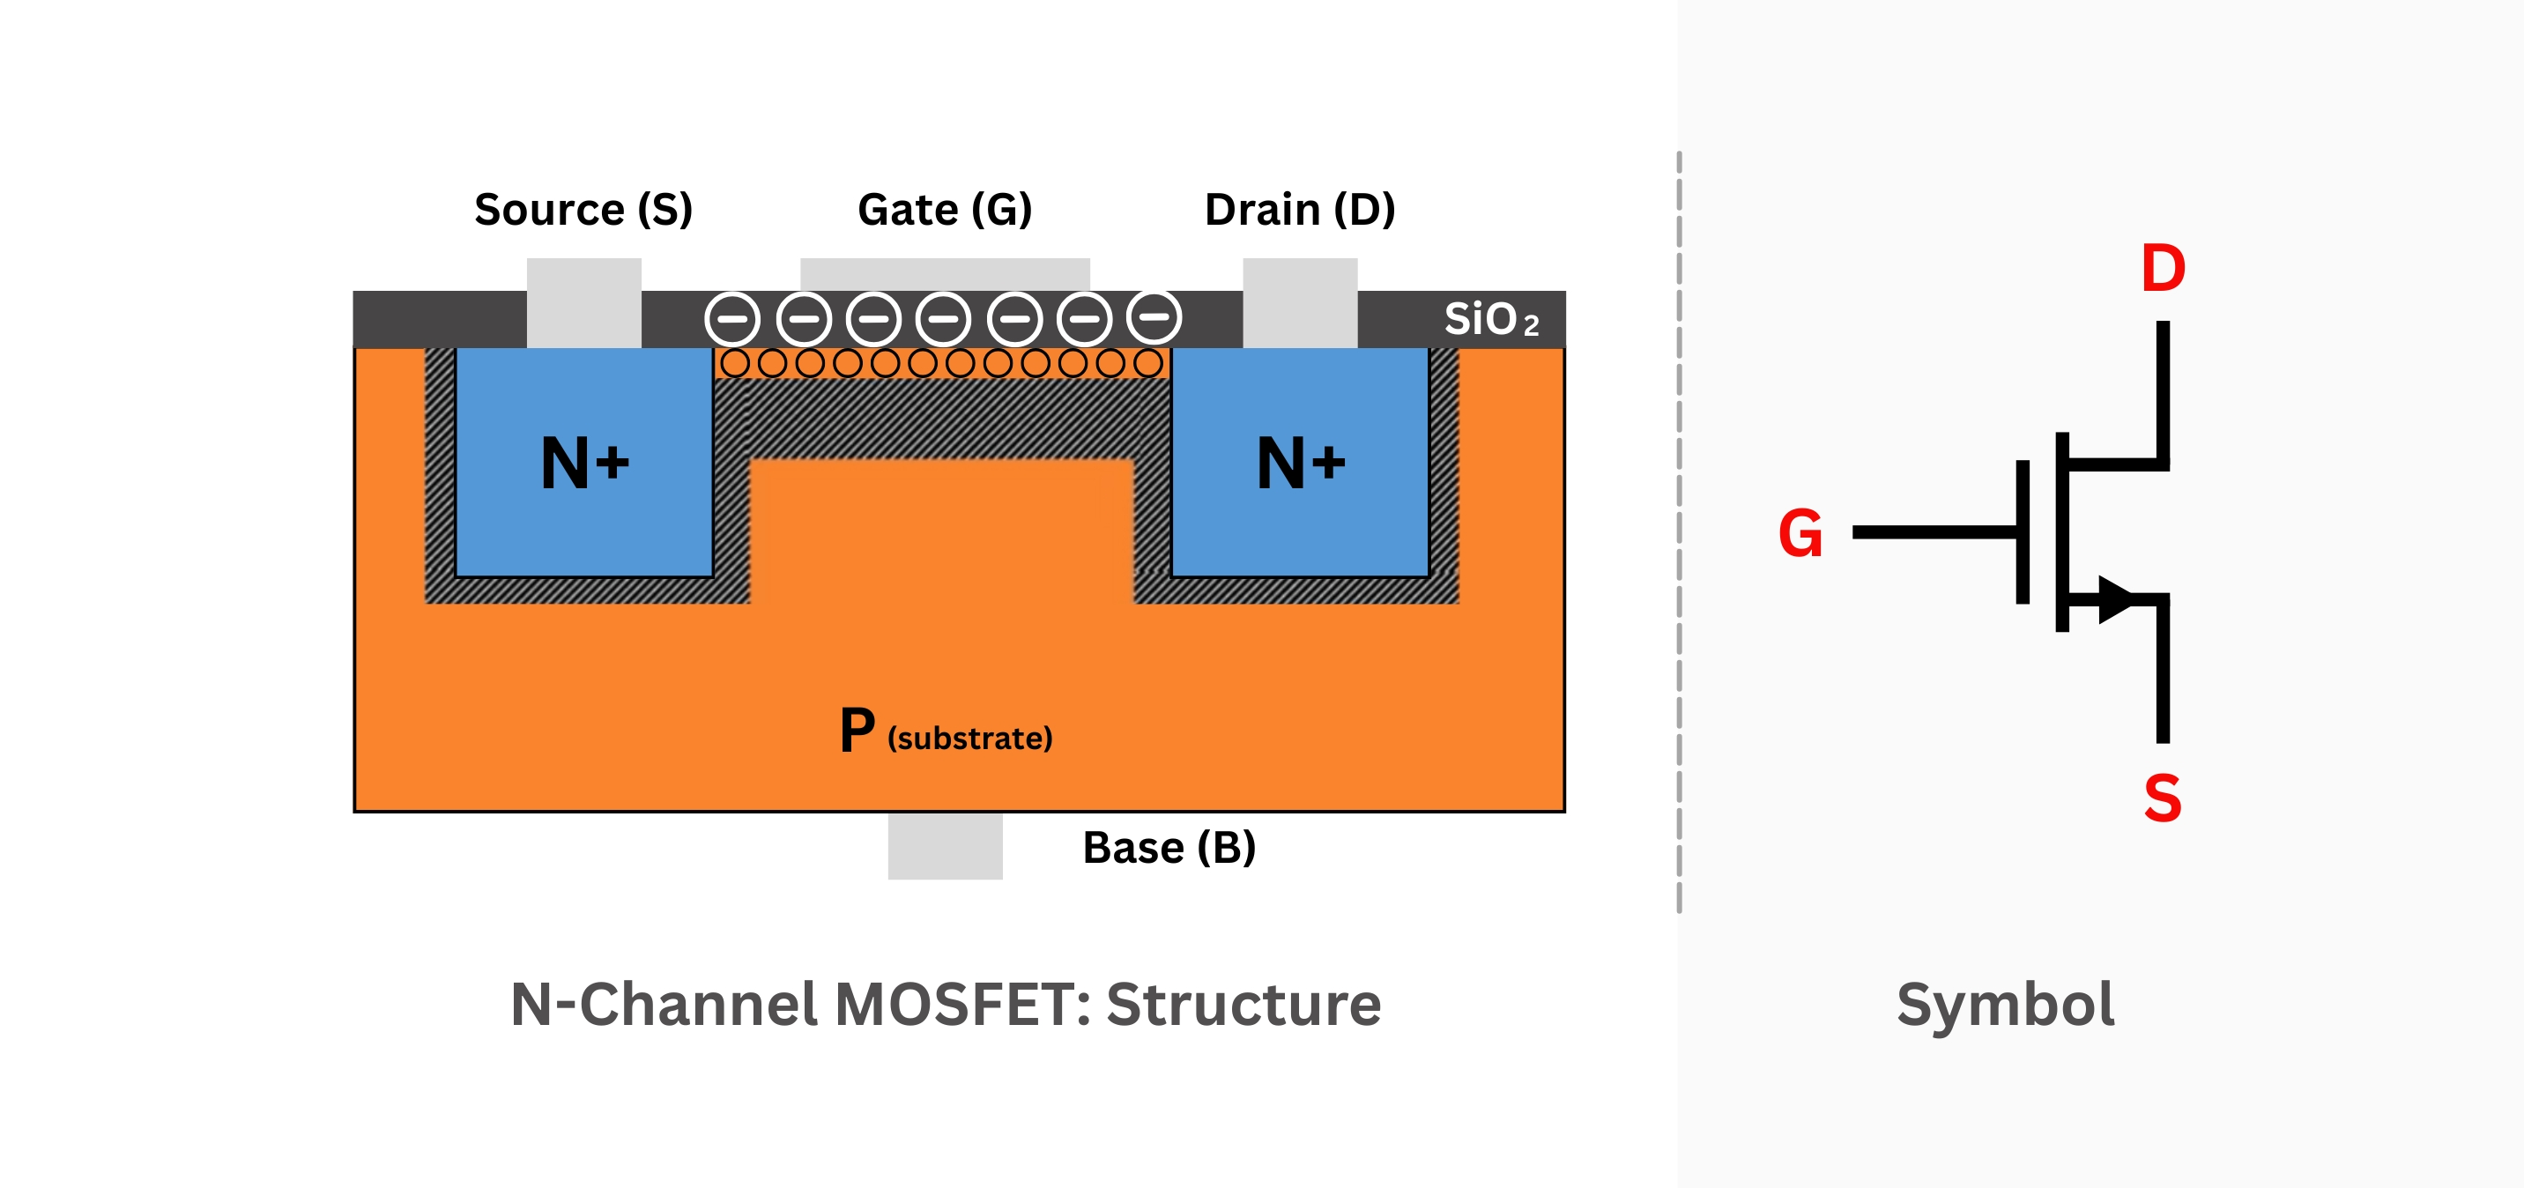
Basic Structure of MOSFET
Three terminals: Gate, Drain, Source
Fourth terminal: Body (substrate)
Thin oxide layer separates gate from channel

Slide 5
Types of MOSFETs
Based on channel type: NMOS and PMOS
Based on operation: Enhancement type and Depletion type

Slide 6
NMOS vs PMOS
NMOS: Electrons are charge carriers
PMOS: Holes are charge carriers
NMOS is faster than PMOS
PMOS requires negative gate voltage

Slide 7
Working Principle of MOSFET
Gate voltage controls current flow
No direct current flows into the gate
Channel forms when VGS exceeds threshold voltage

Slide 8
Operating Regions of MOSFET
Cut-off region: MOSFET is OFF
Triode (Linear) region: Acts as a resistor
Saturation region: Acts as a current source

Slide 9
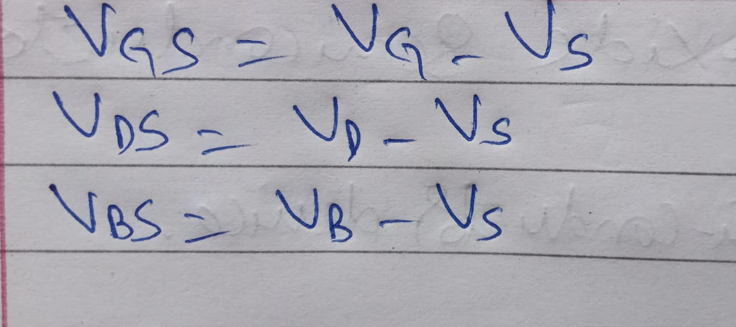
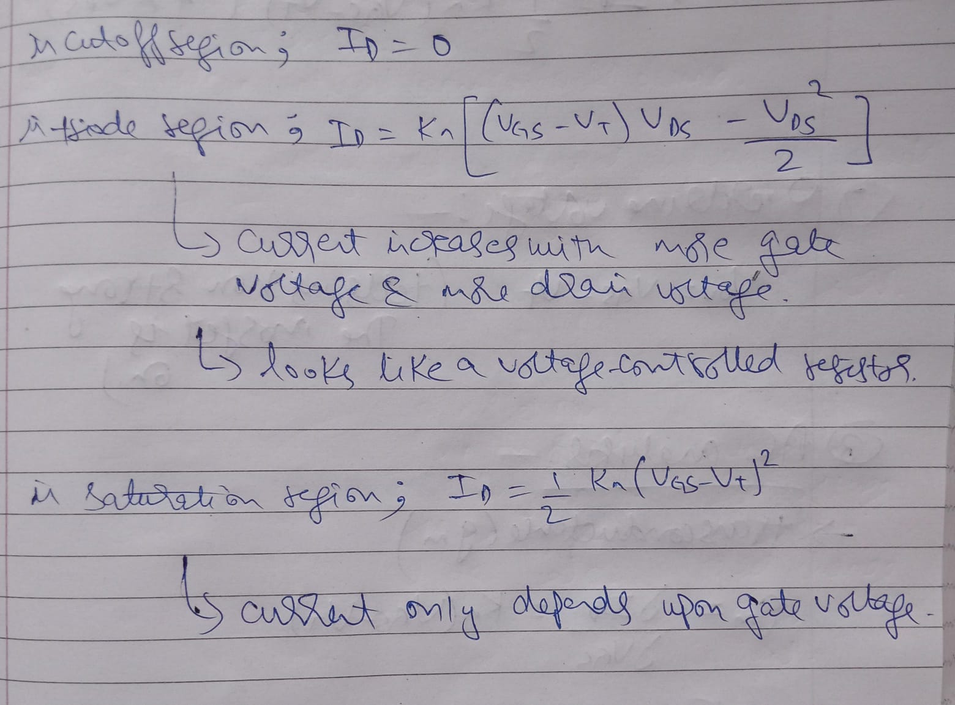
Formulation:-

Slide 10
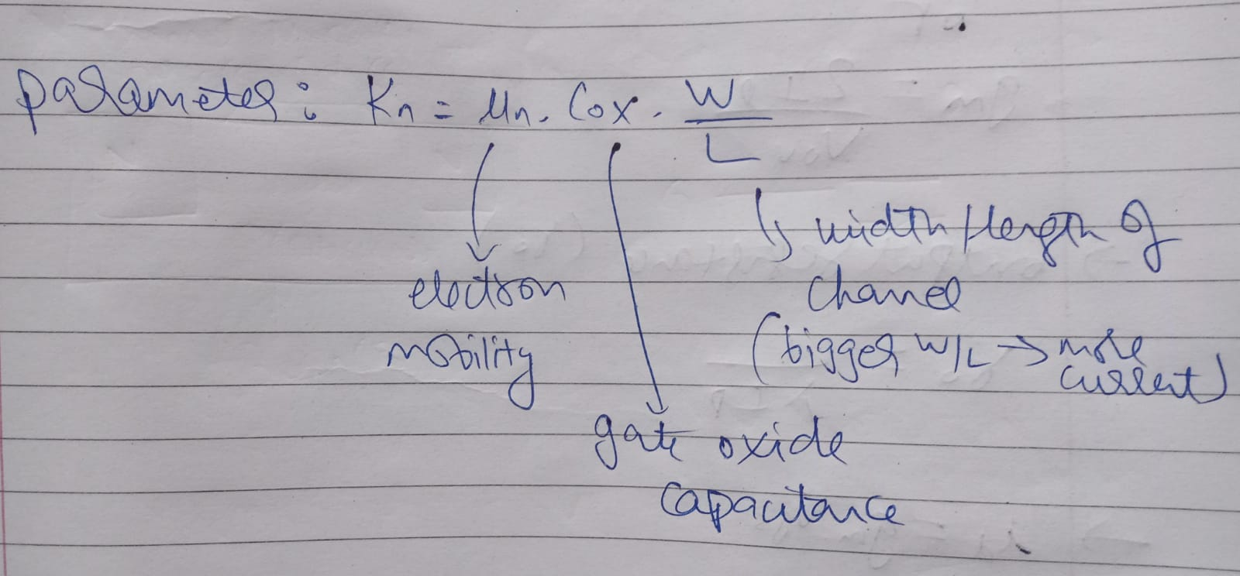
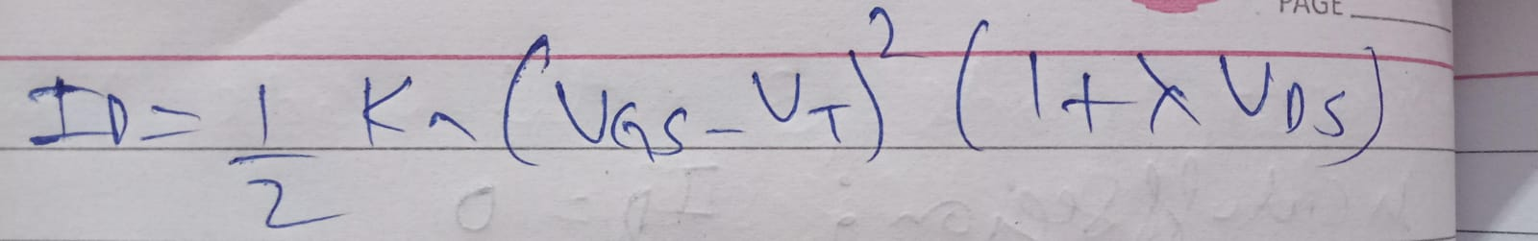
Formulation:-
(Actual expression for drain current in saturation region)

Slide 11
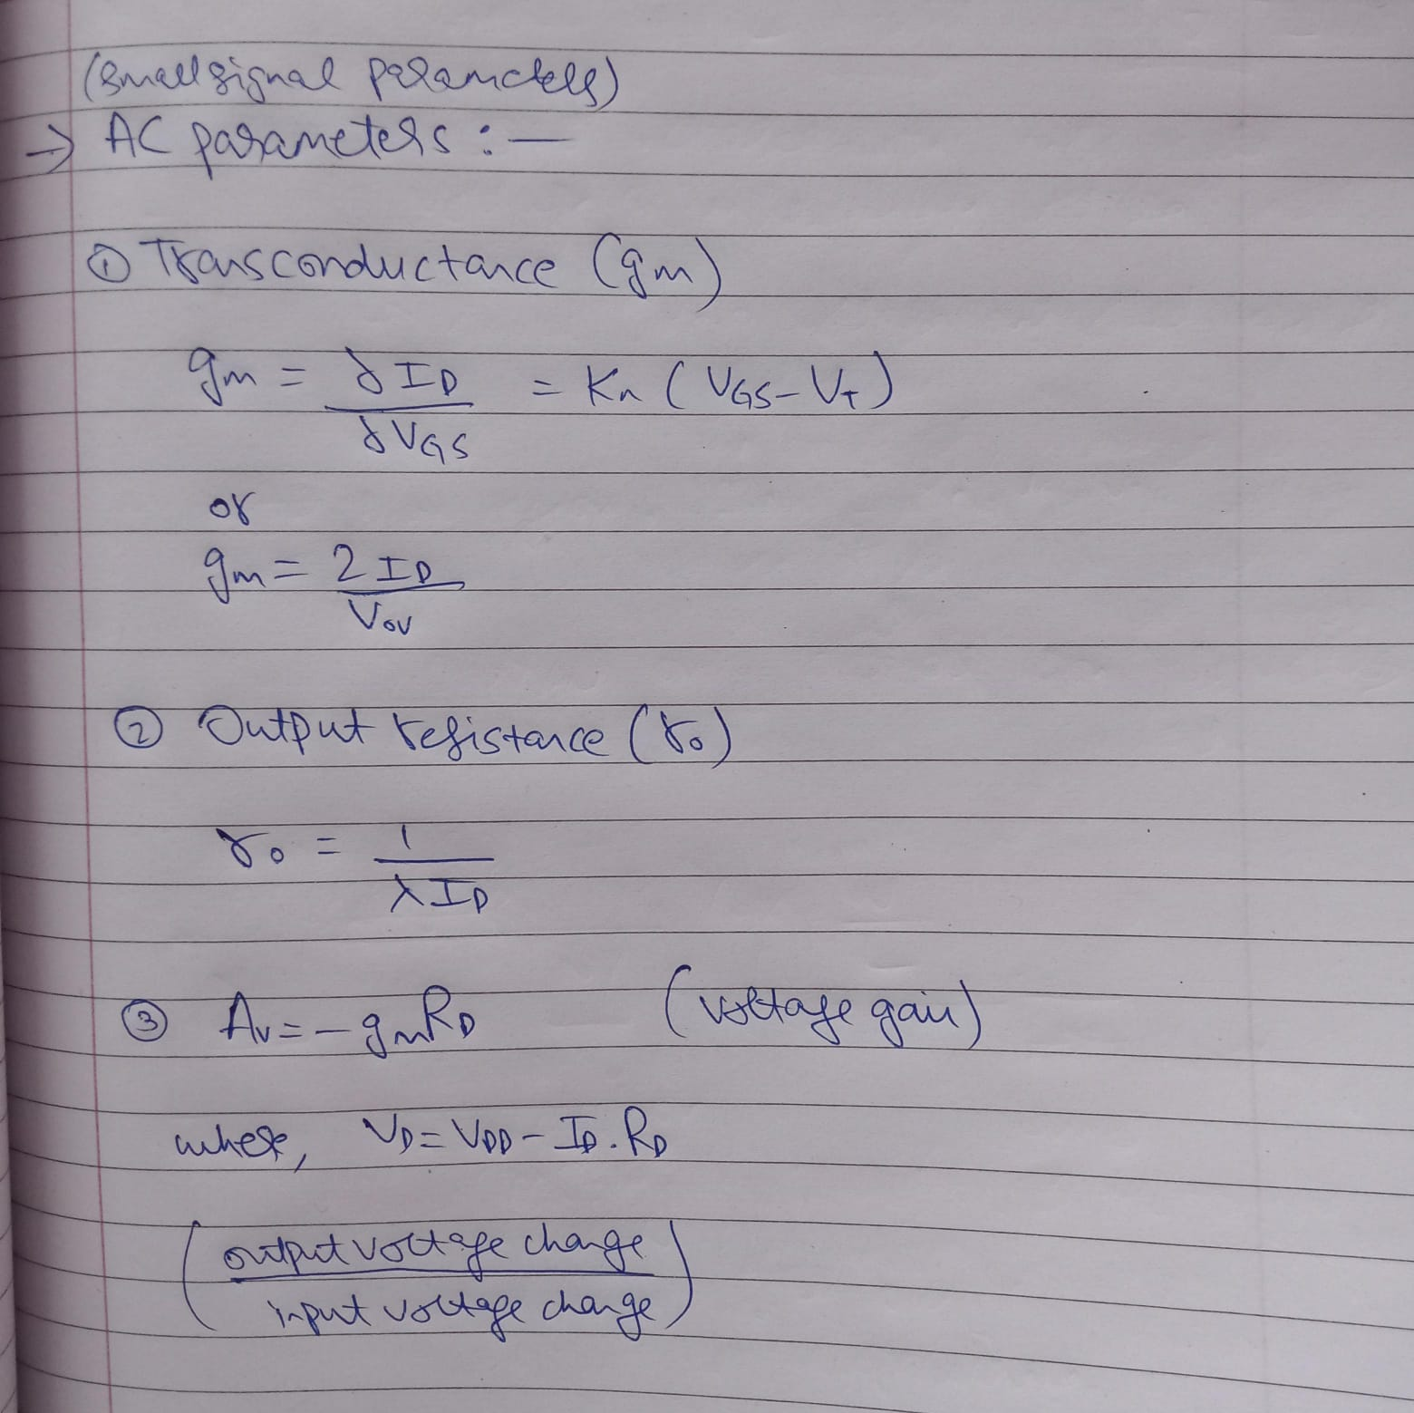
Other parameters:-

Slide 12
Threshold Voltage (VTH)
Minimum gate-source voltage required to turn ON MOSFET
Depends on device fabrication and material
Key parameter in MOSFET operation

Slide 13
Advantages and Disadvantages
Advantages: High efficiency, fast switching, compact size
Disadvantages: Sensitive to static charge, oxide breakdown

Slide 14
Applications of MOSFETs
Digital ICs (processors, memory)
Power electronics
Amplifiers
Switching circuits

