Slide 1


Initial Prototype Presentation
Presented By:
Saudamini Shrivastava
Simeng Sun
Shantanu Ranjan

Slide 2

Problem Overview
Currently, professors
Take attendance by calling out names or
Passing the attendance sheet around
But not the accurate way to identify if each student is present in the class?
Also quite tedious

Slide 3
How is TickMark different?
TickMark that takes attendance in a secure, faster and easier way to validate each student’s presence.
It checks their location.
Unique code will be generated only for those students devices who are actually present in the class.
Proxy of attendance could be stopped.

Slide 4
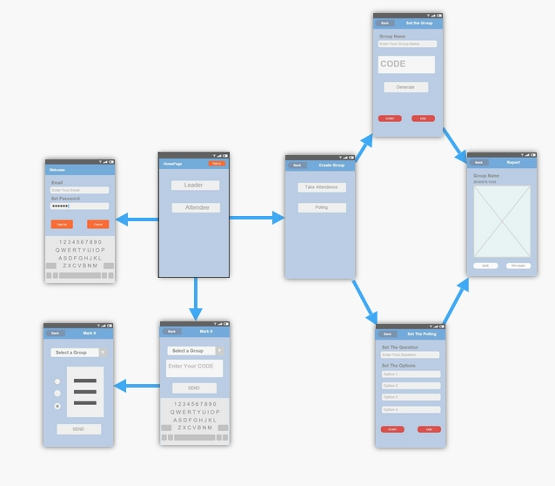
How does it work?

Slide 5
Solution so far..
Major roles
Leader(Professor)
Attendee(Students)
Major functionalities
Taking attendance / Marking attendance
Taking a poll / Giving a poll
Report analysis

Slide 6
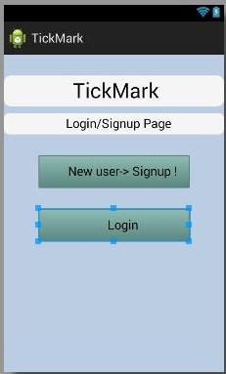
Login/Signup Page
User has two options
Signup
Login
Navigates to homepage (default: student)

Slide 7
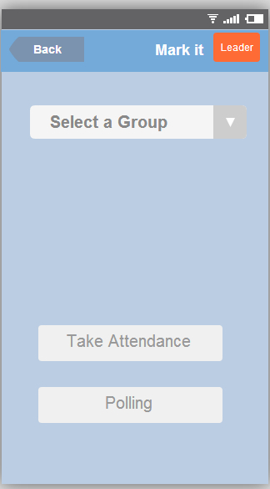
Homepage
Almost all users are students
If user is a professor, then click on the leader
If user is student, select to mark attendance or answer a poll

Slide 8
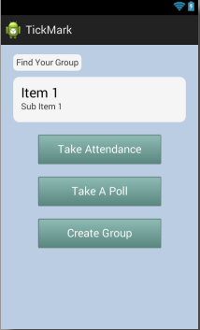
LeaderHomePage
Leader can choose a group and then choose to take attendance or take a poll.
A leader can only see the groups created by himself.
Or he can create a new group.

Slide 9
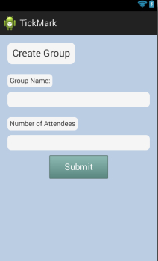
LeaderGroupPage
Create a group with name and number of attendees.
For now we just remember the number expected.
Further we’ll work on importing list.

Slide 10

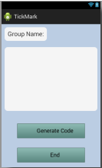
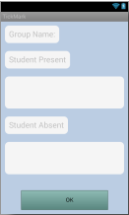
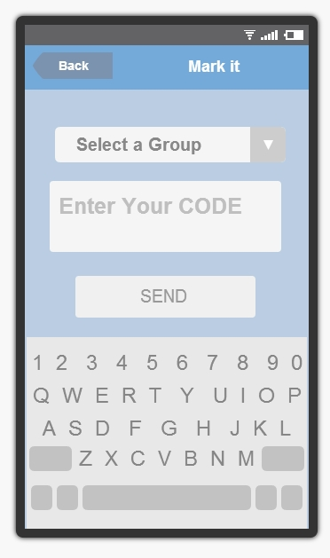
Take Attendance Page
Generates 4 digit alphanumeric code
Report generated
Sends it to attendee device
Code displayed
Presence marked

Slide 11
How it Works?
4 Digit alphanumeric code generated from amazon services
Displays it on leader device
Stores it on web service and sends it to attendee device
Location of attendee is matched with that of leader to receive code
Presence marked
Report generated for present and absent attendees

Slide 12
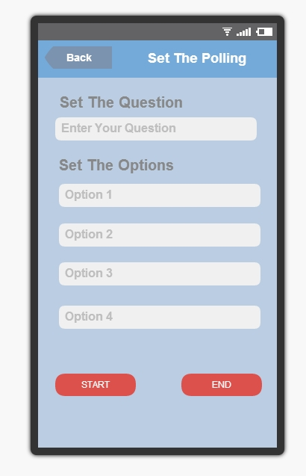
LeaderPollPage
If leader chooses to take a poll
Set the question
Set the options for the poll
Start

Slide 13
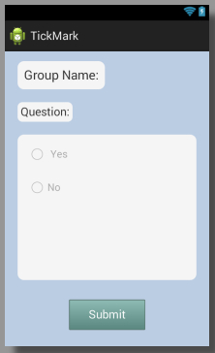
AttendeePollPage
The group name and question will be shown.
Radio buttons for options.
The leader can specify the options.
When submit, the result going to be sent to the server.

Slide 14
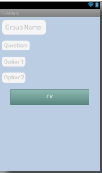
PollReportPage
Sets poll question
Generates report
Receives confirmation
Leader sets poll question
Generates report for poll question based on group name after students have marked their answers
Gets stored in database

Slide 15
What next?
Implementing the location based check
Integrating with web services and database
Importing list of students

Slide 16
Thank you !!
Questions?

