Slide 1
EDA Presentation
Subtitle text here!
<Project Number> <Project name>
<Reference number> <Issue> <Last updated>

Slide 2
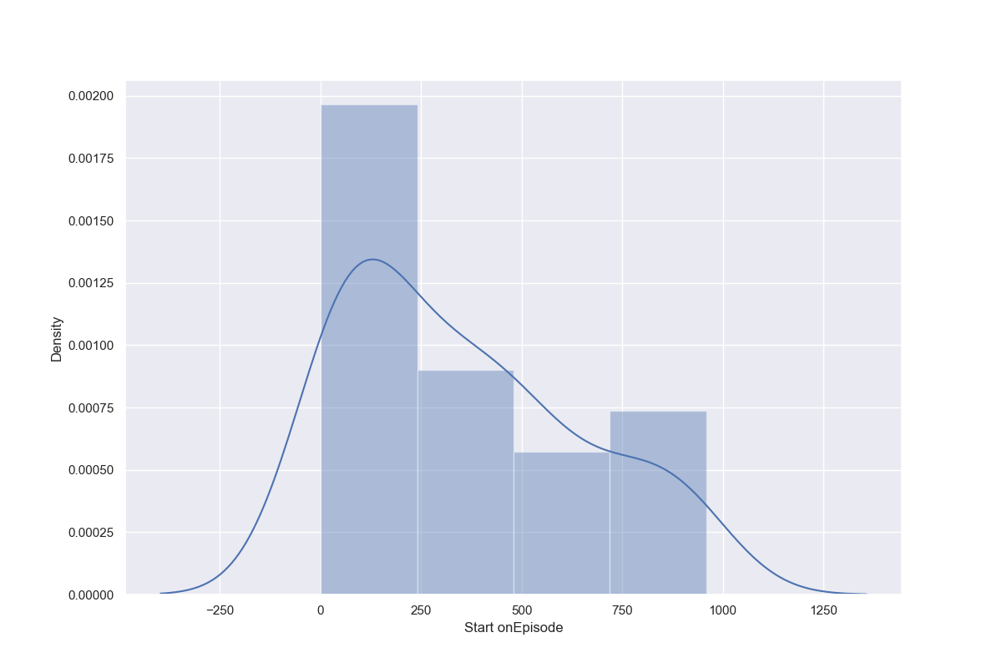
Scatter Plot
<Project Number> <Project name>
<Reference number> <Issue> <Last updated>

Slide 3
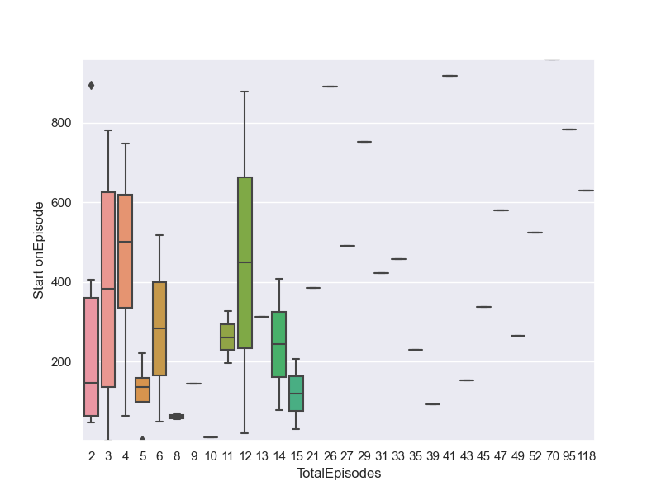
Box Plot
<Project Number> <Project name>
<Reference number> <Issue> <Last updated>

Slide 4
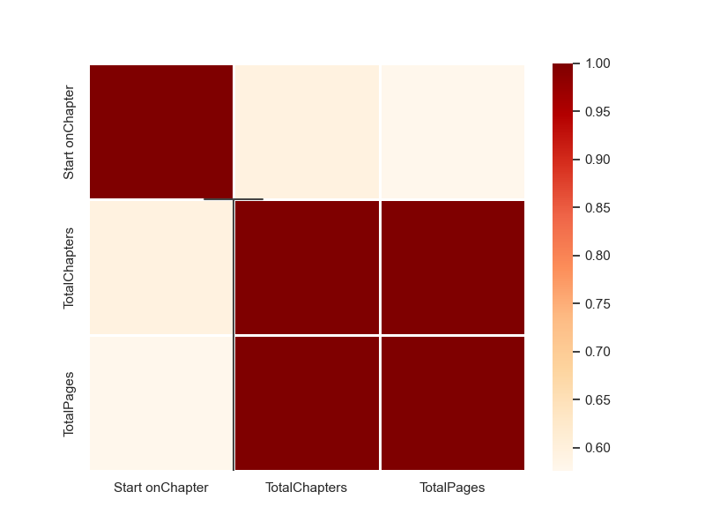
Correlation Matrix
<Project Number> <Project name>
<Reference number> <Issue> <Last updated>

Slide 5
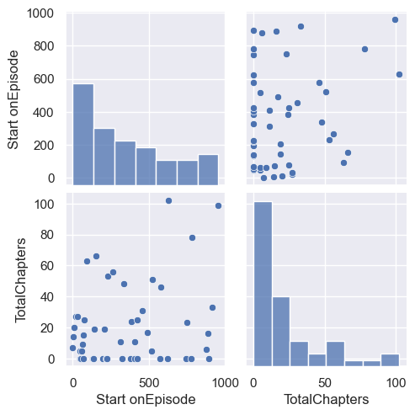
Pair Plot
<Project Number> <Project name>
<Reference number> <Issue> <Last updated>

