Slide 1


Distributed Applications
Load Balancer
Notes:
To change the image on this slide, select the picture and delete it. Then click the Pictures icon in the placeholder to insert your own image.

Slide 2
Slide Contents
What?
Why?
Types
Examples
Load Balancer

Slide 3
What is Load Balancing?
Improving distribution of workload across computing resources
- Wikipedia
Maximize
Minimize
Throughput
Resource use
Response time
Server load
Down time

Slide 4
Why Load Balancing?
Advantages of a load balancer
No single point of failure
Scalable architecture
Efficient use of resources
Concurrency
Improved Security

Slide 5
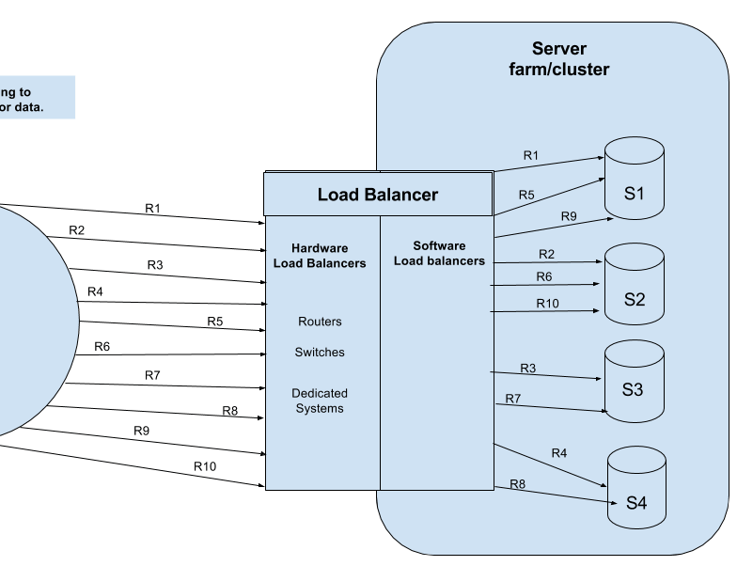
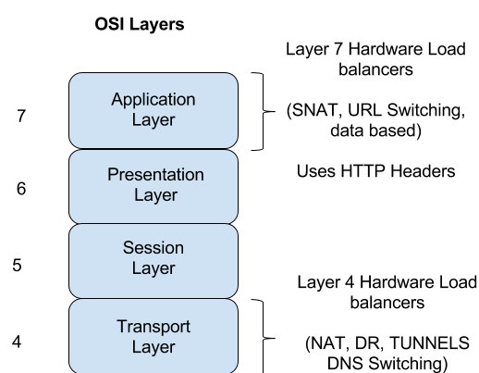
Types of Load Balancers
client
Software Load Balancer
Hardware Load Balancer

Slide 6
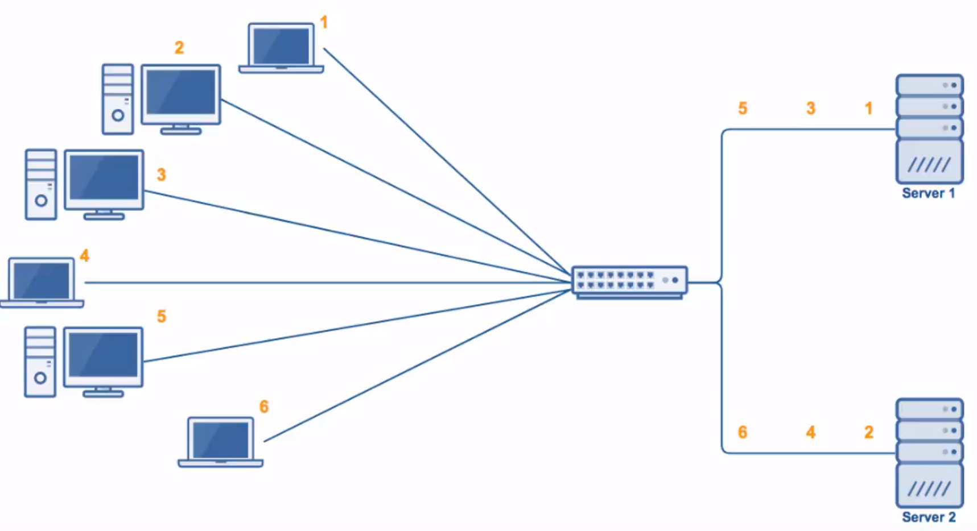
Load Balancing Algorithms
Round Robin
Identical nodes
Easy to implement
Image credit: youtube.com/watch?v=iqOTT7_7qXY

Slide 7
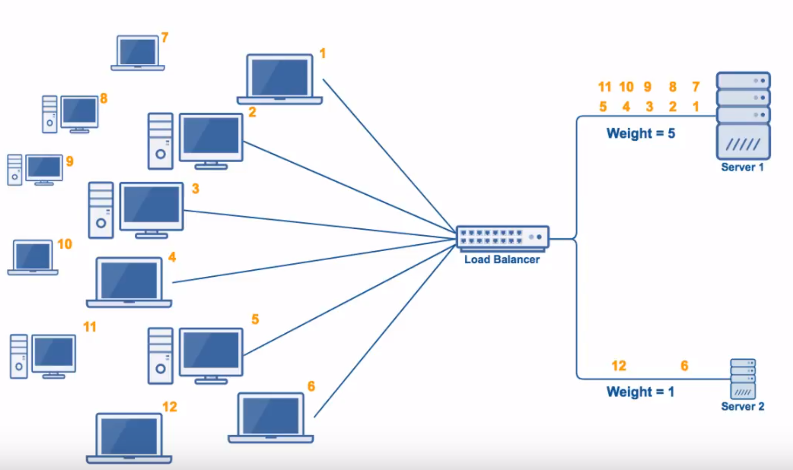
Load Balancing Algorithms
Weighted Round Robin
Non similar nodes
Business critical tasks
Image credit: youtube.com/watch?v=iqOTT7_7qXY

Slide 8
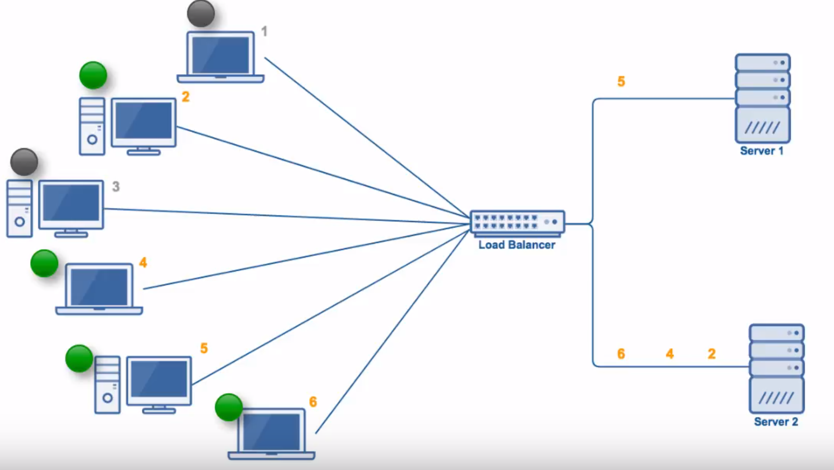
Load Balancing Algorithms
Least Connections
User pattern
Effective
Stable distribution
Image credit: youtube.com/watch?v=iqOTT7_7qXY

Slide 9
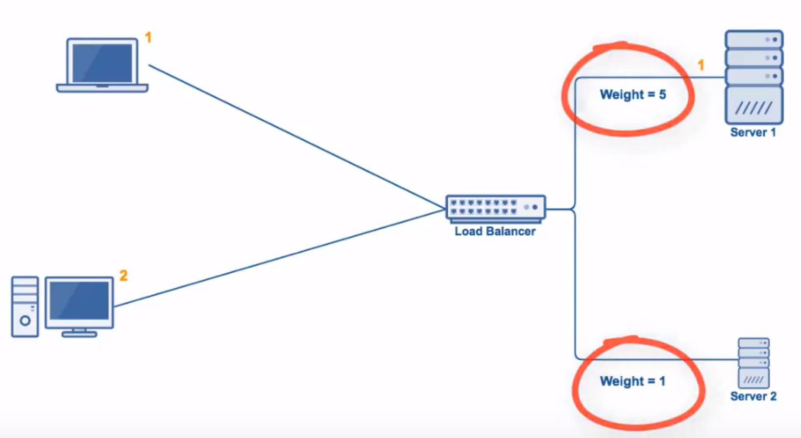
Load Balancing Algorithms
Weighted Least Connections
Weighted Round Robin : Round Robin
Image credit: youtube.com/watch?v=iqOTT7_7qXY

Slide 10
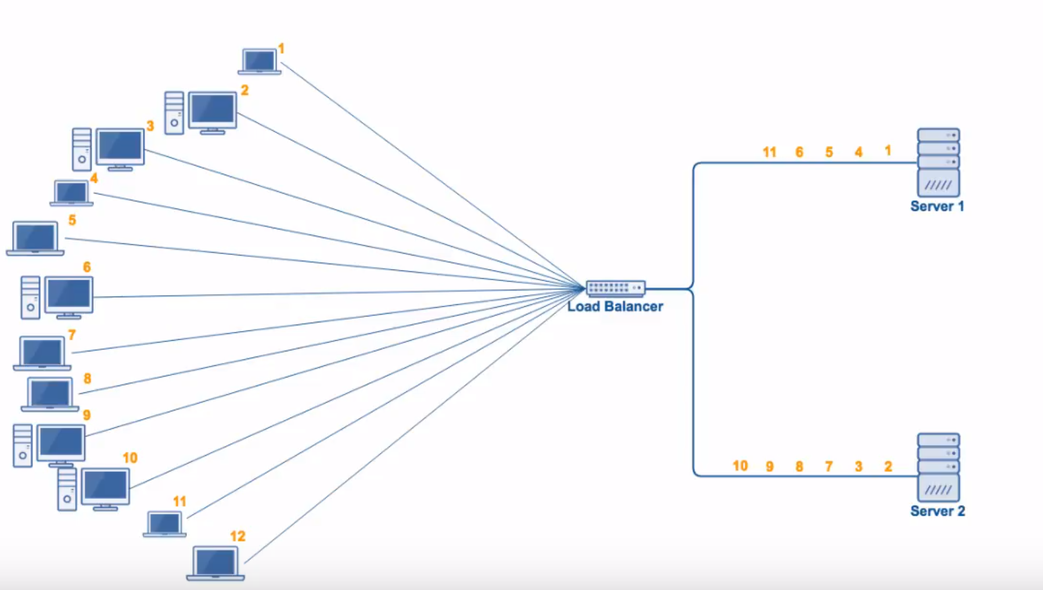
Load Balancing Algorithms
Random
Random number generator algorithm
Similar nodes
Image credit: youtube.com/watch?v=iqOTT7_7qXY

Slide 11
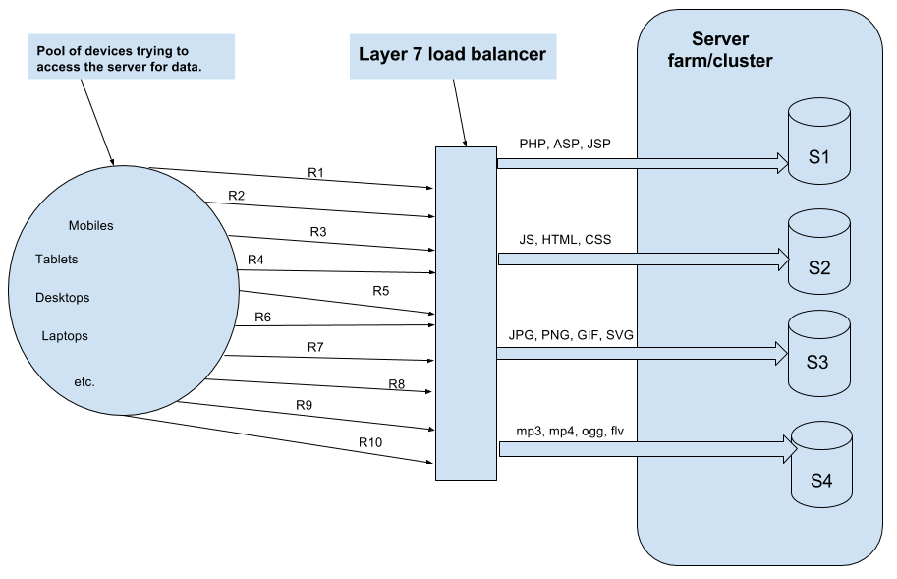
Load Balancing Algorithms
Layer 7
ADN (Application Delivery Network)
Type of content
Image credit: thegeekstuff.com/2016/01/load-balancer-intro

Slide 12
Examples of Load Balancers
Example’s credit: thegeekstuff.com/2016/01/load-balancer-intro
Software Based Load Balancers
HAProxy – A TCP load balancer.
NGINX – A http load balancer with SSL termination support.
mod_athena – Apache based http load balancer.
Varnish – A reverse proxy based load balancer.
Hardware Based Load Balancers
F5 BIG-IP load balancer
CISCO system catalyst
Barracuda load balancer

Slide 13
Thank You !
Questions ?

