Slide 1
Byzantium: Byzantine-Fault-Tolerant Database Replication Providing Snapshot Isolation

Slide 2
WHAT IS BYZANTIUM?
BYZANTIUM IS A DATABASE REPLICATION MIDDLEWARE WHICH IS BYZANTINE FAULT TOLERANT AND PROVIDES SNAPSHOT ISOLATION SEMANTICS.

Slide 3
WHY BYZANTIUM?
DATABASES ARE A KEY COMPONENT OF ANY MODERN SYSTEM (ECOMMERCE, BANKING, ETC.)
DATABASES CAN HAVE HARDWARE / SOFTWARE / MACLICIOUS ATTACKS.
DESPITE OF THESE ISSUES, A DATABASE SYSTEM MUST CONTINUE TO PROVIDE CORRECT RESULTS AND RECOVER FROM ANY FAULTS.
IT HAS BEEN SHOWN IN STUDY THAT MAJORITY OF BUGS IN TOP THREE DB SYSTEMS RESULT IN NON-CRASH FAILURE.

Slide 4
WHY BYZANTIUM OVER OTHERS?
ALLOWS INCREASED CONCURRENCY.
DOES NOT RELY ON ANY CENTRALIZED COMPONENT.
CAN BE USED WITH ANY OFF-THE-SHELF DATABASE SYSTEM.
IS BUILT ON TOP OF AN EXISTING BFT LIBRARY.

Slide 5
TRADITIONAL REPLICATION SYSTEMS
THEY ASSUME REPLICAS FAIL BY CRASHING.
SO THEY DO NOT WORK WELL IN CASE WHERE THE NODES CONTINUE TO OPERATE BUT PROVIDE INCORRECT RESULTS.
THIS IS WHY THERE IS A NEED FOR BYZANTINE FAULT TOLERANT REPLICATION MECHANISM.

Slide 6
HOW BYZANTIUM DOES IT?
IT AIMS FOR THE WEAKER SEMANTICS THAN TRADITIONAL BFT REPLICATION APPROACHES (1-COPY SERIALIZABILITY)
BYZANTIUM USES SNAPSHOT ISOLATION WHICH IS A WEAKER FORM OF SEMANTICS WHICH IS SUPPORTED BY MOST COMMERCIAL DATABASES (ORACLE, MICROSOFT SQL SERVER, ETC.)
THE DESIGN MINIMIZES THE NUMBER OF OPERATIONS NEEDED TO EXECUTE THE 3-PHASE MANAGEMENT PROTOCOL THAT BFT REPLICATION USES TO TOTALLY ORDER REQUESTS.
ALLOWS CONCURRENT TRANSACTIONS TO EXECUTE IN DIFFERENT REPLICAS, TO INCREASE CONCURRENCY.

Slide 7
OVERVIEW OF THE SOLUTION
USING PBFT STATE MACHINE REPLICATION ALGORITHM (Practical byzantine fault tolerance – MIT)
ASSUME THAT OUT OF N = 3F + 1 REPLICAS, AT MOST F NODES ARE FAULTY.

Slide 8
DATABASE MODEL
IN A DATABASE, STATE IS MODIFIED BY APPLYING INSTRUCTIONS.
BEGIN -> RWRWRRWWRRRW -> COMMIT/ROLLBACK.
DIFFERENT SEMANTICS (ISOLATION LEVELS) HAVE BEEN DEFINED FOR DATABASE SYSTEMS WHICH ALLOWS HIGH PERFORMANCE WHEN FULL SERIALIZABILITY IS NOT REQUIRED.
IN SNAPSHOT ISOLATION, A TRANSACTION LOGICALLY EXECUTES IN A SNAPSHOT AND CAN COMMIT ONLY IF NO WRITE CONFLICT OCCURS WITH ANY OTHER CONCURRENT TRANSACTION.

Slide 9
WHEN ENFORCING SERIALIZABILITY, IF A TRANSACTION WRITES A DATA ITEM. ANOTHER TRANSACTION THAT IS READING THE SAME ITEM CANNOT EXECUTE.
BUT WITH BYZANTIUM’S SNAPSHOT ISOLATION, ONLY WRITE-WRITE CONFLICTS ARE NEEDED TO BE AVOIDED.
THIS ALLOWS INCREASED CONCURRENCY AND THUS, HIGH PERFORMANCE.

Slide 10
SYSTEM ARCHITECTURE

Slide 11
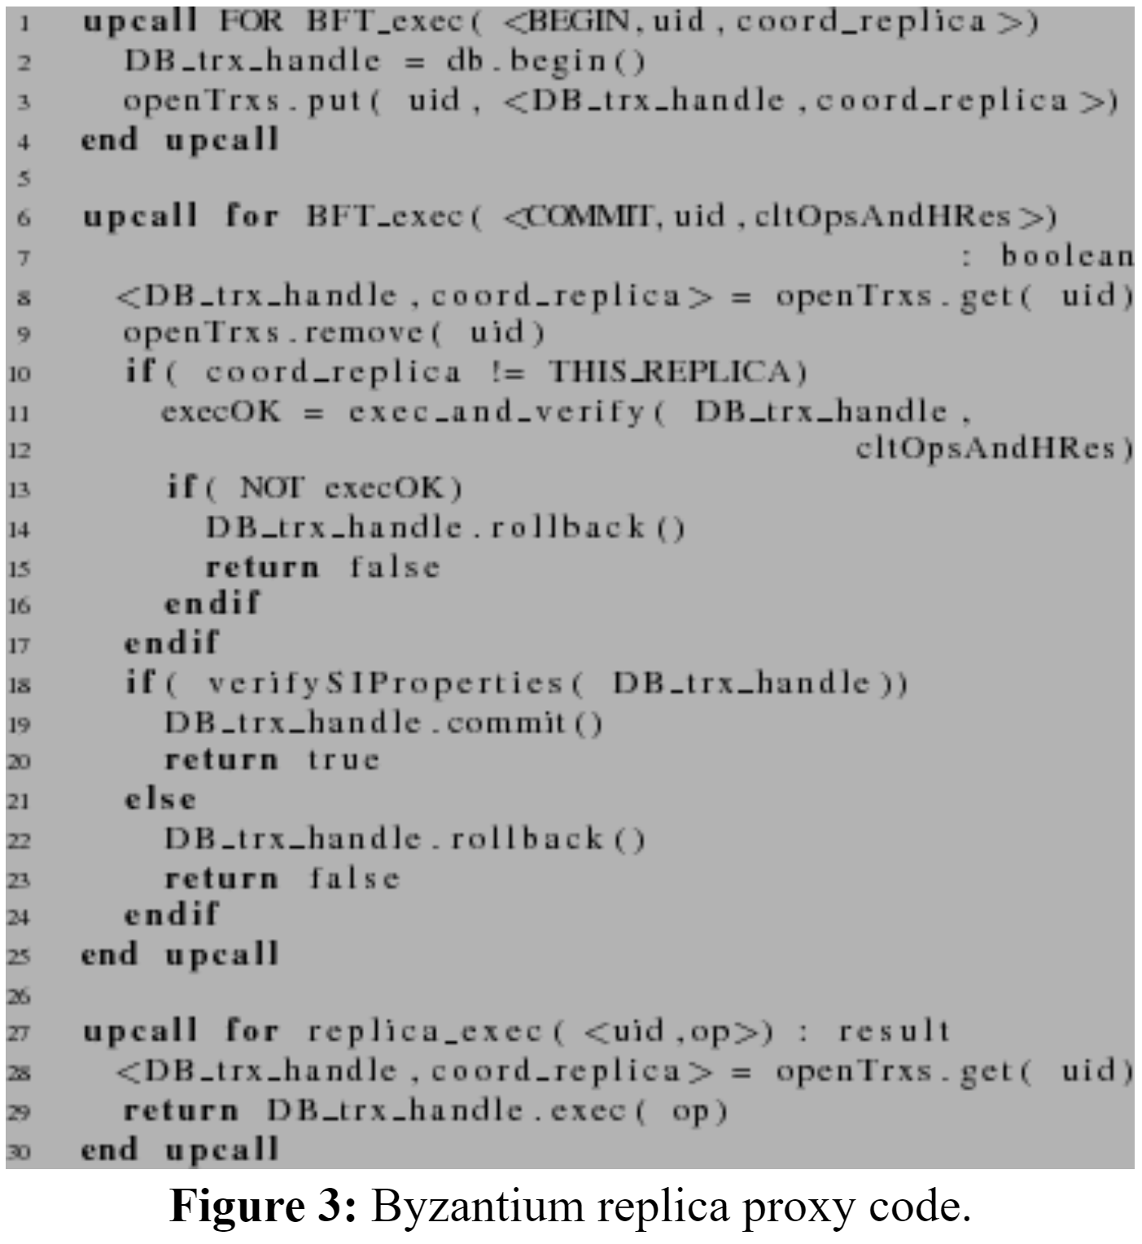
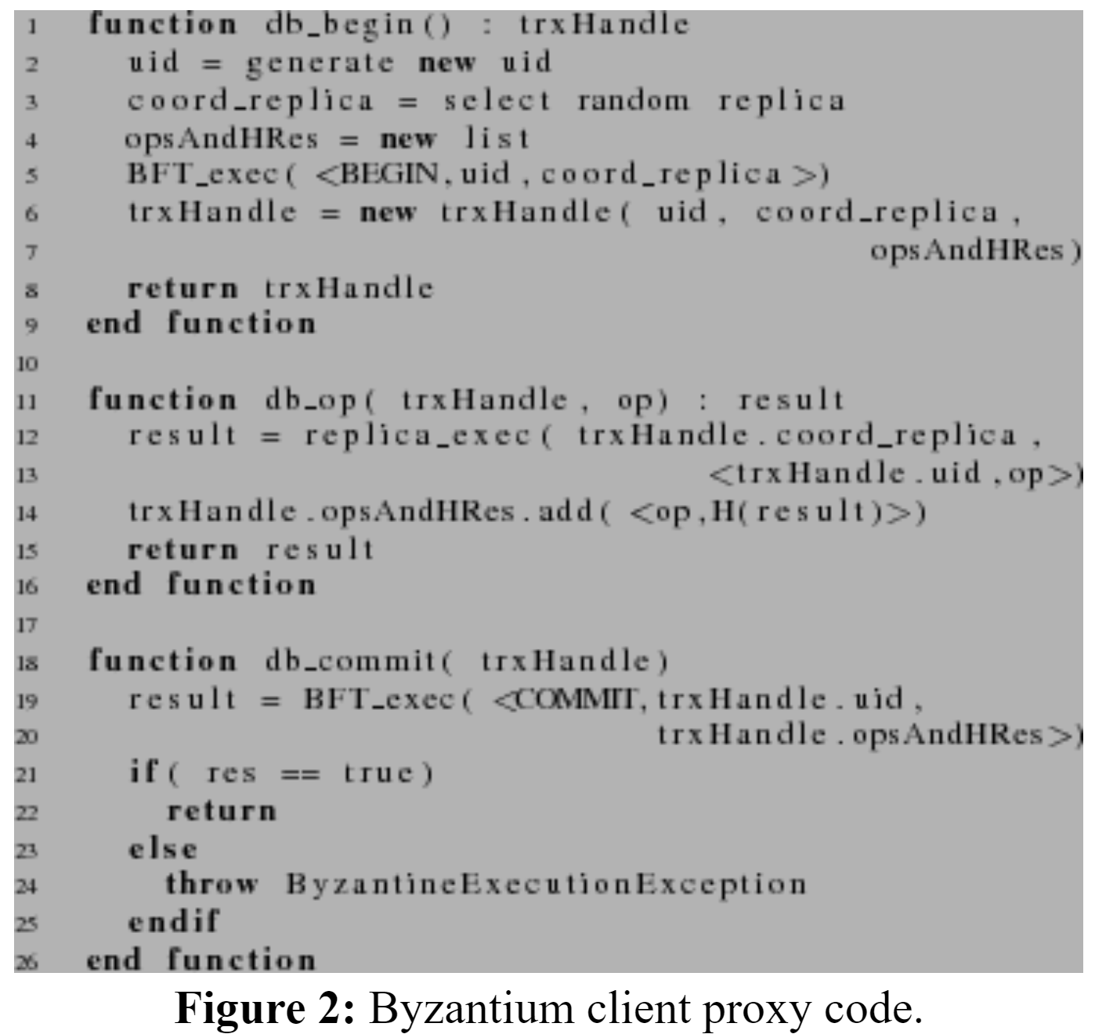
System Operation

Slide 12
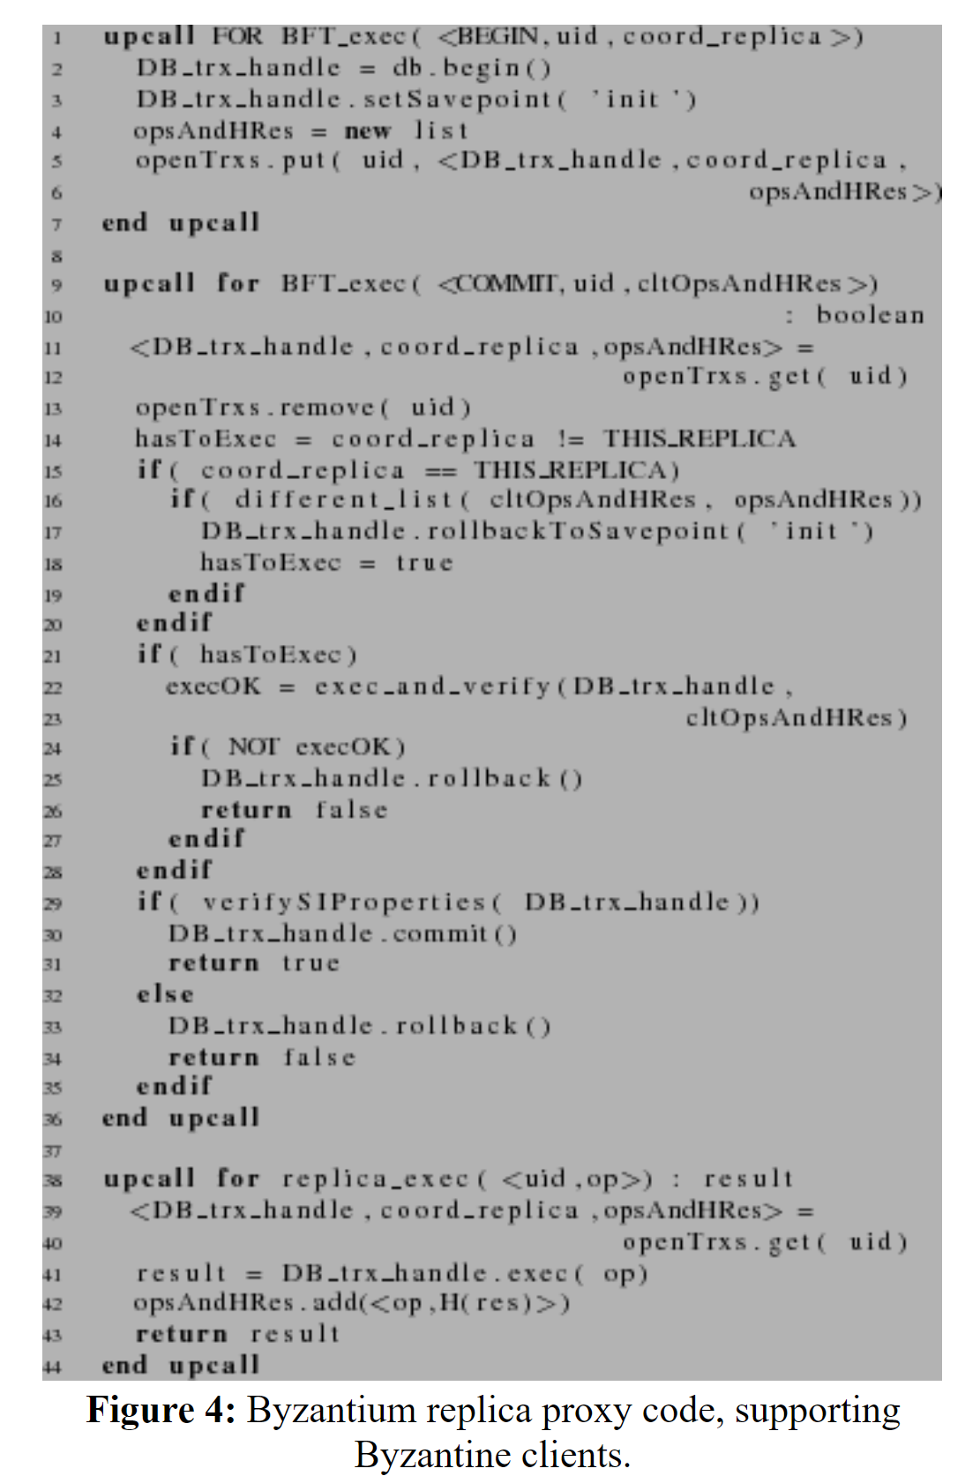
Tolerating Byzantine clients
Clients executes operations in coordinator
Later propagates them to all replicas
Coordinator does not execute since it has already executed
This can be exploited by sending different operation sequence during commit time
Solution –
Log the operations (line 42) & verify before commit
Create savepoint during begin(line 3)
Rollback to savepoint logs do not match(line 16, 17)

Slide 13
Handling Faulty Coordinator
Coordinator returns erroneous results:
Verify correctness of results returned by all replicas
Coordinator fails to return results:
Selects a new coordinator
Re execute previously executed operations
If the results do not match, rollback and abort
At commit time, still verify the sequence of operation is same that the replica has executed

Slide 14
Conclusion
Byzantium, a protocol for BFT database replication that provides SI semantics
Byzantium improves performance by allowing concurrent transactions
Takes advantage of weaker SI semantics to avoid running every database operation through the expensive PBFT protocol

Slide 15
Thankyou !
Question?

