Slide 1
Monolithic
SOA
Micro services
What are all these?

Slide 2
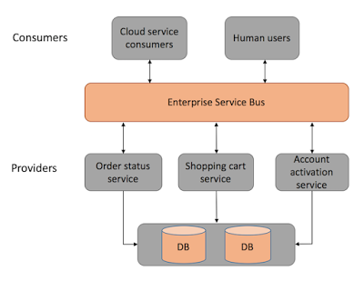
SOA
Service-Oriented Architectures are a way to evolve from
semi-monoliths to a more diversified architecture and usually incorporate functions into small/mid-sized applications.

Slide 3
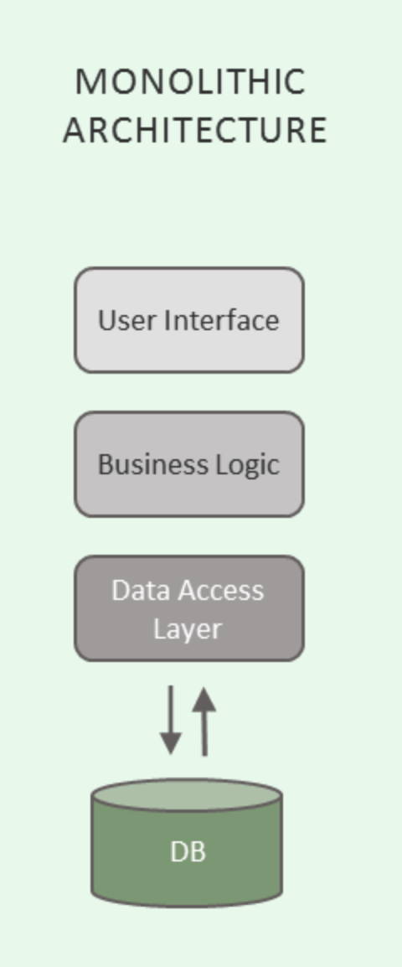
Monolithic Architecture
Monolithic architectures are the ones running on a single application layer that tends to bundle together all the functionalities needed by the architecture.

Slide 4
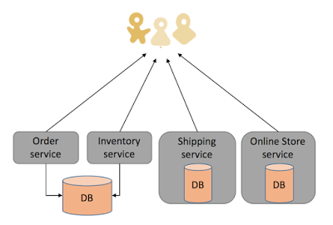
Micro services architecture
Micro services can be seen as an implementation of SOAs, but it requires very small, Unix-inspired services which do one thing, and do it well. The services are made isolated, independent and can only communicate through simple interfaces (APIs).

Slide 5
If we already have SOA and Monolith, why do we need Micro services?
In micro service architecture, services are small, independent, and loosely coupled. So it is easier to deploy new versions of services frequently or scale a service independently.
On the other hand, monolithic architecture has services bundled together, and SOA has larger sized services which makes it difficult to scale and deploy them independently.
Monolith and SOA are usually tightly coupled which makes it difficult to manage and upgrade the services individually, without affecting the sanity of other services.

Slide 6
Scaling Micro services
Instead of dealing with a single application running on a single server—or load-balanced across a few servers—you might have elements of an application written in different programming languages, loaded on different hardware, running on different virtualization hypervisors, and deployed across disparate cloud.
When demand increases for the app, all the underlying components have to be coordinated to scale, or you have to be able to identify which individual elements need to scale to address the surge in demand.
Segregate data across different servers based on routing criteria.
Route requests based on the primary key of the data being accessed, or based on customer type—sending paying or premium customers to servers with more bandwidth and capacity to deliver better performance.

Slide 7
Scaling Micro services
Demand may surge for one component of an app or a certain subset of data, and a microservices architecture enables you to scale only the app components impacted, rather than the entire application and underlying infrastructure.

Slide 8
Communication Methods
“Smart endpoints and dumb pipes”
First Axis:
Synchronous protocol (HTTP)
Asynchronous protocol (AMQP)
Second Axis:
Single receiver(Command Pattern)
Multiple receiver(Publish/Subscribe)

Slide 9
Micro services communication - Synchronous
This means that a service needs to wait on another service to finish it’s task. The system, in effect, acts like a monolith.
Can be used in simple implementations and response routing need not be handled.
HTTP(S) is synchronous and it is a good idea since you can continue the tasks on web page only after getting the response (web content) from the server.
Works best in one-to-one communication.
Financial transactions are synchronous as we require the response before making further decisions.

Slide 10
Micro services communication - Asynchronous
The service does not wait for the result and moves on to the next task assuming the result would eventually get processed.
Results in highly scalable models.
The service is not blocked in case of a delayed/lost response and would be available for other tasks.
A failed service would not affect a healthy running service.
Heavily used in operating systems where multiple services send messages to each other for program execution.

Slide 11
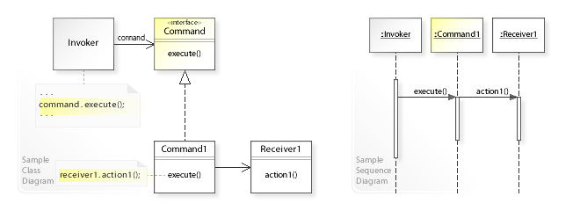
Command Pattern
Invoker doesn’t implement request directly
Refers to a command interface to perform a request

